Slide 1


St John’s TEDS Day
Together Everyone Doing Science
Tuesday 14th June 2022

Slide 2

St John’s

Slide 3
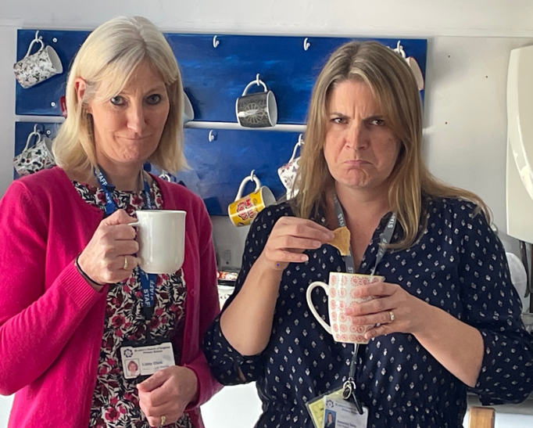
My biscuit has fallen in my tea again!
Not again!!!

Slide 4
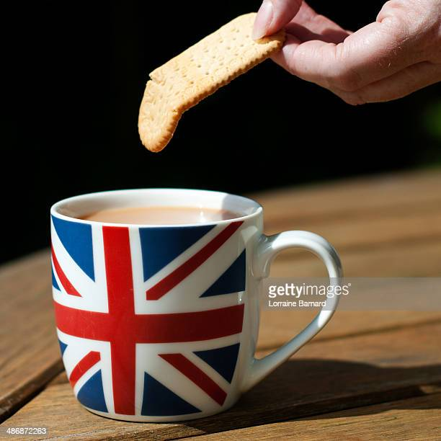
Everyone knows know how much teachers love their tea breaks (and biscuits).
The teachers are having so much difficulty in finding a biscuit that they can dunk into their cuppa, without it breaking off quickly. They are getting so frustrated with the sludge left at the bottom of the cup that they have decided: “Enough is enough!!”
St John’s children are amazing scientists, so Mrs Casewell thinks you are the perfect team for the job!

Slide 5
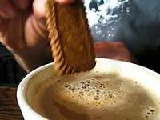
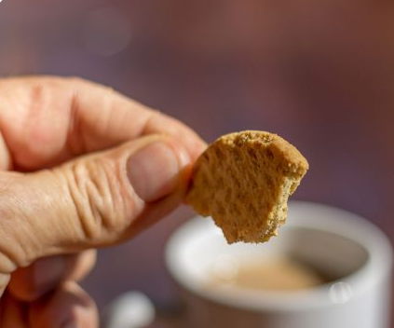
Can you help keep all the teachers happy and solve their problem?
The question is…
Which biscuit is the best dunker?

Slide 6
Each class has an important question to investigate:
Reception : Which is the teachers’ favourite biscuit?
Year 1: What happens when a biscuit gets wet?
Year 2: Which is the best biscuit for dunking into a drink?
Year 3 : Which factors make a biscuit great for dunking?
Year 4: How does the temperature of the liquid affect a dunking biscuit?
Year 5: Does the sugar content of a biscuit affect dunking time?
Year 6: Do more expensive biscuits make better dunkers?

Slide 7

Which type of enquiry will your class use?

Slide 8
You will have to use all your working scientifically skills
Make careful observations
Take accurate measurements
Gather data
Record in a table or chart
Write simple conclusions
Evaluate our investigations
Ask further questions

Slide 9
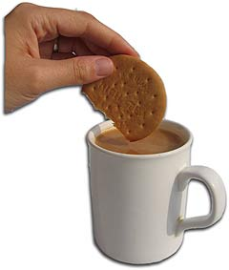
Your teachers will be so pleased when you can answer the question by the end of the day .
Which biscuit is the best dunker?
Let’s get to work, St John’s scientists!

Slide 10
Which type of enquiry will your class use?

Slide 11
What did we find out?

Slide 12
Reception : Which is the teachers’ favourite biscuit?

Slide 13
Year 1:What happens when a biscuit gets wet?

Slide 14
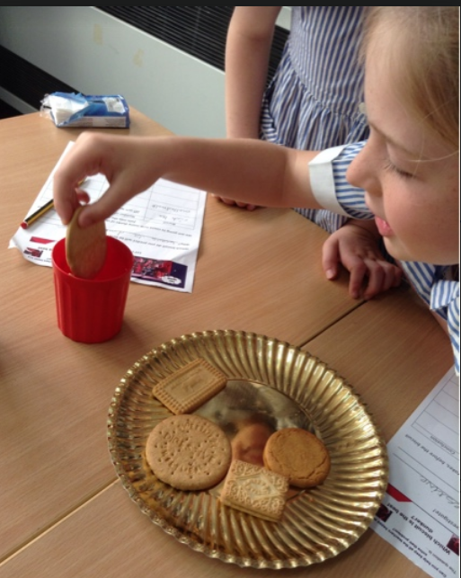
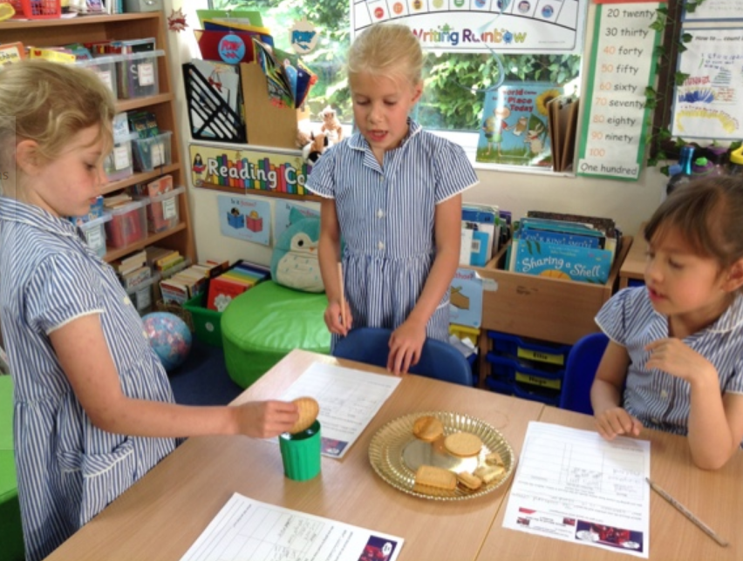
Year 2 :Which is the best biscuit for dunking into a drink?

Slide 15
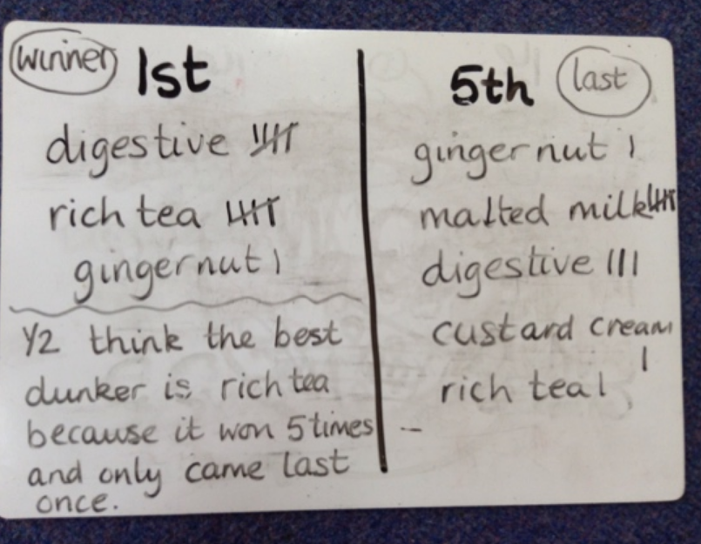
Year 2 results

Slide 16
Year 3 : Which factors make a biscuit great for dunking?

Slide 17
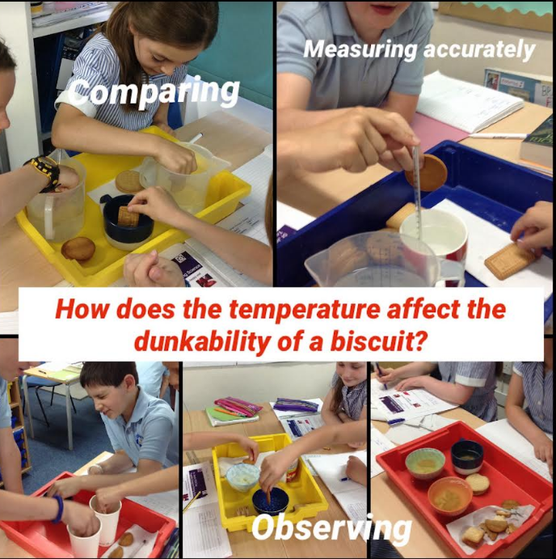
Year 4 : How does the temperature of the liquid affect a dunking biscuit?

Slide 18
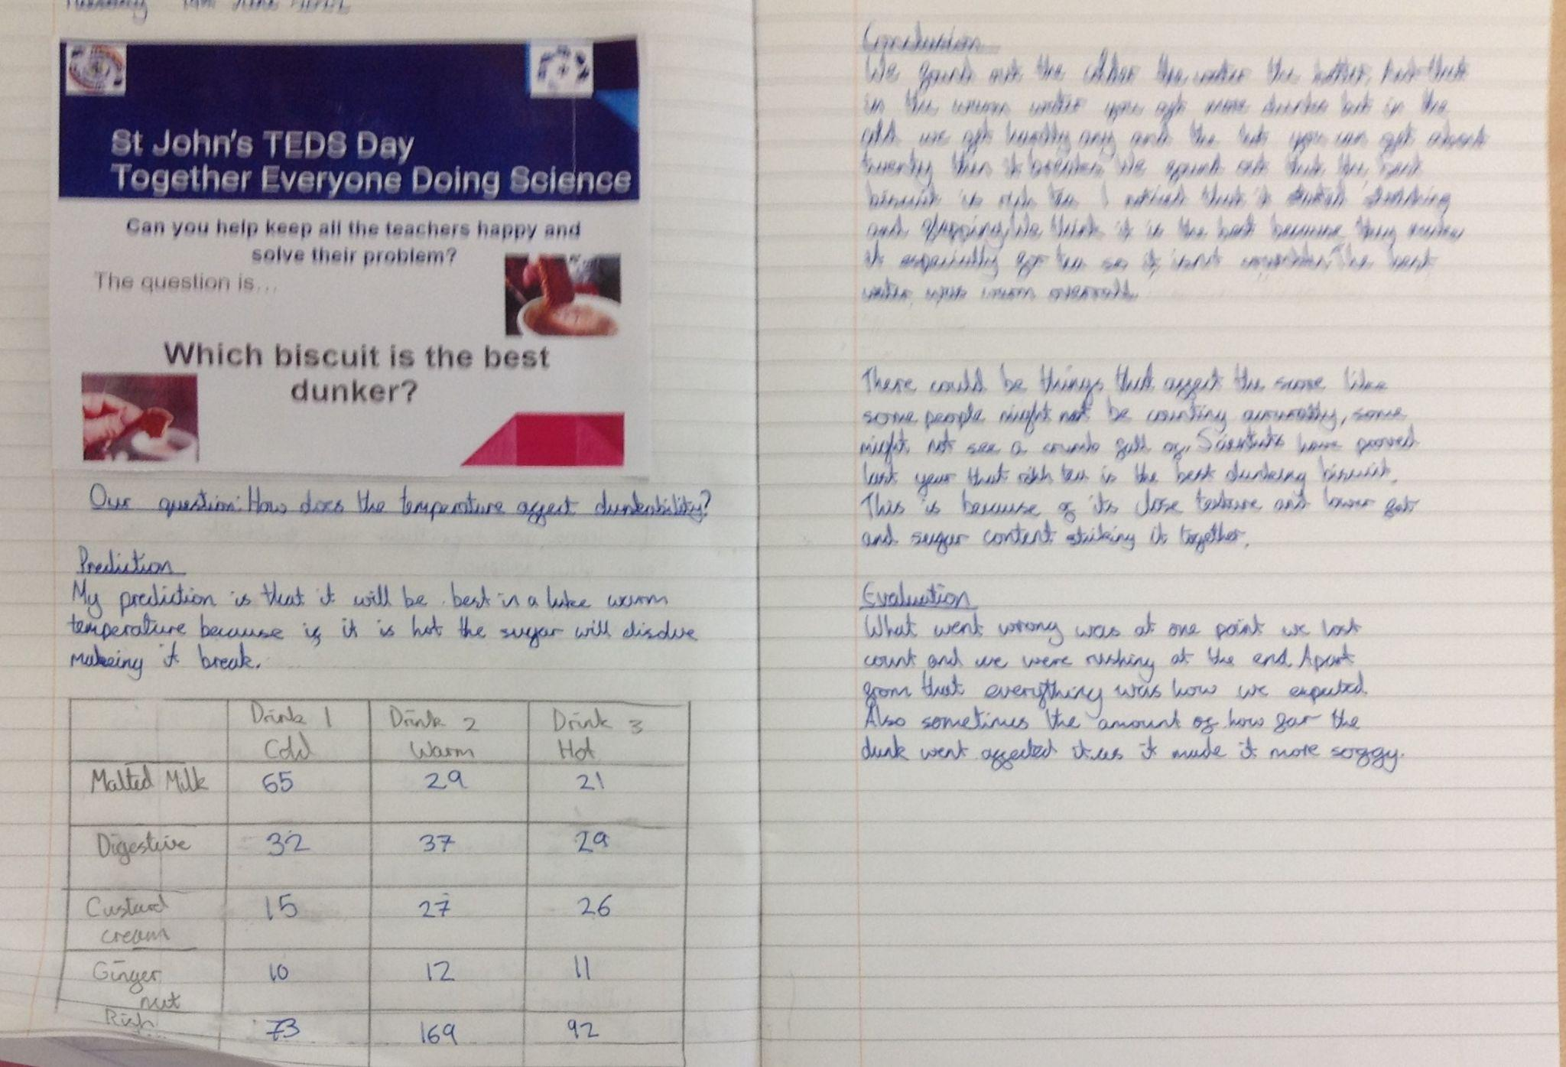
Year 4 results: Warm water is the best for dunking in . However, Rich Tea is the best dunker in all temperatures.

Slide 19
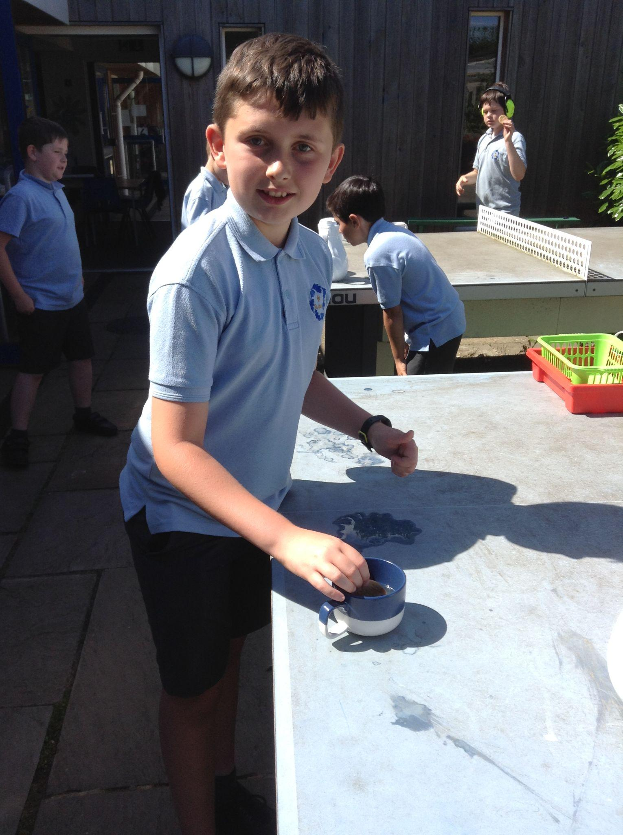
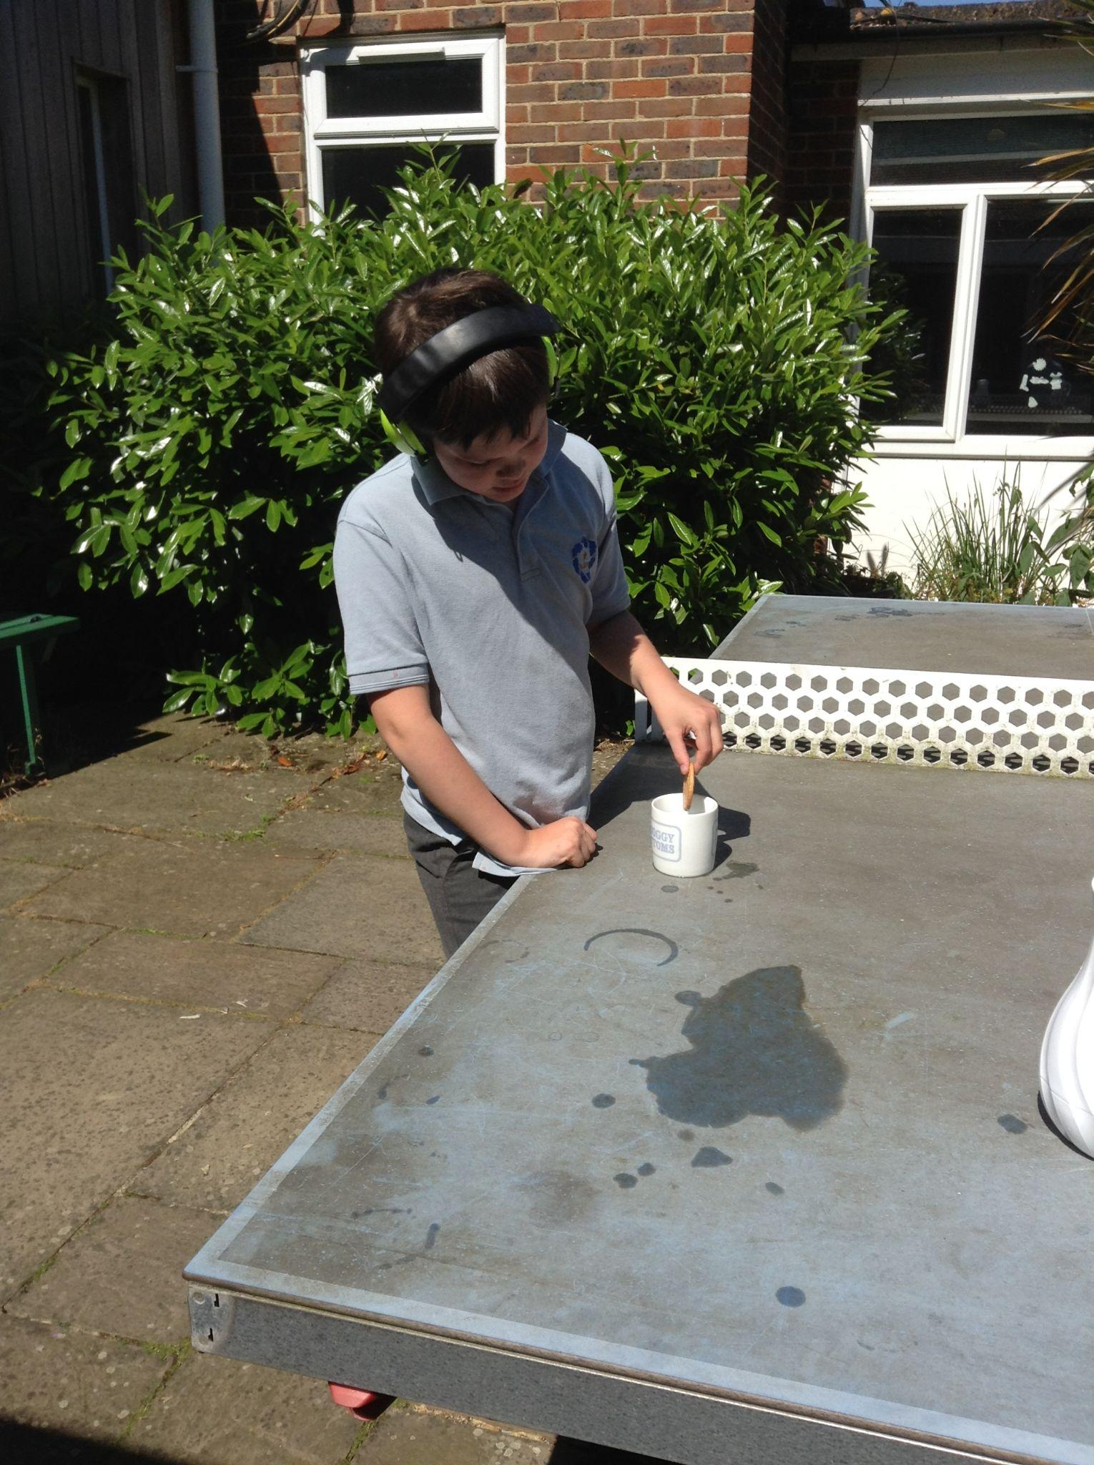
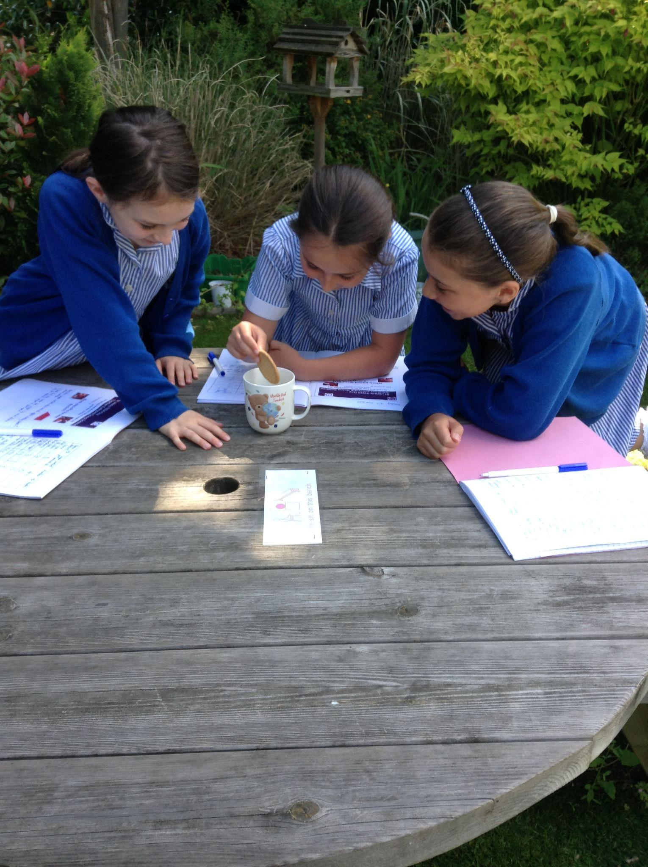
Year 5: Does the sugar content of a biscuit affect dunking time?

Slide 20
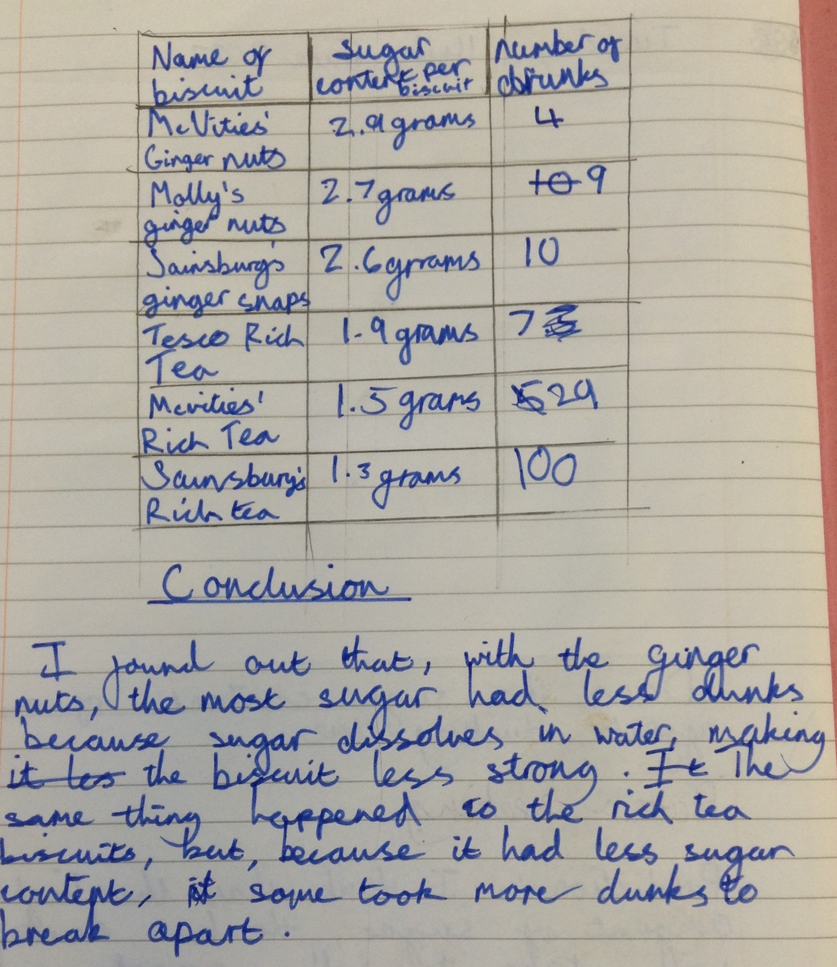
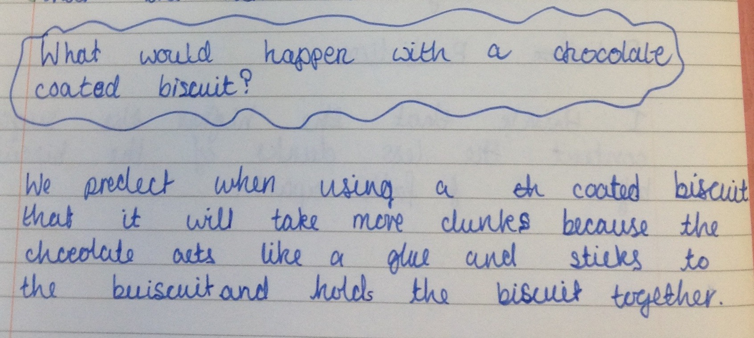
Year 5 results: We found that the Rich Tea biscuits with the lower sugar content were the best for dunking. The ginger snaps with the higher sugar content fell apart easily!

Slide 21
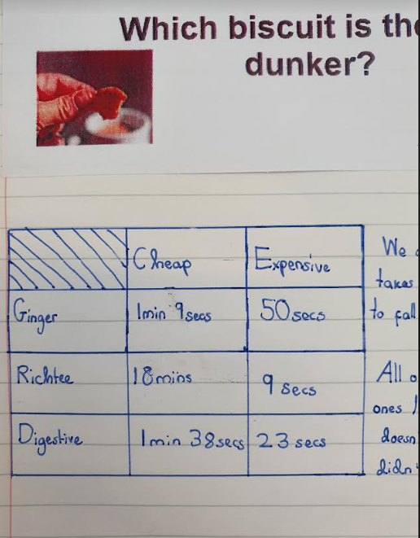
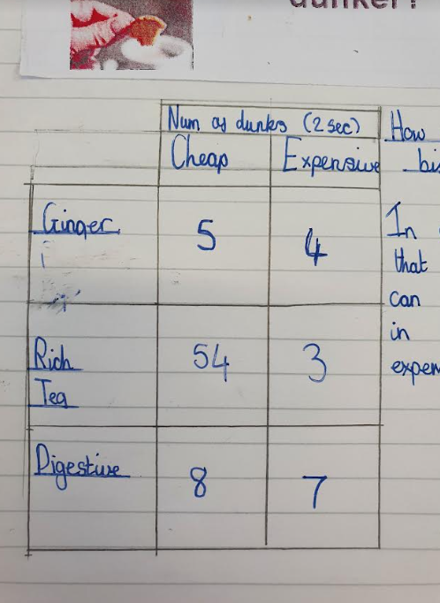
Year 6 : Do more expensive biscuits make better dunkers?

Slide 22
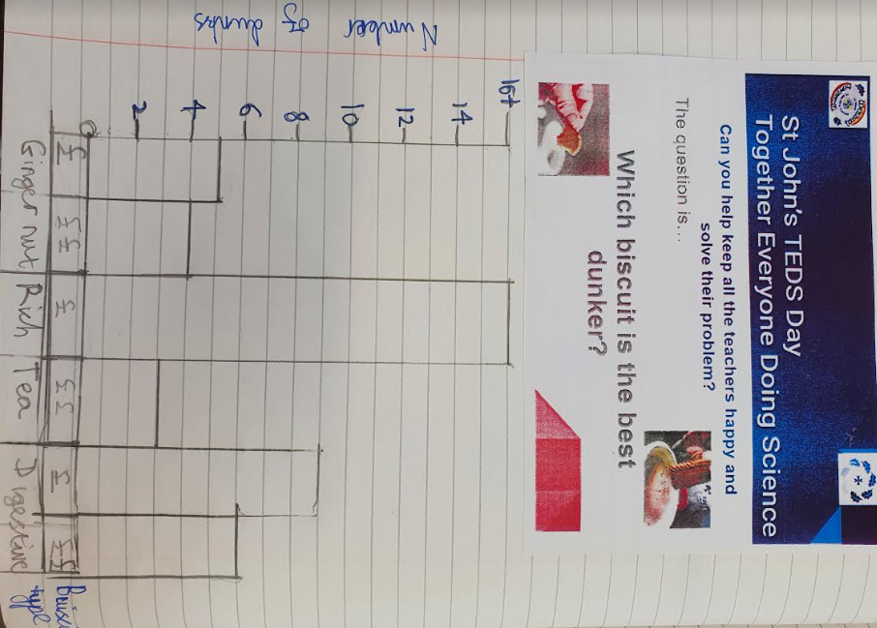
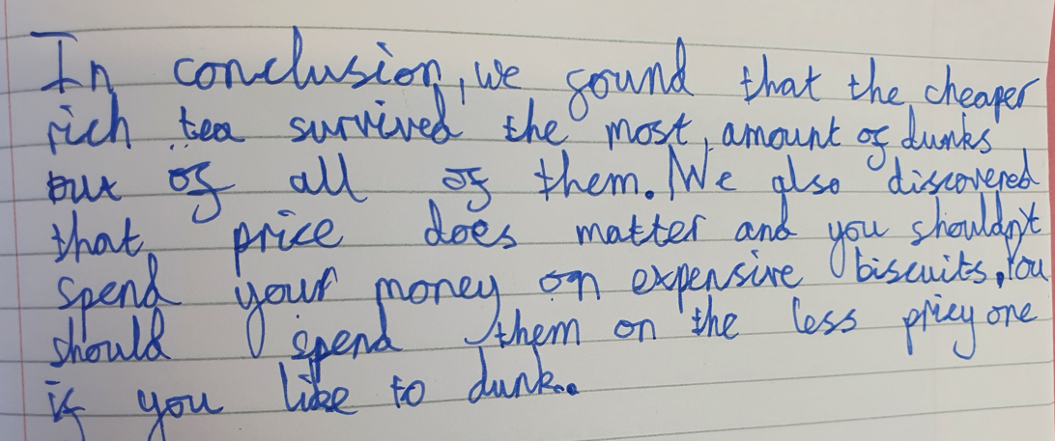

Slide 23
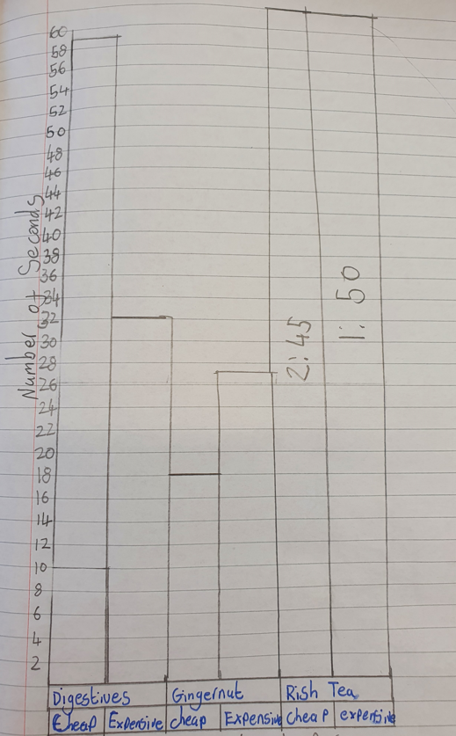
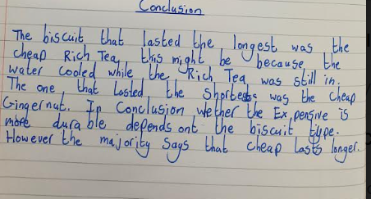
Year 6 say: “Don’t waste your money on expensive biscuits if you like to dunk : Buy cheap!”
ou

Slide 24
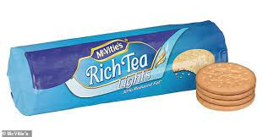
We can all agree that the best dunker is ………..

Slide 25
Well done St John’s scientists you will now have very happy teachers !!!

