Slide 1



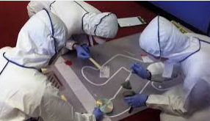
TEDS DAY
THURSDAY 3RD NOVEMBER 2022
FORENSICS

Slide 2
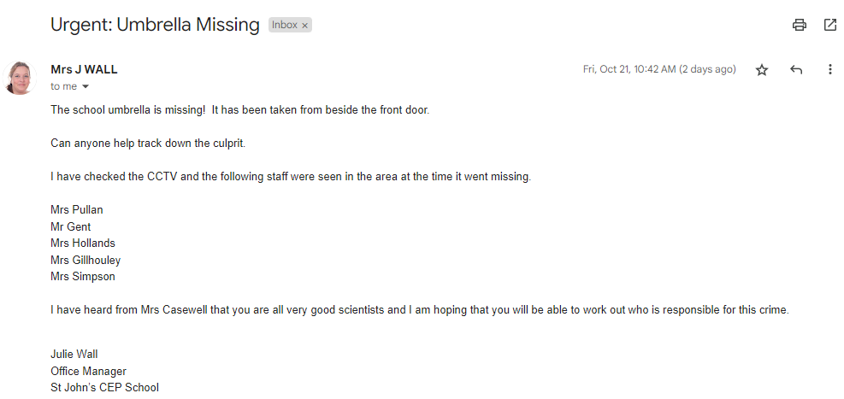
MRS WALL NEEDS YOUR HELP
.

Slide 3
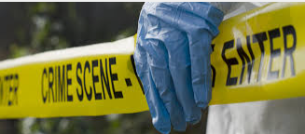
TODAY WE ARE ALL GOING TO BE ….
Forensic scientists

Slide 4

WHAT IS FORENSIC SCIENCE?
A science that blends biology, chemistry and physics to look at evidence, solve crimes and settle legal issues. Forensic scientists use evidence like fingerprints, blood, hair, handwriting and DNA to show the truth about what happened in a situation.
Everywhere we go, whether we’re at home or out and about, we leave traces of evidence.
It’s a puzzle. Whoever is investigating needs to find clues to piece together a puzzle. This puzzle helps determine who the culprit of the crime is.

Slide 5
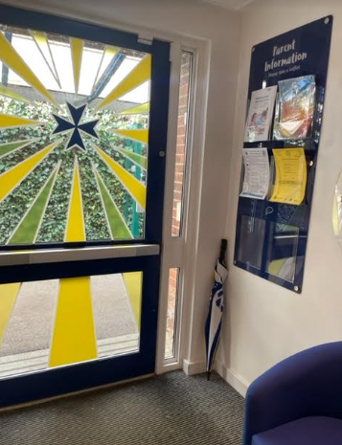
WHO STOLE THE UMBRELLA?
Mrs Wall noticed the umbrella missing from the entrance hall where it is always kept.
Mrs Wall reported overhearing a conversation in the entrance hall between staff about the fact that the school umbrella is one of its kind, the only one left in school, very expensive and that it is the BEST umbrella ever!
Only 5 members of staff were in school when it went missing – so one of them has stolen the umbrella .
The school was closed and locked up that evening, there are no signs of break in.
We need to use forensics to find the culprit.

Slide 6
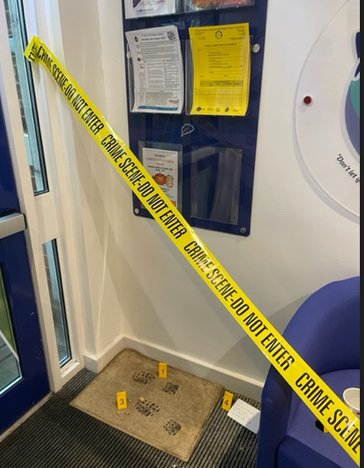
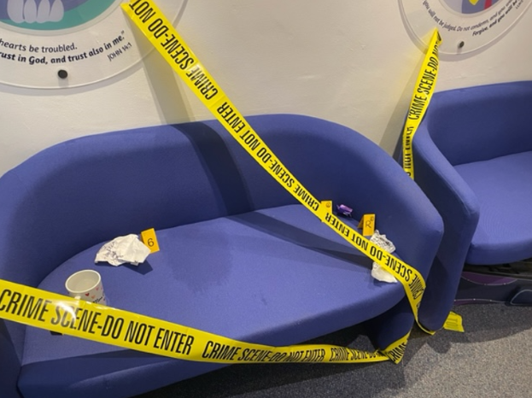

Slide 7
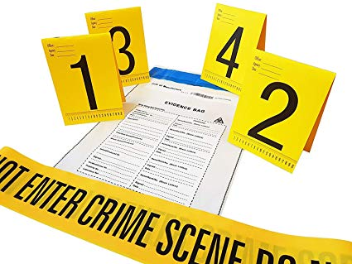
WE ALL NEED TO WORK TOGETHER. EACH CLASS HAS A PIECE OF EVIDENCE . TOGETHER WE CAN HELP SOLVE THE CRIME.
Reception - Footprint pattern matching , wrapper detectives
Year 1 – Footprint measuring, pattern spotting, CCTV detectives
Year 2 – Mystery powder challenge
Year 3 – Soil Detectives
Year 4 – Handwriting, object and fibre analysis
Year 5 – Fingerprinting
Year 6 – Ink chromatography.

Slide 8
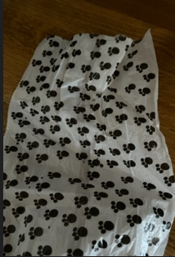

RECEPTION
YOUR TASKS
Match the patterns on the footprints to the footprint at the scene. Can you work out which print belongs to which teacher? Whose print is the one found at the crime scene?
Look at the wrappers found at the scene.
.
Whose pocket could these have fallen out of?

Slide 9
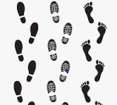

YEAR 1 – FOOTPRINTS AND CCTV
Measure the length and width and record for each teacher’s shoe print. Then measure the width and length of the print found at the scene.
Observe – carefully try to match the shoe pattern .
CCTV ANALYSIS – Look at the photos taken of the 5 suspects as they were seen in the area where the umbrella was missing. Can you work out who is who?
Look at the photograph taken on the meadow . Who could this be holding the umbrella?
Using all your information , who do you think is guilty of stealing the umbrella?
.

Slide 10


YEAR 2 – MYSTERY POWDER
A mysterious white powder has been found at the crime scene.
A sample of it has been taken and is in Evidence Bag 2
Can you test different white powders can see if you can work out what the powder is?
Can you work out who might have dropped it at the scene using the information given by each suspect?

Slide 11
YEAR 3 – SOIL DETECTIVES
Some soil was found at the crime scene.
Can you carry out some tests on different soils and see if you can work out which one was left at the scene. This may help us to identify who the guilty staff member might be.
Look at your evidence sheets. Can you work out who could have left the soil there based on their hobbies, pets or job?

Slide 12
YEAR 4 HANDWRITING AND FIBRE ANALYSIS
1: A mug was found at the scene.
2: Handwriting analysis
3: Fibres : Look the fibre evidence. Can you match the ones at the scene with samples fibre (from the clothing worn on the day of the theft) from the teachers.
https://www.youtube.com/watch?v=BjLHW7qQEl0

Slide 13
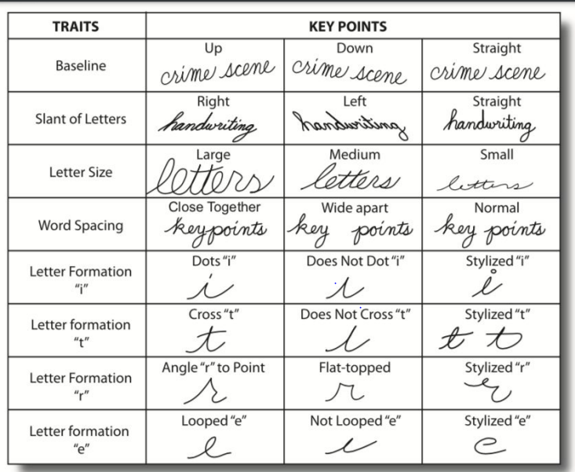
YEAR 4 – THE NOTE
Study and compare,
decide which staff member’s
writing matches the note.

Slide 14
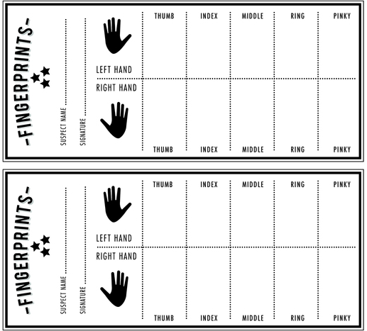
YEAR 5 - FINGERPRINTS
Introduction on fingerprinting.
Using ink strips/pads, the pupils then take their own set of prints
Use fingerprint guides to explore patterns (whorls, arches etc.)
Finally, repeat with one digit on a balloon, and then blow it up to see an enlarged print.
Now – the suspect fingerprint.
Can you work out who the fingerprint belongs to and therefore who may be the guilty staff member ?

Slide 15
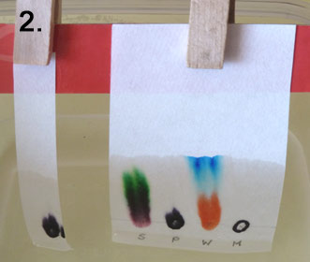
YEAR 6 - CHROMATOGRAPHY
A shopping list written in black pen was found at the scene. We searched the teachers' desks... they all had black pens!
The pens are different, but when used the writing all looks very similar. Can you use a scientific technique called chromatography to analyse the ink in the list and try to find out which pen was used to write it and then who the person who dropped the list was.

Slide 16
TEDS DAY: What have we learnt?
FORENSICS

Slide 17

FINAL ASSEMBLY
Let’s review what each class did.
What have we found out?

Slide 18
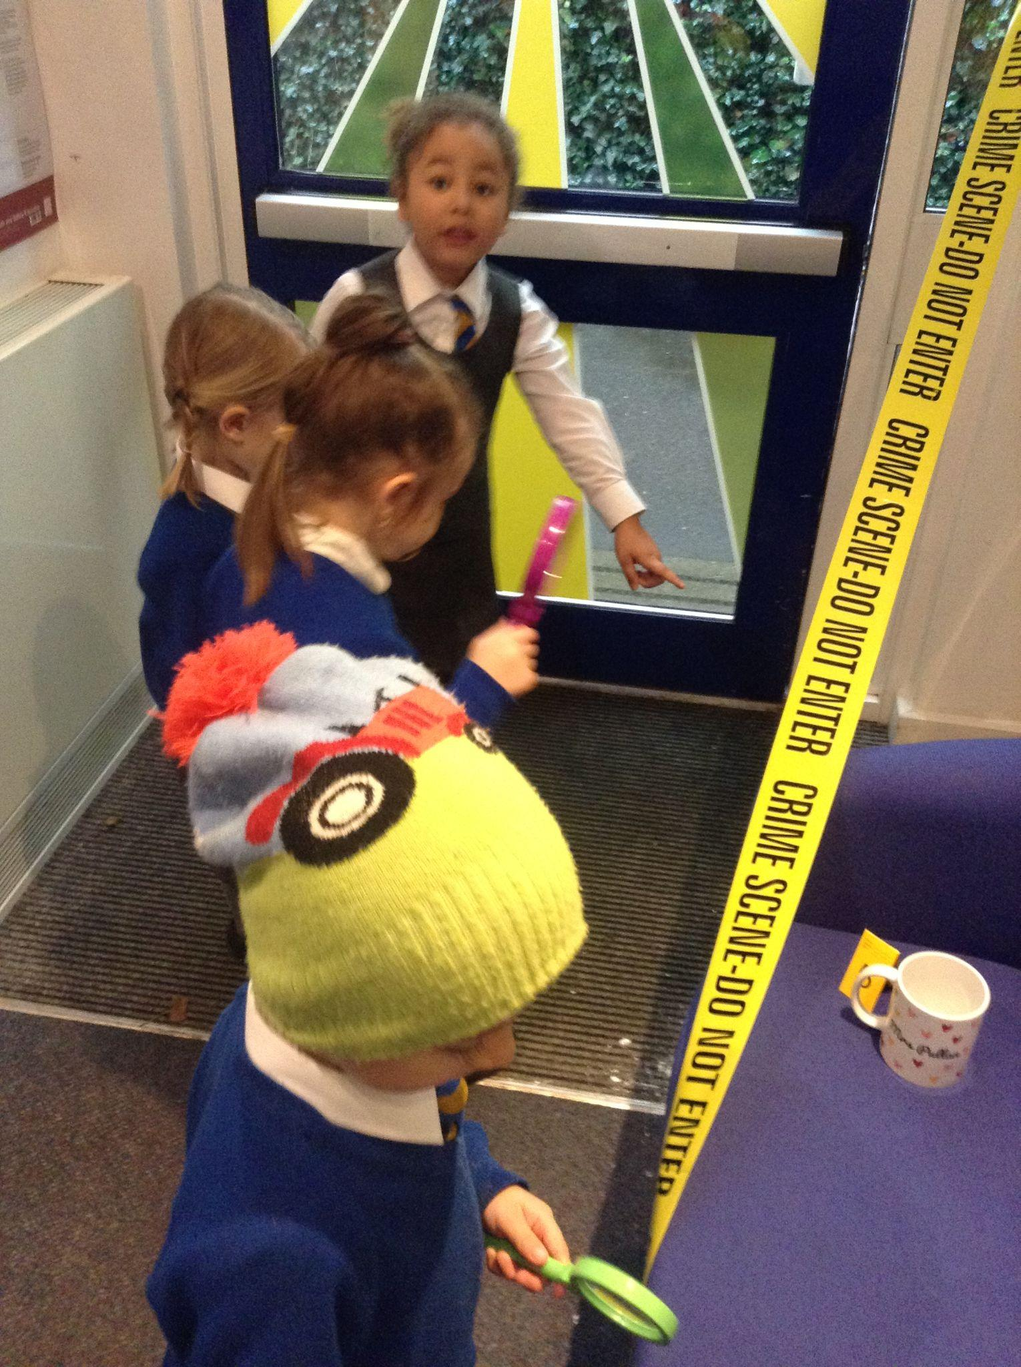
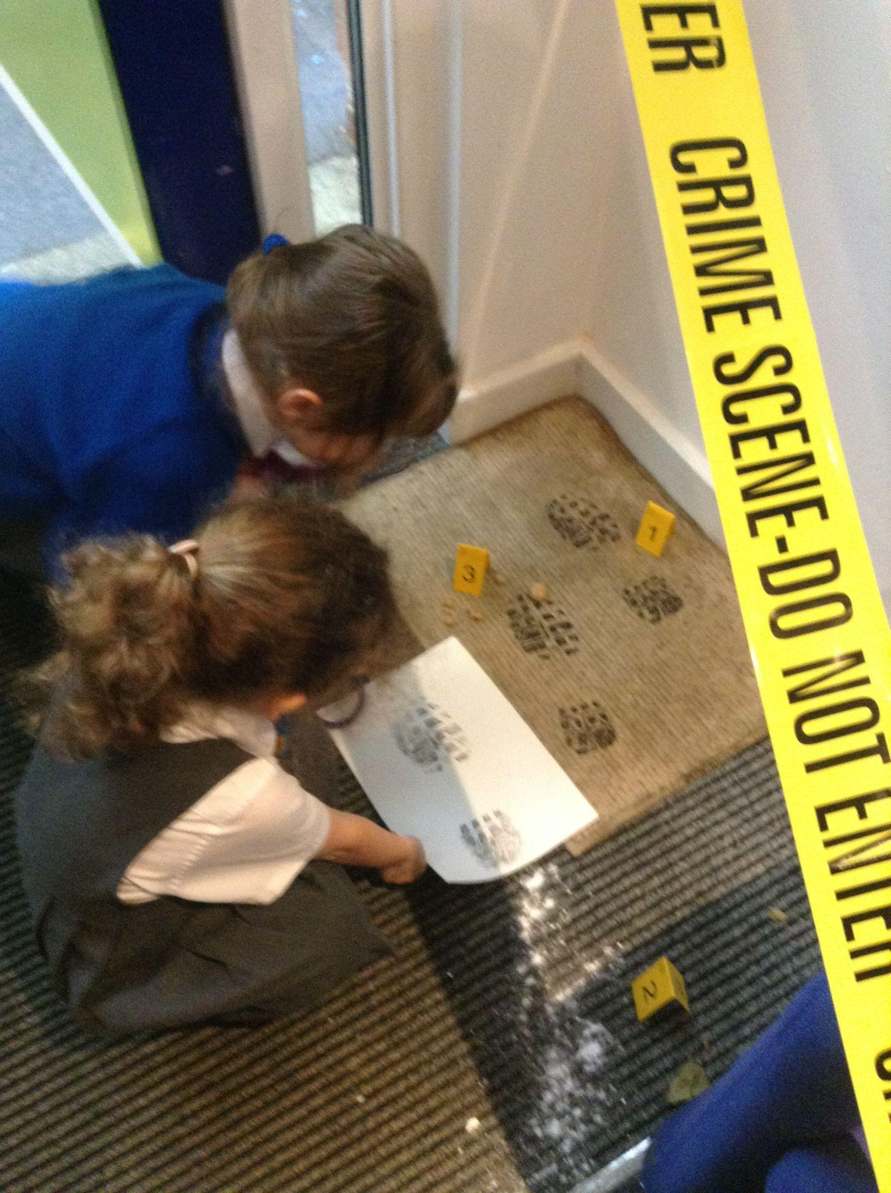
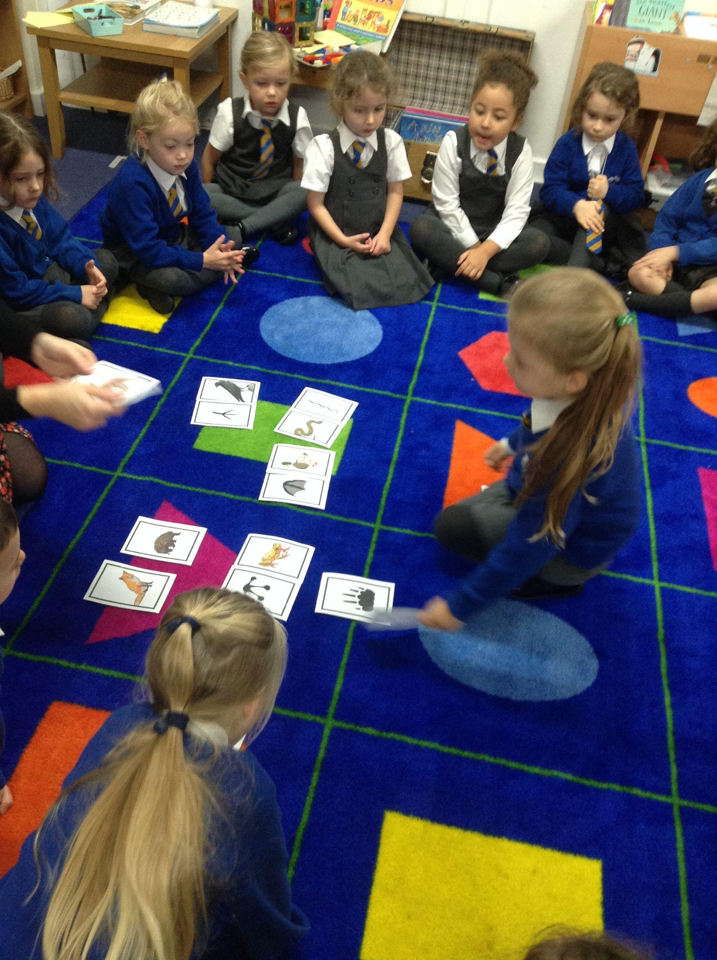
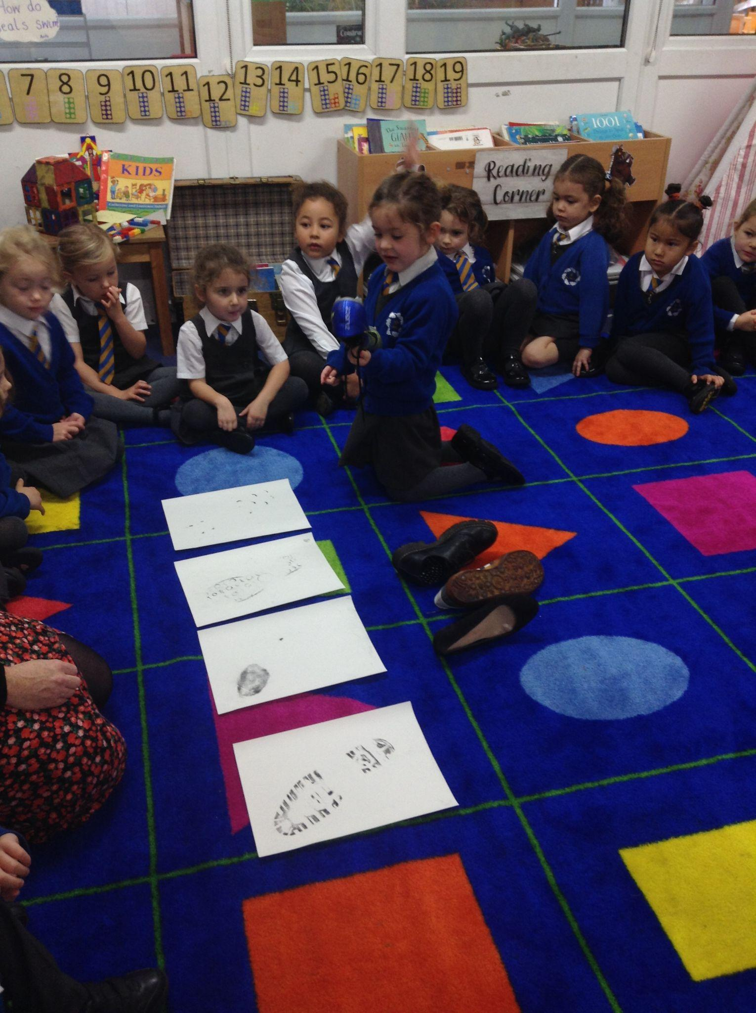
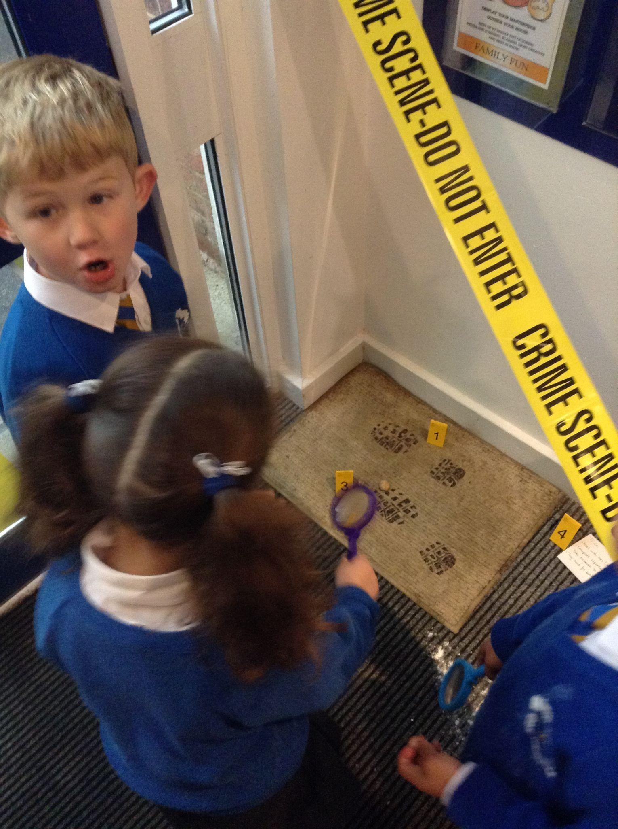
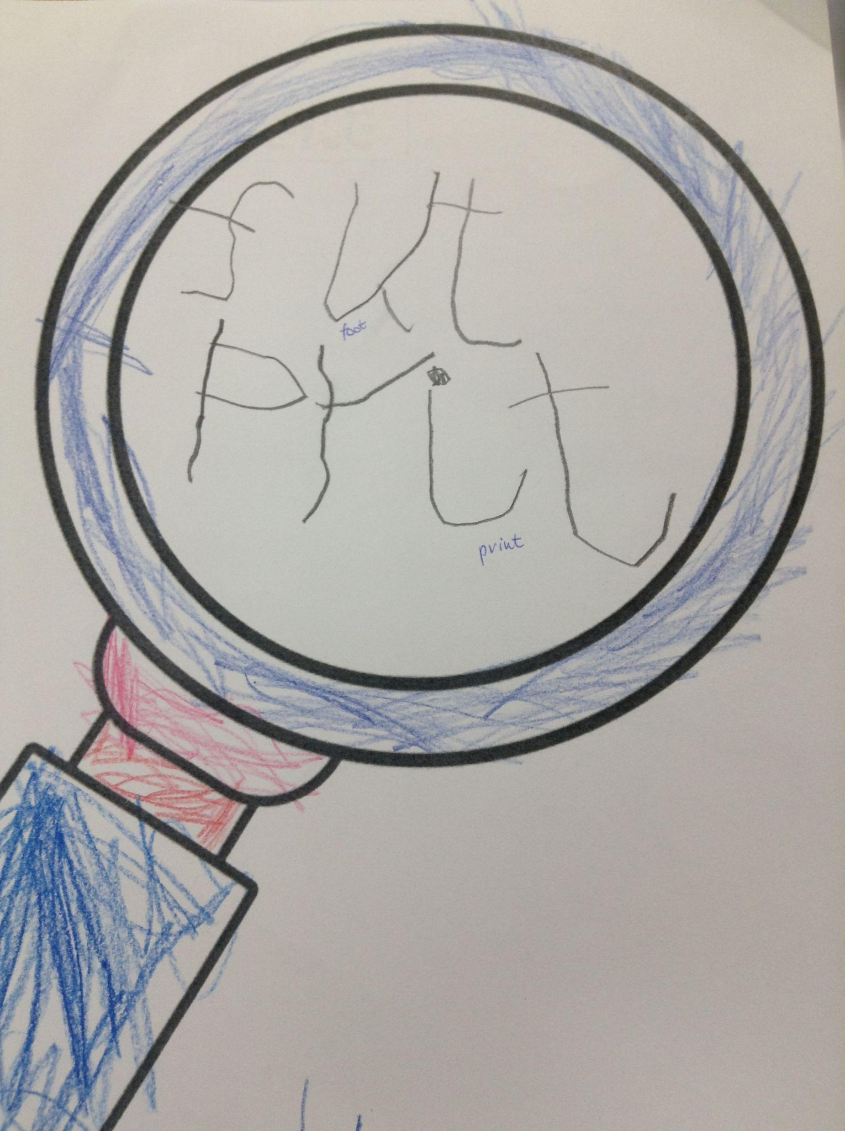
RECEPTION
Reception investigated the footprints at the scene of the crime. We tested our observation skills by matching animals with their footprints then moved onto shoes and footprints before using our forensic skills on the footprint at the crime scene. We found that the footprint matched the shoe of….Mrs Simpson! Some children also noticed the dog poo bags and discovered that Mrs Simpson has a pet dog!

Slide 19
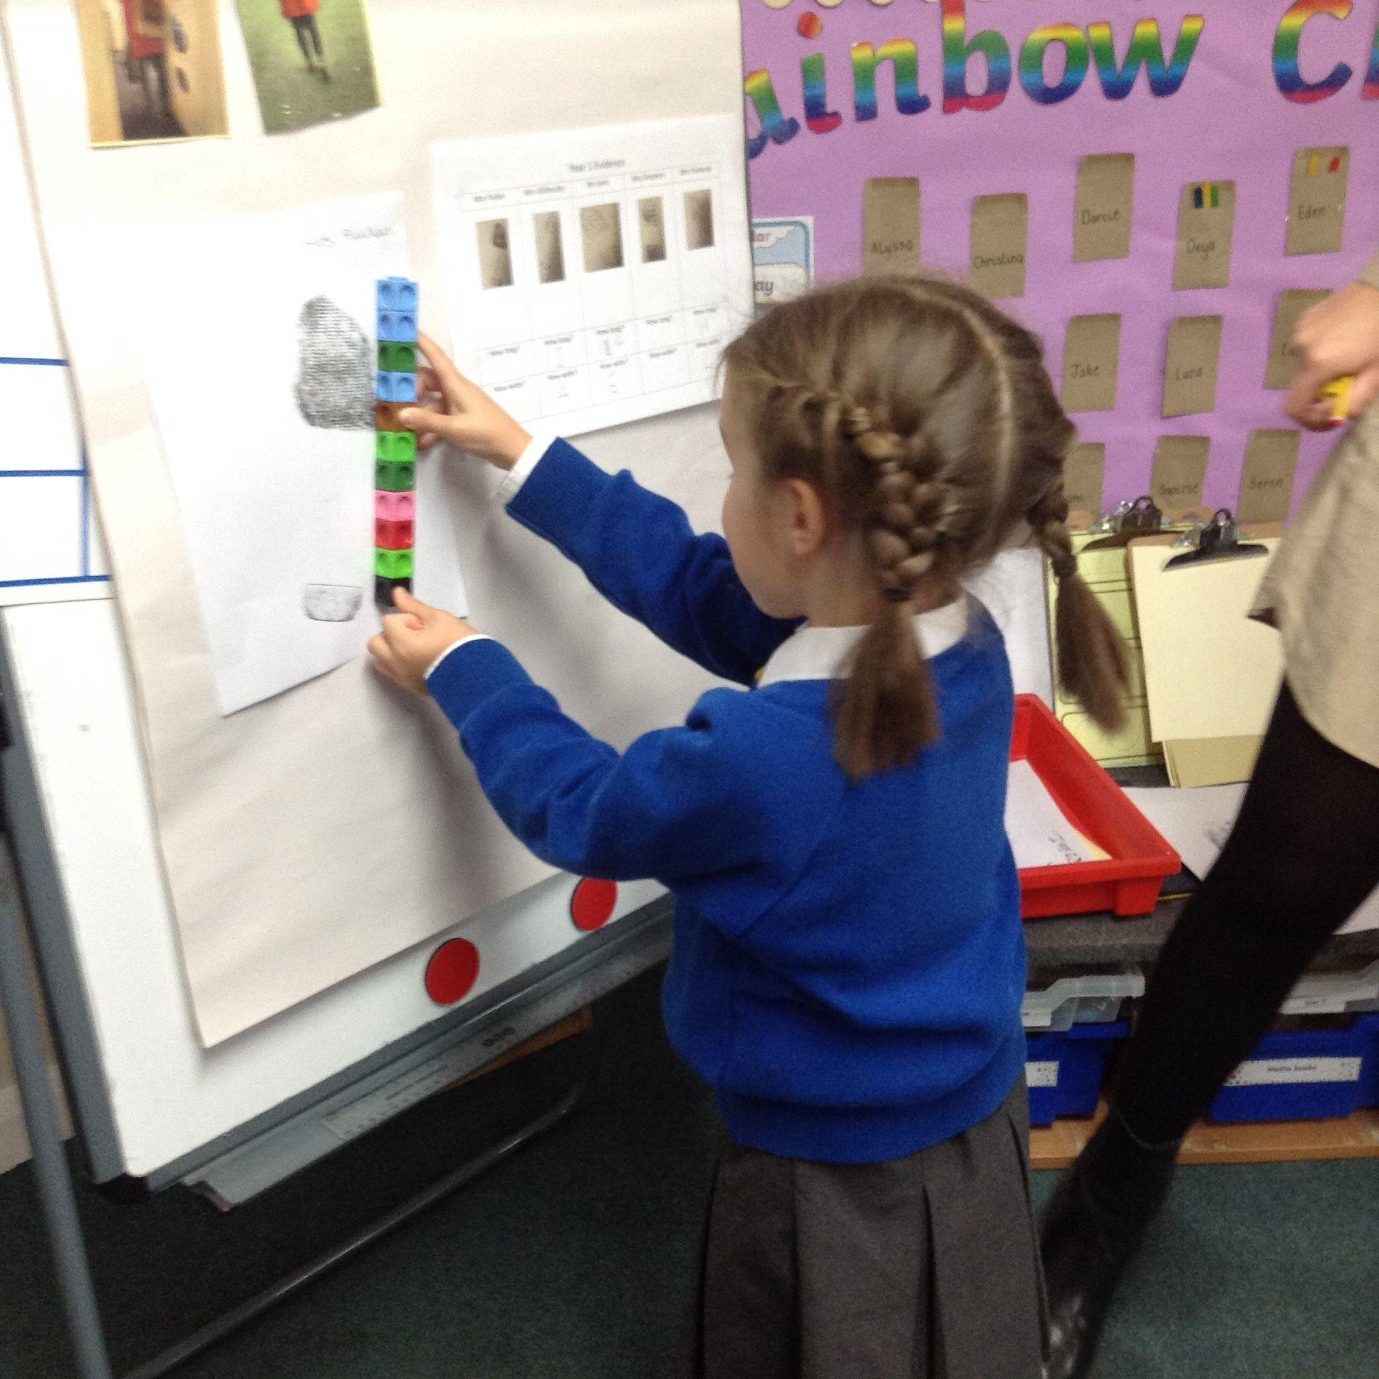
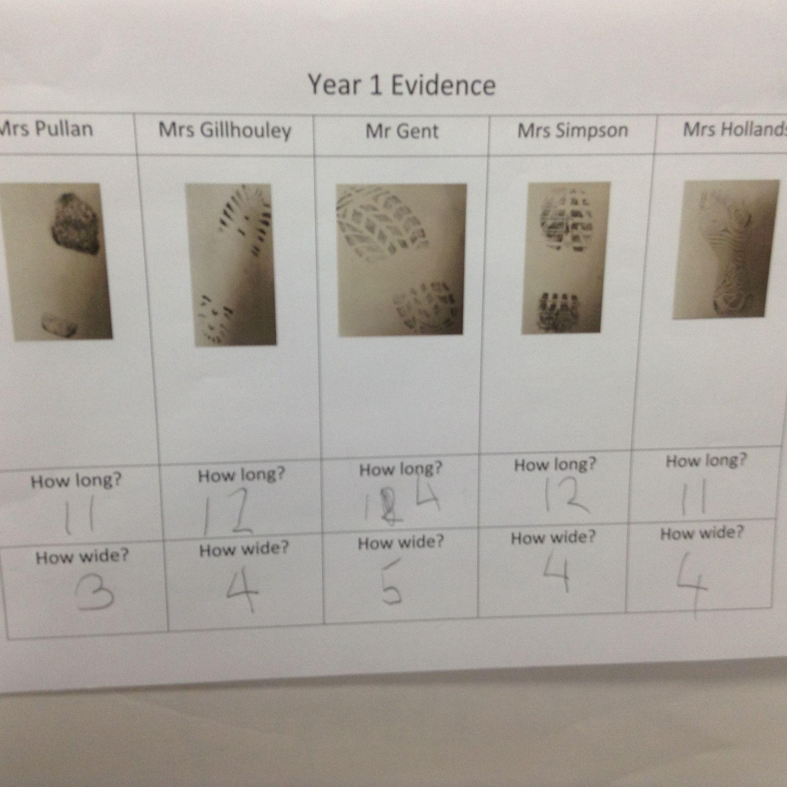
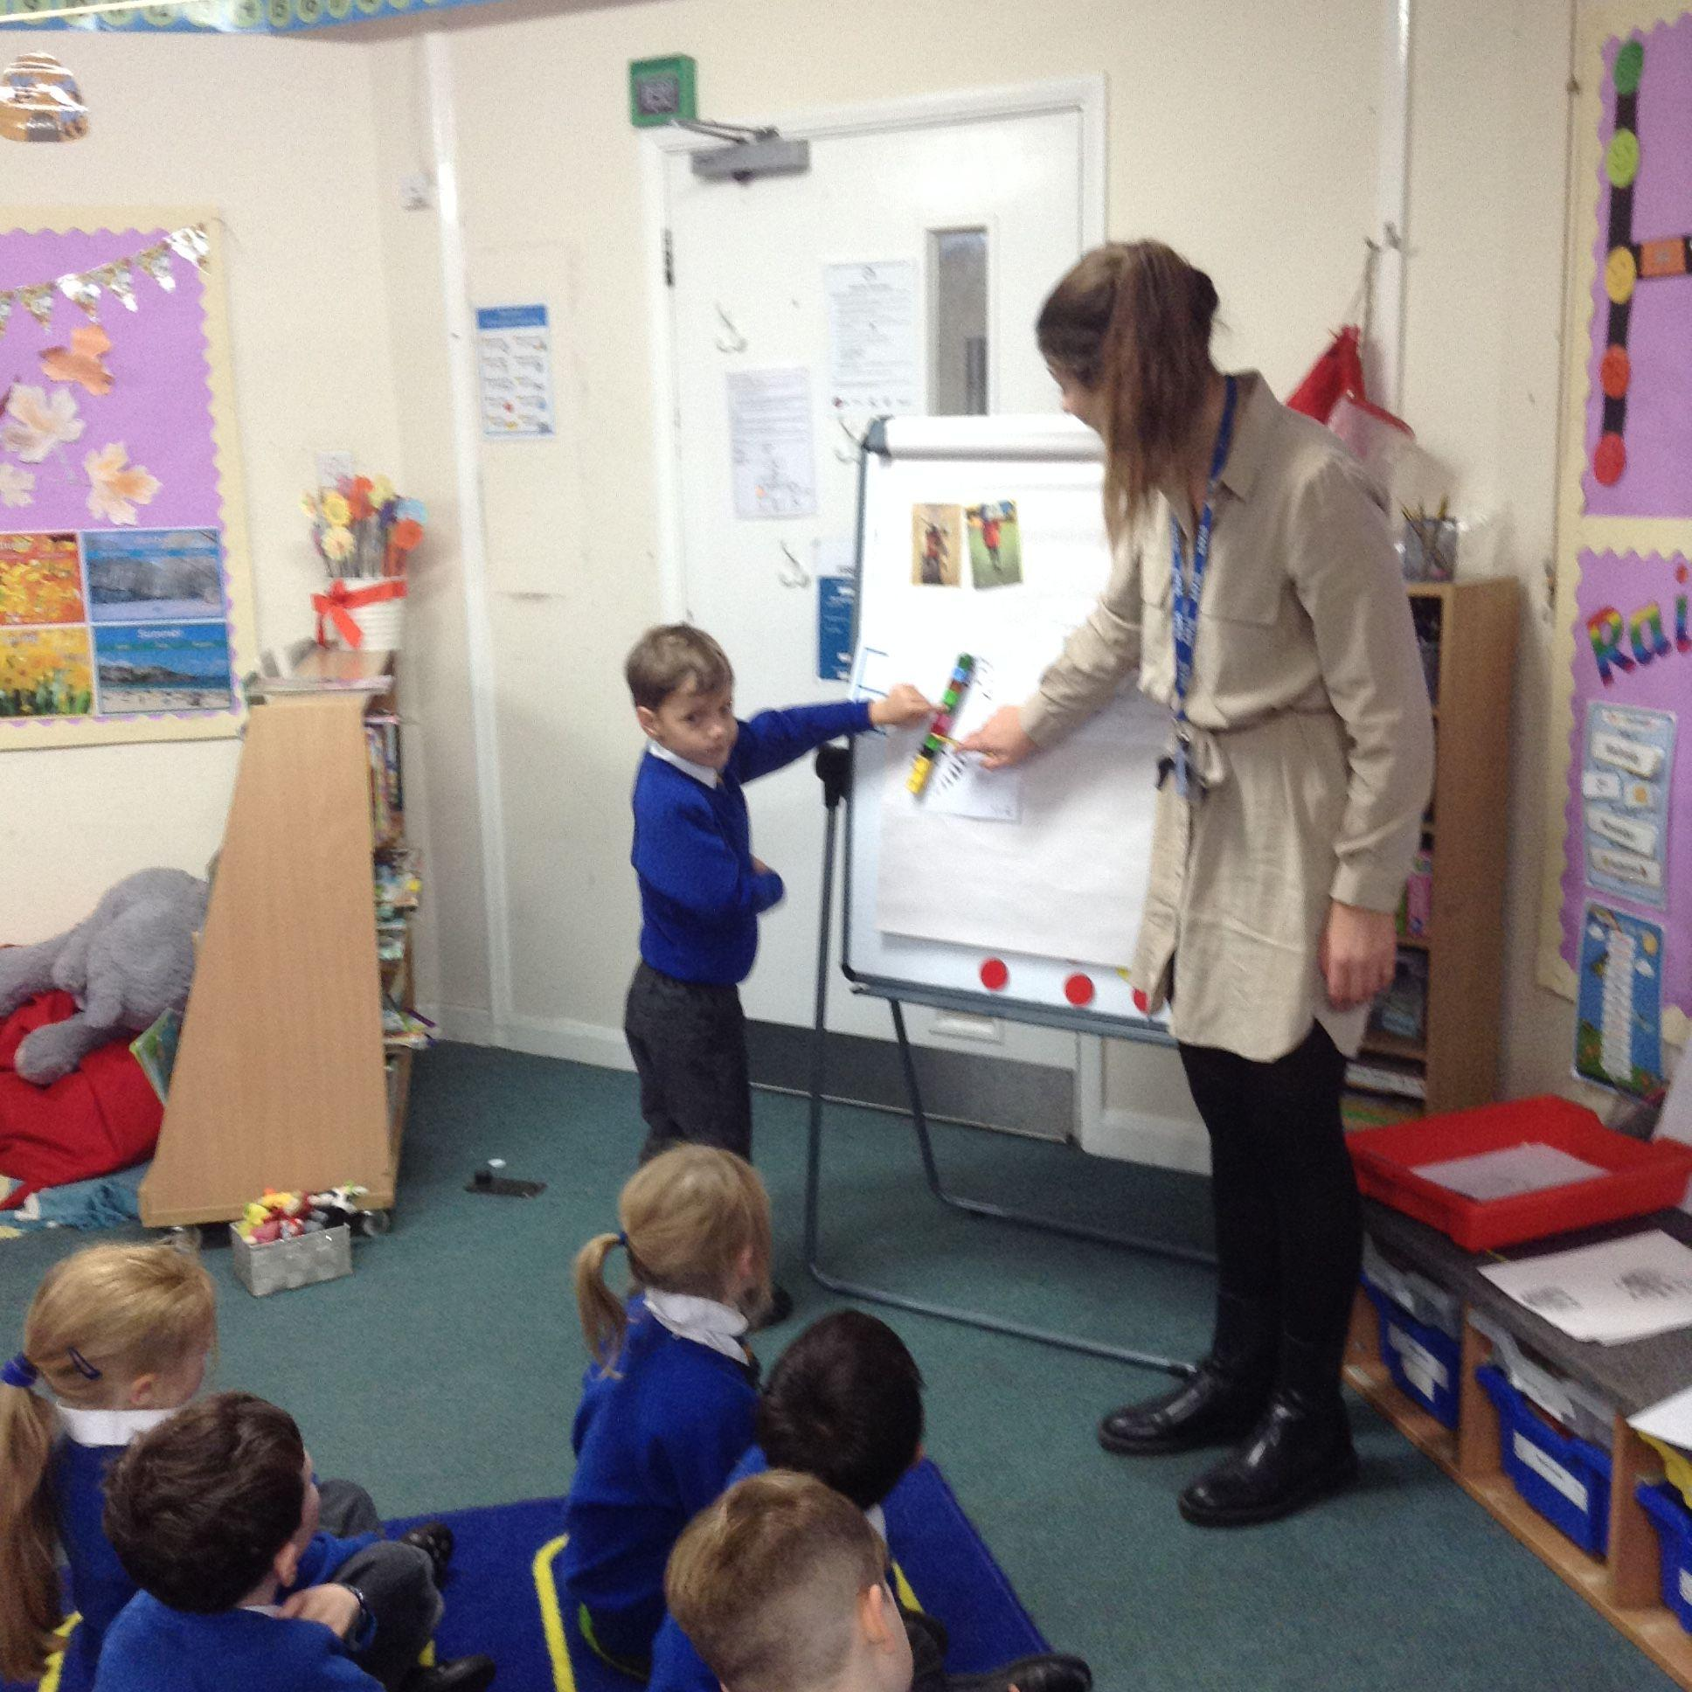
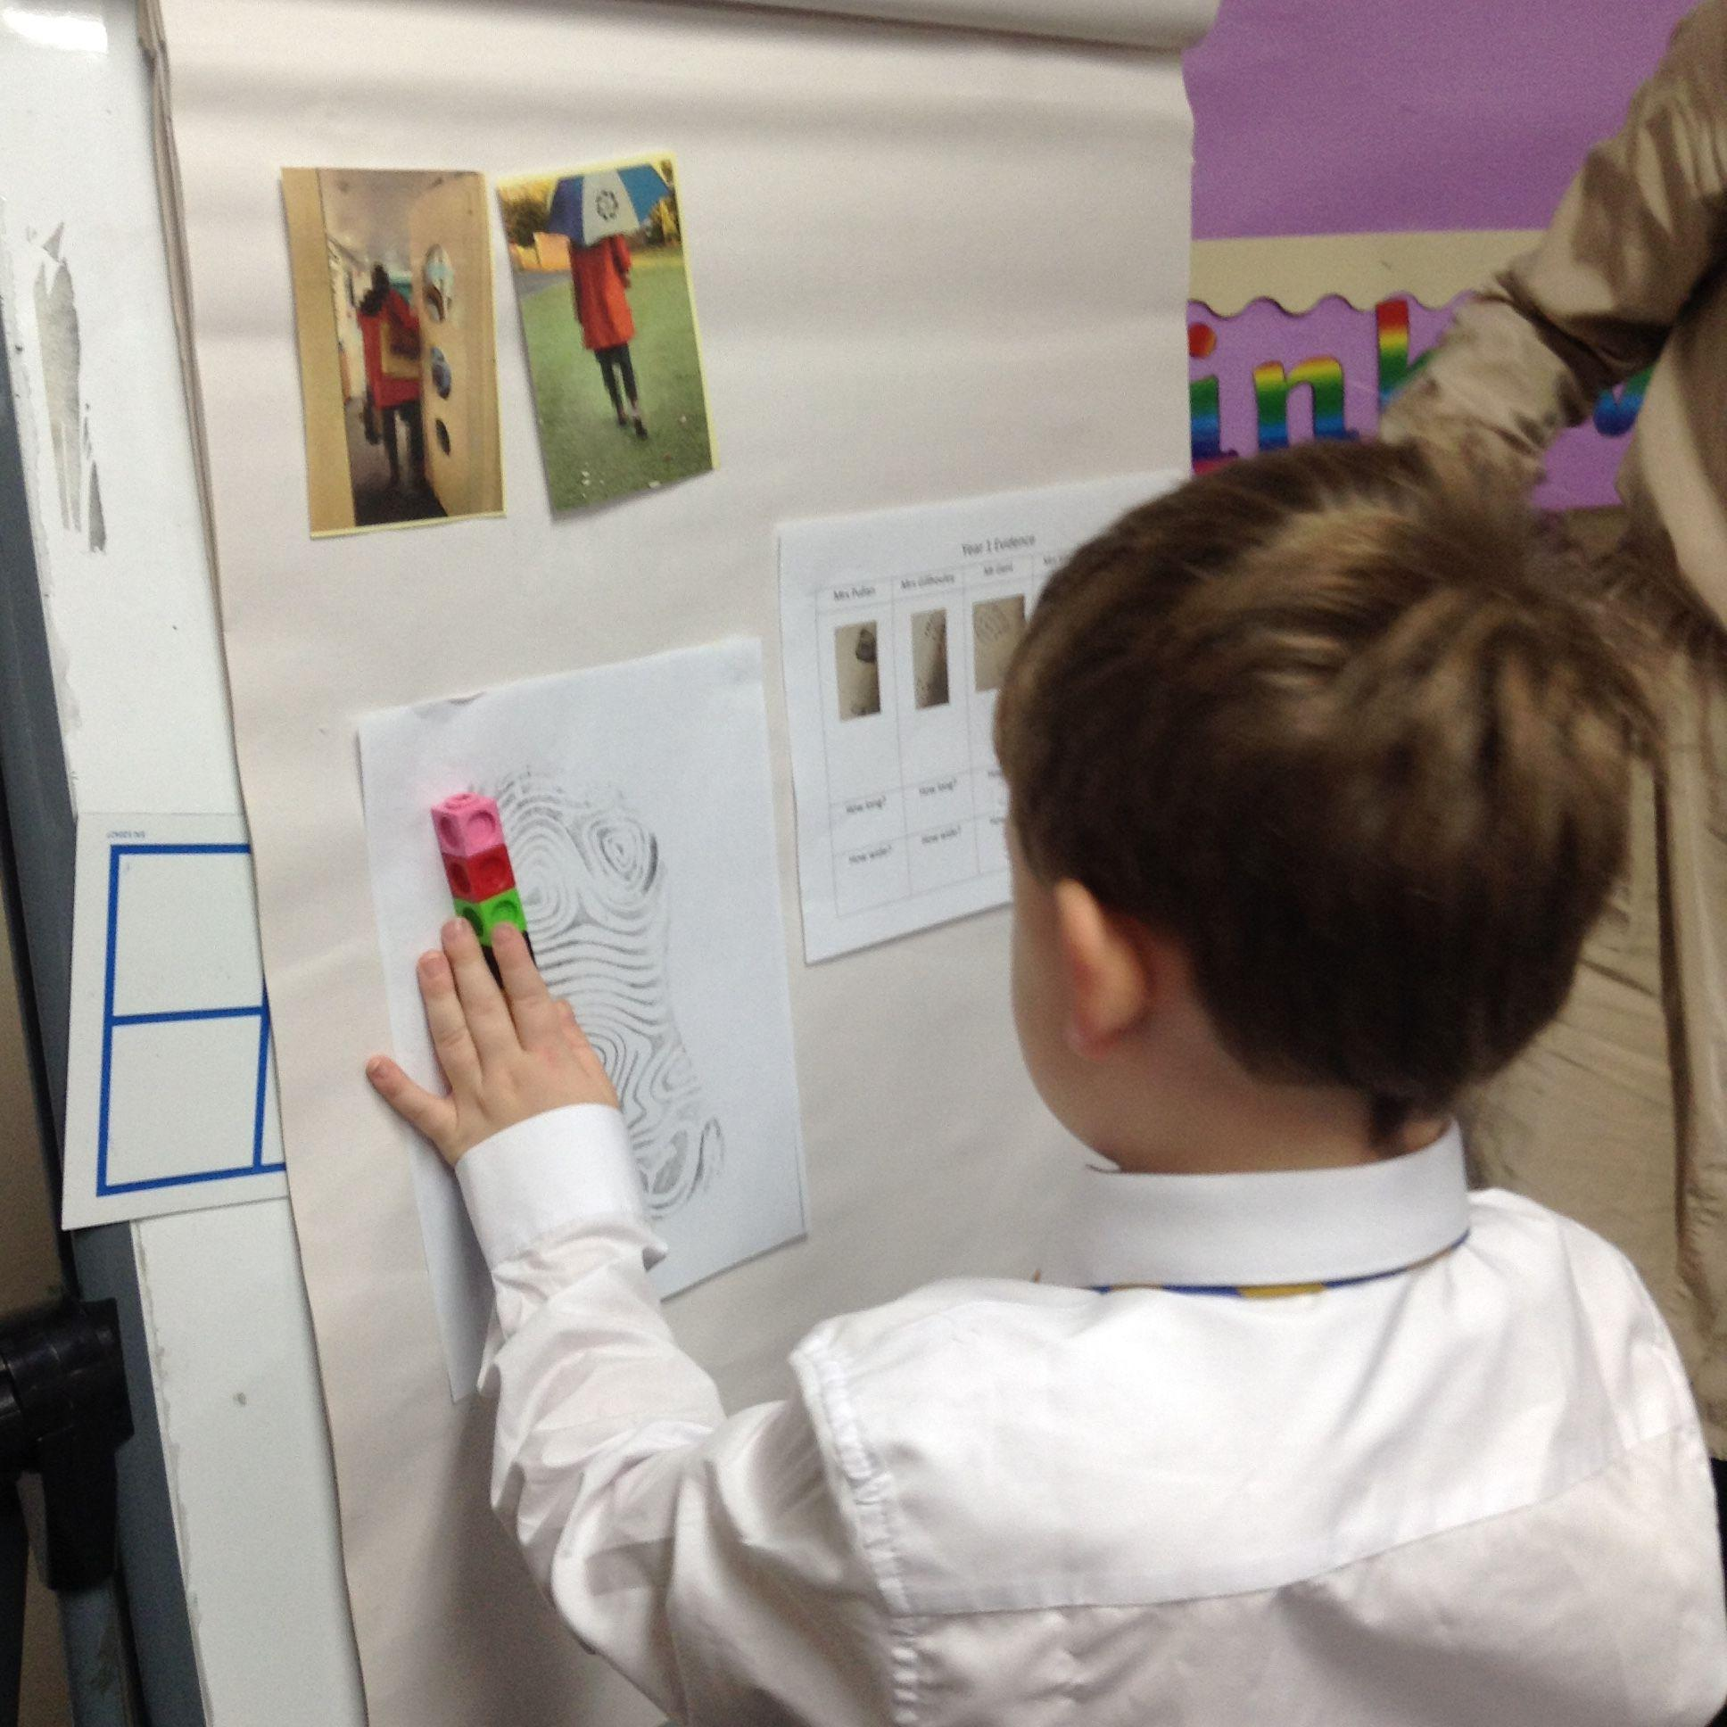
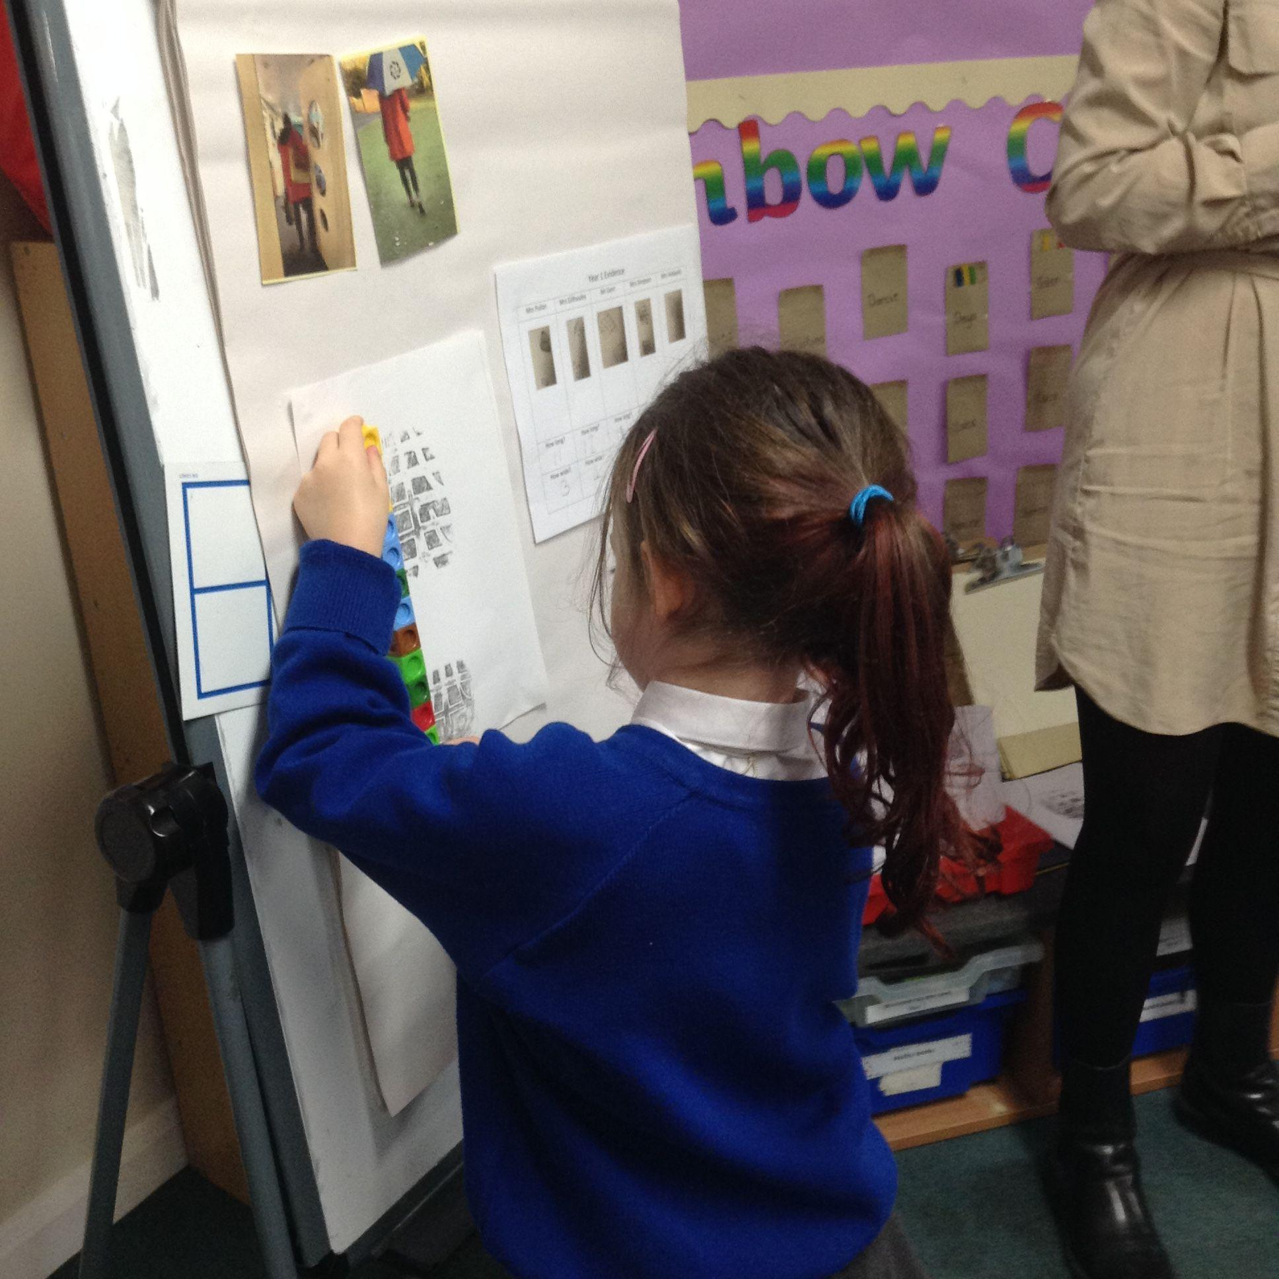
YEAR 1
We were investigating the footprints found at the crime scene! We measured the length and width of the footprints of all the suspects using cubes. We then matched the footprint from the crime scene to Mrs Simpson’s footprint! We also guessed this may have been the suspect because Mrs Simpson was wearing a red coat in the photo!

Slide 20
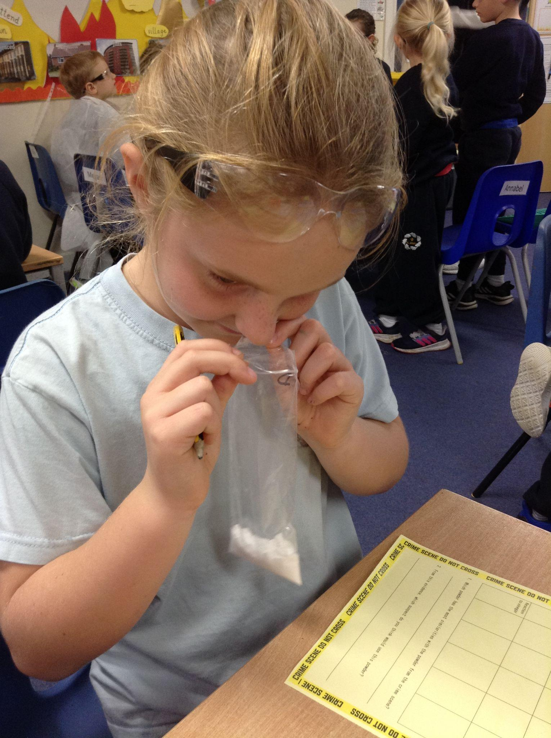
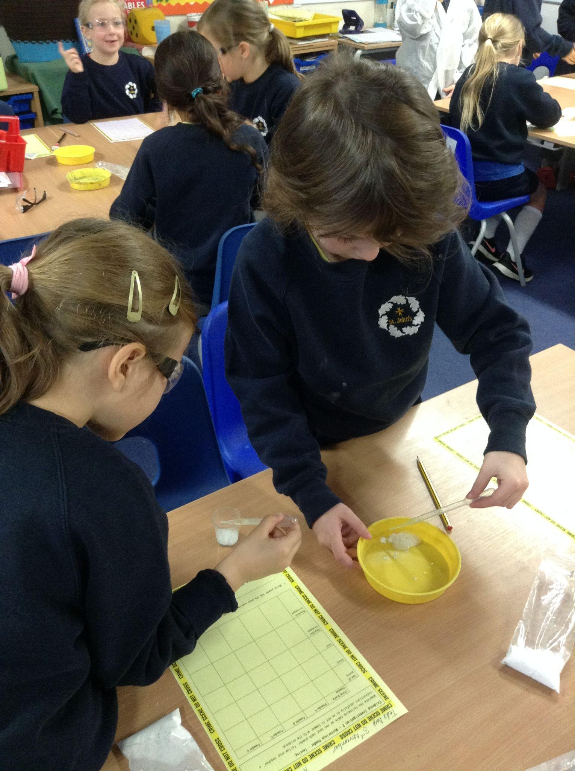
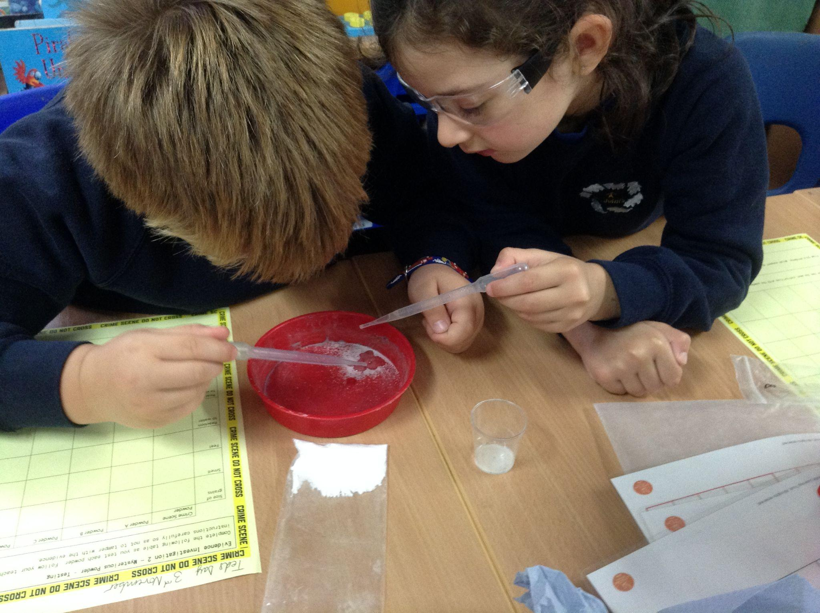
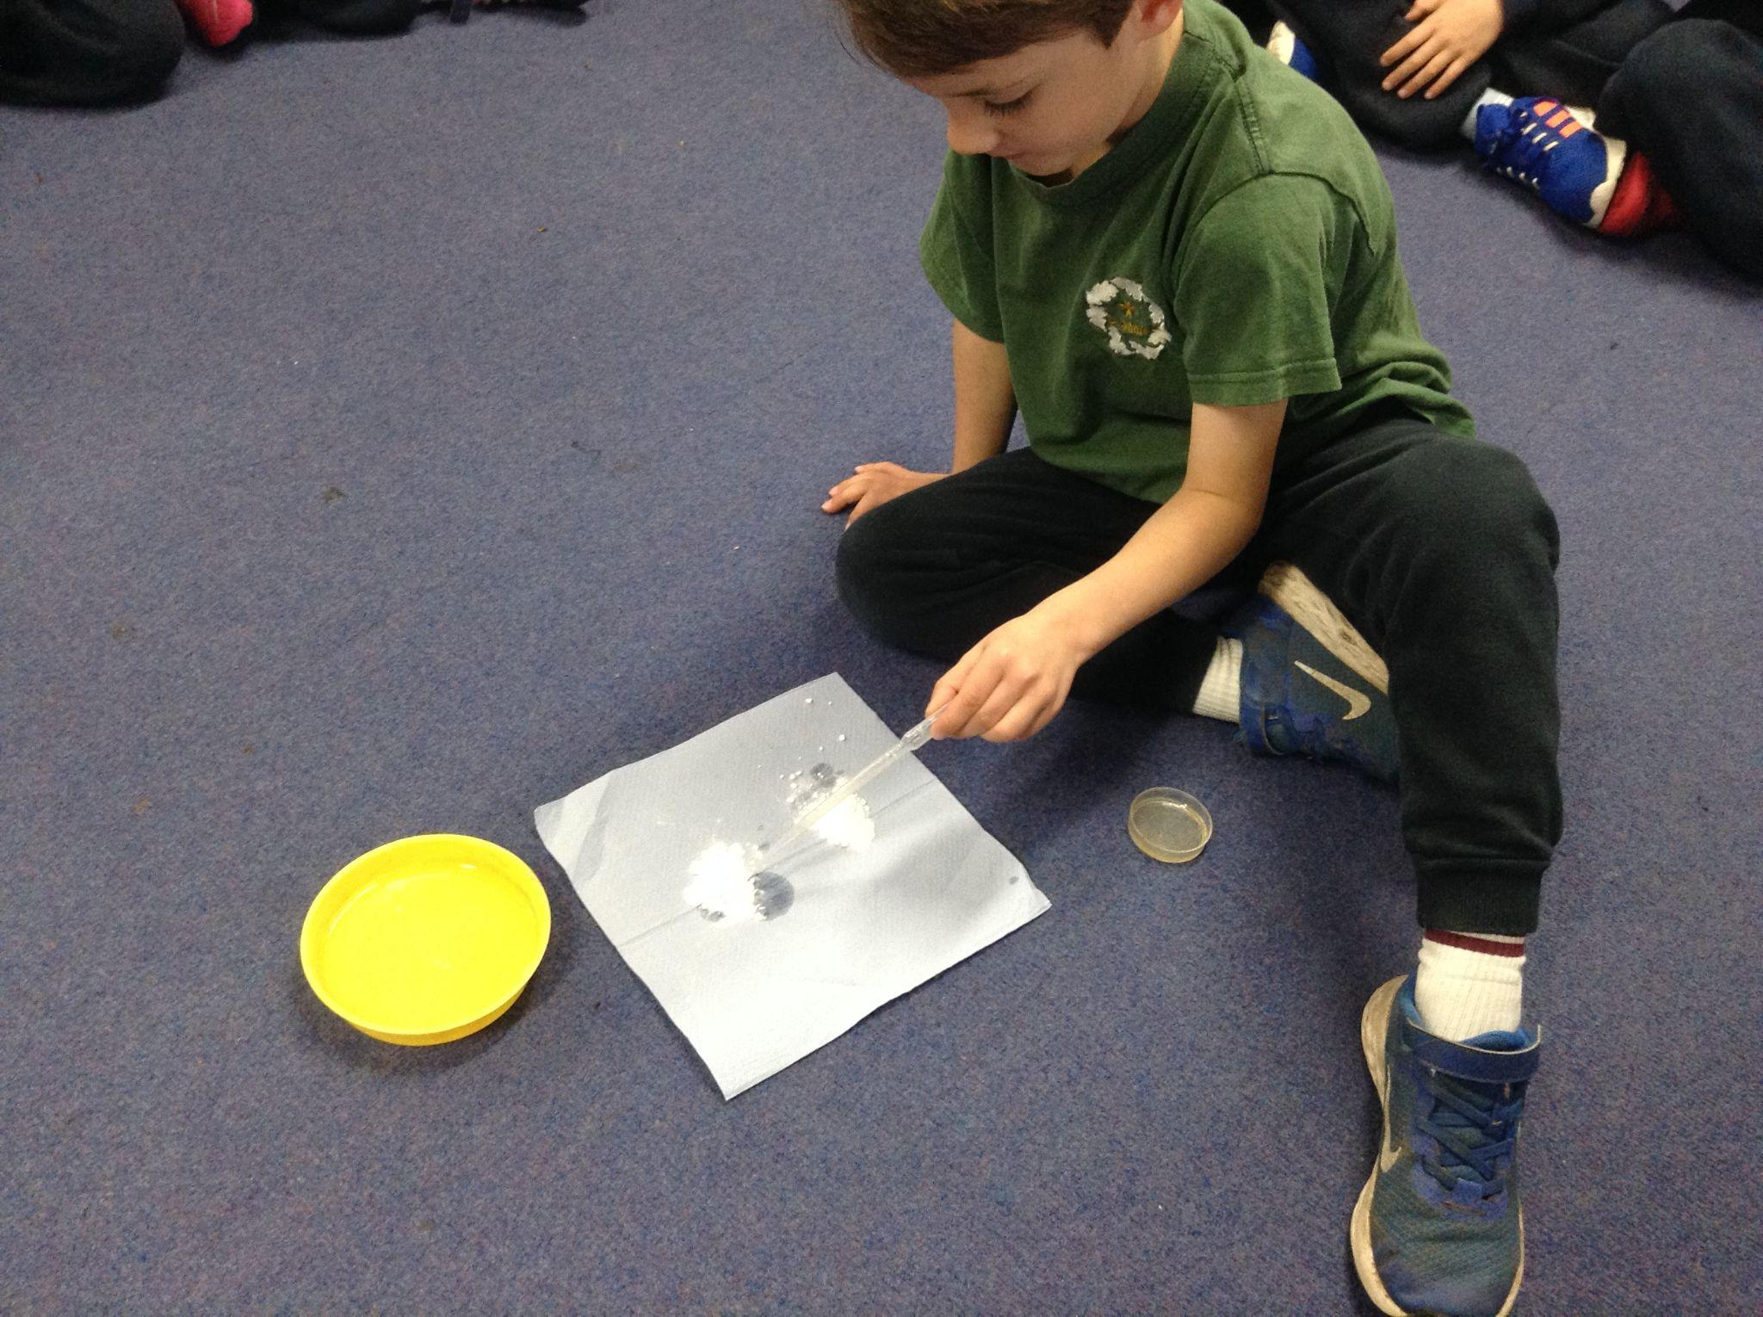
YEAR 2
We wore safety goggles to protect our eyes from these mystery white powders.
Etive helped us to notice that ‘bicarb’ was on the shopping list and that Mrs Simpson’s favourite hobby was baking! The ‘Mystery Powder D’ fizzed and bubbled like a volcano in the same way that bicarbonate of soda does when vinegar is added!
After visiting the scene of the crime we also noticed more evidence to corroborrate our findings: evidence of a twirl eaten AND a dog poo bag!

Slide 21
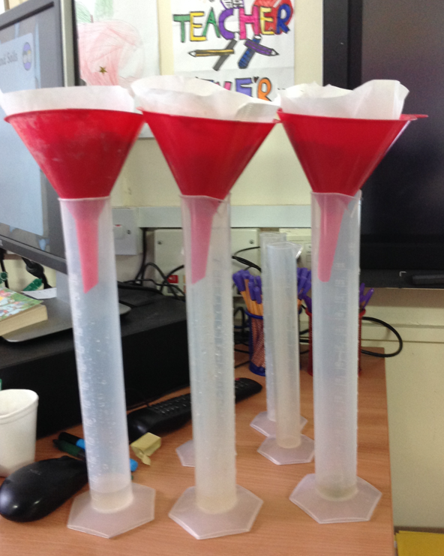
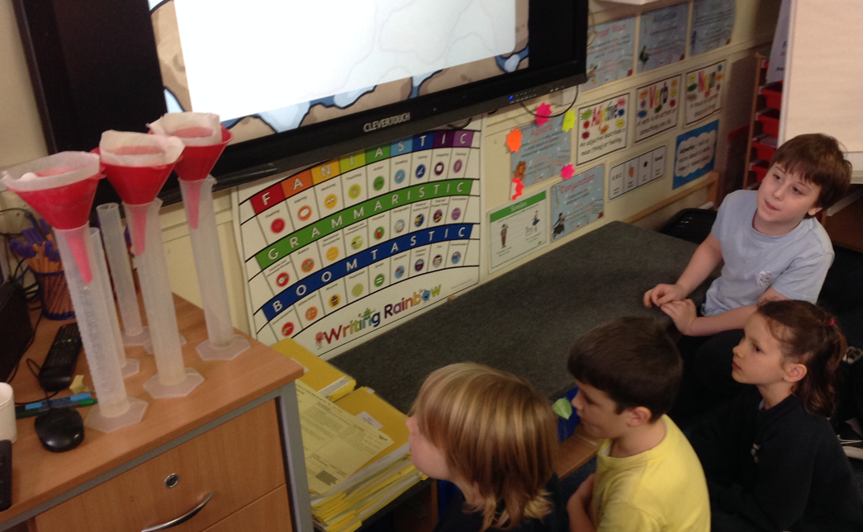
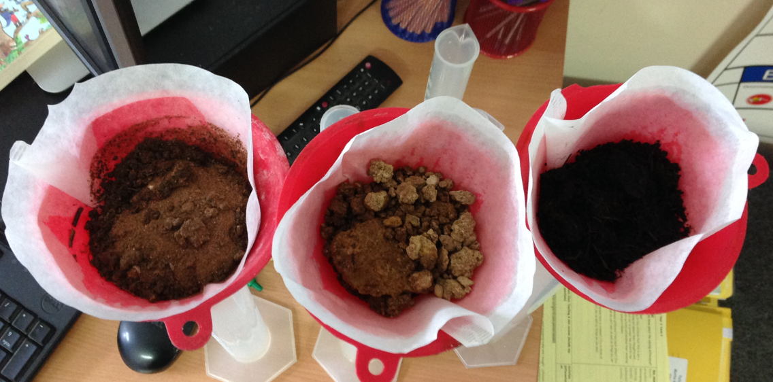
YEAR 3
We learned about how soils are all different and worked out what our three types of soil were based on their permeability. The one that drained the fastest was sandy soil and the one that drained the slowest was the peaty soil. The one in the middle was the clay soil. We found that clay soil is often by streams and rivers. We know that Mrs Simpson likes to walk her dog by the stream near her house!

Slide 22
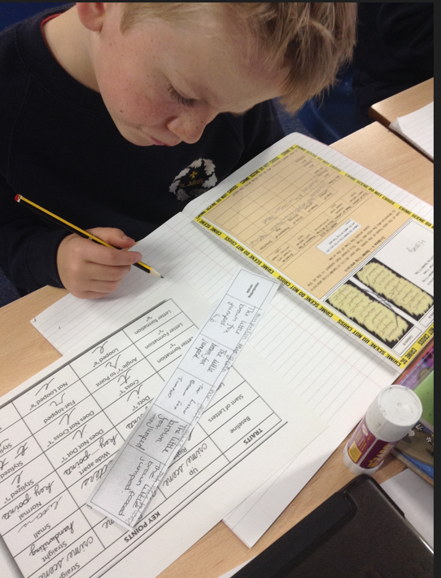
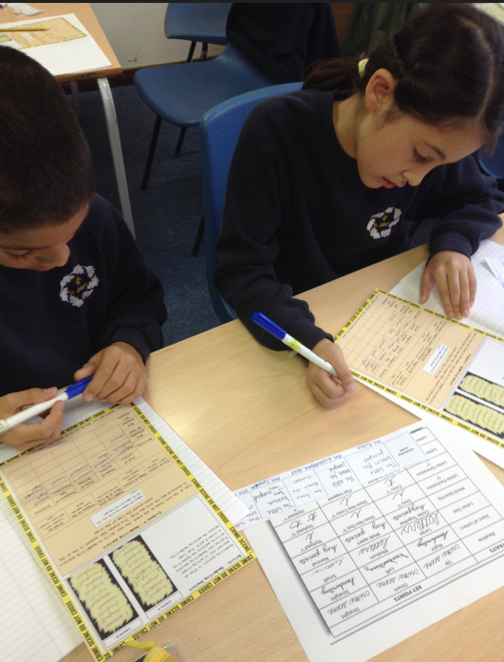
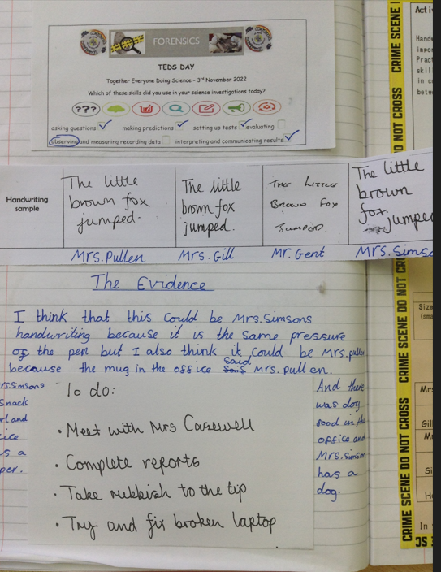
YEAR 4
It is important to observe carefully and make accurate observations.
Ivan , “ Every piece of evidence counts even if it is only a tiny thing. It all gives us clues!”
First, we trained in knowing what to look for when analysing handwriting. We then observed closely the 5 suspects’ handwriting samples.
We then compared the note left at the scene with the samples.

Slide 23
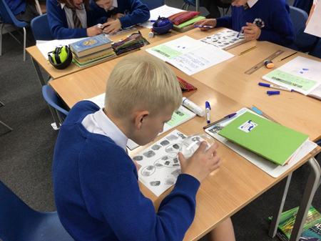
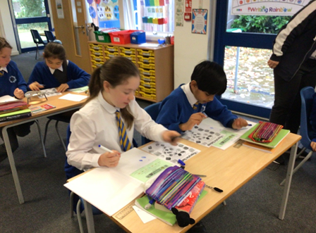
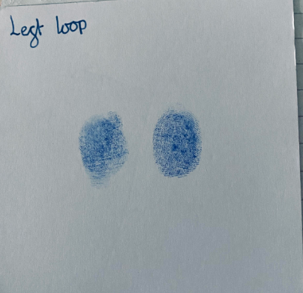
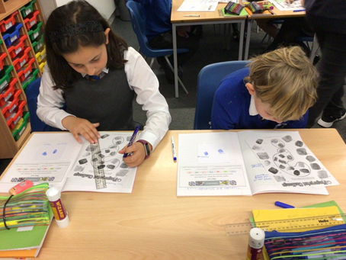
YEAR 5
Year 5 class looked at the crime scene first and started to think they had solved the crime. However, we discussed how evidence could be planted to frame someone. So we needed to investigate further and used forensic fingerprinting to find out who the culprit was and we are sure we know

Slide 24
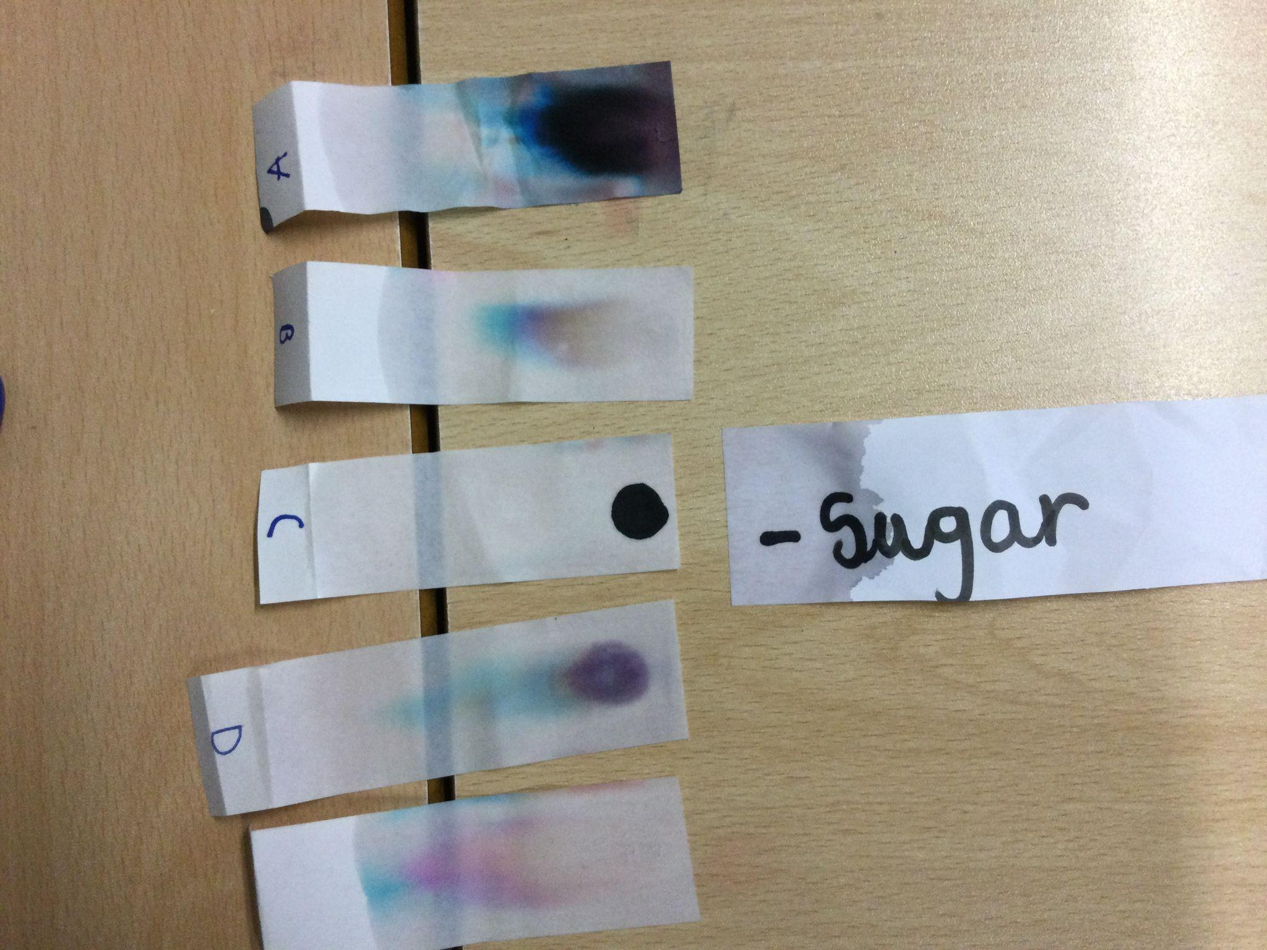
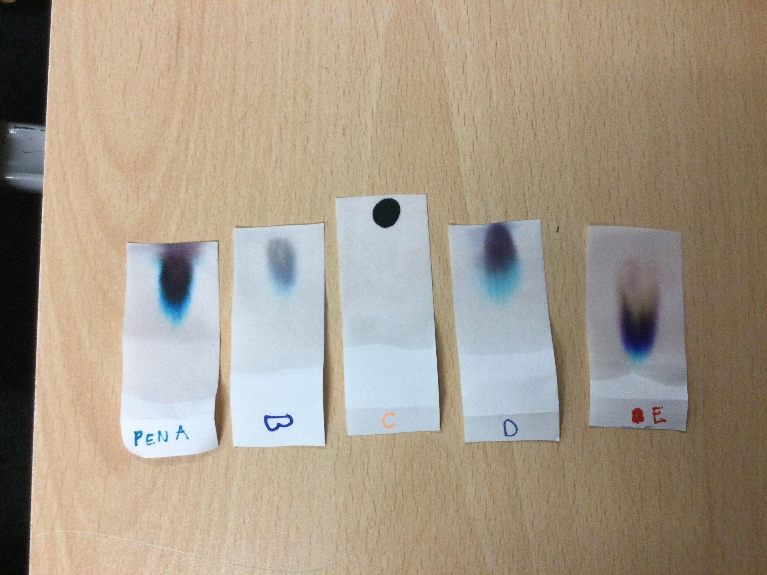
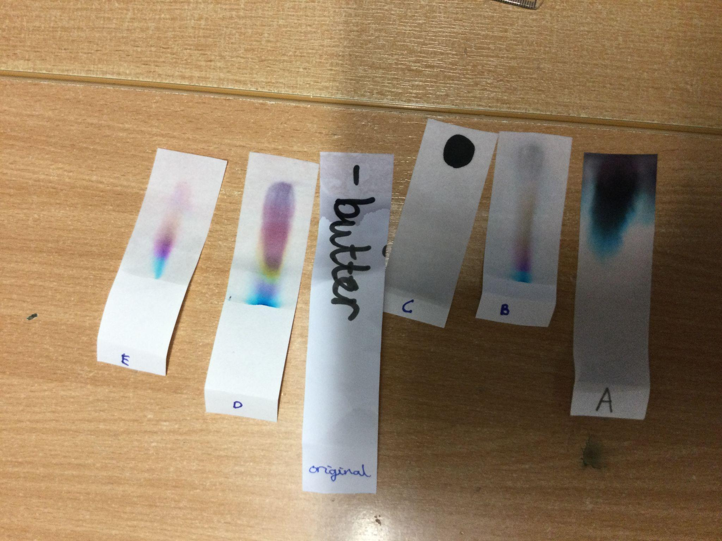
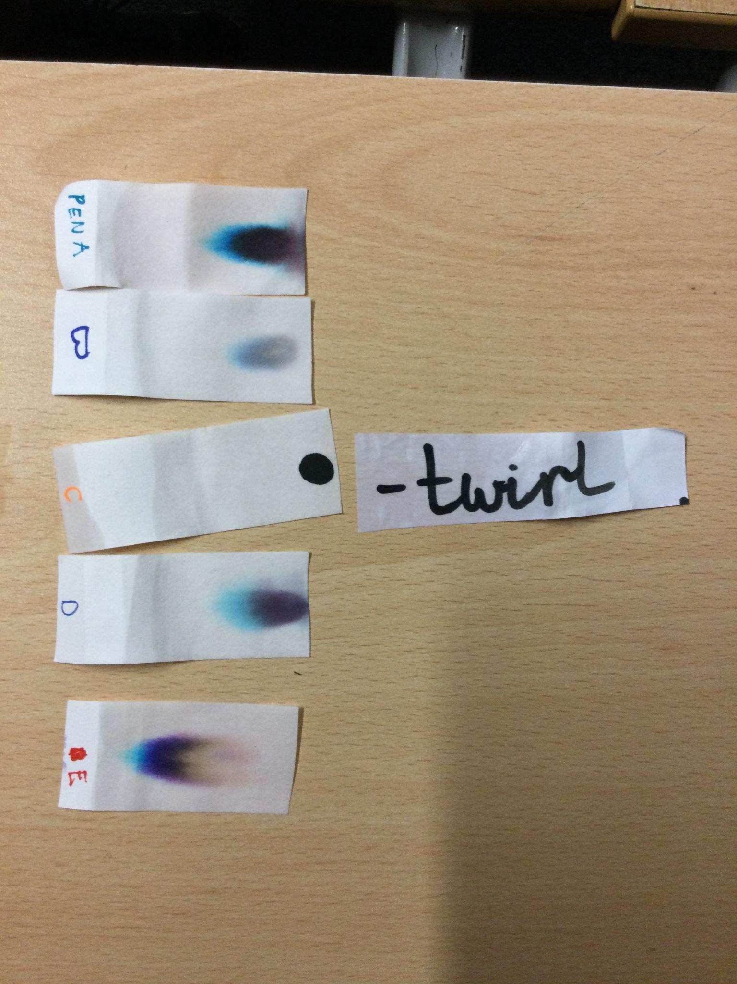
YEAR 6
We used chromatography techniques to separate the colours of the 5 pens that were found by Mrs Casewell in the desk drawers of the suspects. All the pens separated out except one! This pen matched the pen from the shopping list that was dropped. This was pen C. Some people thought whoever used the pen tried to frame the most likely suspect!
We think we know who the thief is!
Our results were CONCLUSIVE!

Slide 25
THE GUILTY STAFF MEMBER IS…..

