Slide 1

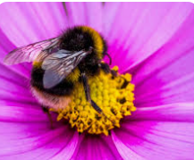
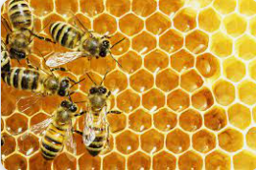
TEDS DAY
MONDAY 3rd JULY 2023
Buzzing about Bees

Slide 2
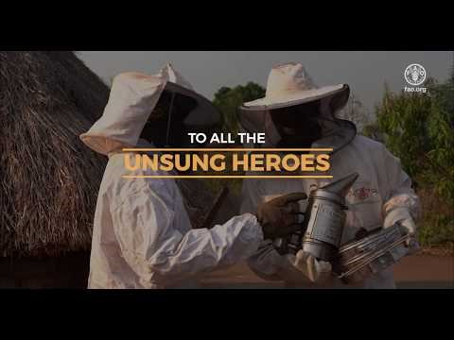
Today we are going to be Bee Detectives and learn about the vital role bees have in our world.
https://www.youtube.com/watch?v=jn8H-qelRqU

Slide 3
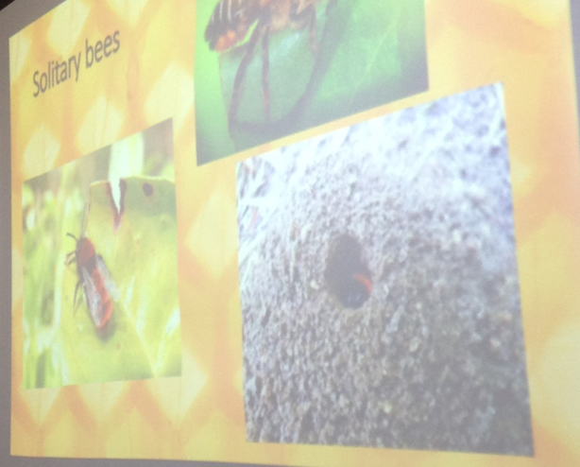
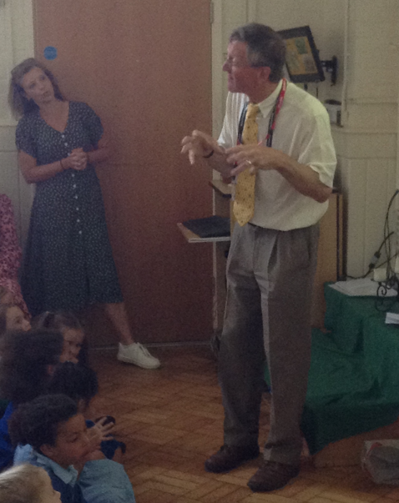
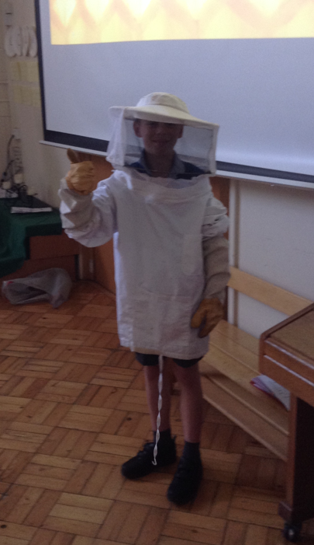
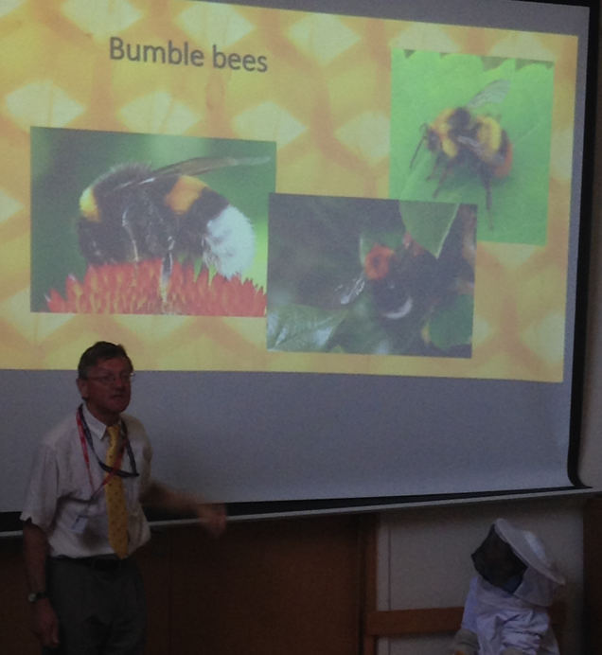
Welcome our Bee Keeper Visitor

Slide 4

KS1 Sc1 Scientific Enquiry
• Ideas & evidence in science
• Considering evidence and evaluating
Sc2 Life Processes
• Green plants
• Living things and their environment
KS2 Sc1 Scientific Enquiry
• Links between cause and effect
Sc2 Life Processes
• Life processes common to humans and other animals
• Make links between life processes in familiar animals, plants & environment
• Plant reproduction
• Living things and their environment, about ways in which living things & the environment needing protection

Slide 5
What have you been learning in your classes?

Slide 6
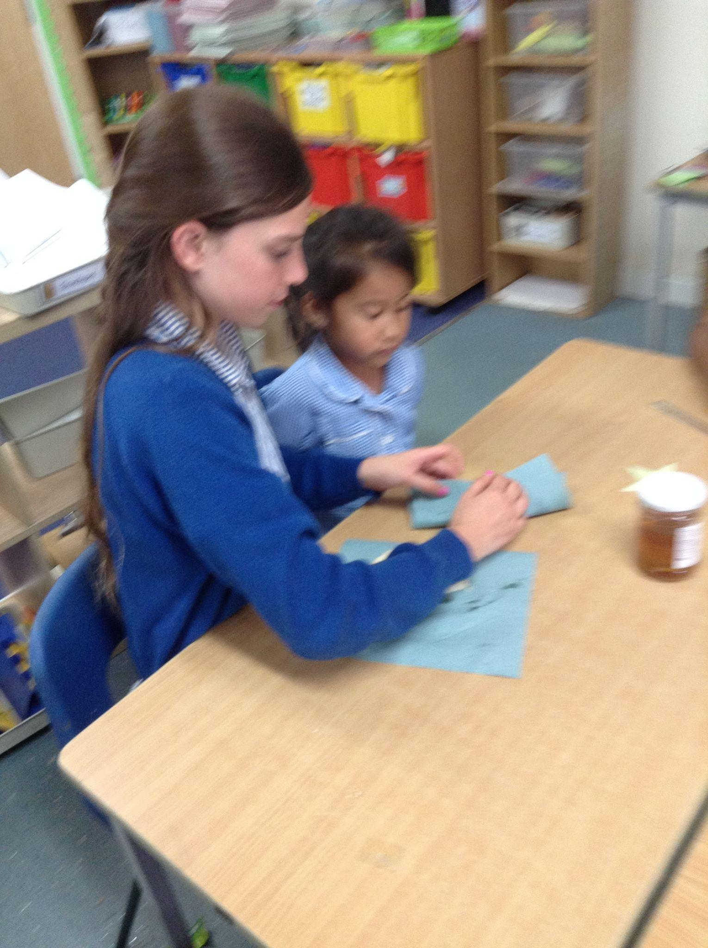
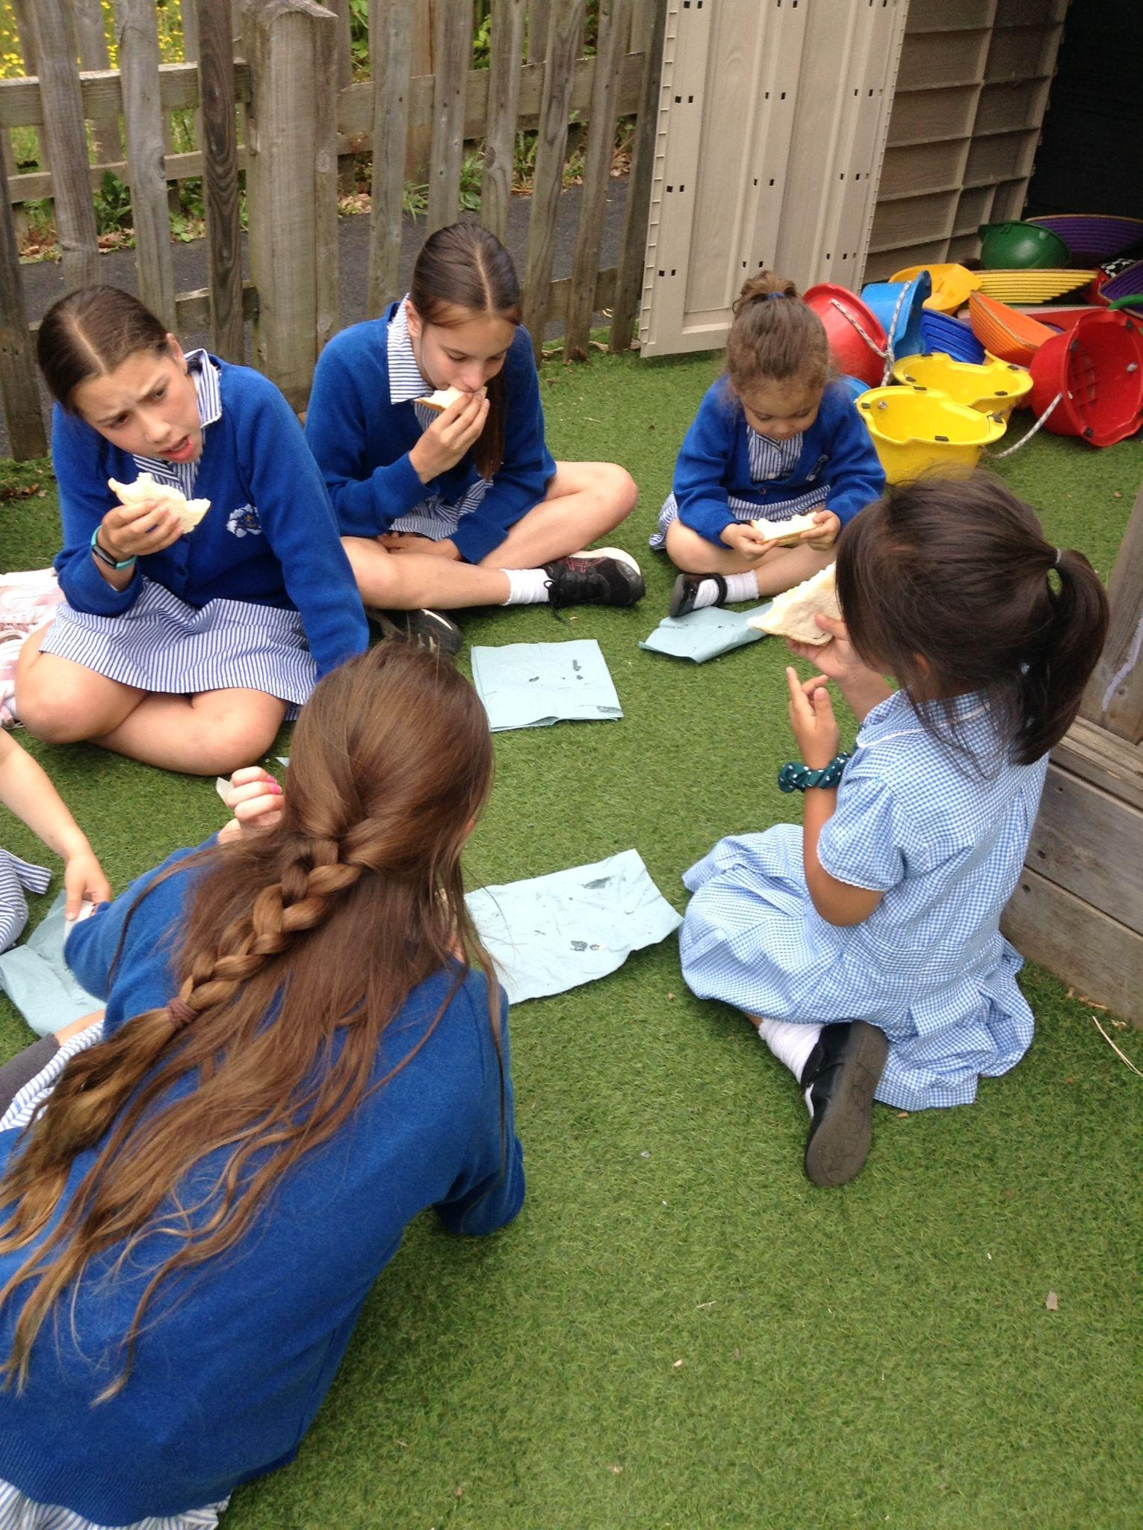
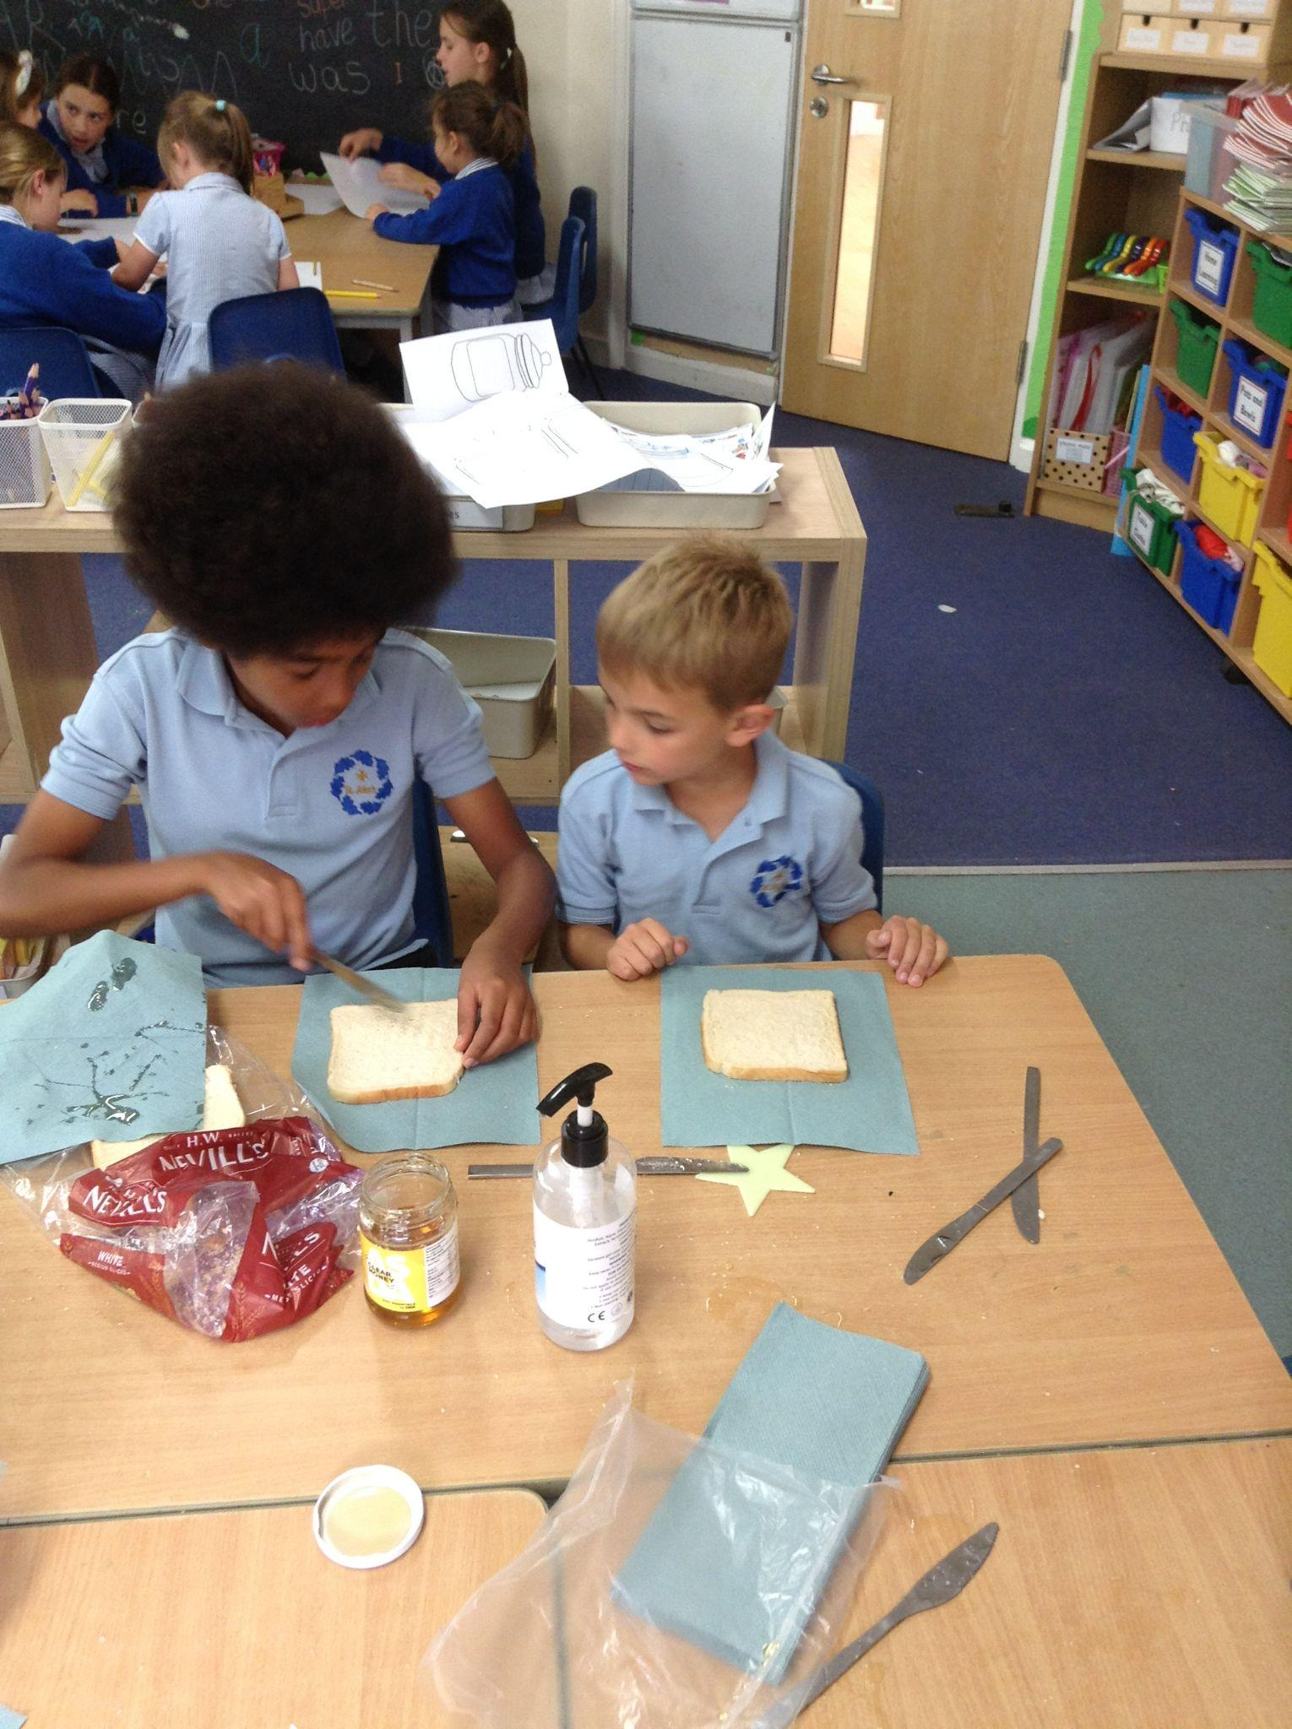
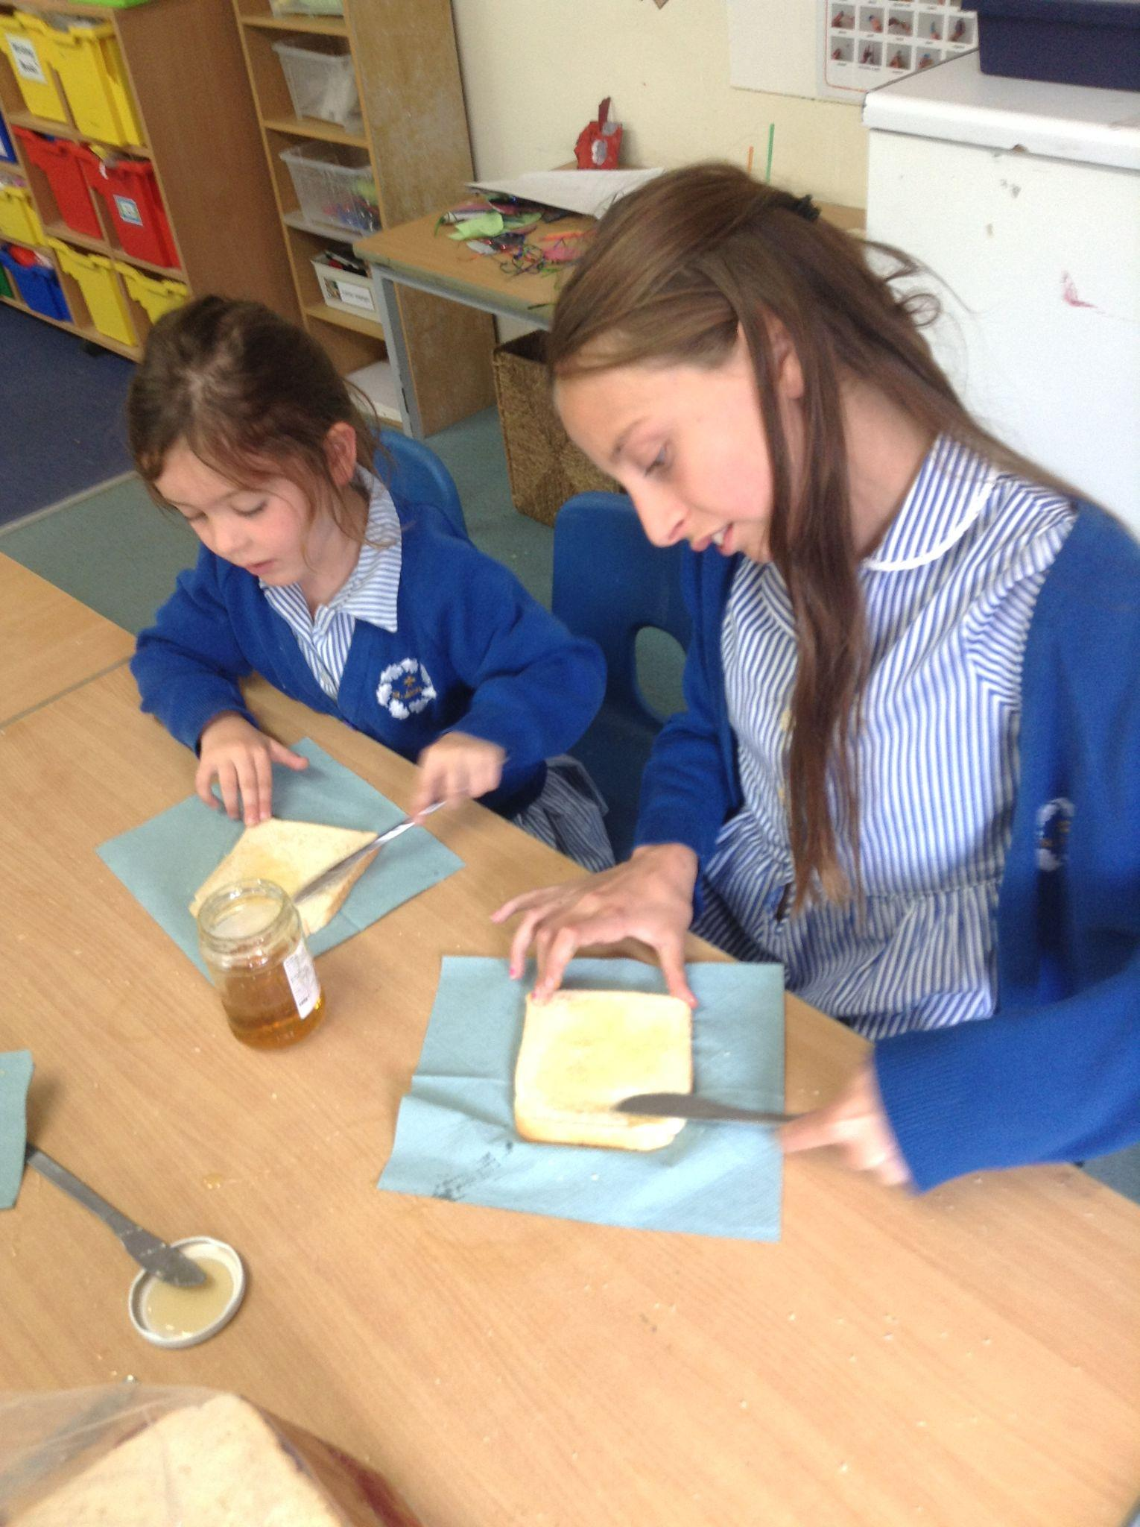
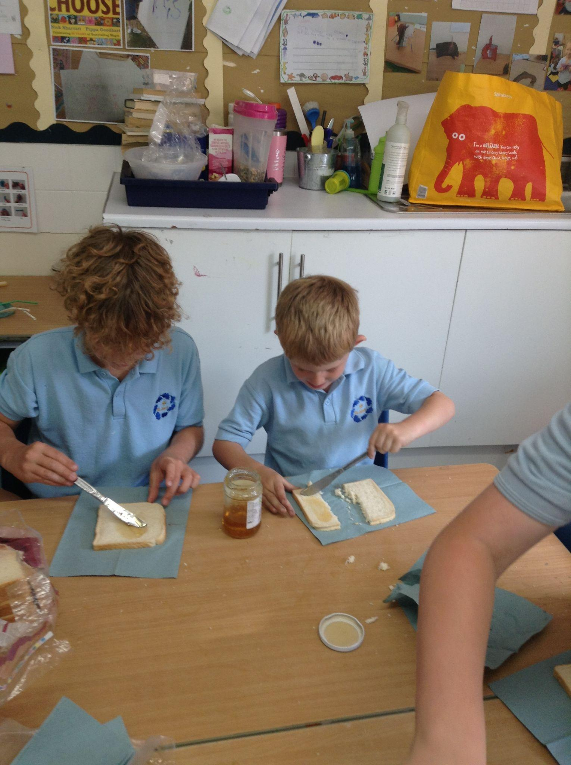
RECEPTION
Reception learned all about how bees make honey. We watched a video of bees working together in a hive and heard how they travel to up to 1000 flowers to collect nectar. They then use enzymes in their honey stomachs to make a substance that they vomit into the mouths of other bees. We worked with our buddies to make honey sandwiches and ate them outside. We found out that bee sick is delicious!

Slide 7
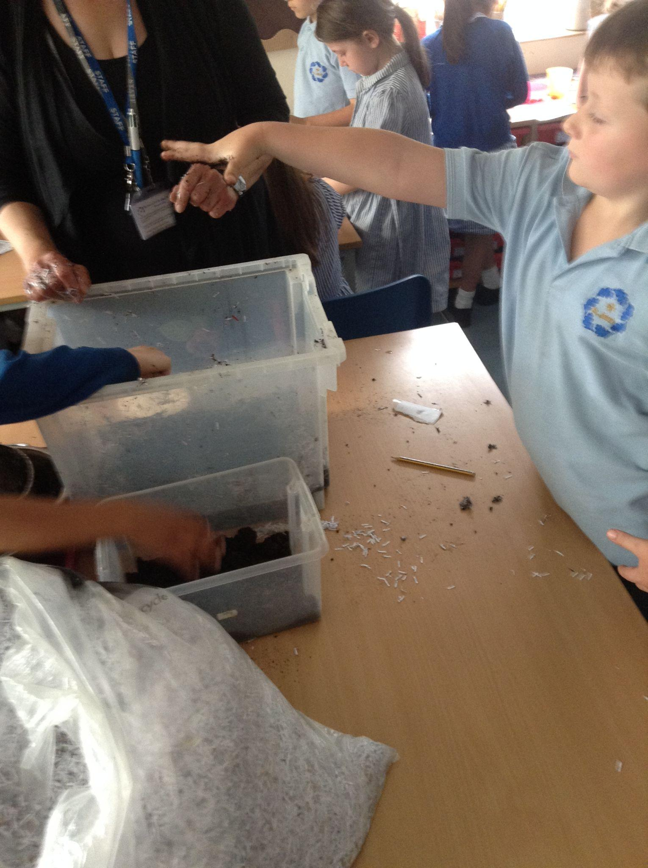
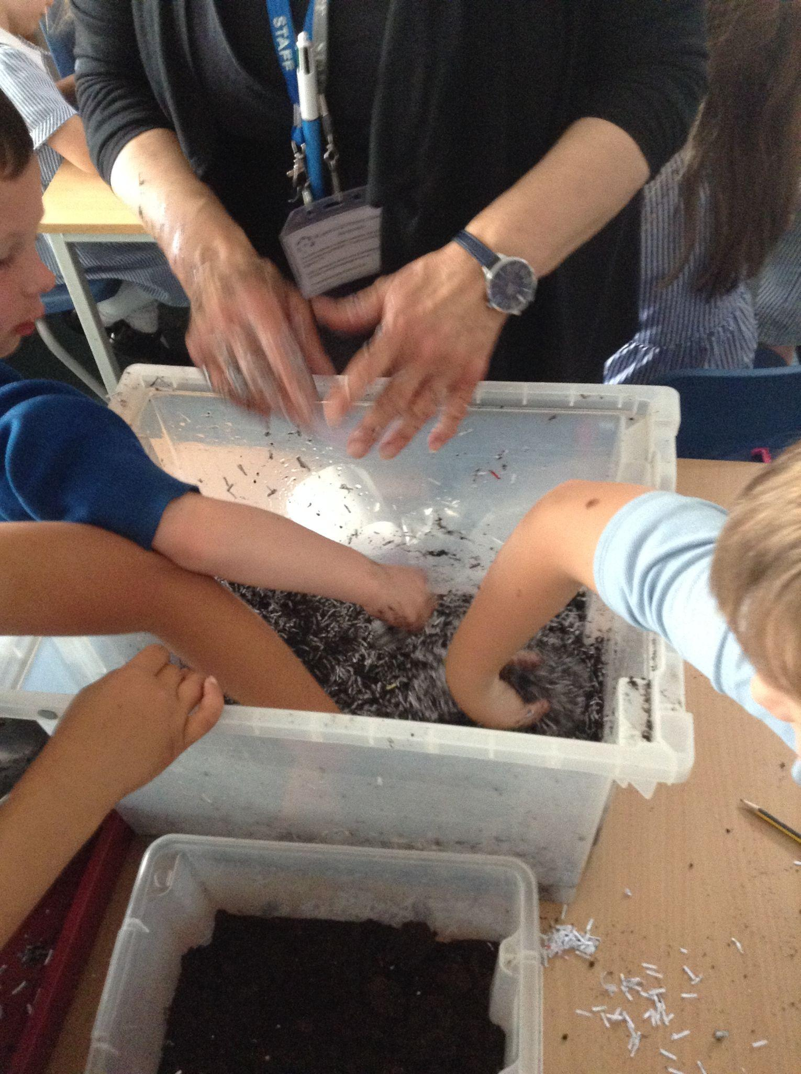
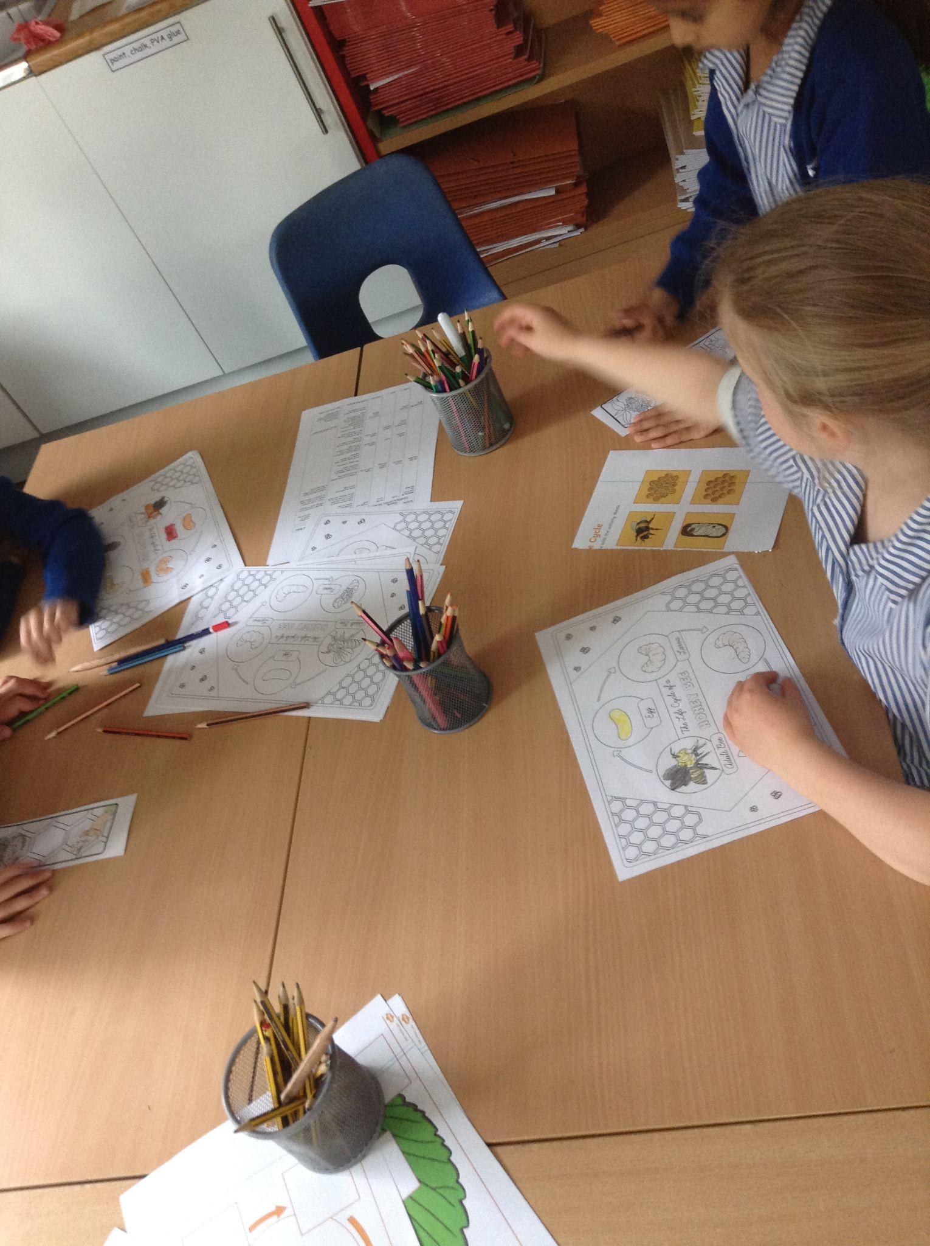
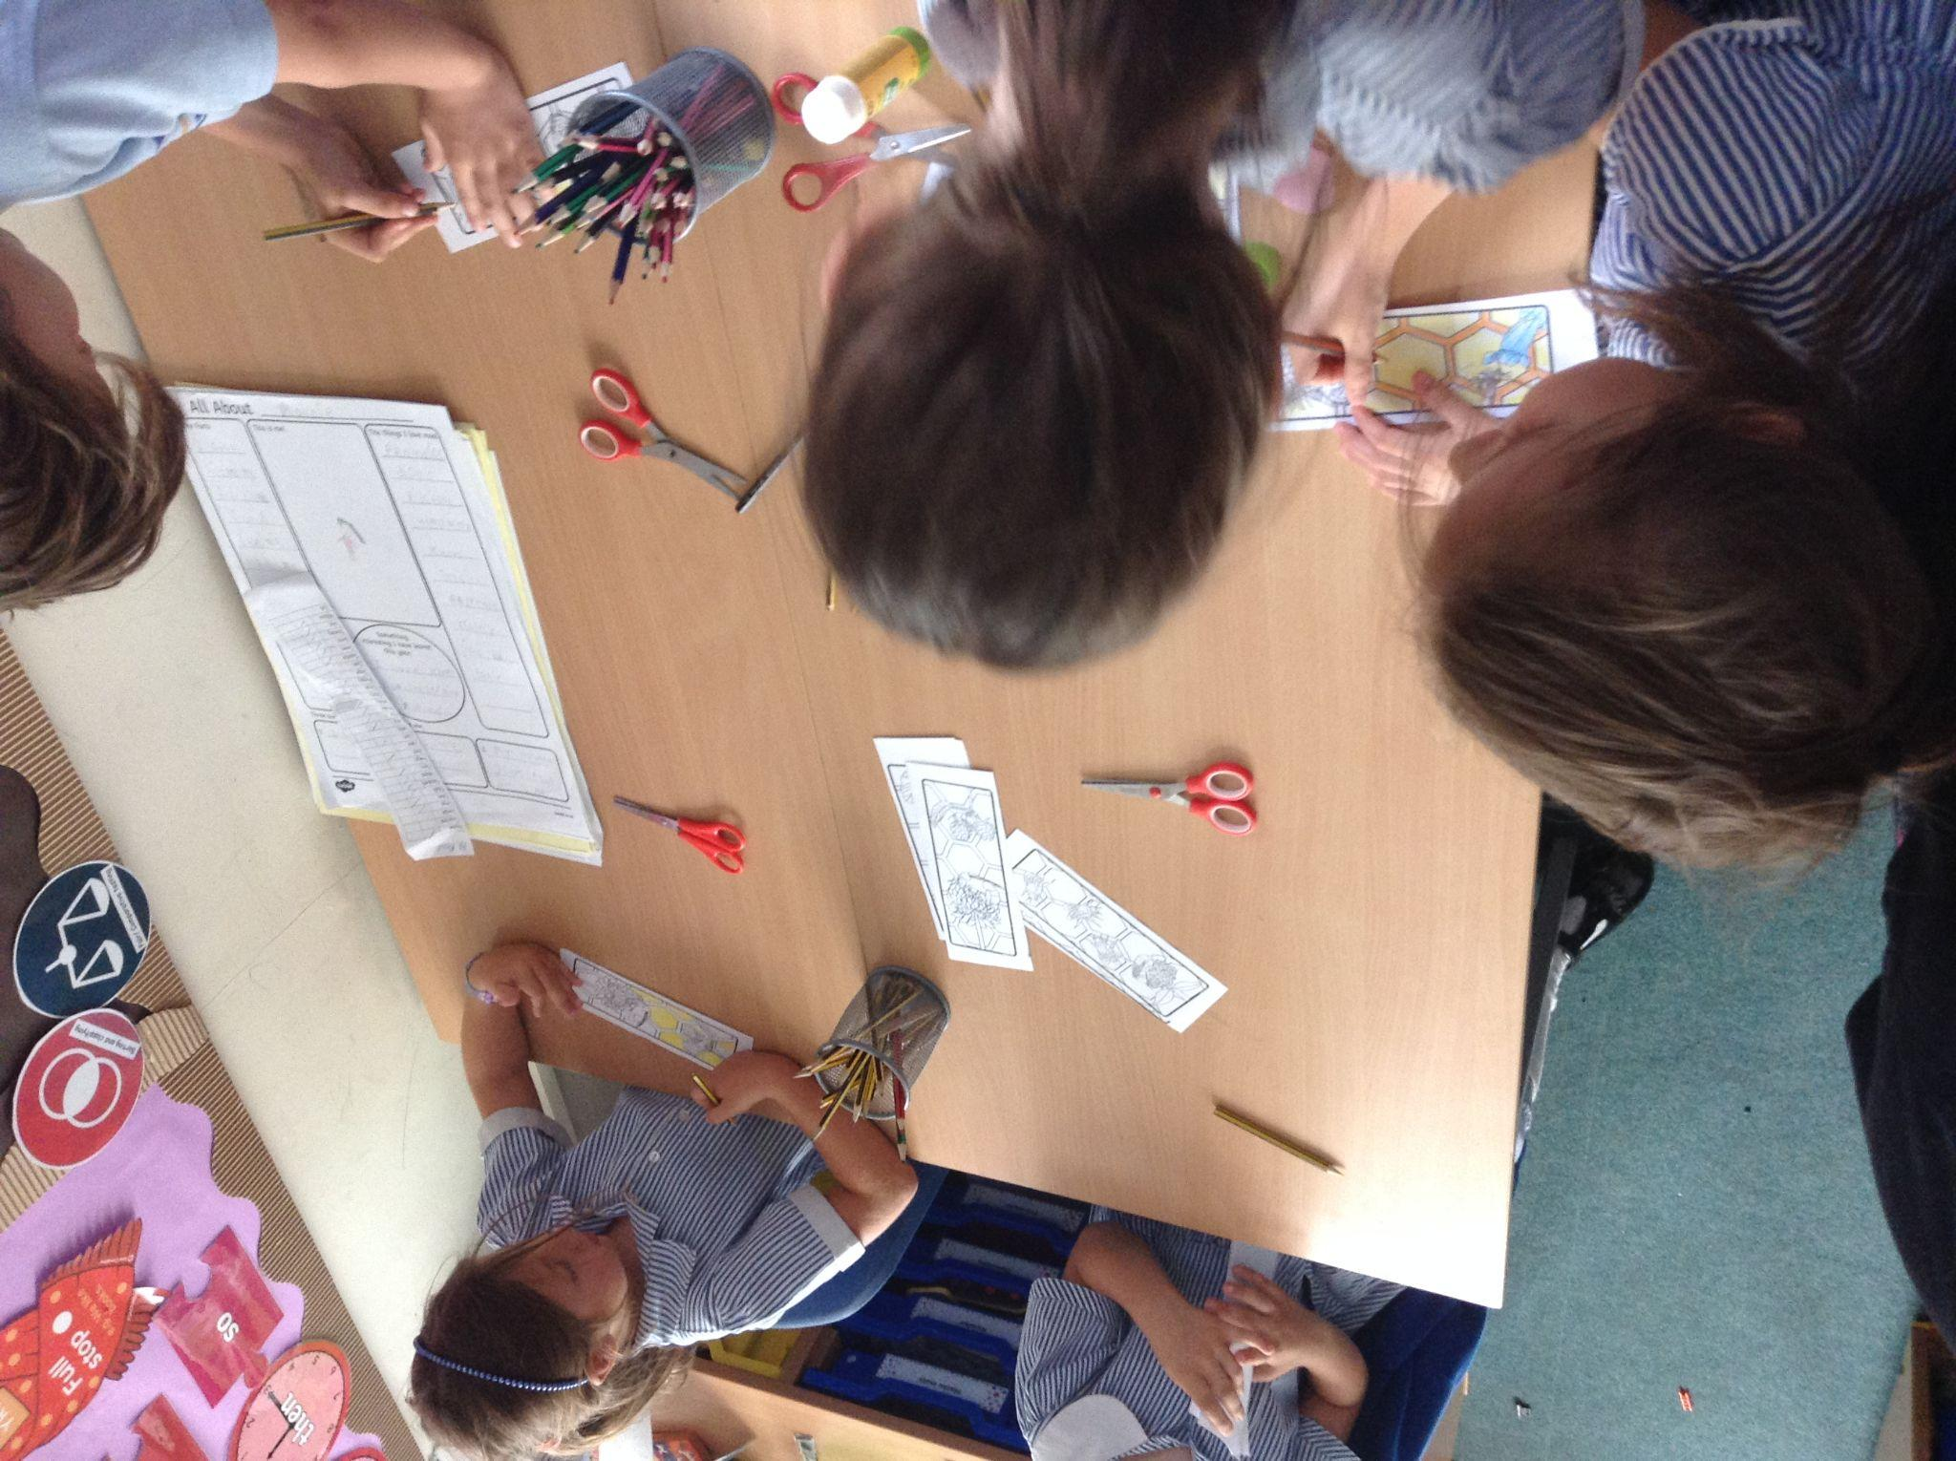
YEAR 1
We made seed bombs, created the life cycle of a bee and made bee bookmarks!

Slide 8
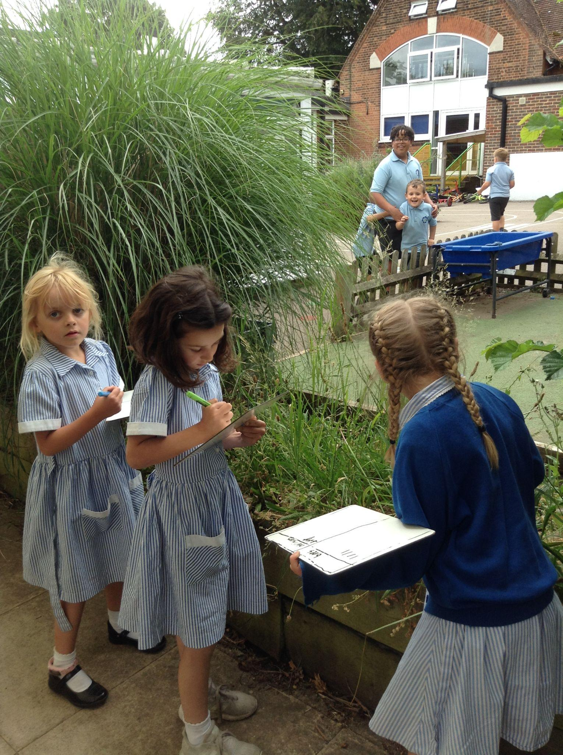
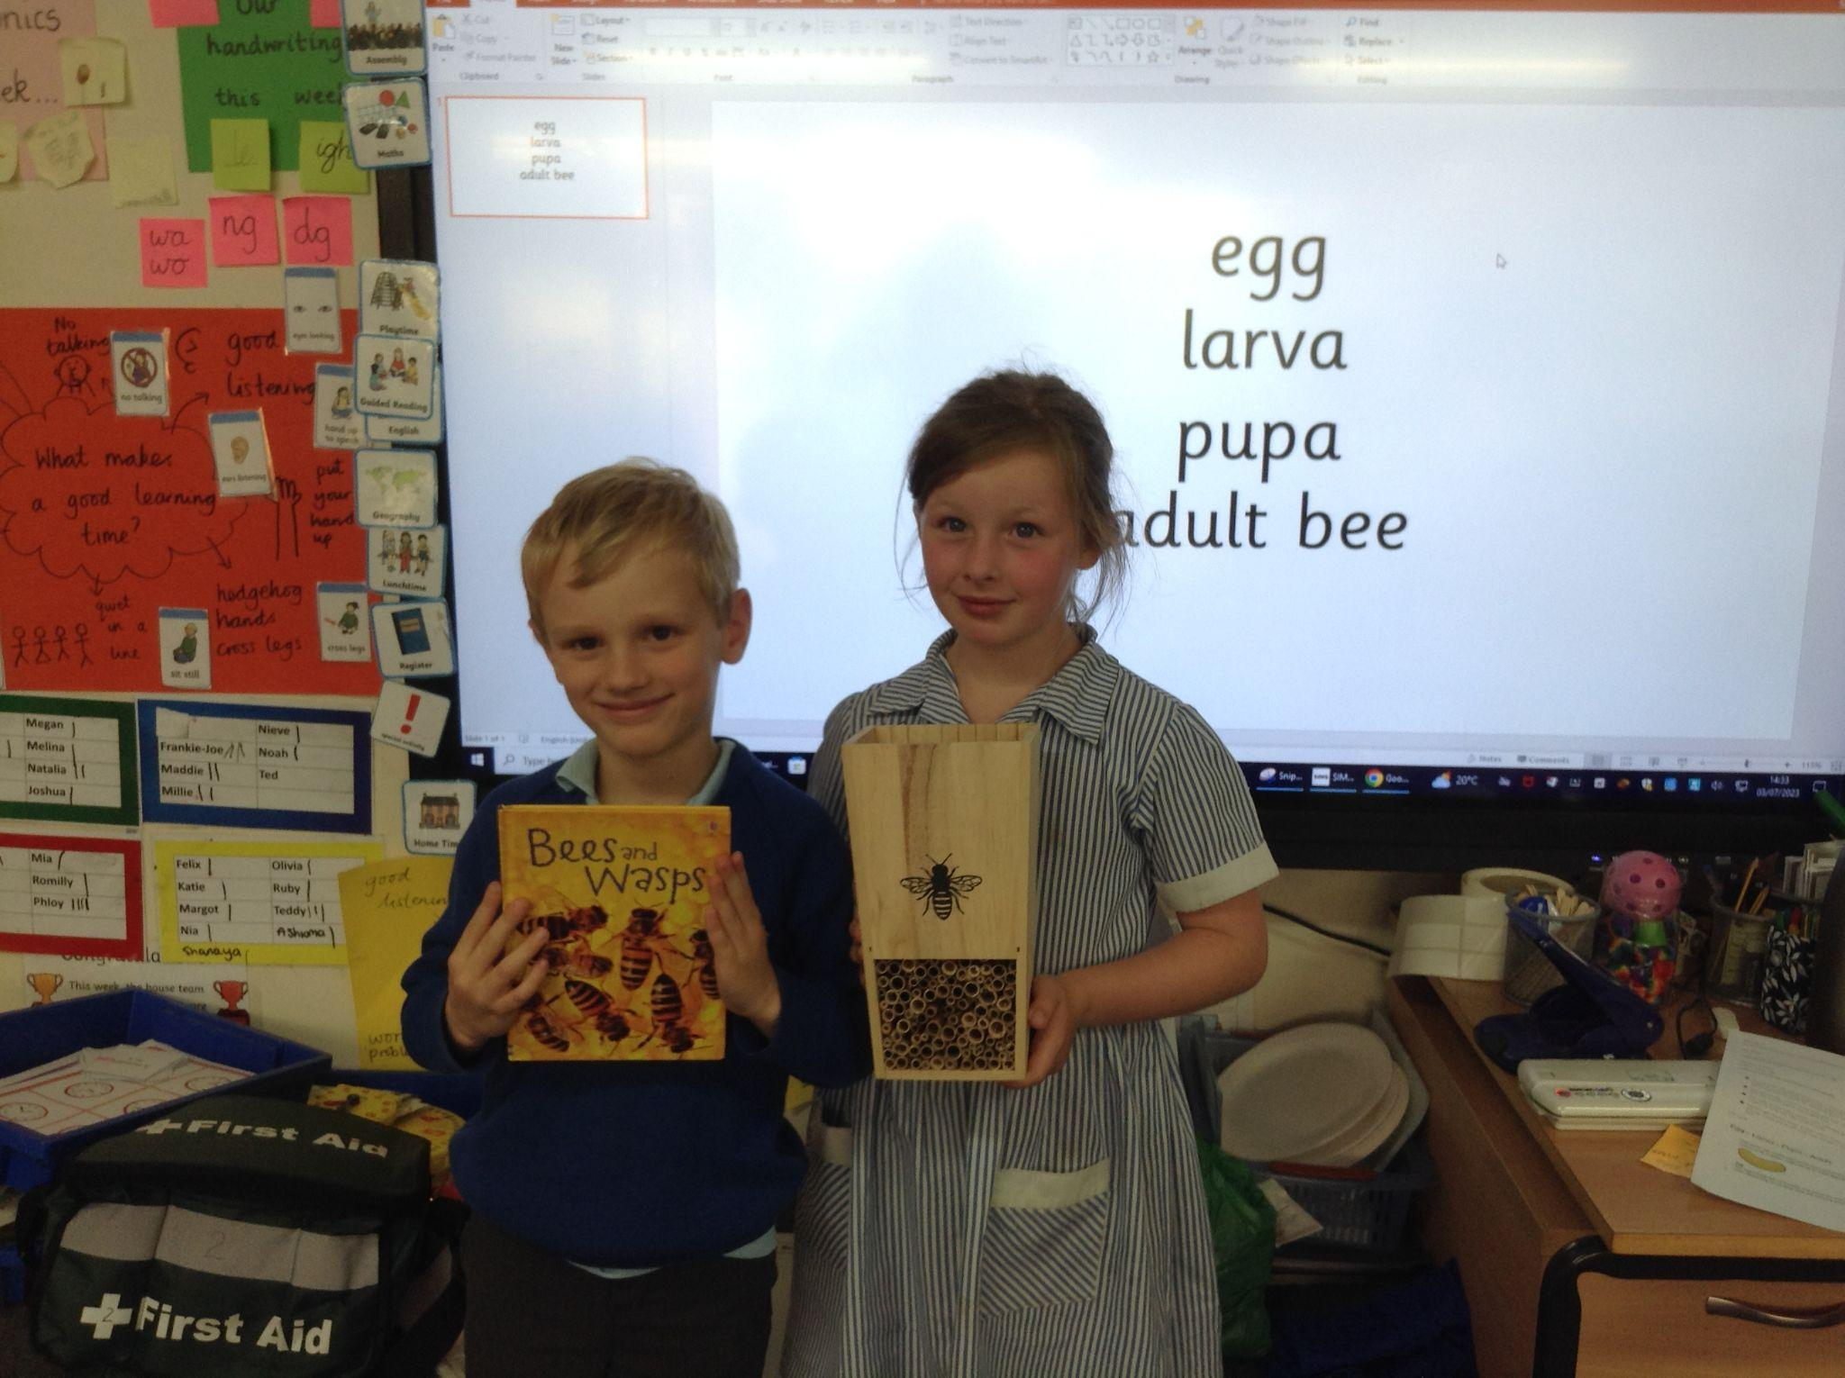
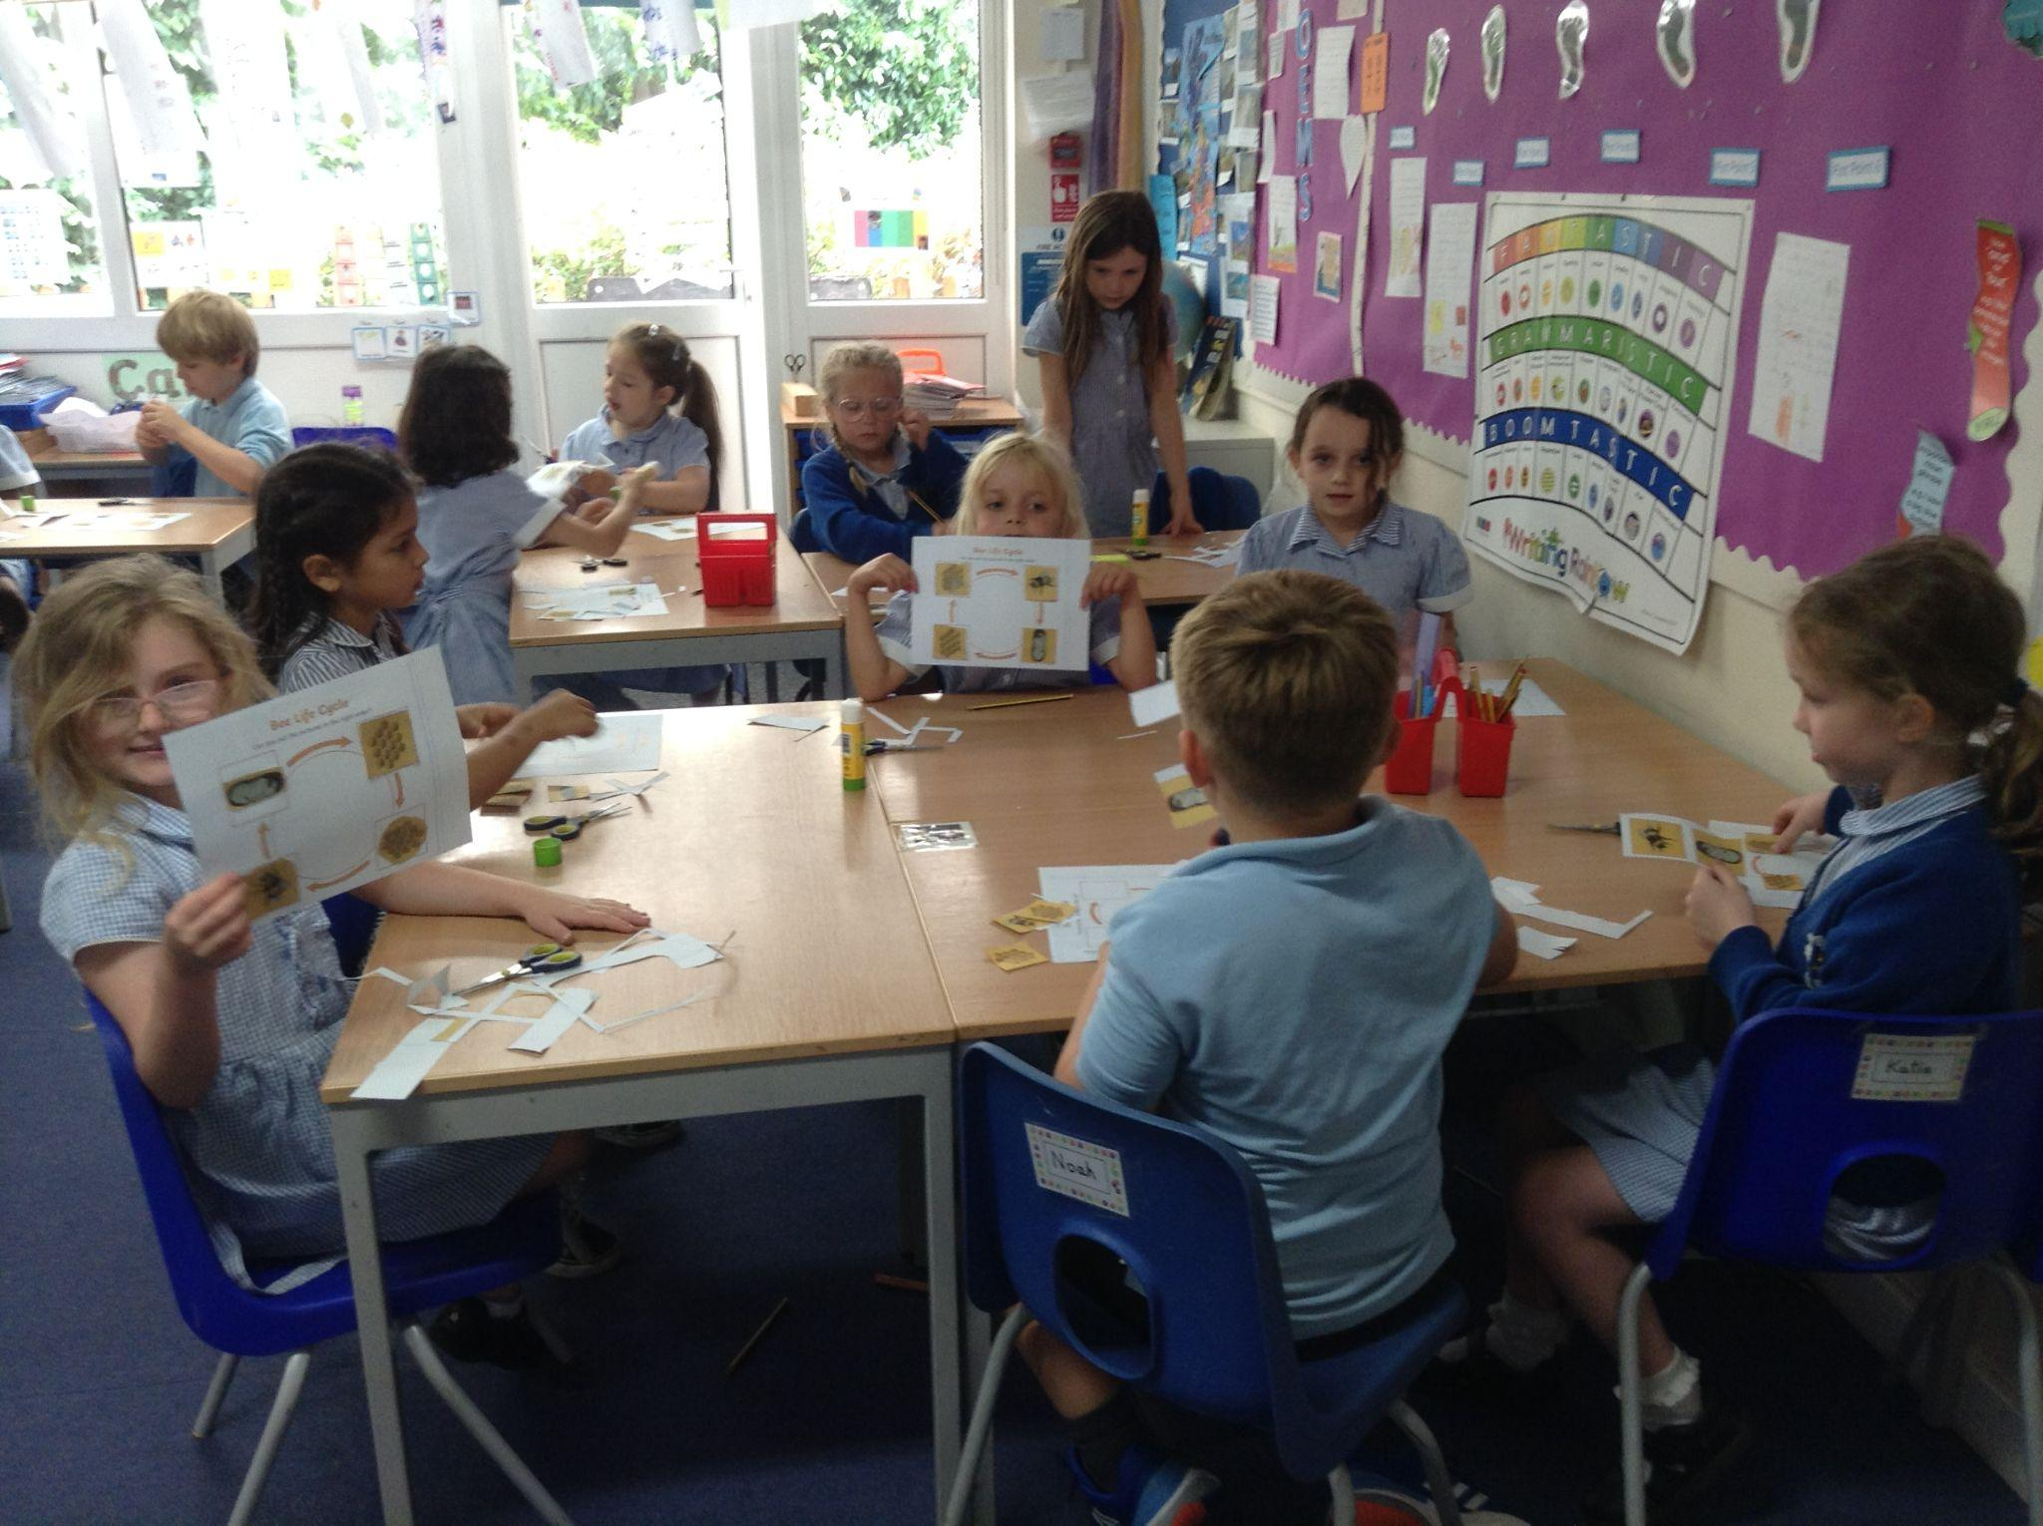
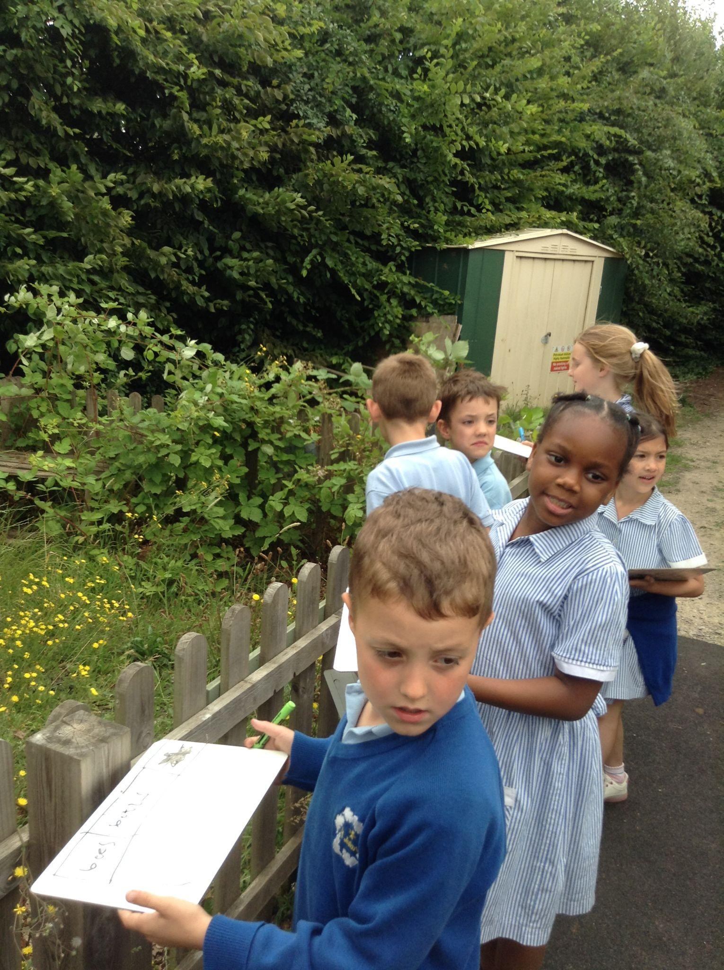
YEAR 2
Year 2 learnt all about the lifecycle of a bee and we talked about where we would put our bee hotel. We also went on a bee hunt around the school grounds.

Slide 9
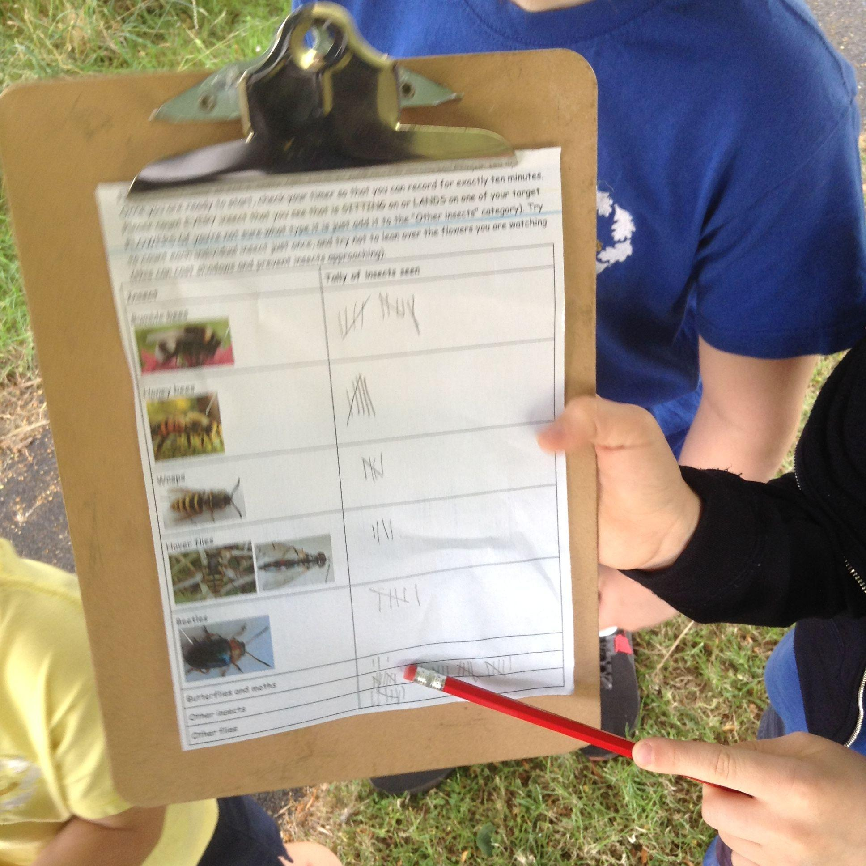
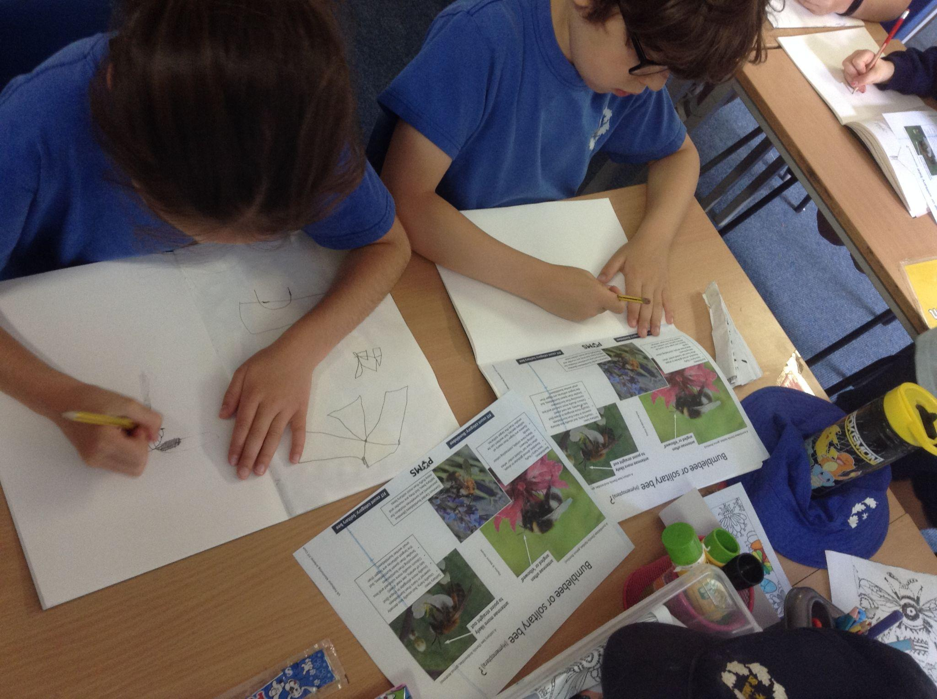
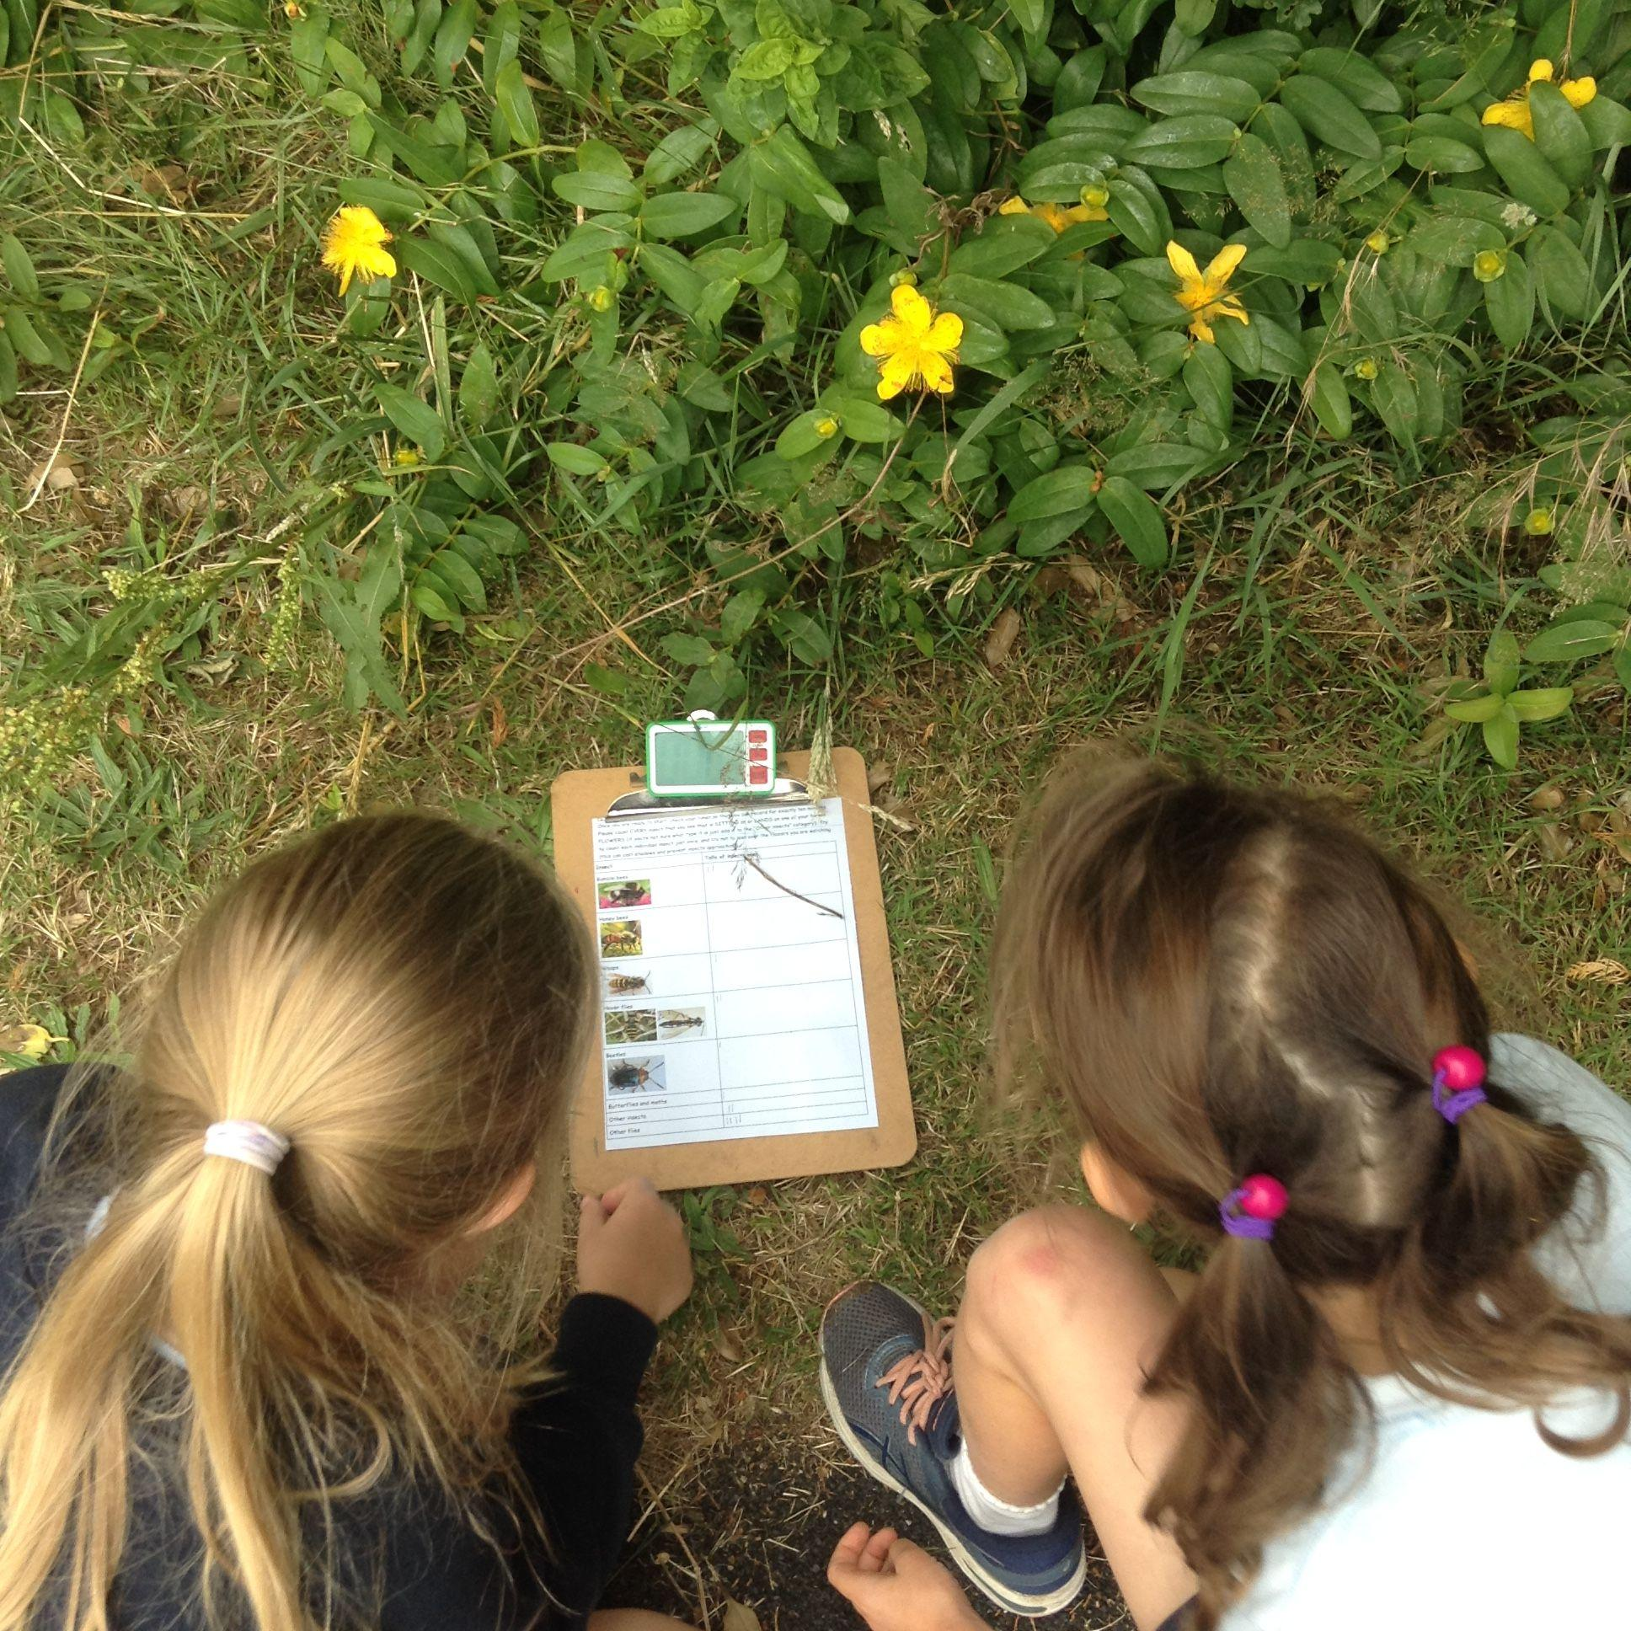
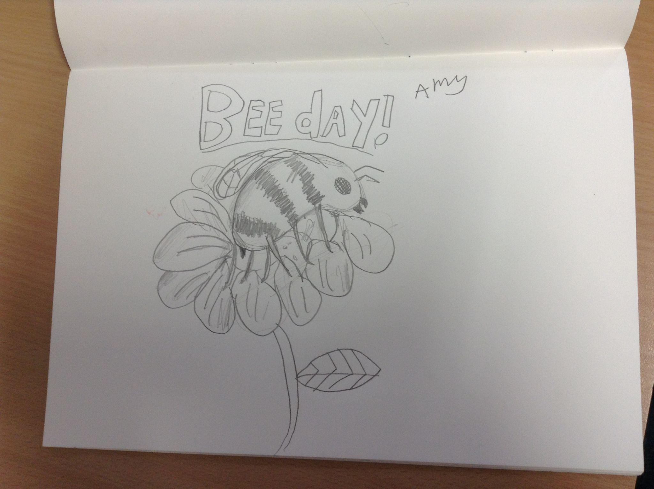
Year 3
Science- FIT counting of bees and other insects
Art- Observational bee drawings

Slide 10
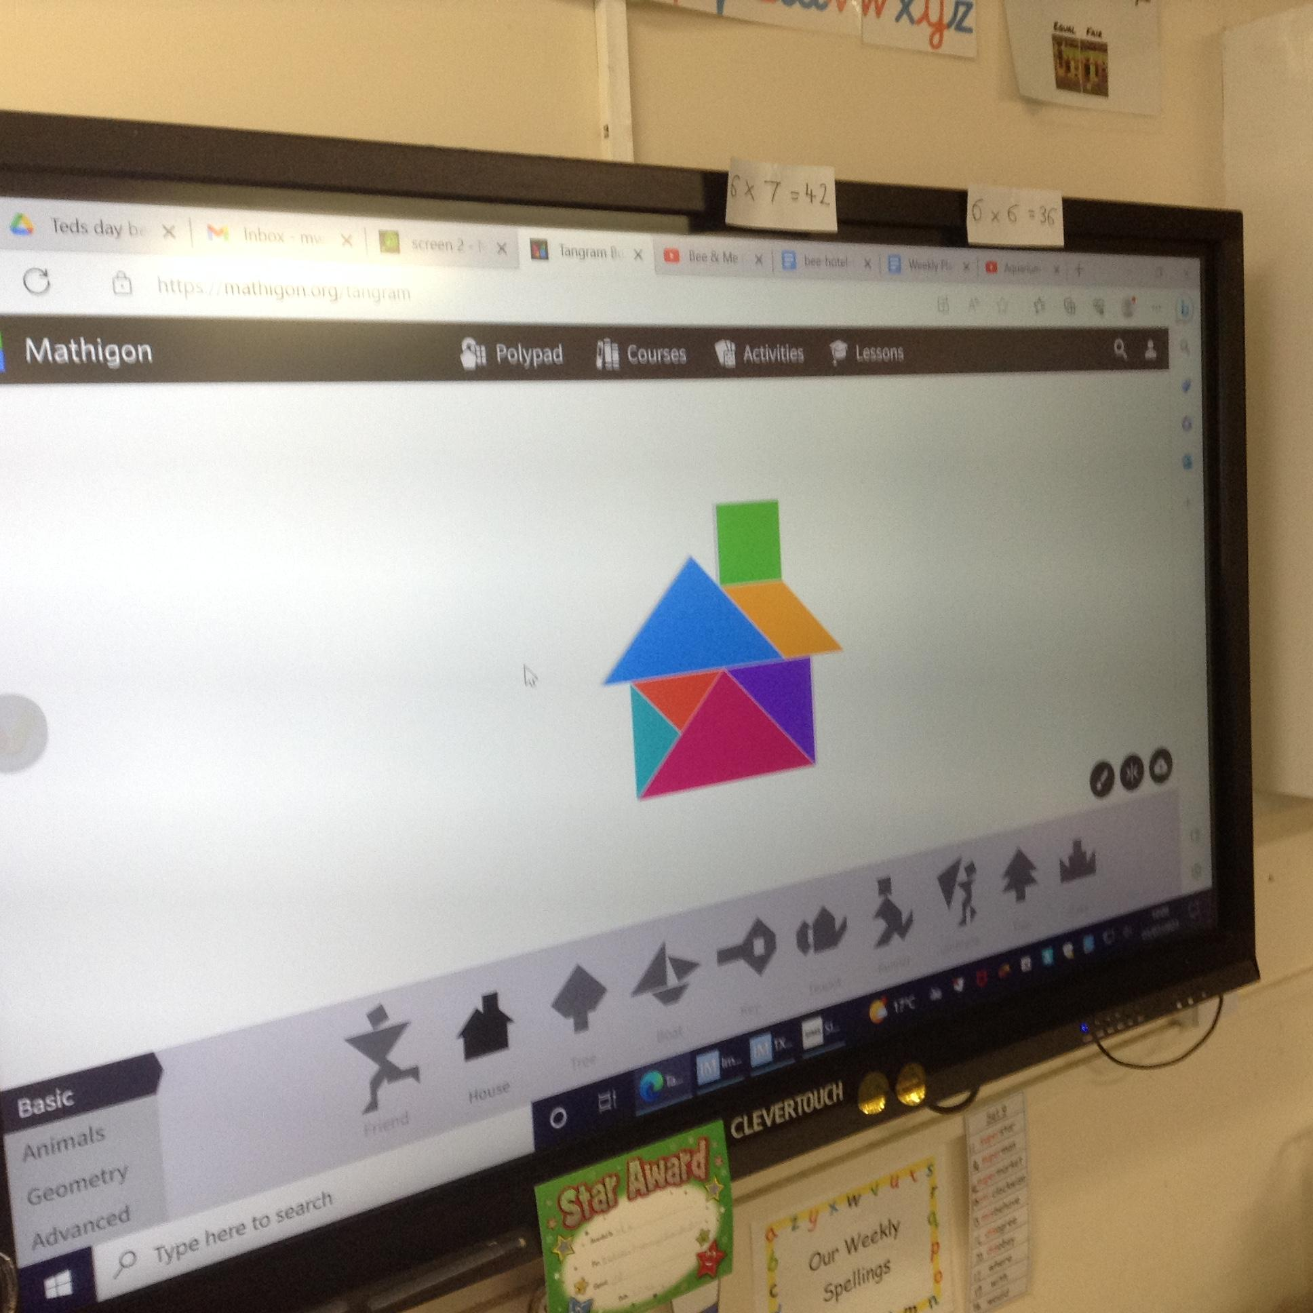
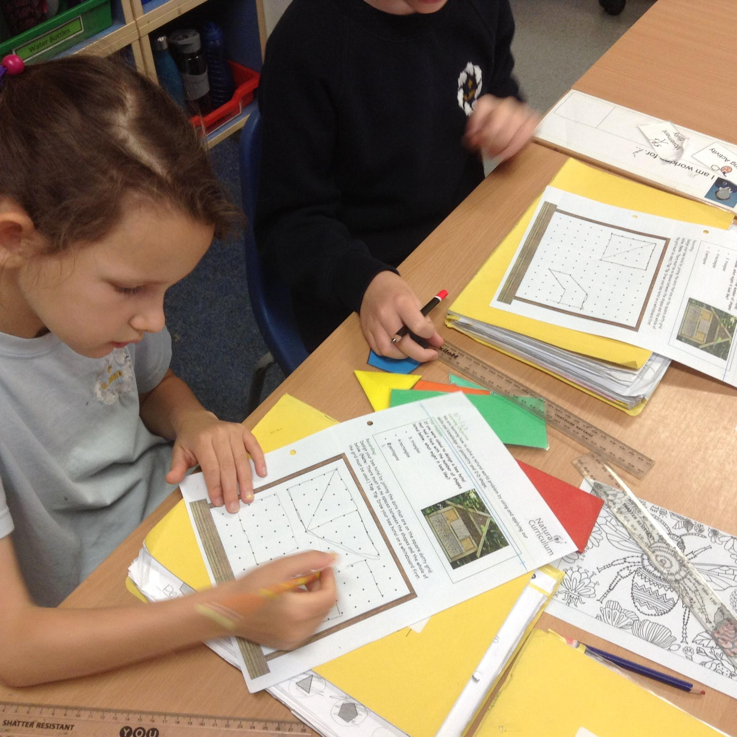
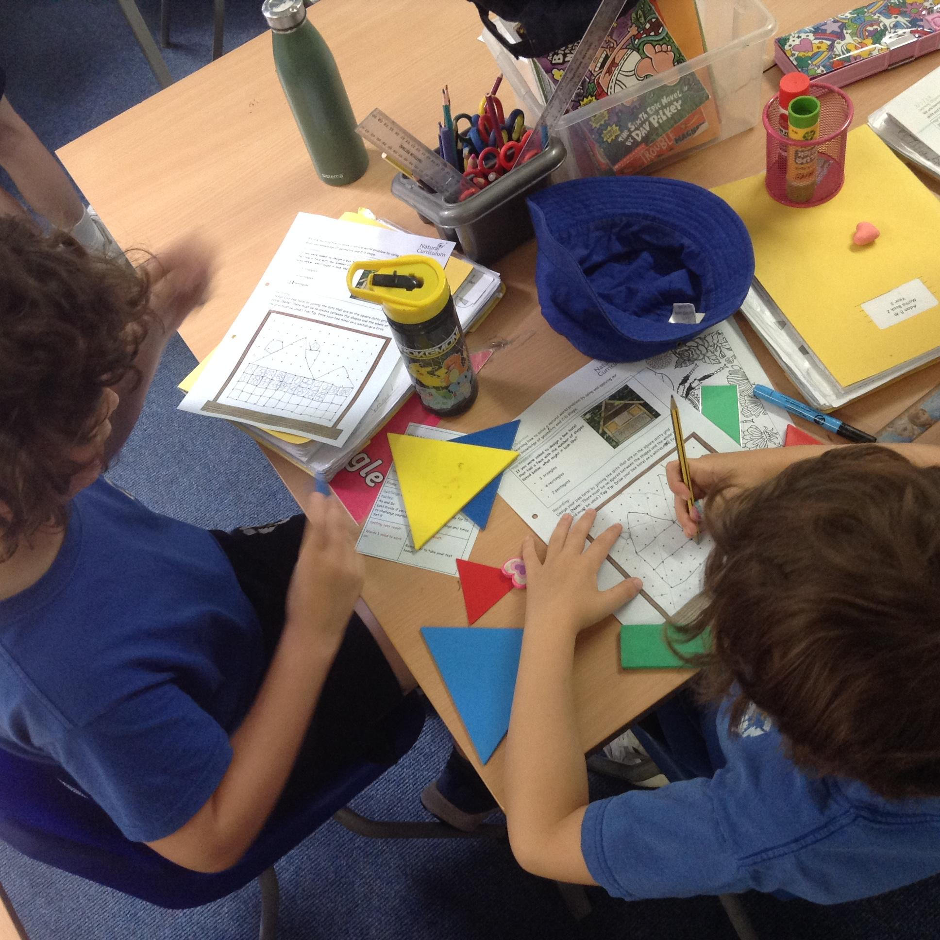
Year 3
Maths- Exploring tangrams and designing a bee hotel using 2D shapes

Slide 11
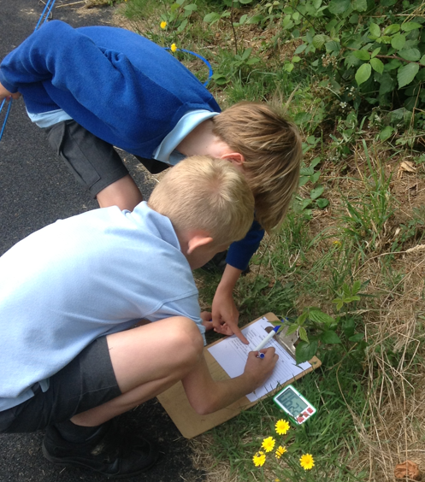
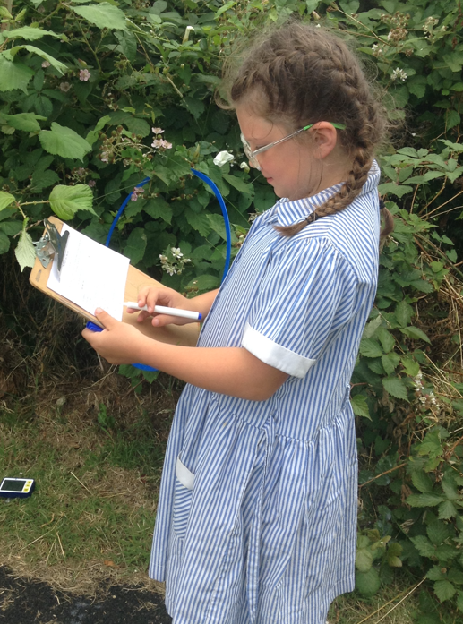
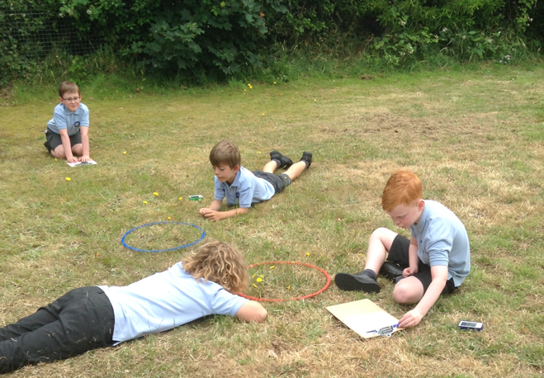
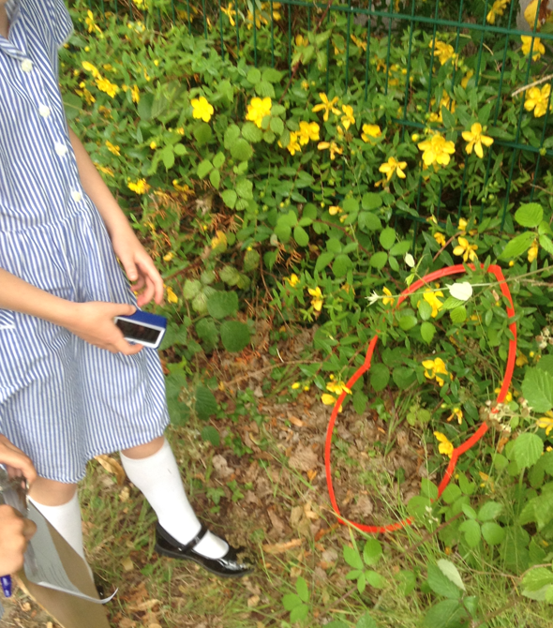
YEAR 4
Year 4 carried out a big bee survey and tomorrow we will use our data to create bar charts. We also researched why the bees are disappearing and are making posters to tell people how we can help save them.
We can all make a difference!

Slide 12
YEAR 5

Slide 13
YEAR 6

Slide 14
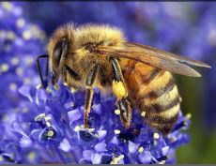
What will you do to help to save the bees?

