Slide 1
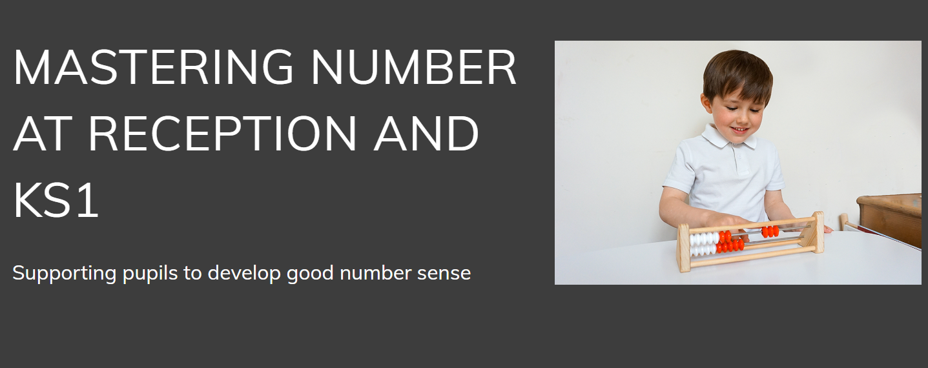
Welcome to

Slide 2
Mathematics matters. Developing an understanding of mathematical concepts when we are young is essential, and children’s early mathematical understanding is strongly associated with their later school achievement.
But many parents state the biggest barrier to helping their children with mathematics is their own confidence in the subject, and parents’ fears and worries about maths impact their children’s achievement at school.
Source: www.educationendowmentfoundation.org.uk

Slide 3
Mastery in Number @KS1
This programme develops solid number sense, including fluency and flexibility with number facts, which has a lasting impact on future learning for all children.

Slide 4
This project aims to secure firm foundations in the development of good number sense for all children from Reception through to Year 1 and Year 2.
The aim over time is that children will leave KS1 with fluency in calculation and a confidence and flexibility with number.
Attention will be given to key knowledge and understanding needed in Reception classes, and progression through KS1 to support success in the future.

Slide 5
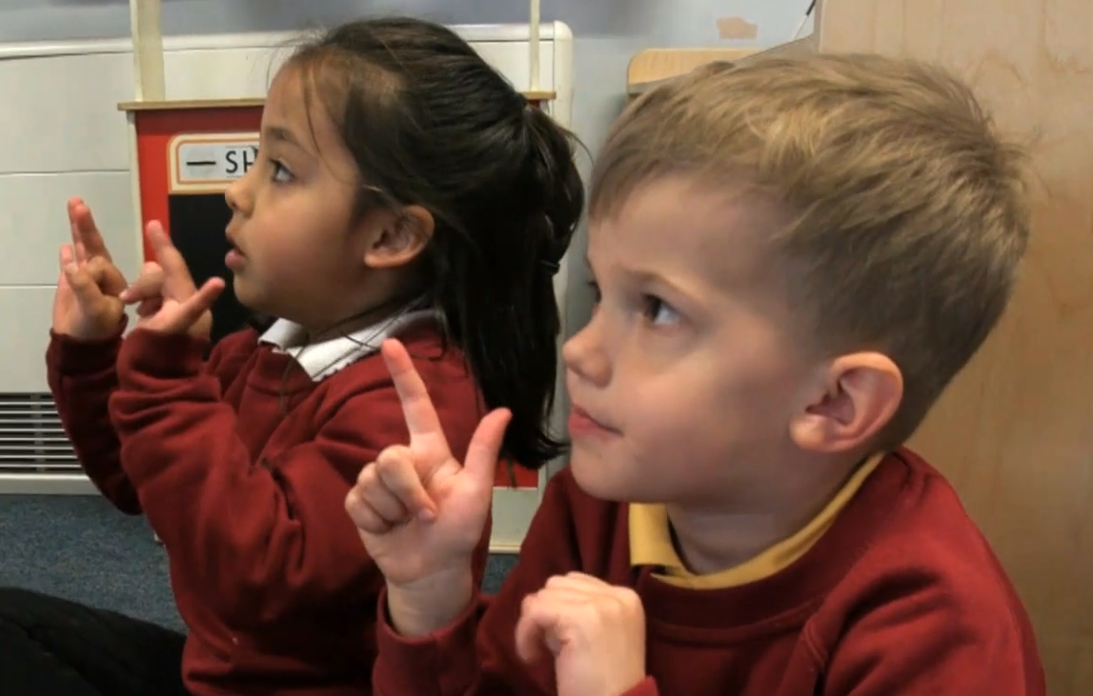
If this video does not work watch:
Mastering Number: Introduction to the programme from Debbie Morgan – YouTube from 25:00 mins -26:28mins

Slide 6
Don’t count – see the amount
This is subitising

Slide 7
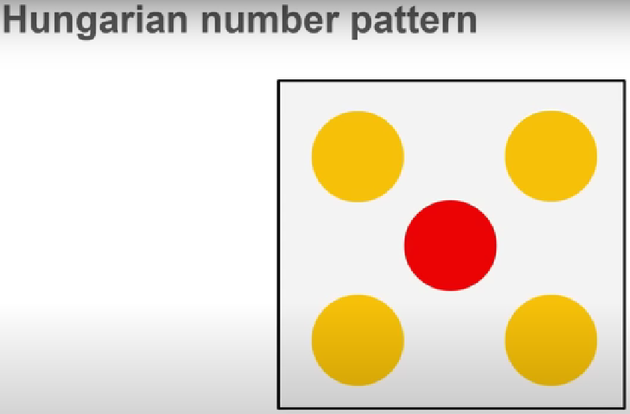

Slide 8
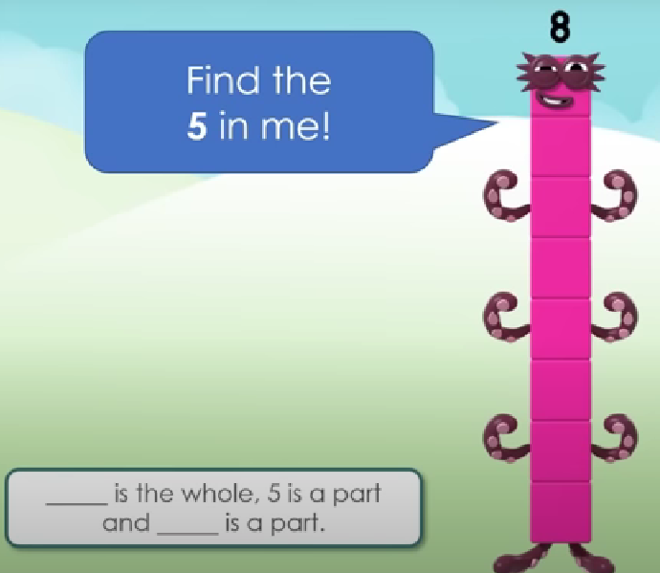
Numberblocks

Slide 9
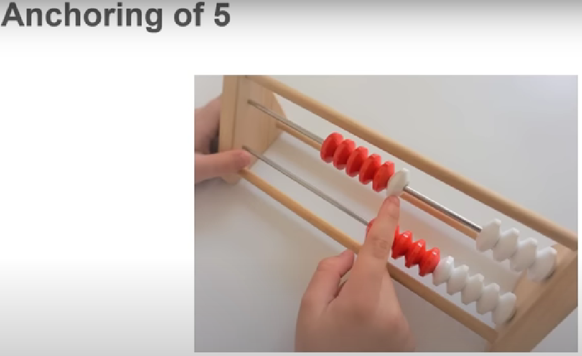

Slide 10
Set 1
Whisper the number you see
Don’t count –
see the amount
www.stevewyborney.com

Slide 11
Set 1
www.stevewyborney.com

Slide 12
www.stevewyborney.com

Slide 13
www.stevewyborney.com

Slide 14
www.stevewyborney.com

Slide 15
www.stevewyborney.com

Slide 16
www.stevewyborney.com

Slide 17
www.stevewyborney.com

Slide 18
www.stevewyborney.com

Slide 19
www.stevewyborney.com

Slide 20
www.stevewyborney.com

Slide 21
www.stevewyborney.com

Slide 22
www.stevewyborney.com

Slide 23
www.stevewyborney.com

Slide 24
www.stevewyborney.com

Slide 25
www.stevewyborney.com

Slide 26
www.stevewyborney.com

Slide 27
www.stevewyborney.com

Slide 28
www.stevewyborney.com

Slide 29
www.stevewyborney.com

Slide 30
www.stevewyborney.com

Slide 31
www.stevewyborney.com

Slide 32
www.stevewyborney.com

Slide 33
Set 1 CHALLENGE
www.stevewyborney.com

Slide 34
You are about to see a larger group of dots.
Instead of saying how may dots there are, find as many ways as you can to show how you know what the total is.
Here is an example.
www.stevewyborney.com

Slide 35
2 + 3 + 2 = 7
2 + 3 + 2 = 7
4 + 4 – 1 = 7
9 – 2 = 7
5 + 2 = 7
3 + 3 + 1 = 7

Slide 36
Now I’ll show you a large copy of your pattern.
Then I’ll show you several smaller copies so you can find as many ways as possible of showing different ways of seeing the total.
Here it is!
www.stevewyborney.com

Slide 37
www.stevewyborney.com

Slide 38
Reception – use of fingers…
6
Notes:
- The children will have previously explored die patterns as a way of representing numbers from 1–6
and used their subitising skills to explore pairs of numbers within 5.
- They will have previously built a secure sense of the value and composition of 5, which will now
support their understanding of numbers between 5 and 10 by revealing their ‘5 and a bit’ structure.
- When the children can compose and flexibly decompose numbers mentally, they will become more
fluent in their knowledge of number bonds and will be able to use these to become efficient when
calculating in Key Stage 1 and Key Stage 2.
- We start with fingers as another way of thinking about numbers as 5 and a bit more. We then extend
this to help the children think about the composition of numbers – 3 and 3, 4 and 2 – all shown on our
fingers which we always have with us!

Slide 39
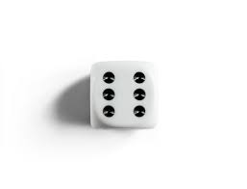
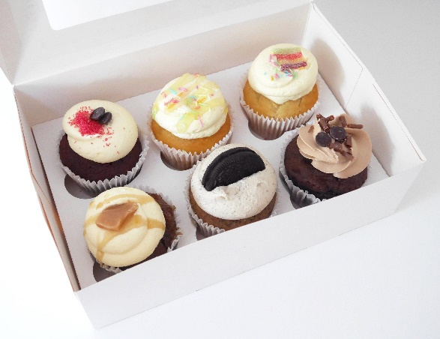


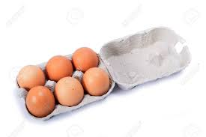
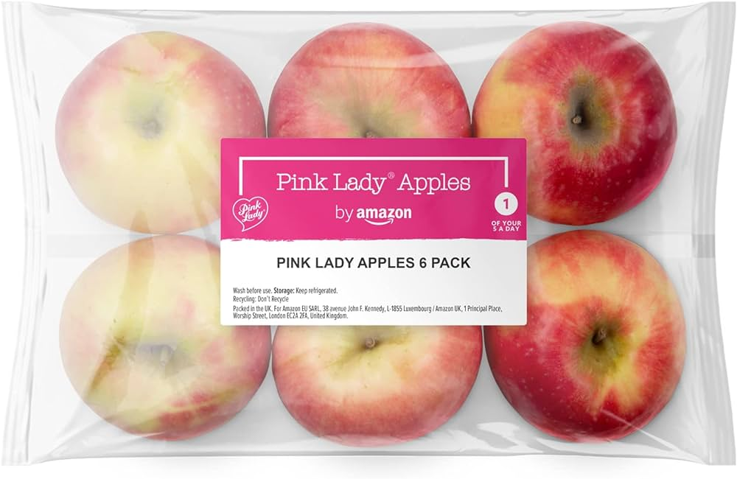
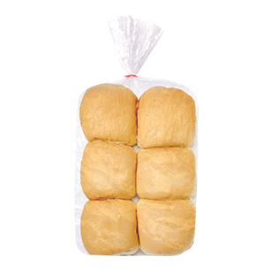
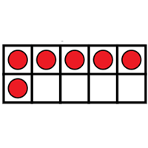

Slide 40
6 or not 6?

Slide 44
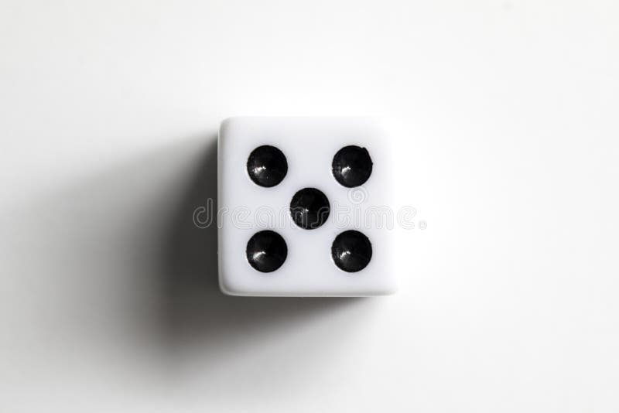

Slide 46
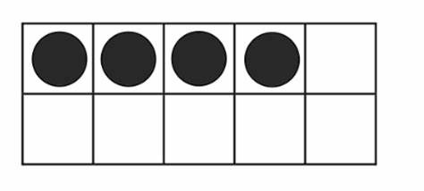

Slide 48
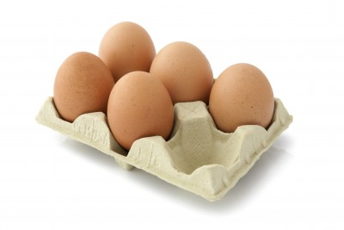

Slide 49
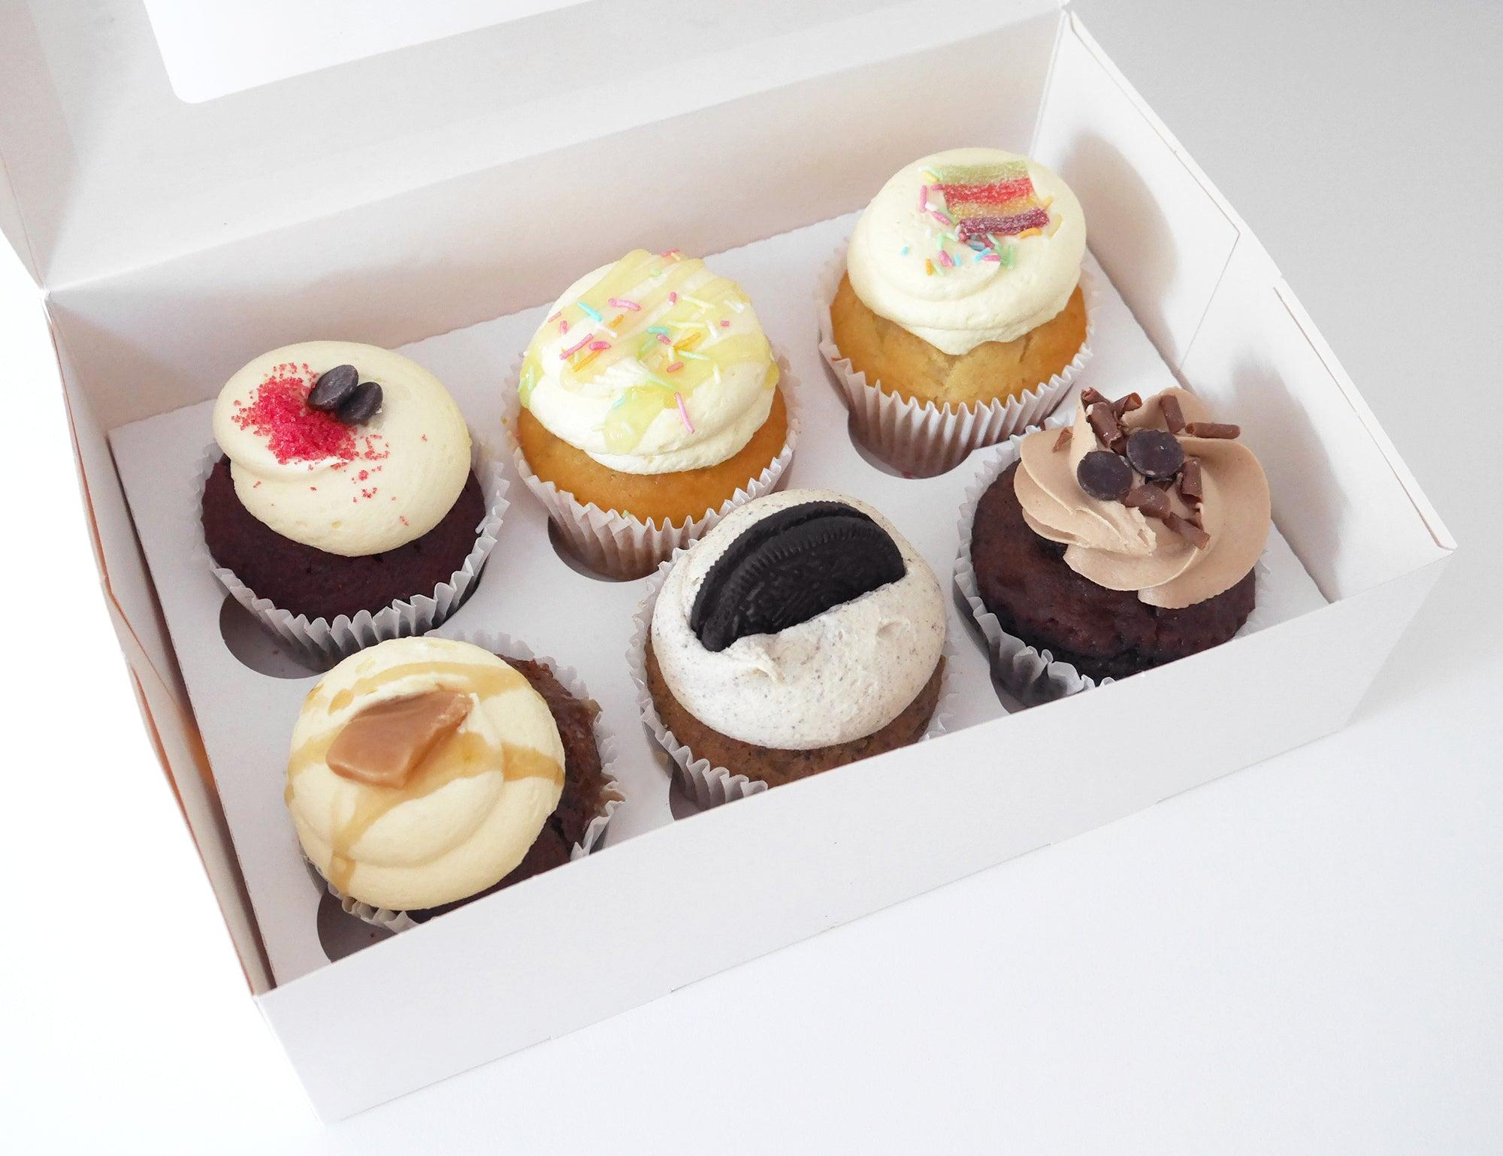

Slide 50


Slide 52
If this video does not work watch:
Mastering Number at KS1 and Reception (youtube.com)
17:25 mins - 20:42 mins

Slide 53
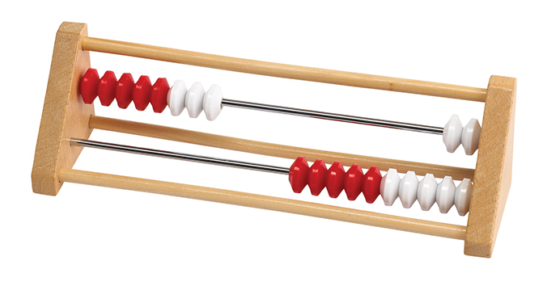
Year 1
Use of Rekenreks

Slide 54
https://apps.mathlearningcenter.org/number-rack/

Slide 55
Look at the rekenrek. What do you notice?
Mastering Number 2021/22 ncetm.org.uk

Slide 56


What does 8 look like on the rekenrek?
Can you imagine 8 birds on the line?
Mastering Number 2021/22 ncetm.org.uk

Slide 57
_____ needs _____ to make 8.
Mastering Number 2021/22 ncetm.org.uk

Slide 58
_____ needs _____ to make 8.
Mastering Number 2021/22 ncetm.org.uk

Slide 59
_____ needs _____ to make 8.
Mastering Number 2021/22 ncetm.org.uk

Slide 60
_____ needs _____ to make 8.
Mastering Number 2021/22 ncetm.org.uk

Slide 61

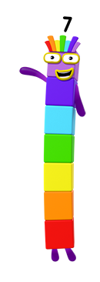
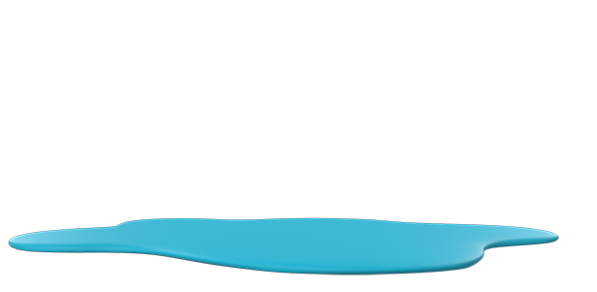
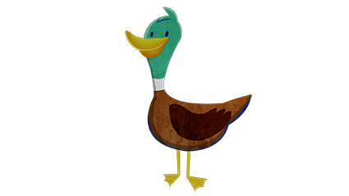
Can you help me?
Say how many ducks have flown away.
Image © 2021 Alphablocks Ltd. All rights reserved. Mastering Number 2021/22 ncetm.org.uk

Slide 62
Image © 2021 Alphablocks Ltd. All rights reserved. Mastering Number 2021/22 ncetm.org.uk

Slide 63
Image © 2021 Alphablocks Ltd. All rights reserved. Mastering Number 2021/22 ncetm.org.uk

Slide 64
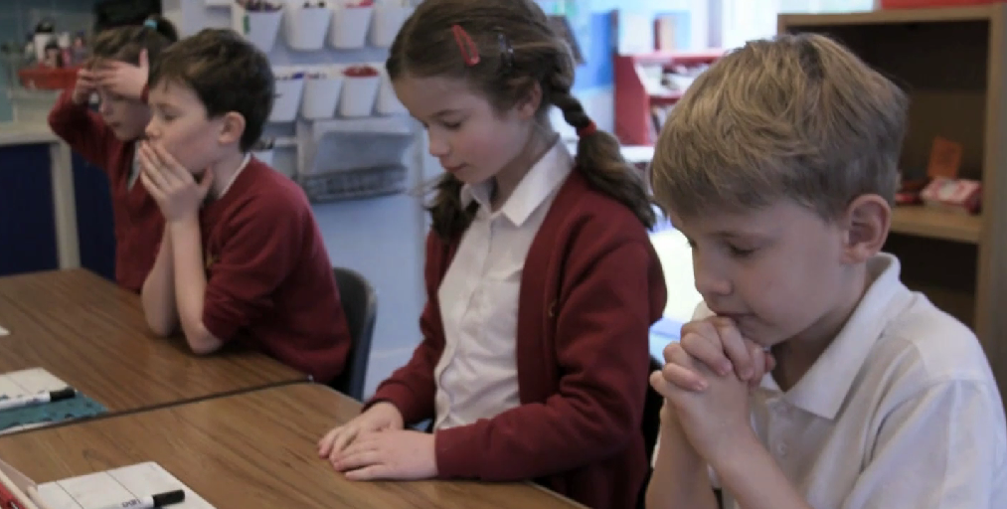
Visualising the rekenrek on Vimeo

Slide 65
Year 2
Doubles
Notes:
To start with, we focus on doubles up to 5. We learn doubling as seeing 2 equal groups. We subitise quickly, to be able to read how many dots there are in each group without counting from 1 each time, recognising the numbers from sight. The ‘quick peek’ ensures children are subitising, instead of counting the dots individually.

Slide 66
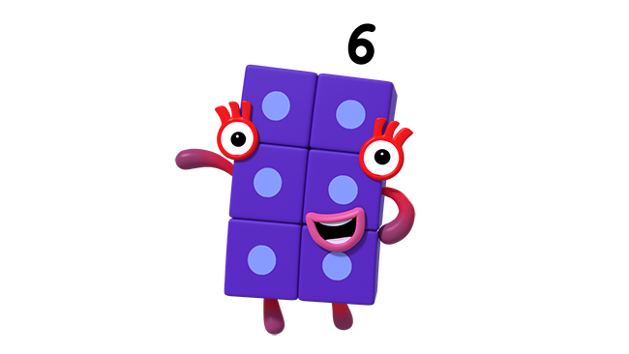
Come and play my dice game! Show these numbers quickly on your fingers. But watch out! I will only give you a quick peek…
Image © 2021 Alphablocks Ltd. All rights reserved. Mastering Number 2021/22 ncetm.org.uk
Notes:
This sets the expectation that children will subitise.

Slide 67
When the counters land on the dice, show the same number on your fingers
Mastering Number 2021/22 ncetm.org.uk
Notes:
The mastery course teaches us to share multiple visual images and representations with the children. Here, the children can see ‘doubling’ or ‘2 equal groups’ as mirrored dice patterns. It also encourages the children to participate by mirroring the same number of both their hands. Always reinforcing the idea of doubling as 2 equal groups.

Slide 68
Mastering Number 2021/22 ncetm.org.uk

Slide 69
Mastering Number 2021/22 ncetm.org.uk

Slide 70
Mastering Number 2021/22 ncetm.org.uk

Slide 71
Mastering Number 2021/22 ncetm.org.uk

Slide 72
Mastering Number 2021/22 ncetm.org.uk

Slide 73
Mastering Number 2021/22 ncetm.org.uk

Slide 74
Mastering Number 2021/22 ncetm.org.uk

Slide 75
Mastering Number 2021/22 ncetm.org.uk

Slide 76
Mastering Number 2021/22 ncetm.org.uk

Slide 77
Mastering Number 2021/22 ncetm.org.uk
Notes:
We might discuss at this point what children notice about the patterns they have been looking at and making with their fingers. They might recognise that the images show ‘doubling’. Stumbling across the learning objective of ‘doubling’ themselves is always nice because classmates can show their understanding and it can work well as an opportunity for others to learn from their peers. Everyone has already had a go at doubling, even if they didn’t realise they were doing it.

Slide 78
Mastering Number 2021/22 ncetm.org.uk

Slide 79
Did you notice I was showing you some doubles patterns?
Image © 2021 Alphablocks Ltd. All rights reserved. Mastering Number 2021/22 ncetm.org.uk

Slide 80

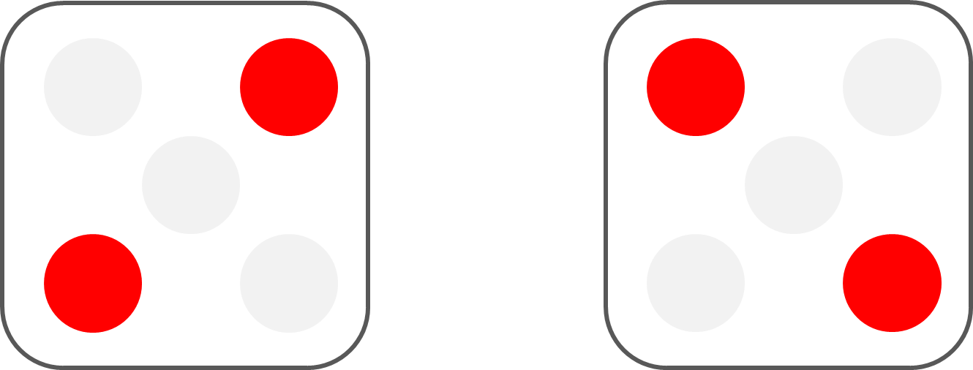
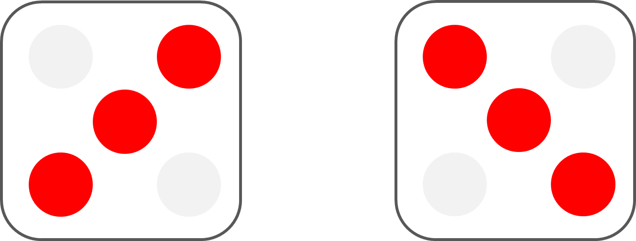
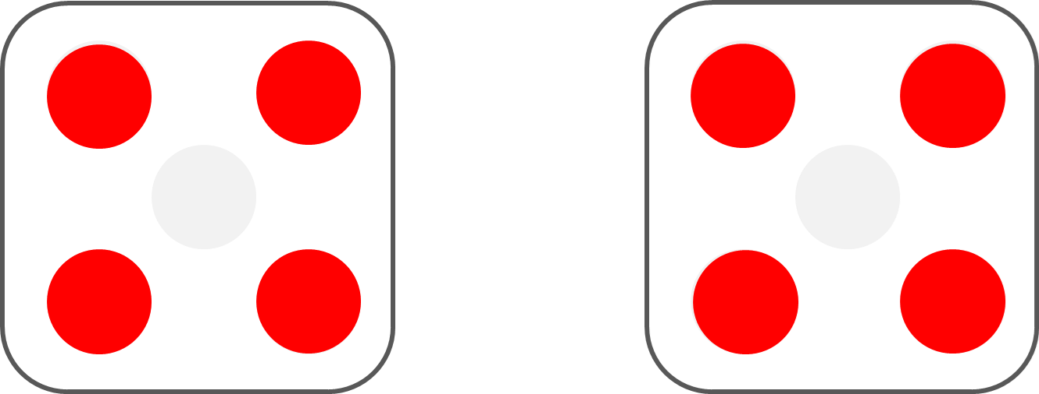
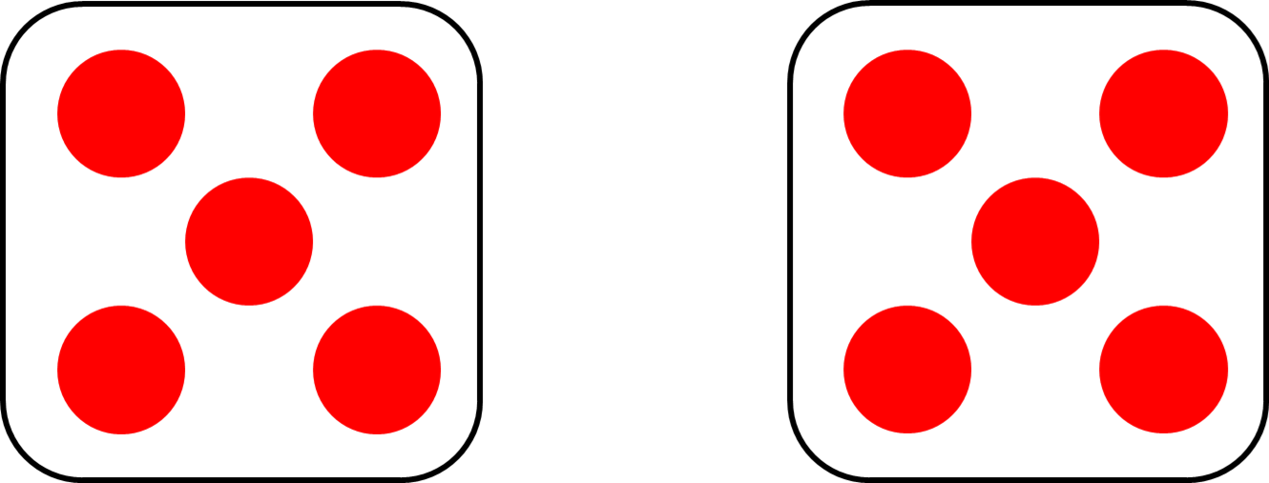
Double _____ is _____ .
Mastering Number 2021/22 ncetm.org.uk
Notes:
These sentence stems are key in our maths mastery course and we refer to them in our daily maths lessons too to ensure continuity, as well as to reinforce our understanding; always making connections between ncetm/’rekenrek’ sessions, as well as maths lessons.
Double ___ is ___ .

Slide 81
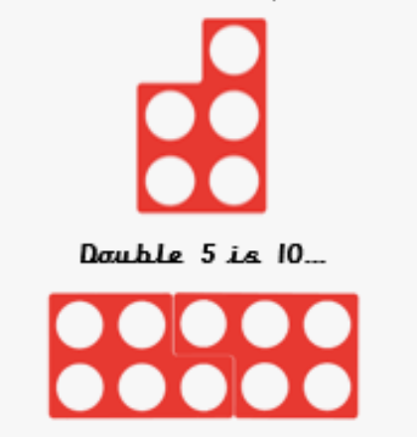
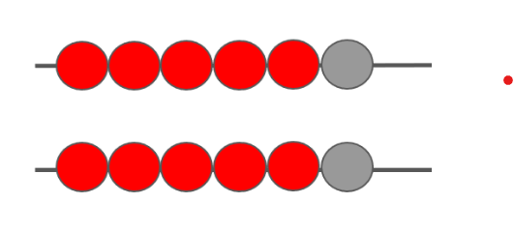
We also show doubling with different visual images. These include doubling on the rekenreks and using numicon.
The different representations help to reinforce different message about ‘doubling’.
Notes:
Here, the doubling on the rekenrek reinforces the concept of doubling as 2 equal groups, with each bead having a pair.
The image of doubling the odd number 5 numicon piece, reinforces the idea that even if we double an odd number the doubled number is always even.
Giving the children many different visual representations helps them to build connections. Once their understanding of the concept of doubling is secure, we can then show the children how to build on what they have already learnt, but simply apply to bigger numbers.

Slide 82
You will need a friend to help you show this next double!
Image © 2021 Alphablocks Ltd. All rights reserved. Mastering Number 2021/22 ncetm.org.uk
Notes:
Why do we need friend to help us? To double 6, what can we do to help us that we have already learnt?

Slide 83

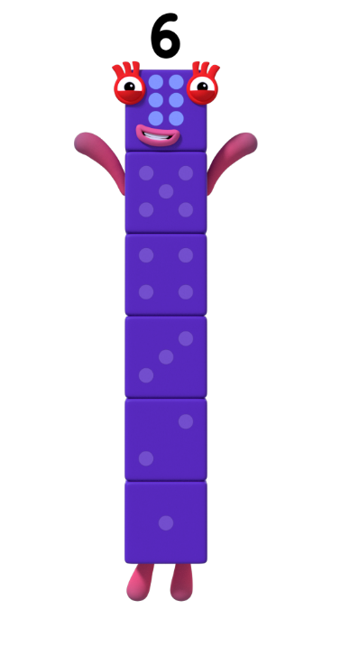
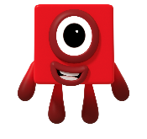
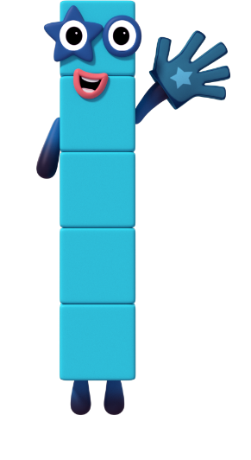
I can be made of 5 and 1!
Image © 2021 Alphablocks Ltd. All rights reserved. Mastering Number 2021/22 ncetm.org.uk

Slide 84
So double 6 can be made of double 5 and double 1 combined!
Images © 2021 Alphablocks Ltd. All rights reserved. Mastering Number 2021/22 ncetm.org.uk

Slide 85
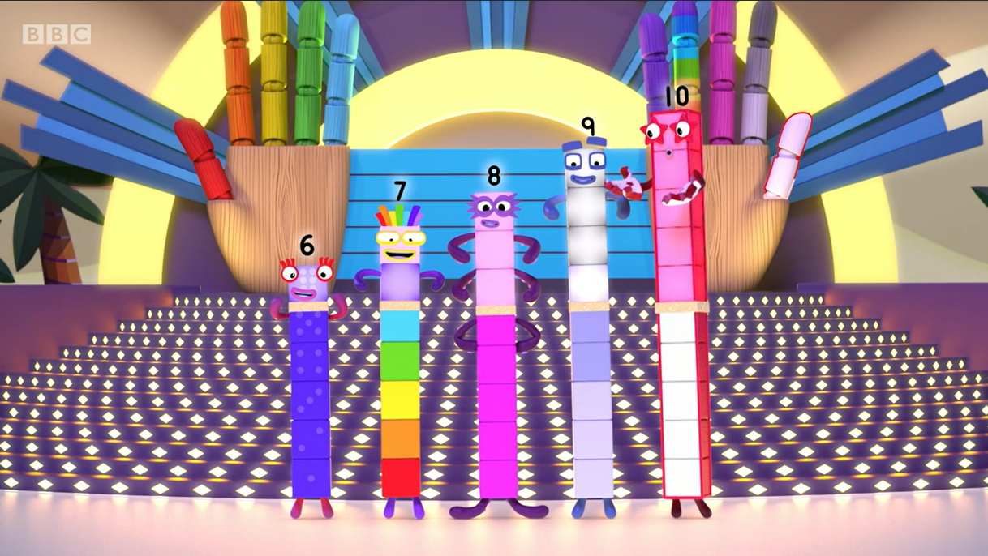
So when you double each of our numbers, you can see double 5 hiding!
Remember that we have 5 hiding inside us!
Remember that we have 5 hiding inside our numbers!
Image © 2021 Alphablocks Ltd. All rights reserved. Mastering Number 2021/22 ncetm.org.uk

Slide 86
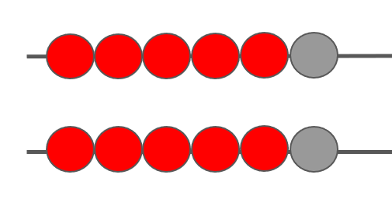
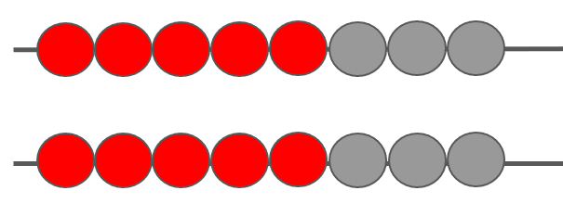
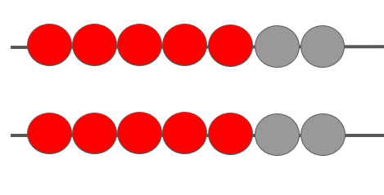
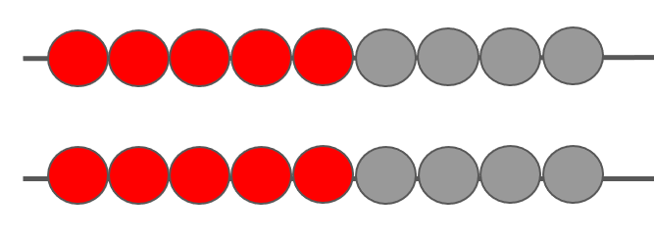
Practise making these doubles and spotting the ‘hidden doubles’
Mastering Number 2021/22 ncetm.org.uk
Notes:
Again, once children are secure, we use their understanding to move onto quick mental recall of ‘near-doubles’. For example, seeing 6 + 7 as Double 6 add 1 more.

Slide 87



