Slide 1

Normandy
3rd June-6th June

Slide 2
About us
Our
Experience
  Over 28 years experience in the educational travel industry with over 20,000 students traveling with us every year
  We provide safe, high-quality, competitively priced tours that support classroom learning and we’re here to help group leaders tackle all the practicalities of taking a group away
Our
Passion
  We share your passion for your subject. Most of us at Travelbound are experts in one or more subject fields, fluent in more than one language and have travelled extensively
  This mix of on-the-ground knowledge and subject expertise means we know how to make the most out of every step of your school trip
Our
Protection
  Part of Travelopia, we offer the highest level of financial protection. Travelopia’s global presence ensures that we have a year-round worldwide support network
  We are proud to have been awarded full accreditation for the LOtC Quality Badge scheme, are a full member of the School Travel Forum and fully bonded by ABTA and ATOL

Slide 3
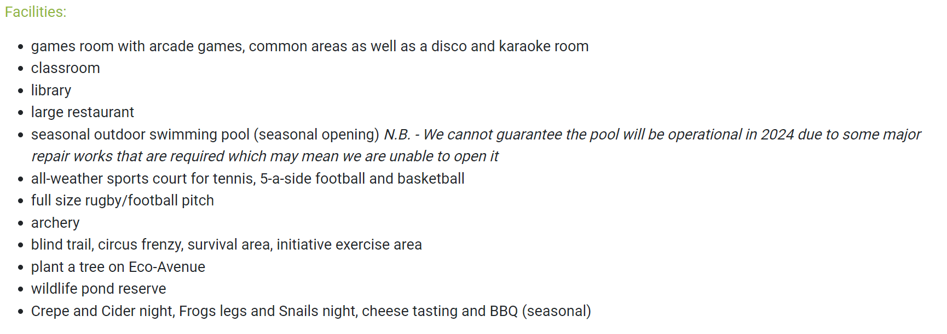
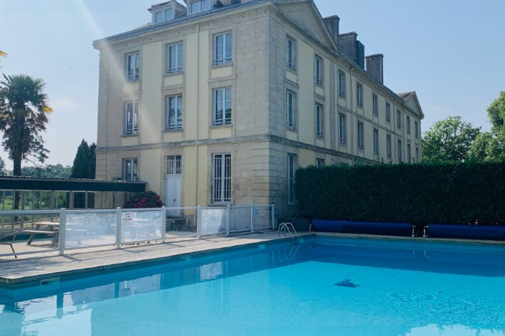


Slide 4
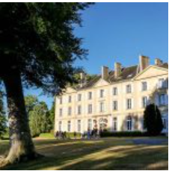

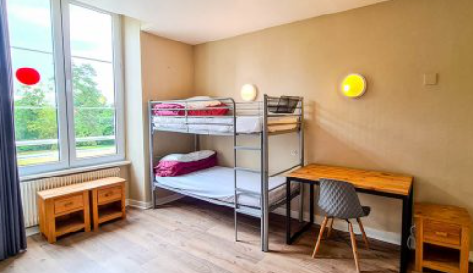
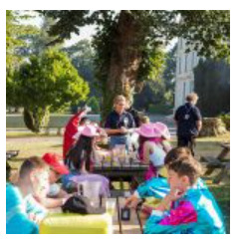
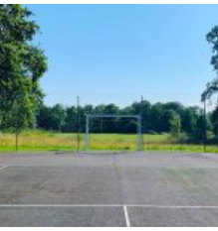
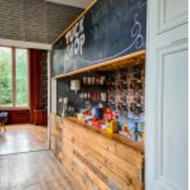
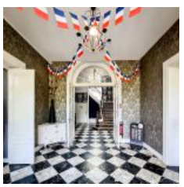
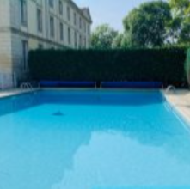

Slide 5
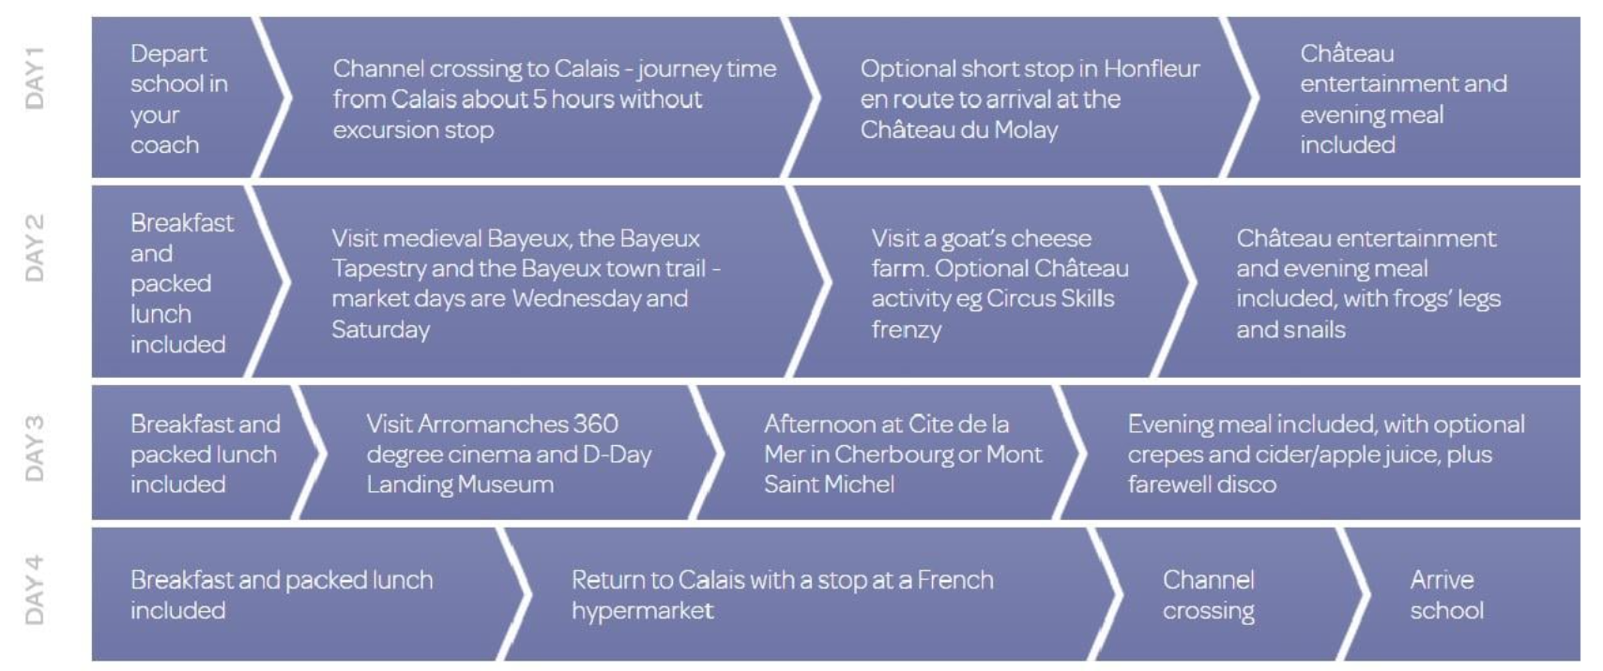

Slide 6
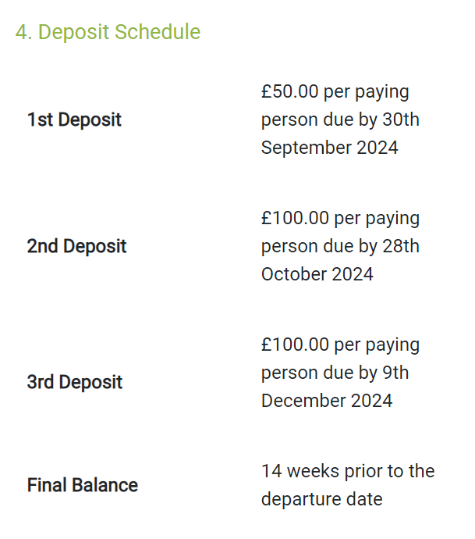
Total Price £575
£150.00 per paying person due by 28th October 2024
£150.00 per paying person due by 9th December 2024
£225 per paying person due by 24th February 2025

