Slide 1

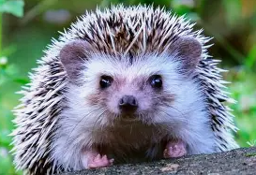

Welcome to Year 2!
(Hedgehogs class)

Slide 2
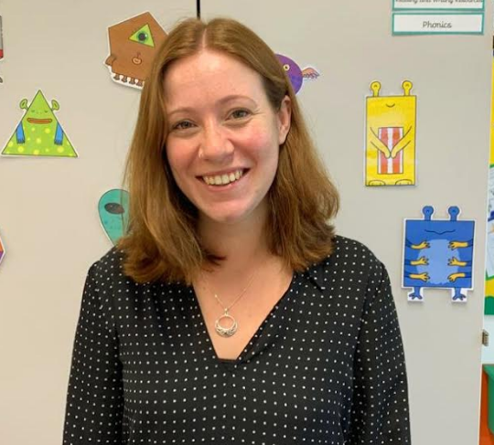
Teacher- Miss Williams
I started at St John’s 3 years ago and have previous experience working in schools in North London, in years 1, 2, 3 and 8.
I have also worked in a specialist SEN provision for non verbal children with ASC and DiGeorge Syndrome and am passionate about inclusion and mental health in the classroom.
I have been the year 3 teacher at St John's for 3 years, which will help me to know where the children need to be by the end of Year 2.

Slide 3
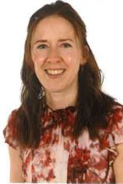
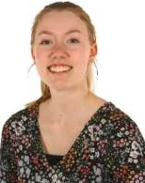
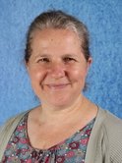
Teaching Assistants
Mrs Shea- 1:1 support
Miss Jeffrey- classroom support and PPA cover
Mrs Robinson- classroom support and interventions

Slide 4
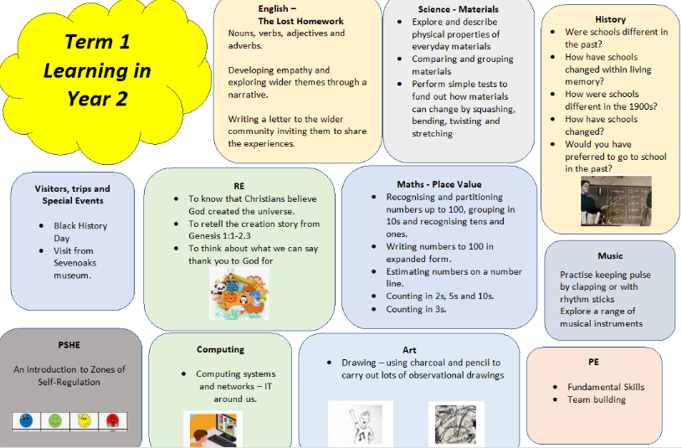

Slide 5

French
I am the French teacher/ subject leader. I have a French degree and experience teaching with La Jolie Ronde, I also lived in France for 2 years!
When I teach French to KS2, Year 2 will have one of the KS2 teachers. I will try to give them a lesson suited to their specialities, so that the children will benefit from being taught by a range of teachers.
I will begin to introduce French vocabulary into Year 2, such as days of the week, colours and greetings, they will be well prepared for French in KS2.
I will be running a KS1 French club, if any of the children would like to listen to French stories, play games and sing songs!

Slide 6
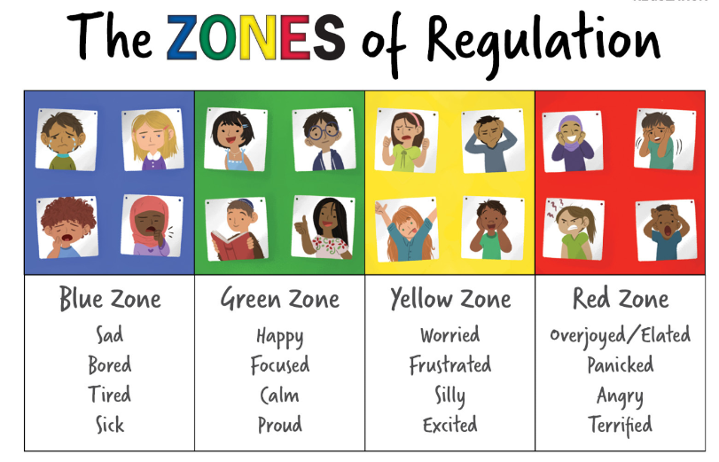
PSHE- Zones of regulation
This is to help children understand their own emotions and how to self-regulate.
The different colours represent different feelings. For example, a child in the blue zone might feel sad, bored, tired or sick. We are discussing strategies in lessons on how to get out of the blue or red zone and into the green zone.
If you could try to use the zones with your children at home, that would be really helpful!

Slide 7
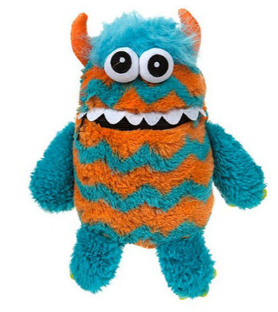
PSHE- Worry monster
We also have the worry monster, where children can write their worries, anonymously or not and I will discuss with the individual or the whole class.

Slide 8
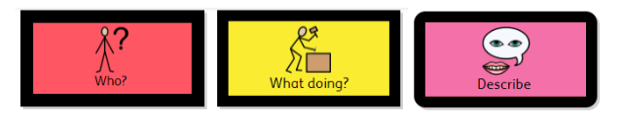
SEND learners
Assistive technology- access to clicker 7 on the ipads
Regular meetings with SENDCo
Movement breaks
Review of feelings and which zone of regulation we are in
Use of scaffolding, colourful semantics and Widgit software
Experience working in a specialist SEND provision

Slide 9
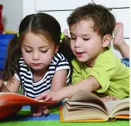
Reading books
We ask that you read daily with your child. Each week in Year 2 we endeavour to set an e-book pitched at a personalised appropriate level for your child as well as a hand-held paper copy of a book pitched at a similar level. These will go out every Thursday.
In Year 2, children tend to progress from e-books onto colour-banded books. When this happens, we will no longer send the Little Wandle e-books home, and instead you will receive just a hand-help paper copy of the appropriate colour-band for your child.
In addition, we will offer an opportunity for your child to borrow a ‘reading for pleasure’ book from our class book corner, which they can exchange daily if they so wish.
We will offer opportunities to borrow a school library book as regularly as possible. Please keep completed school library books in book bags until we are able to change them for a new one.

Slide 10

Homework
The Maths homework will be online through the website ‘MyMaths’. We will set weekly tasks every Thursday and ask that it is completed by the following Tuesday.
For English homework we ask that you read daily with your child. Please make a note in the reading diaries to let us know of any words your child struggled with in the e-books and likewise in the paperbacks. Please could you also make a note of which page your child has reached or if the book is finished and you are ready for a new one. Repeated reading is crucial to build fluency, pace and comprehension so we will be changing these books weekly, every Thursday.

Slide 11
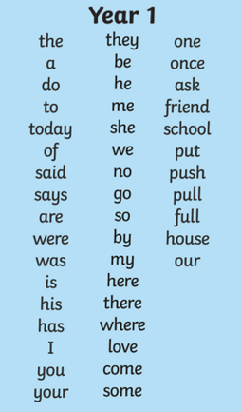
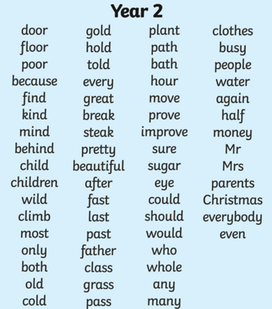
Spellings
As part of the English homework we also ask that you access the class page of the school website to view the Year 2 common exception words.
Please practise these words across the year, a few at a time. Ideas and suggestions of how to approach learning these spellings are provided on the class page of the school website.

Slide 12
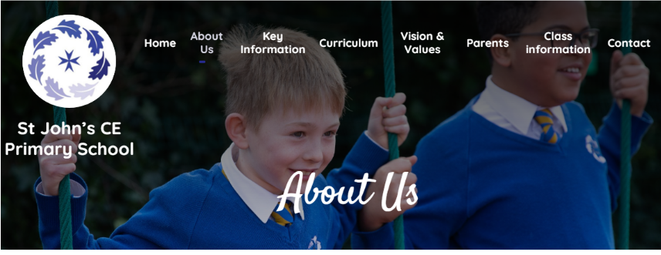
Our website- spellings, curriculum and resources on the Year 2 page

Slide 13
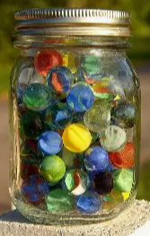
Expectations
Behaviour policy- use of rule reminder, warning and then sanction. Can be found on the school website.
Marble jar- I use whole class rewards to encourage the children to work together as a class. Then they can choose a whole class reward, for example a ‘pyjama day’ or ‘bring a teddy to school day’.
House points- the house with the most house points at the end of each term wins a non uniform day for their house.
Special mentions- every Thursday during Act of Worship. Each child will receive a special mention at some point in the year. We are always looking out for acts of kindness or extra effort put into class work!

Slide 14
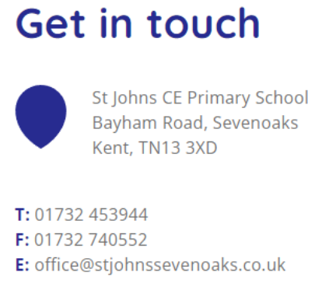
Or please come and ask me on the playground at the end of the day!

