Slide 1
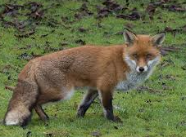

Meet the Teacher
Year 5 FOX CLASS - 2025

Slide 2
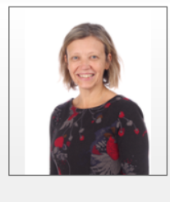
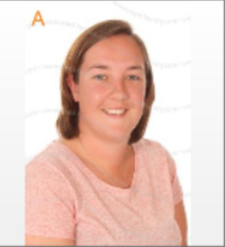
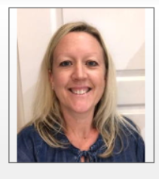
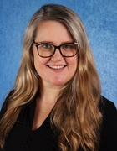
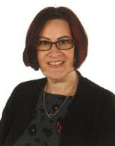
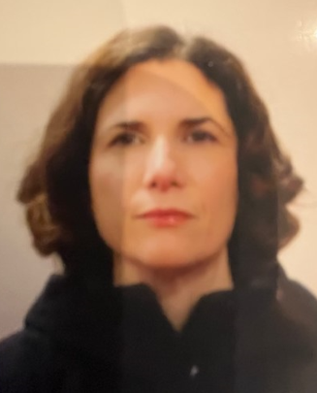
Welcome to FOX CLASS
Class teacher: Mrs Bev Casewell (Mon-Thurs) and Mrs Danielle Hollands (Thurs/Fri)
Support staff : Mrs Webb (Mon and Tues) and Mrs Hoemke (Weds - Fri)
Additional staff: Mrs Fairbairn and Mrs Askin

Slide 3
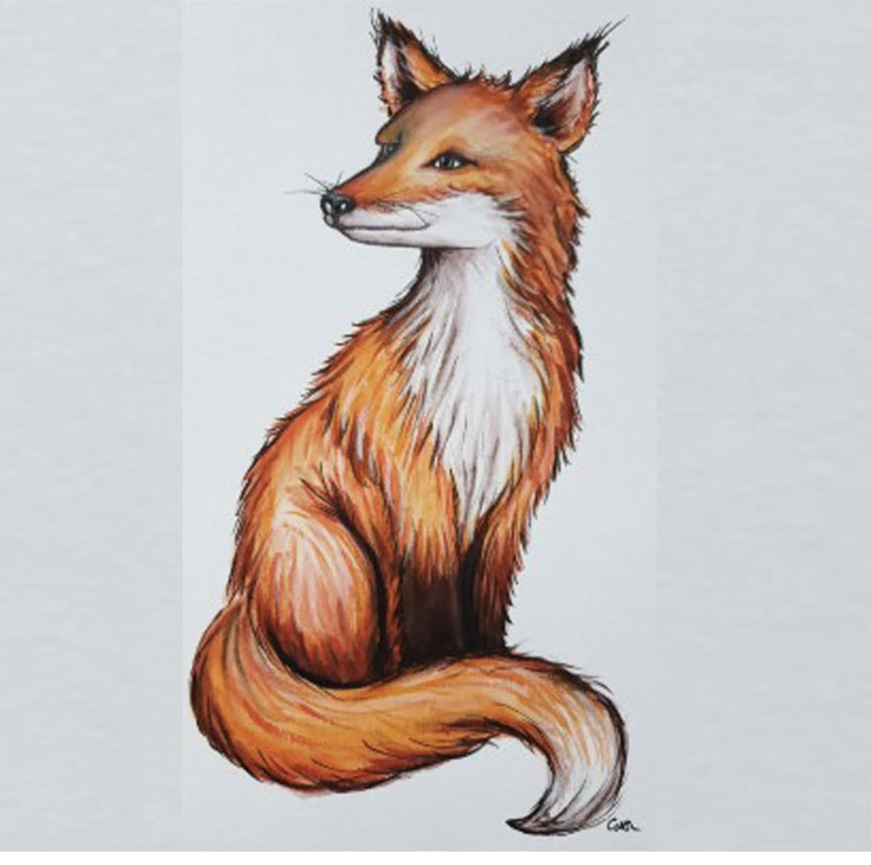
Our class characteristics
great problem solvers
persevering
intelligent
focused
quiet
resourceful
agile thinkers
courageous
determined

Slide 4
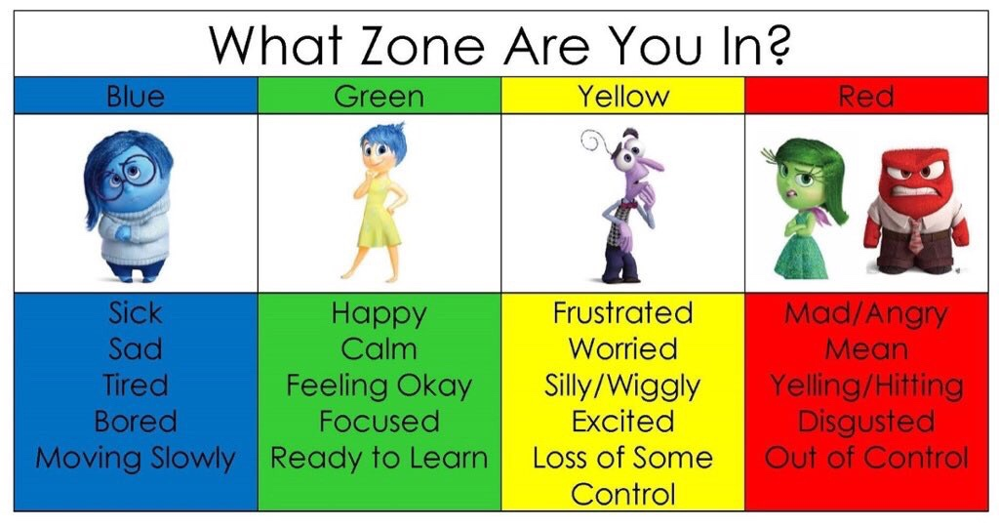
Zones of Regulation
Zones of Regulation
Children will be reminded of our strategies to self-regulate so that they can manage their emotions and behaviour. This will enable everyone to be in the appropriate zone for learning and for having a good day at school.
You may want to refer to these zones at home too!

Slide 5
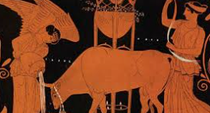
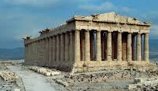

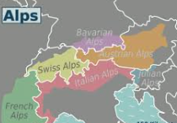

What will the children be learning about this year?
Greeks
Tudors
Life Cycles
Earth and Space
Mountains

Slide 6
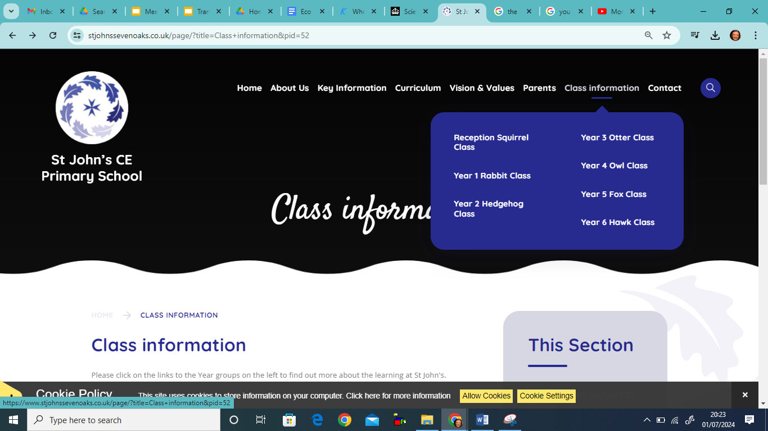
You can also find out more by referring on the Year 5 Whole Year Curriculum Map on the website

Slide 7
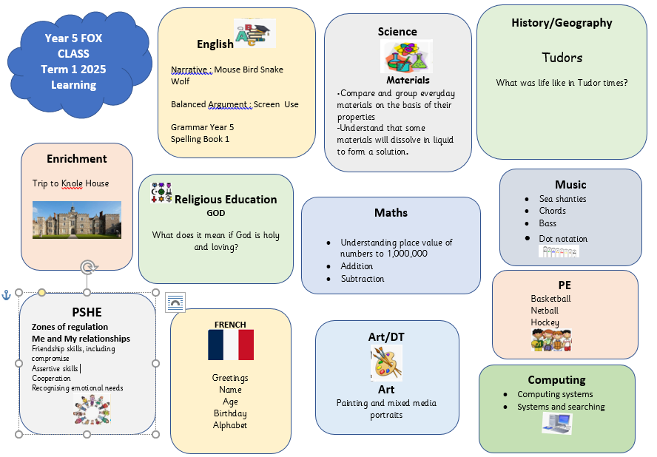
At the start of each term you will be able to find a map of our termly overview on the class page as well as spelling booklets and additional resources to support learning at home

Slide 8
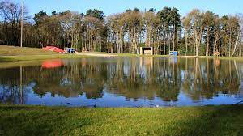
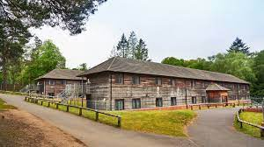
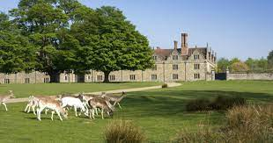
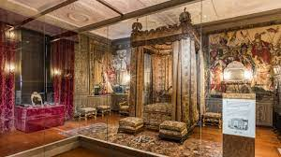
Highlights in Year 5
Knole House
Tudor Experience
September 2025
Look out for a letter!!
2 night Residential
Information meeting will be held later in year.

Slide 9


Homework Expectations and Routines
Maths Homework: MyMaths will set on a digital platform matched to what children are learning in the week or to consolidate prior learning.
Grammar Homework: This will be sent home on Thursdays and should be returned to school completed on Tuesdays.
This homework usually consolidates learning in class and we appreciate your support in ensuring children complete this at home. From time to time, we will set creative or topic- based homework.
.

Slide 10


Please read daily with your child for at least 20-30 minutes daily, discussing the text and ensuring that they understand new vocabulary and what they have read.
This should be recorded in their reading record.

Slide 11

Spelling
Spelling tests will be on Tuesday.
Spellings are on the class web page and the set we are working on will be written in the planners.
Additionally, each week the children will learn 2 of their “rocket words” which are taken from the list of words that the children need to know by the end of Year 5 These words w are written at the end of each spelling set.
Although we practise in class, your support in helping your child to learn these at home would be greatly appreciated.
For children who may find spelling challenging, we will talk to parents directly as they will expected to only learn the highlighted spellings each week and may have an additional set to support them.
Some children may have individualised spellings.

Slide 12
Times Tables
Times tables will be tested on Tuesdays

Slide 13

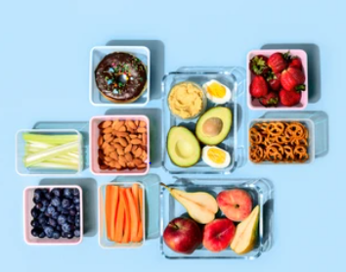
SNACKS FOR BREAK TIME
Please provide healthy options in clearly named pots
Fresh/dried Fruit or vegetables
Pita bread/ crackers/rice cakes or sandwich ( for hungrier children)
Cheese
Healthy cereal bars or fruit strips

Slide 14
Getting in touch
For day to day communication such as changes to your child’s pick up arrangements please write in the planners, speak to the person on the gate upon arrival or contact the school office.
Most importantly, please do come and talk to us directly if you have any questions or would like further information and support
Email or call the school office if you have any concerns and we will get back to you as soon as we can.
Telephone:
Office email: office@stjohnssevenoaks.co.uk.
01732 453944

