Slide 1

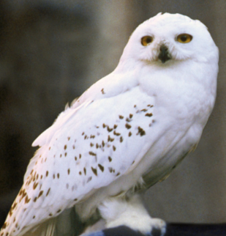
Meet the Teacher
Year 4
Owl Class 2025

Slide 2
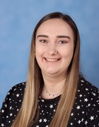
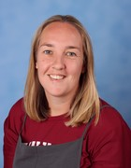
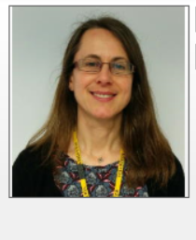
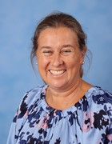
The Year 4 team
Class teacher: Miss Beth Forsey and Mrs Danielle Hollands (Thursday)
Support staff: Mrs Reynolds (Monday and Tuesday) and Mrs Thompson (Wednesday-Friday)

Slide 3
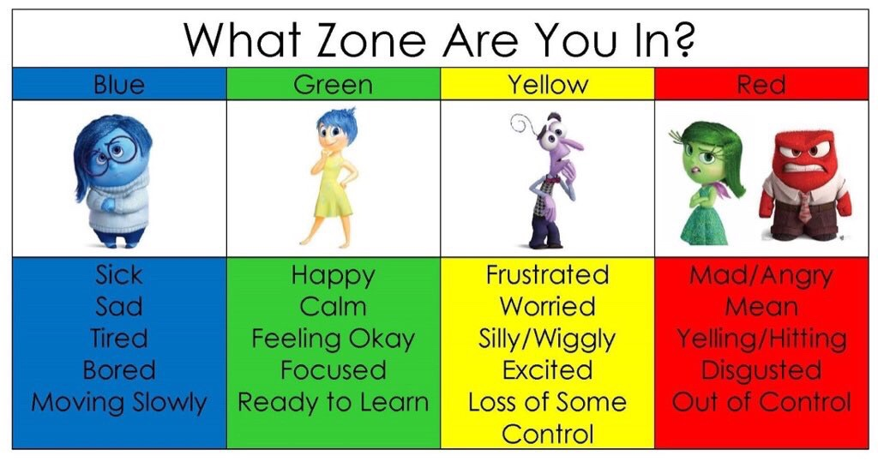
Zones of Regulation
Zones of Regulation
Children will be reminded of our strategies to self-regulate so that they can manage their emotions and behaviour. This will enable everyone to be in the appropriate zone for learning and for having a good day at school.
You may want to refer to these zones at home too!

Slide 4

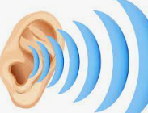

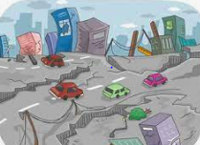

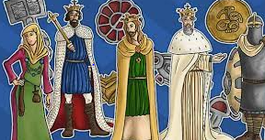
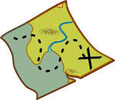
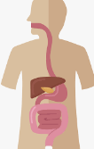


What will the children be learning about this year?

Slide 5
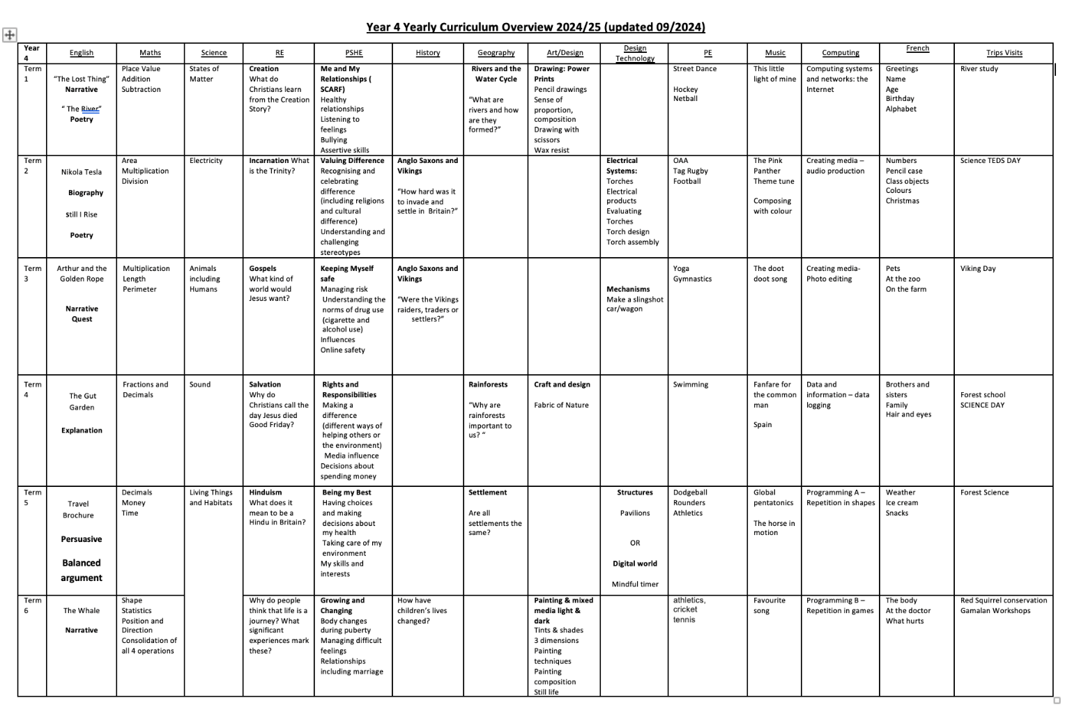
You can also find out more by referring on the Year 4 whole year curriculum map on the website.

Slide 6
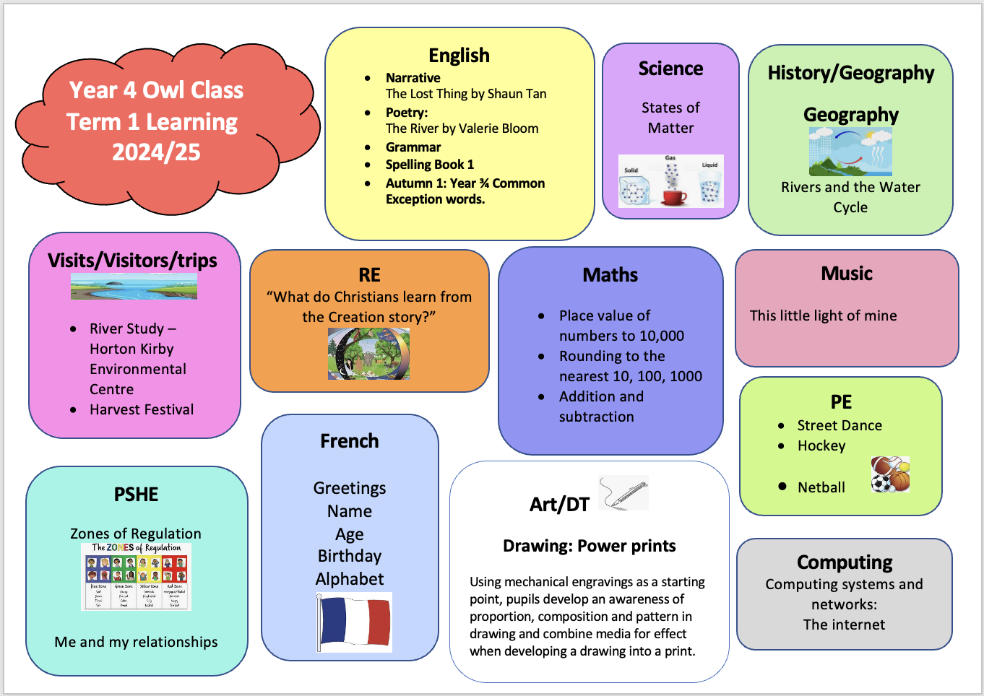
At the start of each term you will be able to find a map of our term’s curriculum on the website.
I will also aim to provide regular information for ways you can support your children at home.

Slide 7
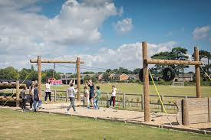
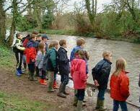
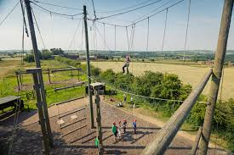
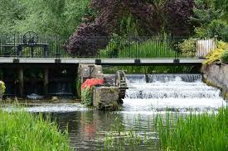
Highlights in Year 4
Sevenoaks Wildlife Reserve River Trip
October 2025
Look out for a letter soon!!
1 night Residential Trip
Information meeting will be held nearer the time (after Christmas)!

Slide 8

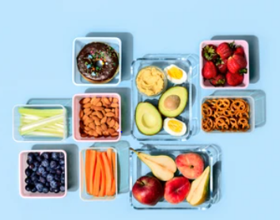
Snacks for break time
Please provide healthy options in clearly named pots
Fresh/dried Fruit or vegetables
Pita bread/ crackers/rice cakes or sandwich ( for hungrier children)
Cheese
Healthy cereal bars or fruit strips

Slide 9
Homework expectations
Homework will be sent home on Thursdays and should be returned to school completed on Tuesdays.
Children will be set a piece of MyMaths homework which is an online platform each week which will consolidate their learning in class, as well as a written piece which may focus on grammar, spelling practice, maths consolidation or creative projects linked to our topics. We appreciate your support in ensuring children complete this at home.

Slide 10

Reading
Planners should be in school each day as we will use it to communicate or write about any reading done in school.
Children should aim to read for at least 10/15 minutes each day – from a book that they are enjoying, whether this is their banded reading book, from the library or a book from home!
If your children are interested in specific book types please let me know as I can ensure we have a wide variety available in class!

Slide 11


Times Tables
Times tables tests will be on Thursdays.
We will learn all times tables up to 12x12 in Year 4 so practicing at home will be beneficial – there are lots of online games/websites to support learning these.
The Government Multiplication Tables Check will be in May/June 2026, by which time the children are expected to know all their times tables and will complete an online test made up of 25 questions, with 6 seconds to answer each one.

Slide 12

Spellings
Spelling tests will be on Thursday.
Spellings are on the class web page and the set we are working on will be written in the planners.
Additionally, each week the children will learn 2 of their “rocket words” which are taken from the list of words that the children need to know by the end of Year 4 (at the front of their planners and on the class webpage). These words will be written in the planners each week.
Although we practise in class, your support in helping your child to learn these at home would be greatly appreciated.

Slide 13
Unique to Year 4
CATS TESTS – Cognitive Ability Tests
In May/June time
Results used to provide further information about your child’s learning: areas of strength and areas to work on.
Additionally, results used to support making decisions about whether to put the children forward for the 11+

Slide 14
Getting in touch
For day to day communication such as changes to your child’s pick up arrangements please write in the planners, speak to the person on the gate upon arrival or contact the school office.
Most importantly, please do come and talk to us directly if you have any concerns or would like further information and support.
Email or call the school office if you have any concerns and I will get back to you as soon as I can.
Office email: office@stjohnssevenoaks.co.uk.
Telephone: 01732 453944

