Slide 1
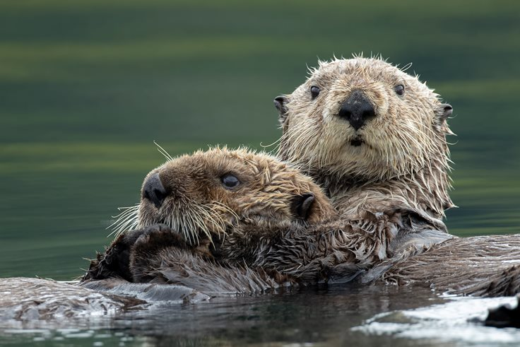
Welcome to Year 3
Otters’ Class

Slide 2


Meet the Team:
Mrs Woodhouse
Mon – Wed
Mrs Miles
Thurs – Fri (but here all week)
Fulltime TA
All week

Slide 3

The week in Year 3:
Everyday - Maths and English
Once a Week - Science, History/ Geography, Art/D.T., R.E., P.S.H.E., French, Music, Computing, P.E.
Throughout the week (shorter sessions) – Handwriting, Spellings, Grammar, Shared Reading, Times Tables

Slide 4
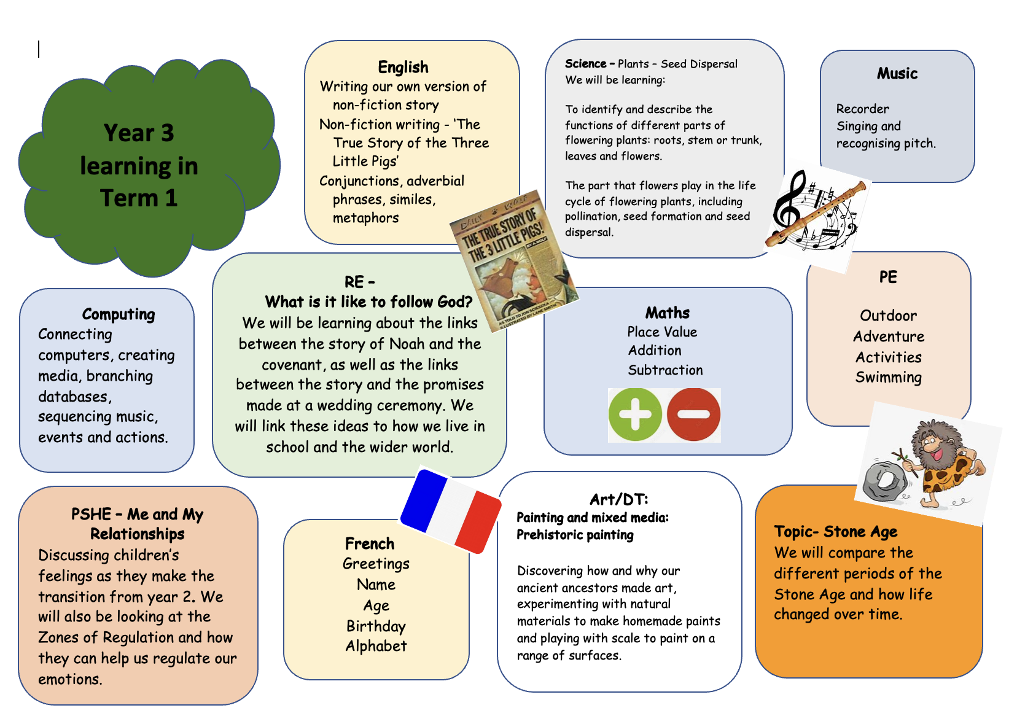
Term 1 Learning:

Slide 5
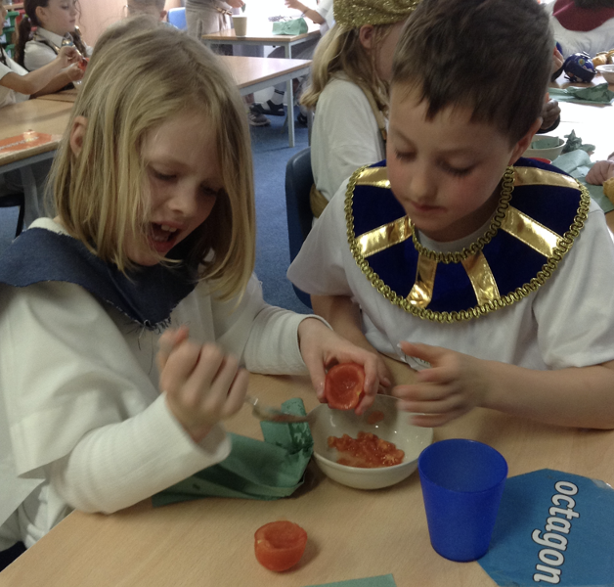
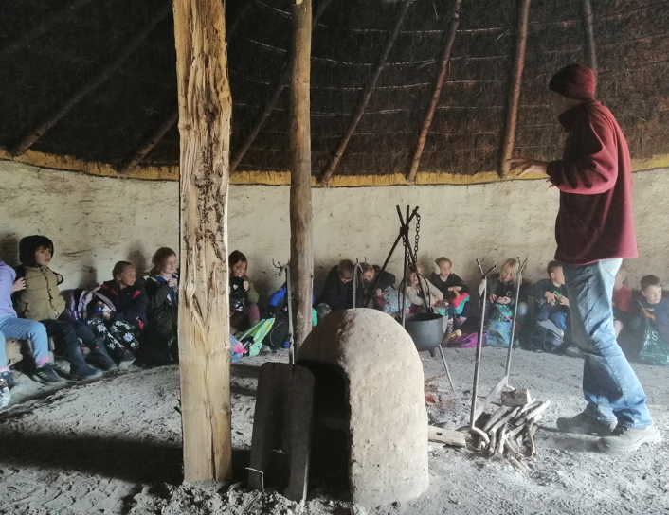
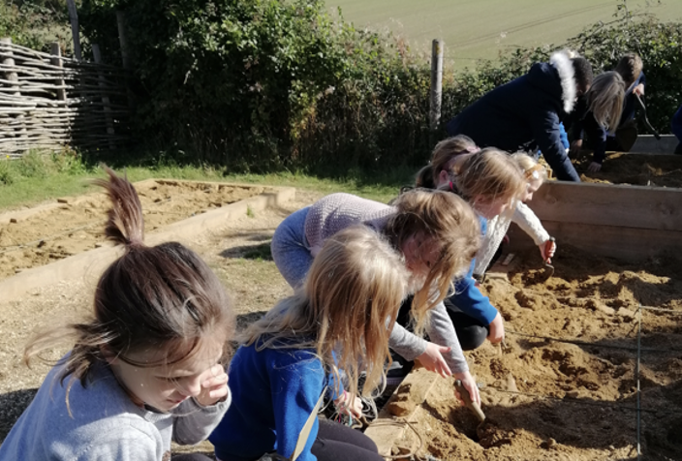
Trips and Theme Days:

Slide 6

SEND Learners:
Thorough handover with the Year 2 team about the needs of all the children
Adaptive teaching – allowing the children to access the same work as the rest of the class with adaptations
Use of widgits/ visual cues
Movement breaks, fidget toys, wobble cushions to be provided by school when necessary
Zones of Regulation

Slide 7

Homework:
Spellings – On website
Maths – MyMaths app
Reading – Banded books, record in reading record

Slide 8

Other things to know:
Behaviour policy – Class and school rules, positive, use reminders, warnings and restorative sanction
P.E. kit to be kept in school
Waterbottle
No need for pencil case or
equipment, we will provide
everything needed
Contact us by using…..
Label everything!

