Slide 1


TEDS DAY
Together Everyone Doing Science
26th November 2025

Slide 2


Slide 3

Santa and everyone at the North Pole need your help.
Which type of enquiry will your class use today?

Slide 4
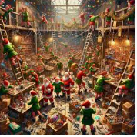
Reception
Oh dear!
The elves are having a terrible time at the North Pole and so much is going wrong.
Someone has left muddy footprints all over Santa’s workshop and they want to find out who it was. We found out it, it was the chimney sweep cleaners!
They have dropped all the candy and now it is in a muddle and needs sorting. We sorted the sweets out that were mixed up, some were red and striped and some were blue
Santa has asked them to make reindeer food exactly the right weight. We managed to sort the food out and use our measuring cups and scales to make the correct amount of food. We found that there were paper clips, and leaves in and between their food.
They need to make Santa a new coat and they need to find out which material is best to keep him warm. We had a look at the different materials and saw that there was bubble wrap, soft paper, tin foil and other hard materials! We decided that the bubble wrap and the plastic could keep him warm from the cold wind.
There are loads of problems for you to solve.
Can you help?

Slide 5
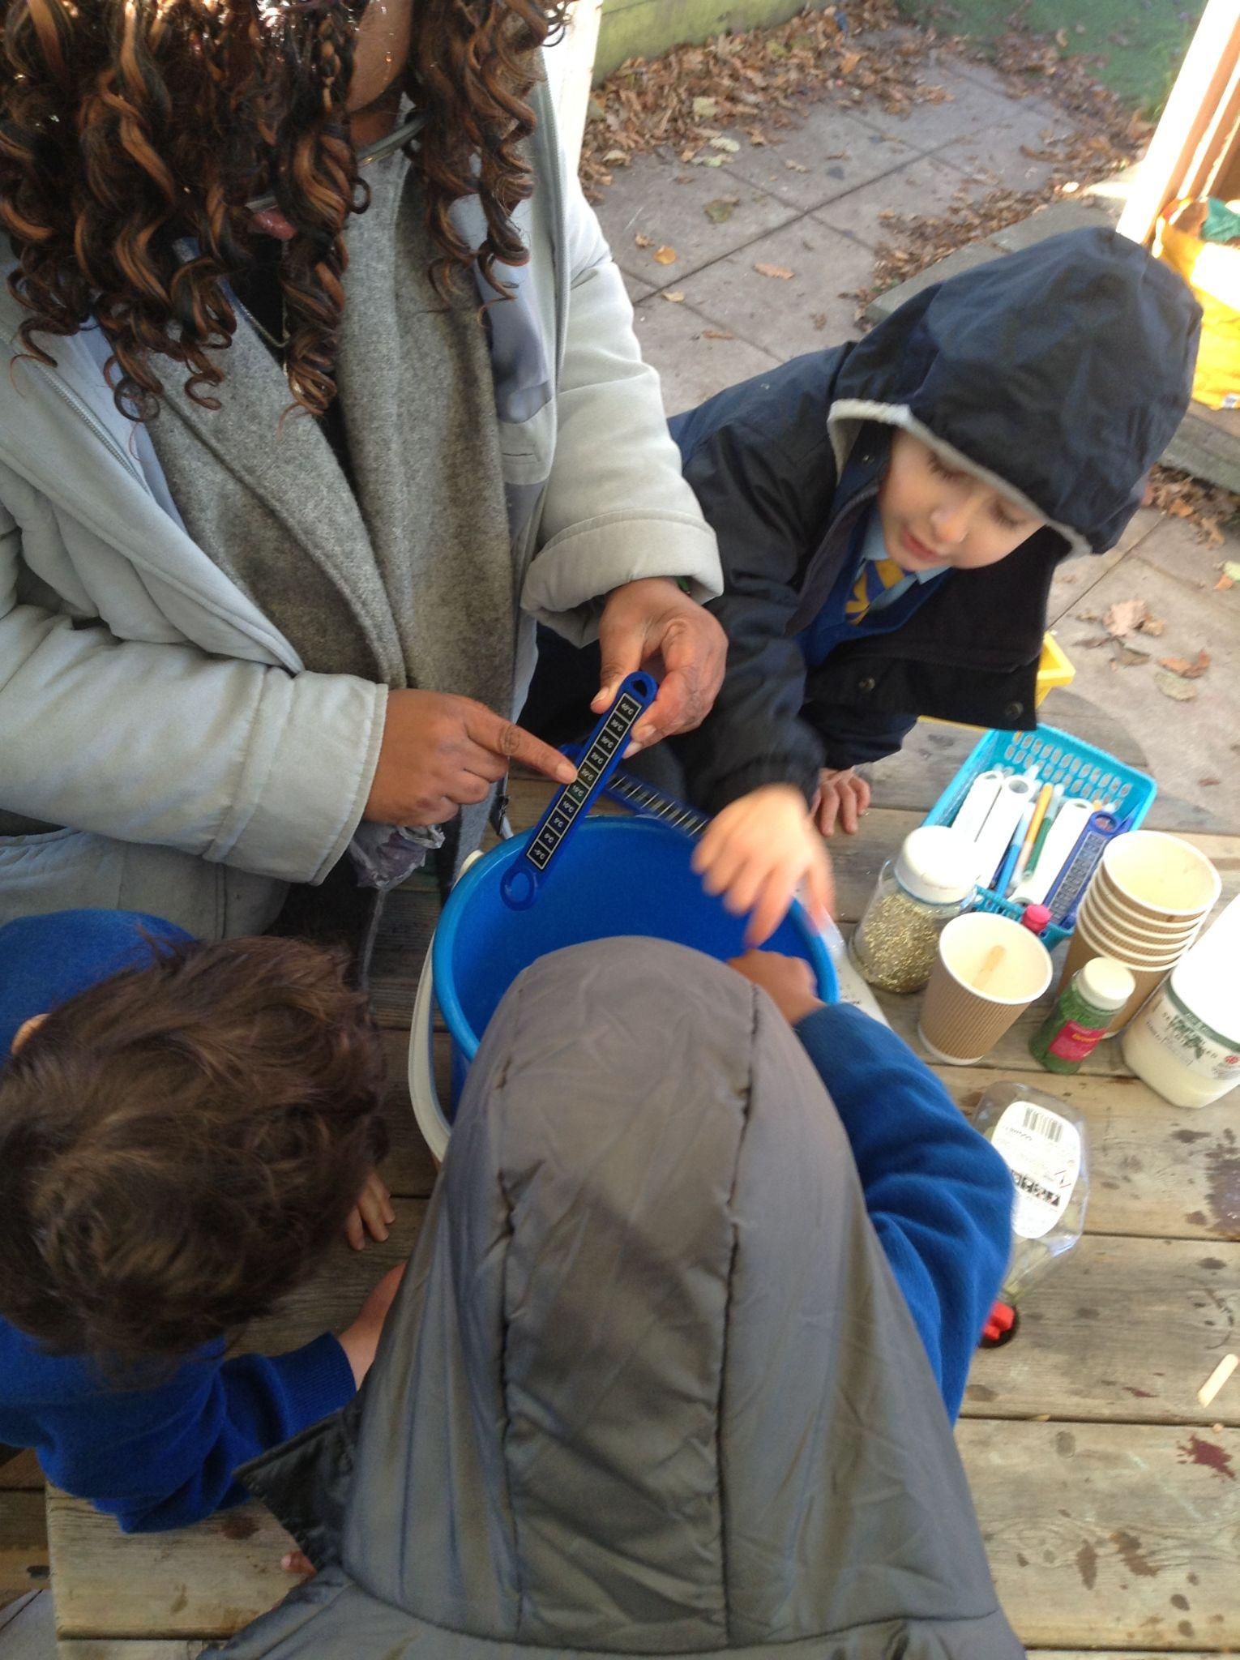
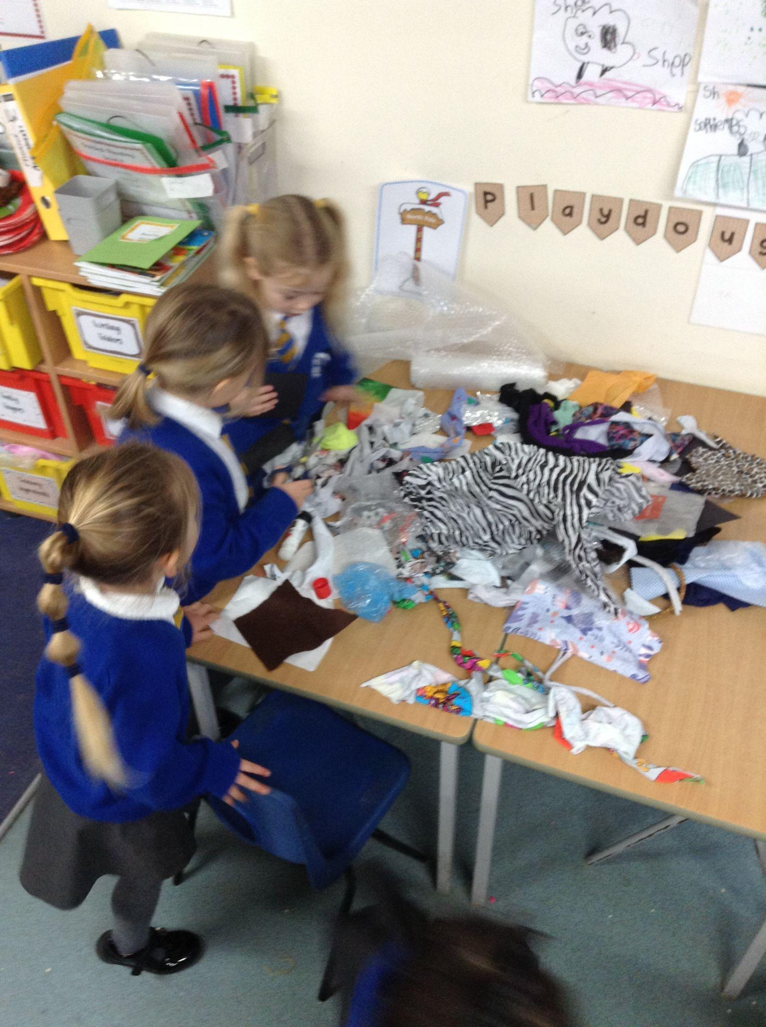
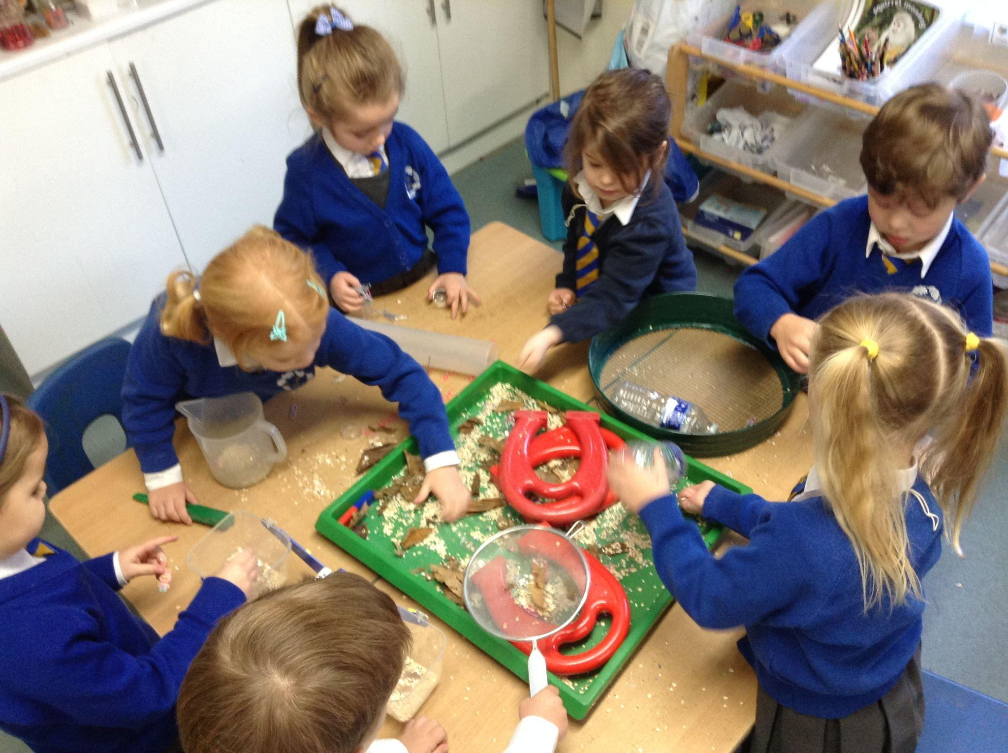
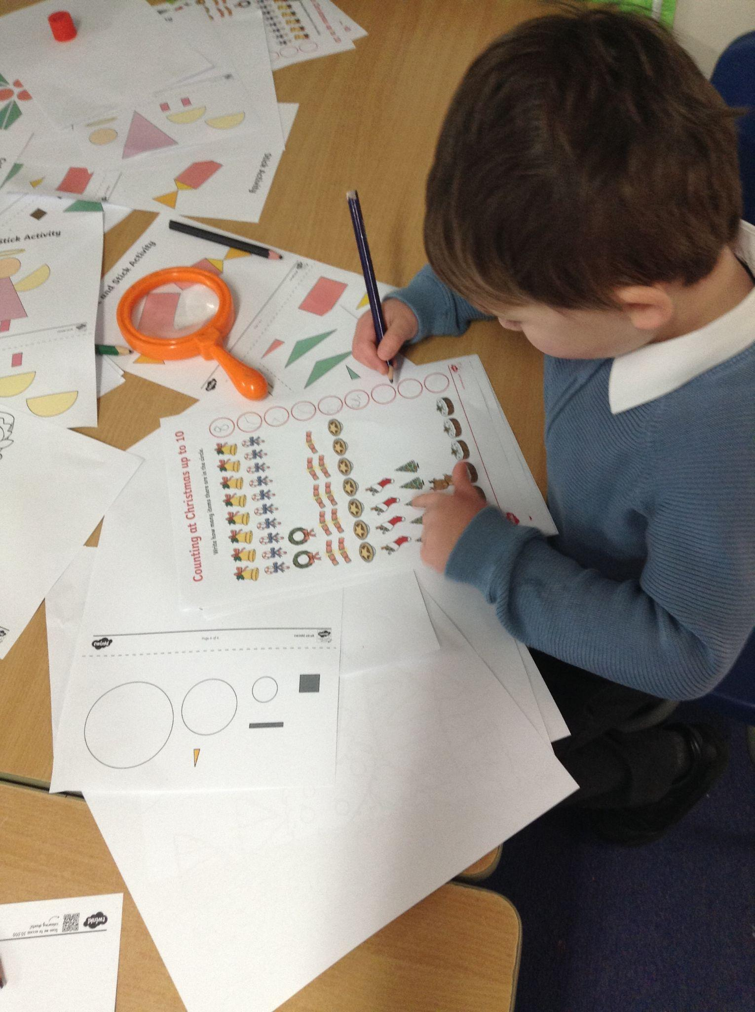
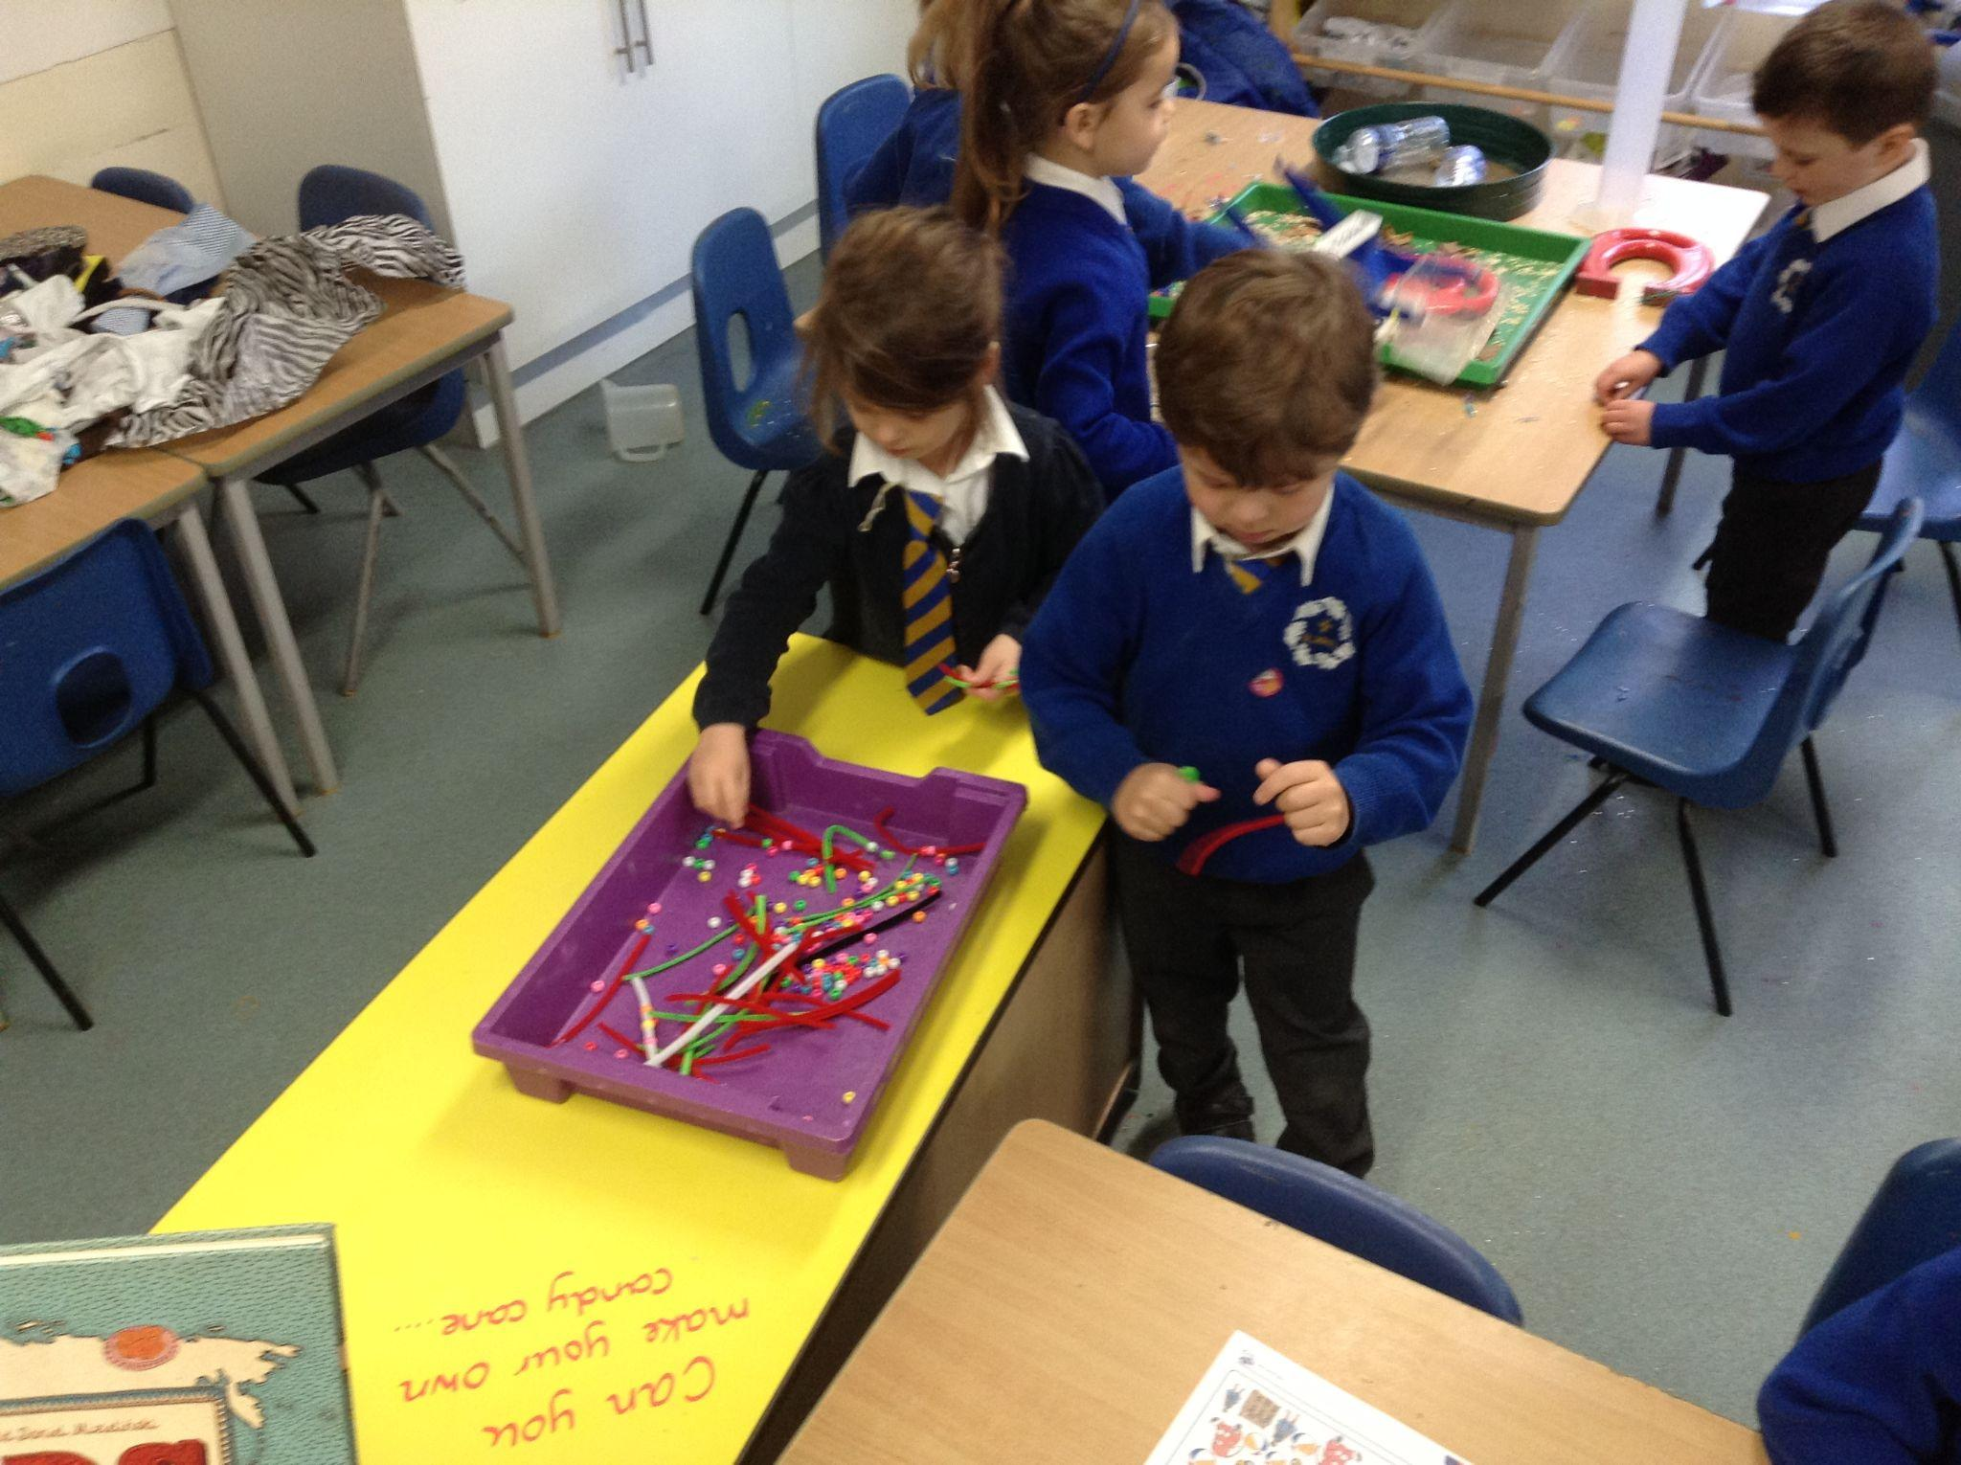
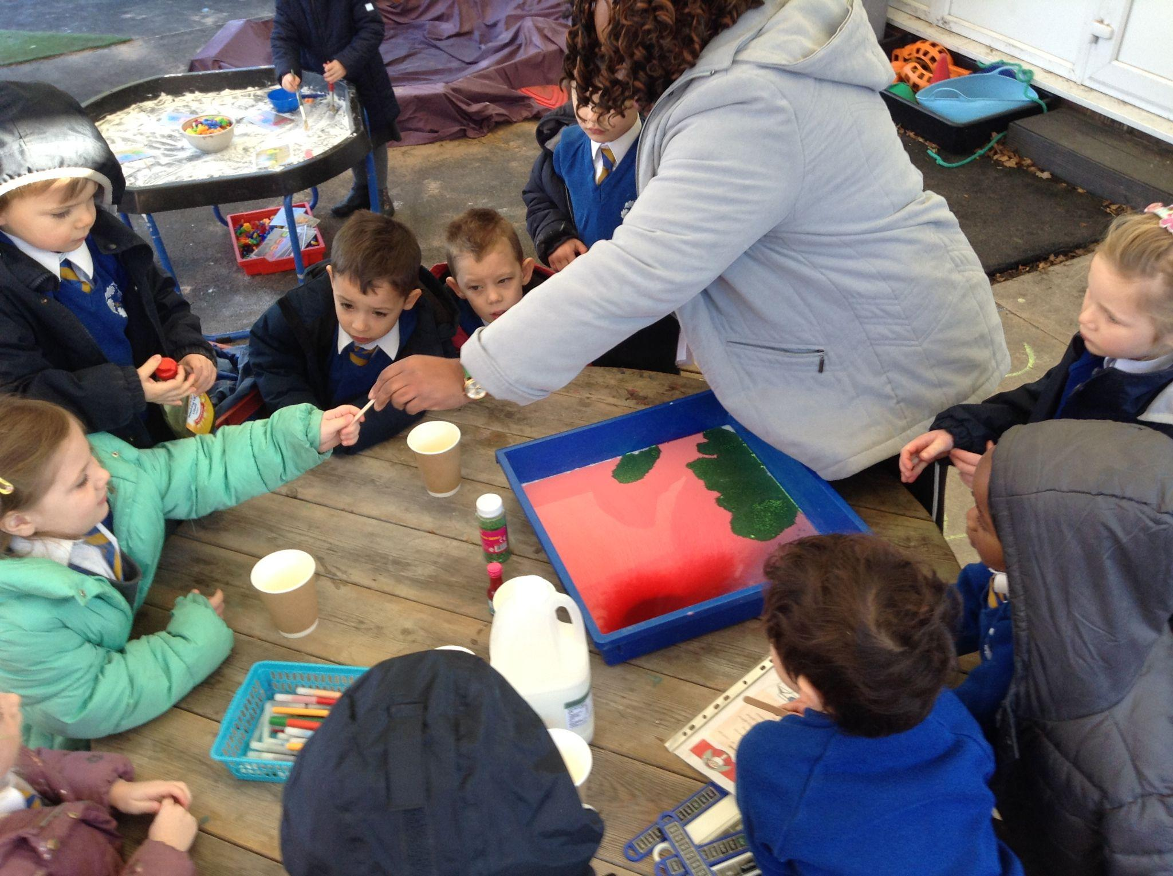
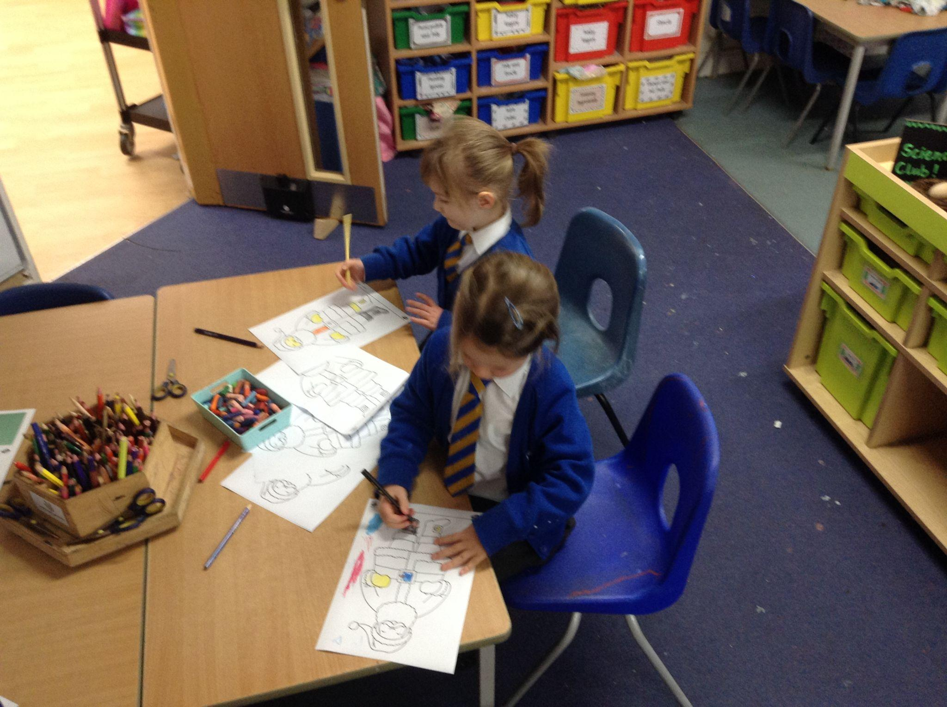
The elves were having a terrible time at the North Pole and so much is going wrong. The Reception class thought of some good ideas to help them and they got to help Santa and the elves out!

Slide 6
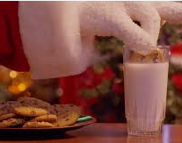
Year 1
I love having a cup of hot chocolate or milk at the end of a long day. I love dunking biscuits too! But, they keep going soggy, falling to the bottom of my mug or messing all over me. I can’t have that . Can you help me find out the best biscuit for dunking?
Santa’s biscuits keep going soggy.
Which biscuit is the best for dunking?

Slide 7
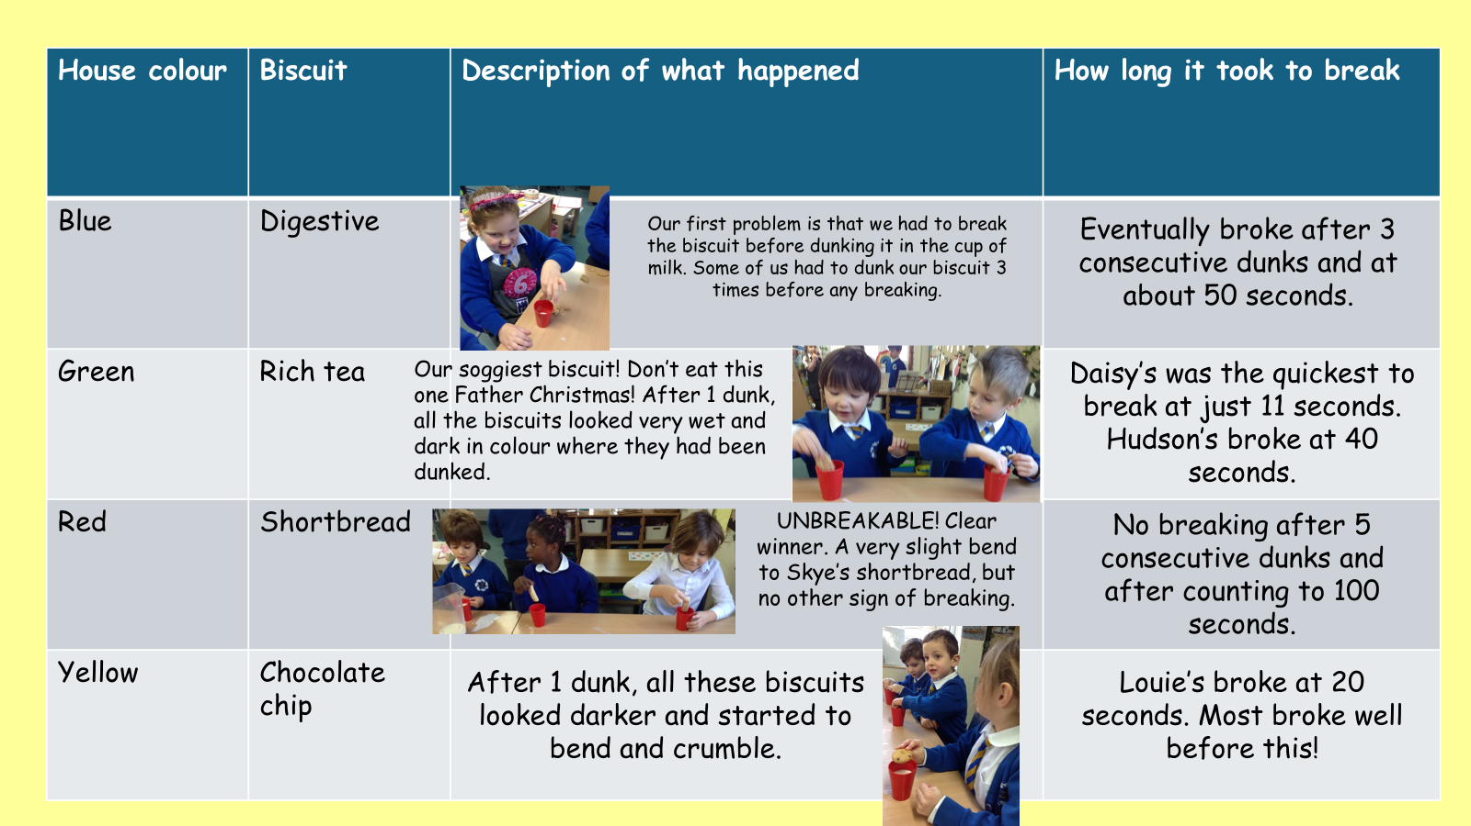

Slide 8
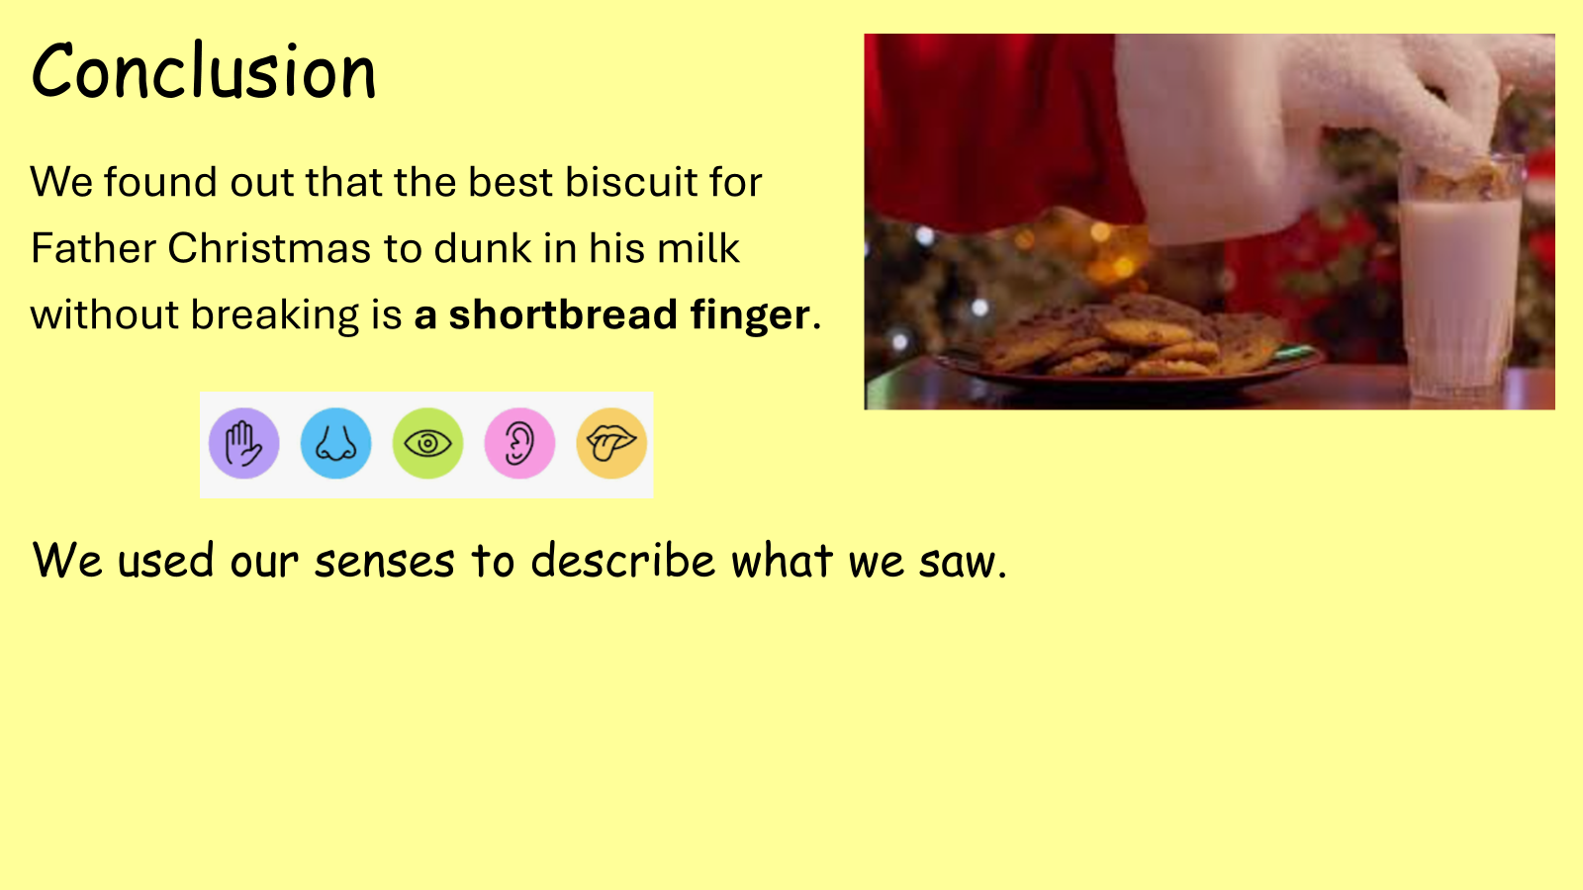

Slide 9
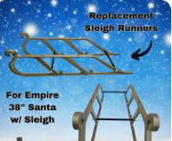
Year 2
Can you help us design new runners for Santa’s sleigh. He wants to be able to land his sleigh on rooftops and gardens and not leave deep marks in the snow, especially when the sleigh is packed with presents.
Can you find some runners that will spread the load more evenly and leave less of an imprint ?
Which sleigh runner design leaves the smallest imprint in the “snow”?

Slide 10
Year 2
Dear Santa,
You should use wide strips of foil for your sleigh runners because they are light, smooth, flat and wide, which means that the weight of the presents is spread evenly across the snow. This meant that there was nearly no marks left in the snow.
Runner material | Depth of imprint
Thin lollysticks | 12mm
Thick lollysticks | 10mm
Pencils | 11mm
Foam | 3mm
Rulers | 8mm
Foil | 1mm
Straws | 20mm

Slide 11
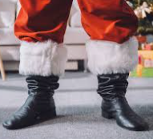
Year 3
Ho ho ho!
I keep slipping on
floors in people’s houses. I need boots with better grip!
Please test different
boots on different
surfaces so I can
stay safe on
Christmas Eve!”
“Which shoe gives Santa the best grip so he doesn’t slip on Christmas Eve?”

Slide 12
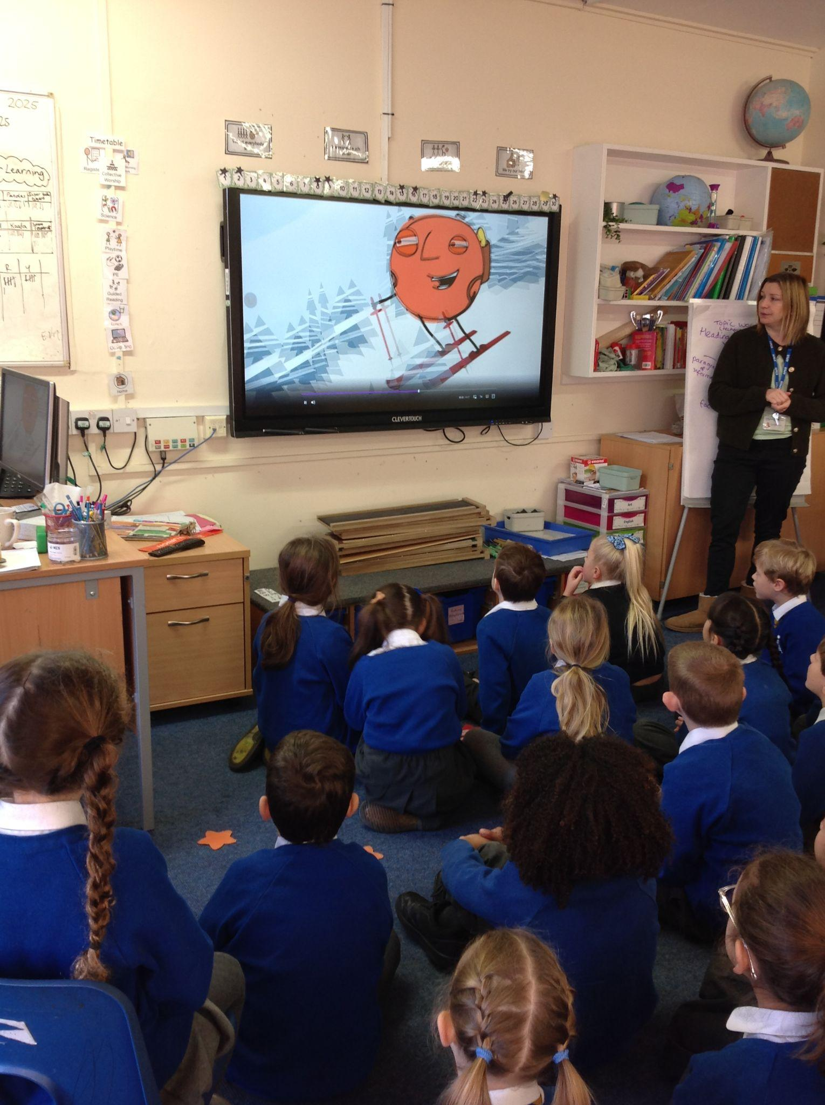
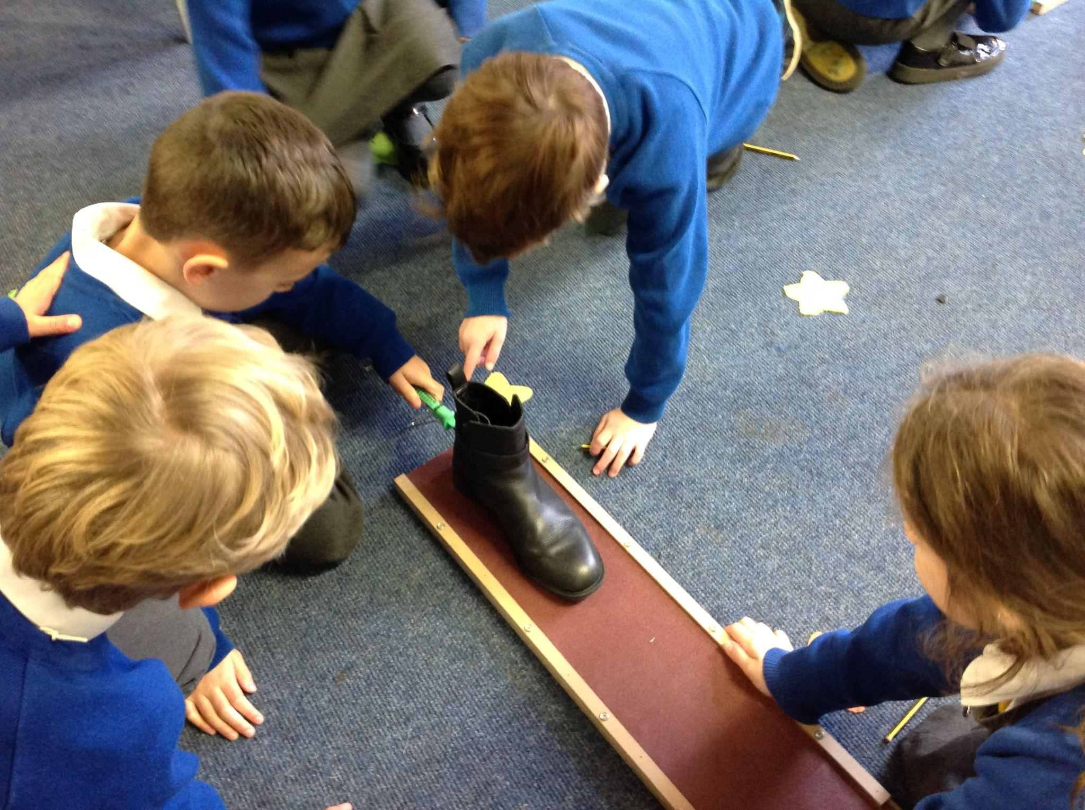
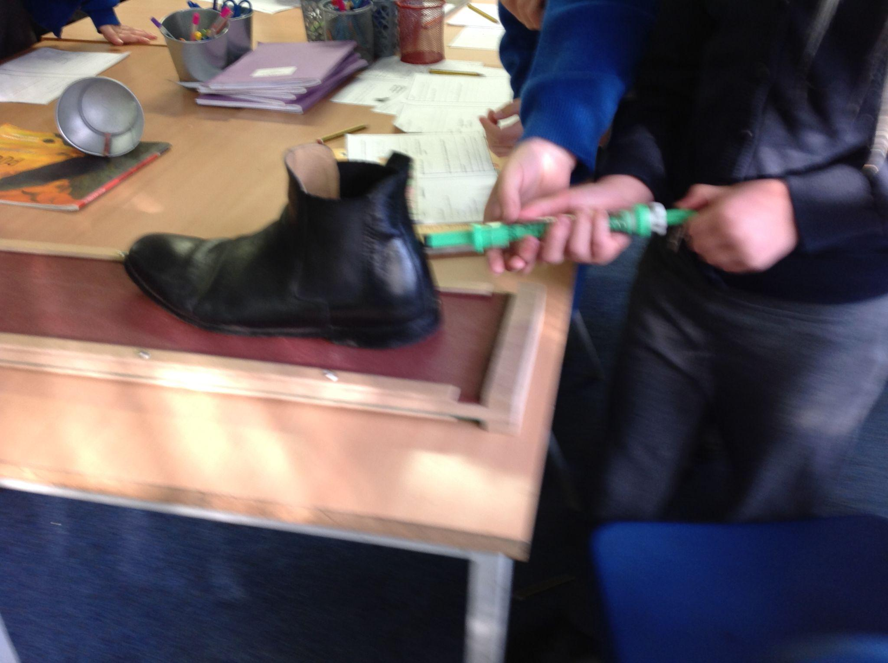
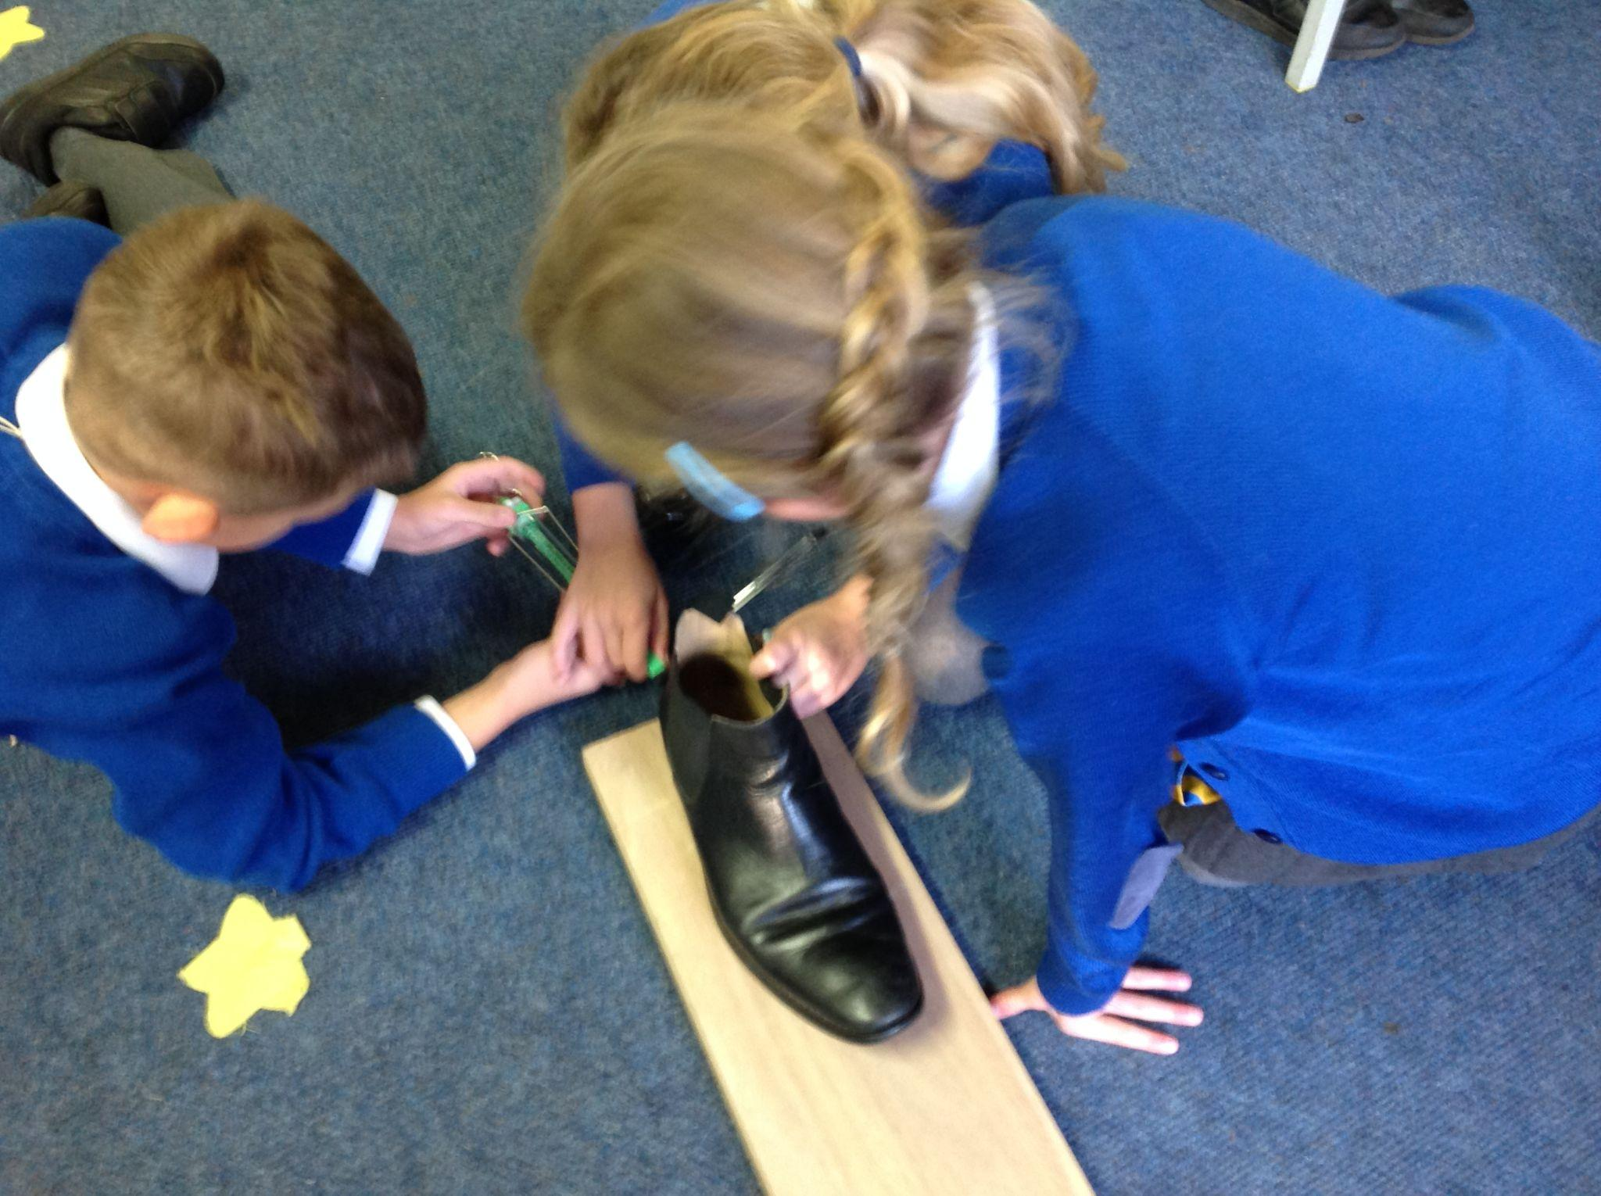
Which material would be good on the sole of Santa’s boot?
In Year 3 we received a letter from Santa explaining that he needs new boots that will help stop him slipping over on people’s floors when he delivers all the presents on Christmas Eve.
First, we found out why Santa sometimes slips. We discovered a force called Friction acts when two surfaces rub against each other. When there is a lot of friction you grip well but when a surface is smooth there is less friction - causing you to fall over easily! We tested different boots on different surfaces like; Sandpaper, wood, laminate, carpet and rubber.
We did this by investigating the amount of friction acting on the surfaces of the different boots and materials. If there is a lot of friction acting then the boots will grip better and Santa won’t slip over.

Slide 13
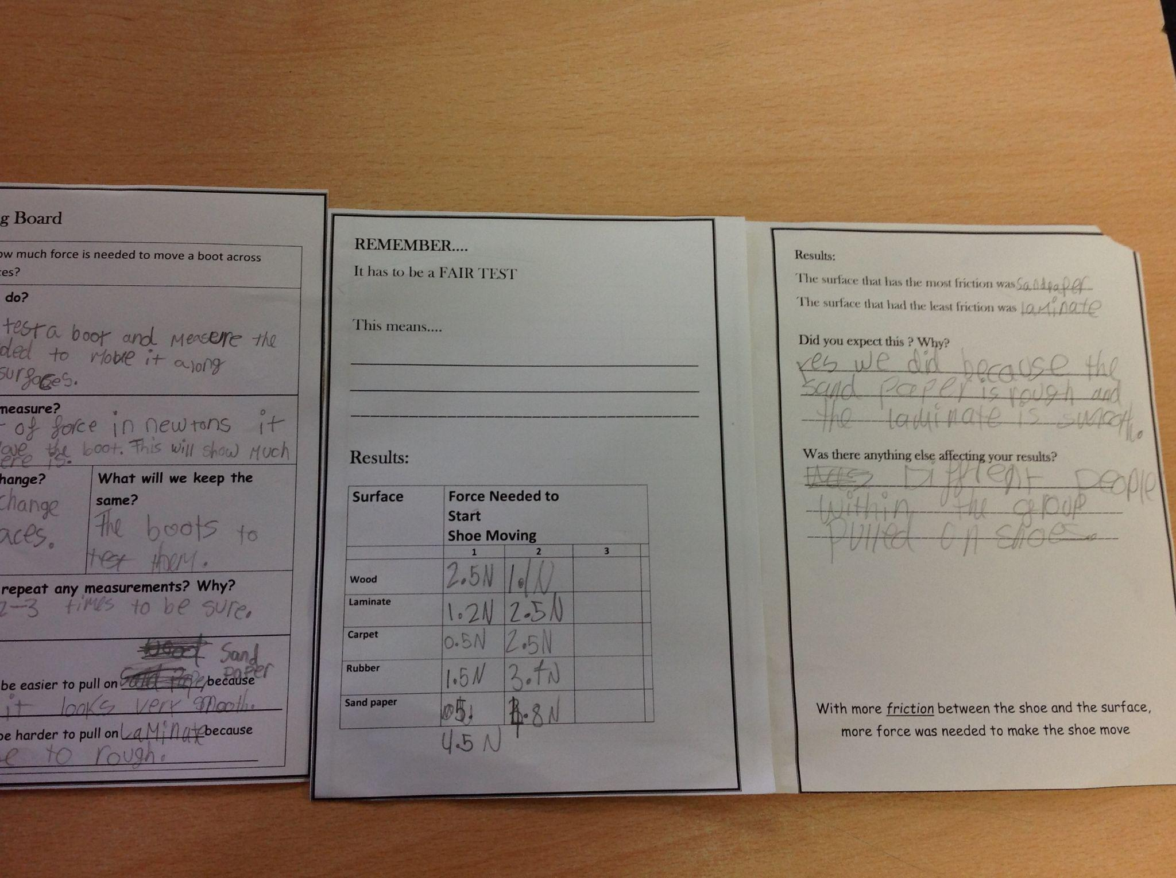
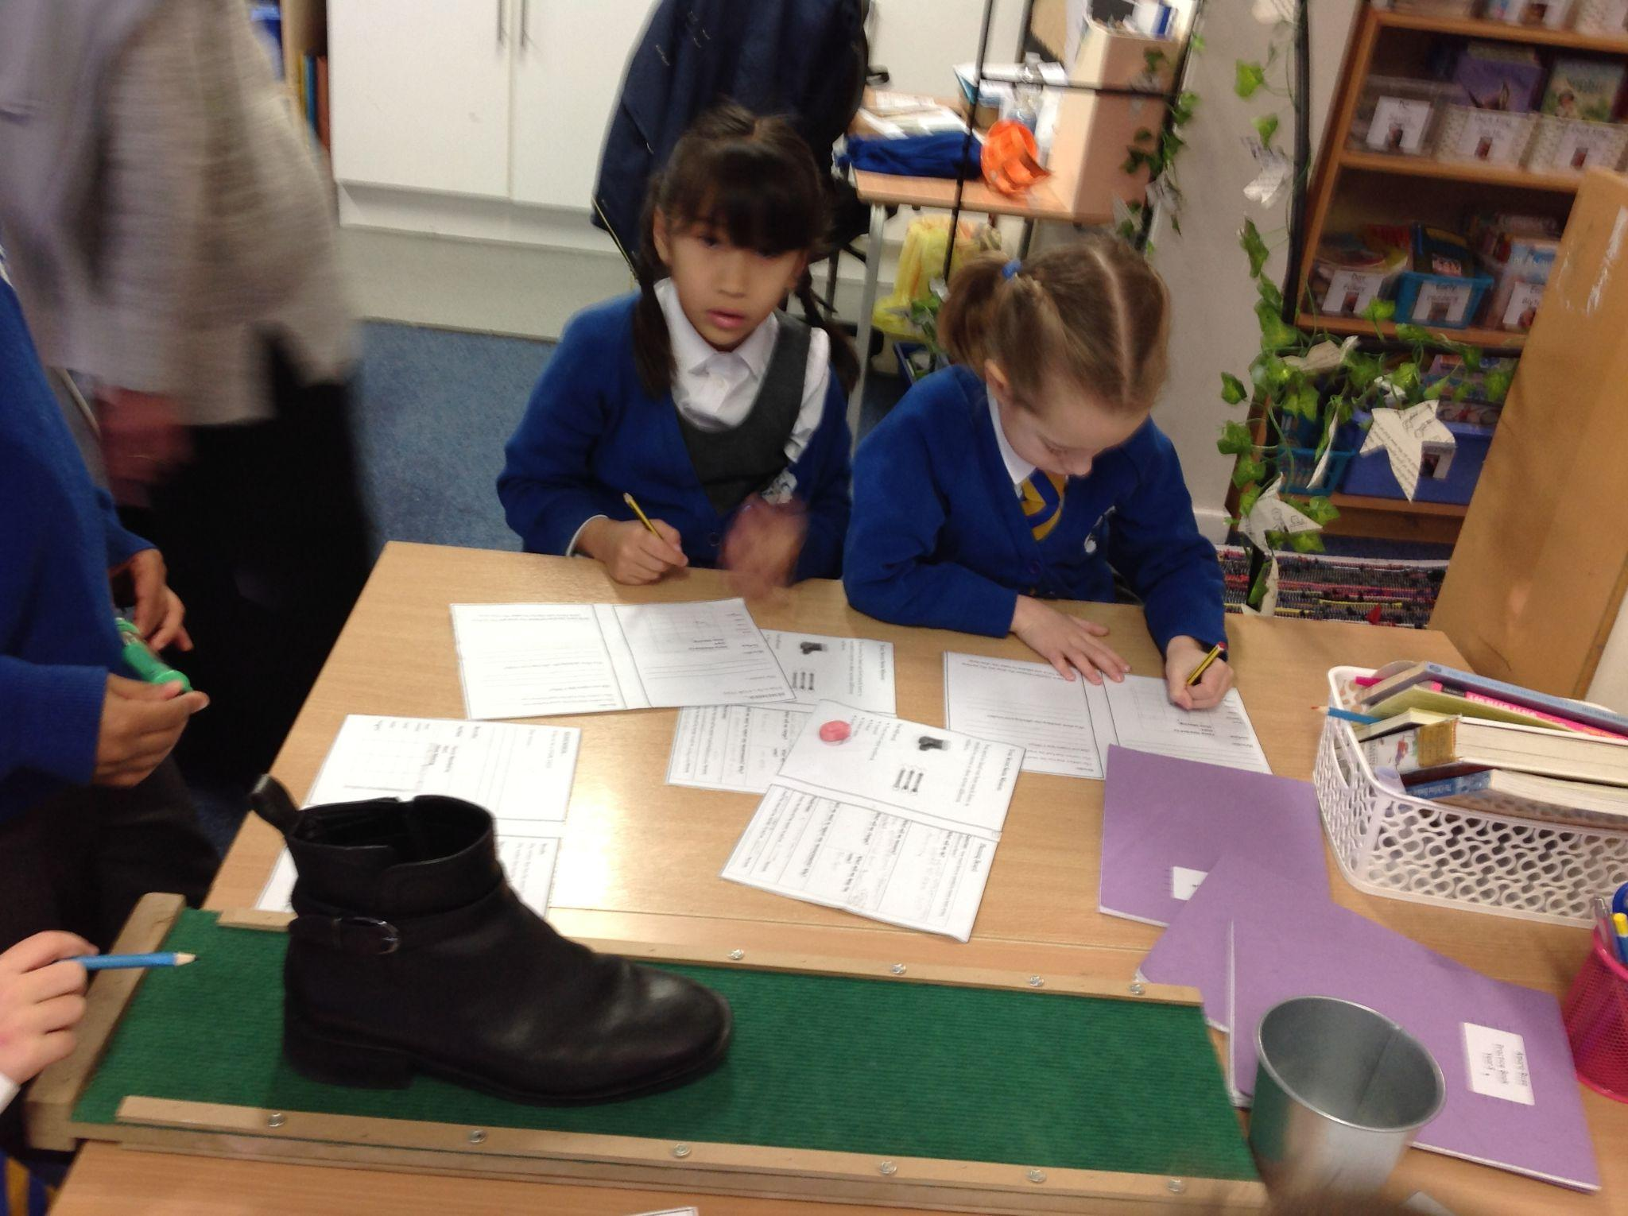
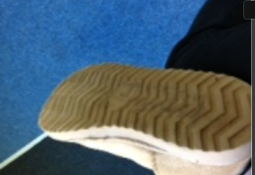
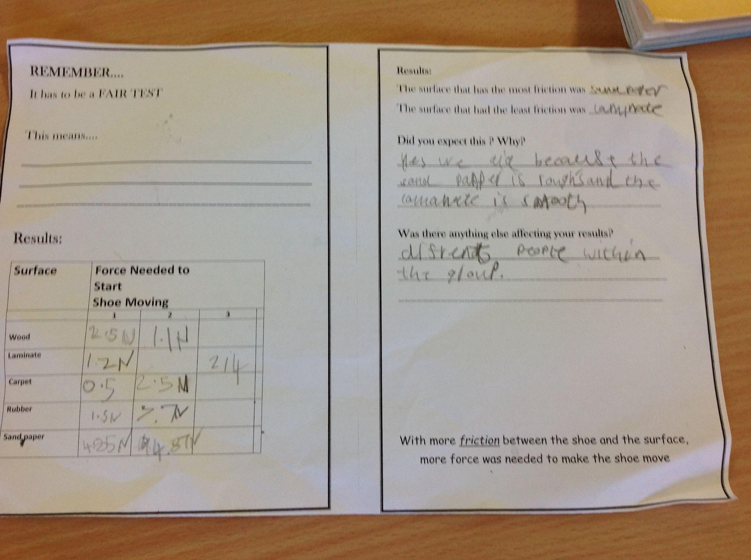
We found out that boots with a chunky grip that were rubber were better at gripping surfaces. because bumpy surfaces create more friction.
We also suggested that Santa could invent boots with sandpaper type grips. As this surface has the most friction of all those that we tested.
We discovered that boots with the smooth leather soles needed less force to move on the different surfaces. Because there is less friction which would make them more slippery!
So Santa needs big grippy boots made of rubber or sandpaper so that he does not slip and wake anybody up on Christmas Eve!

Slide 14
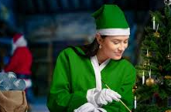
Year 4
Disaster has struck at the North Pole!
The lights on the sleigh have stopped working. The elf electricians are all in a muddle and have misplaced the circuit wires and need your help to create a new circuit so that the lights will work.
“Which materials conduct electricity well enough to light Santa’s sleigh?”

Slide 15
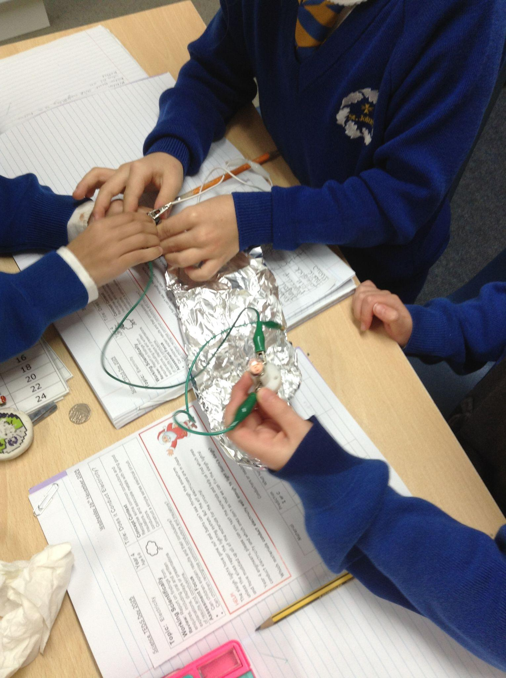
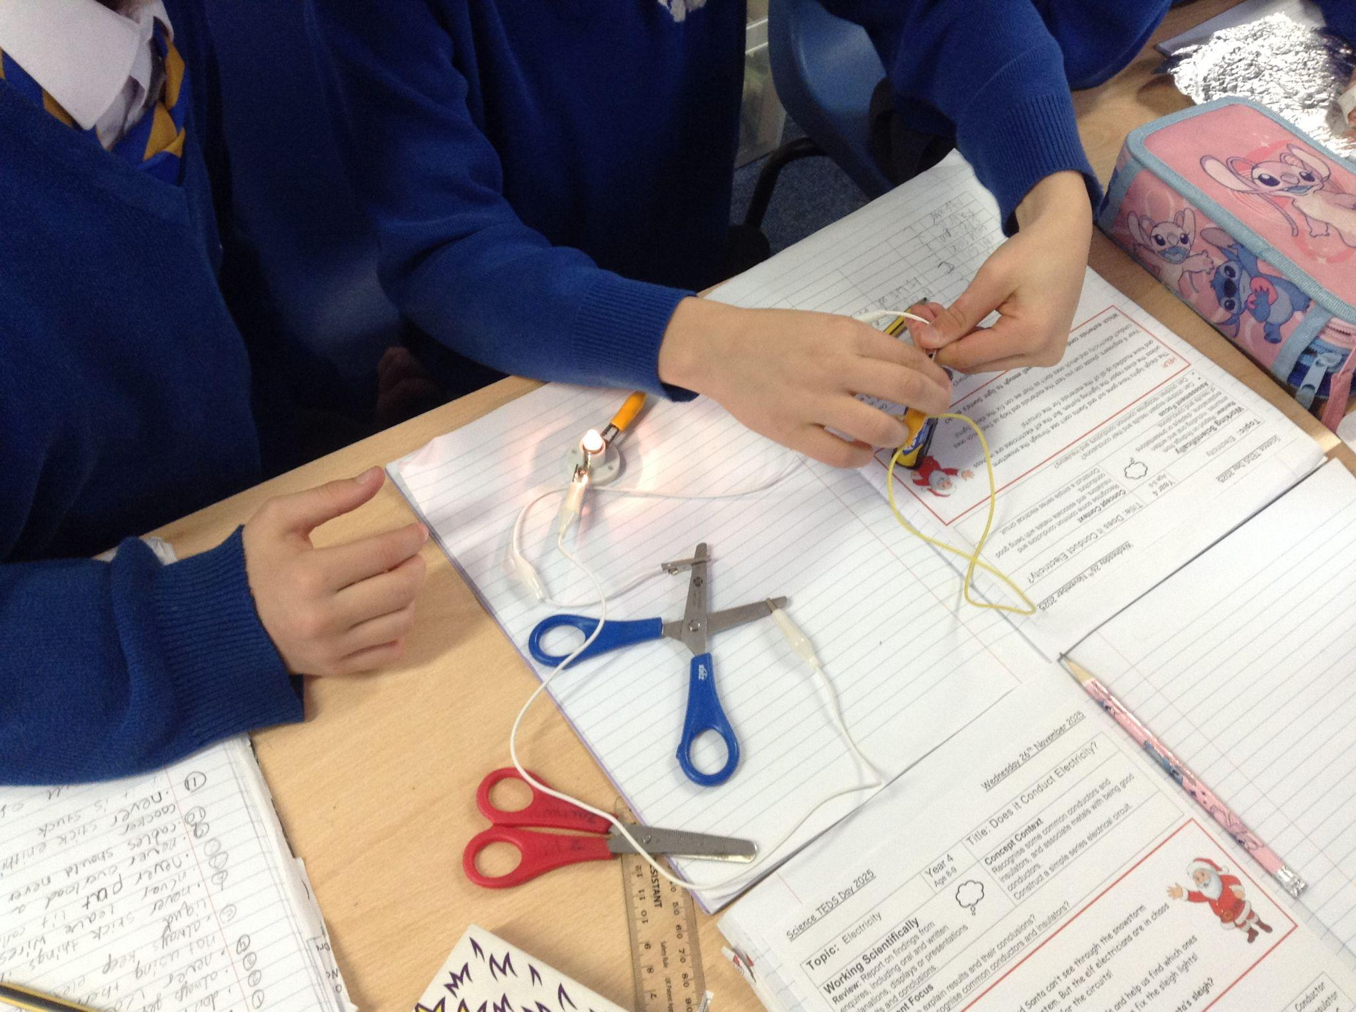
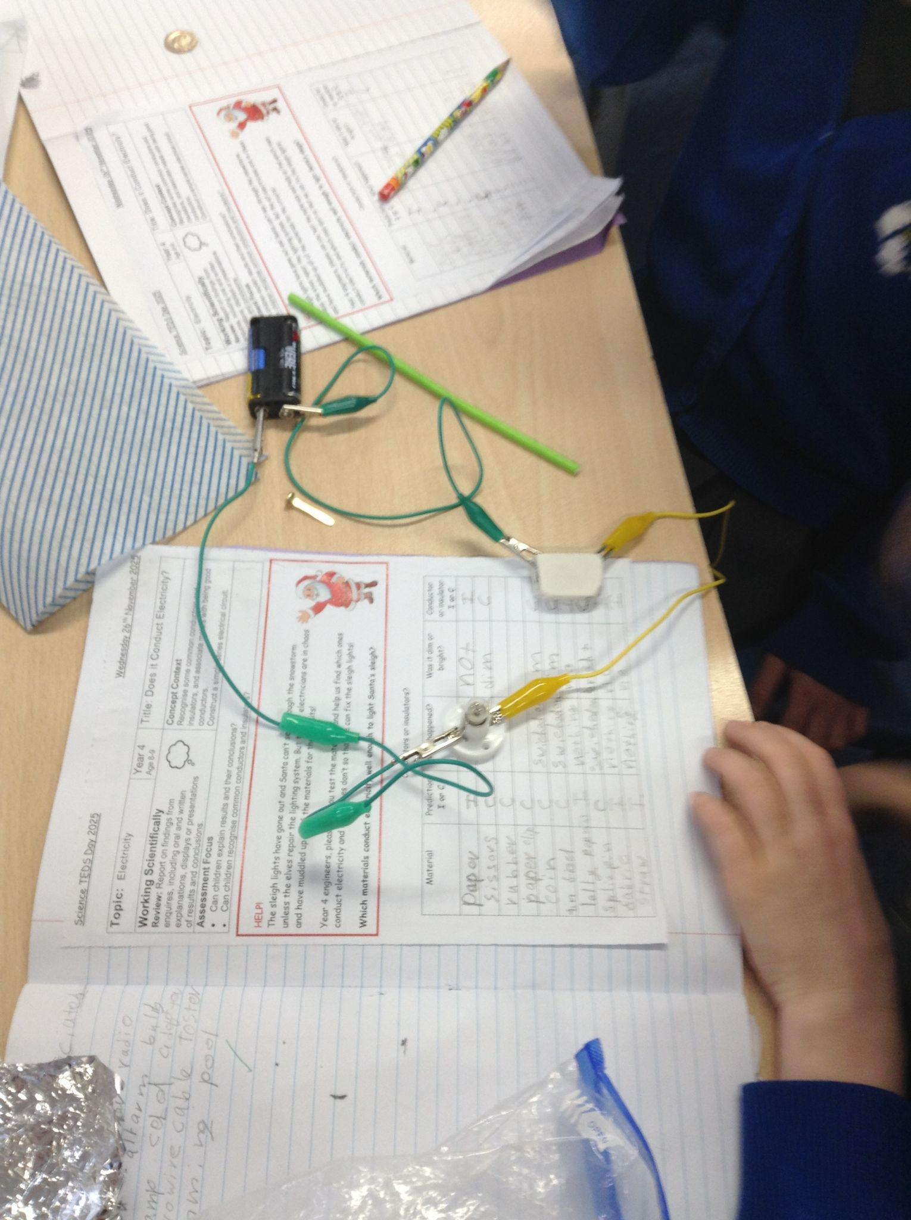
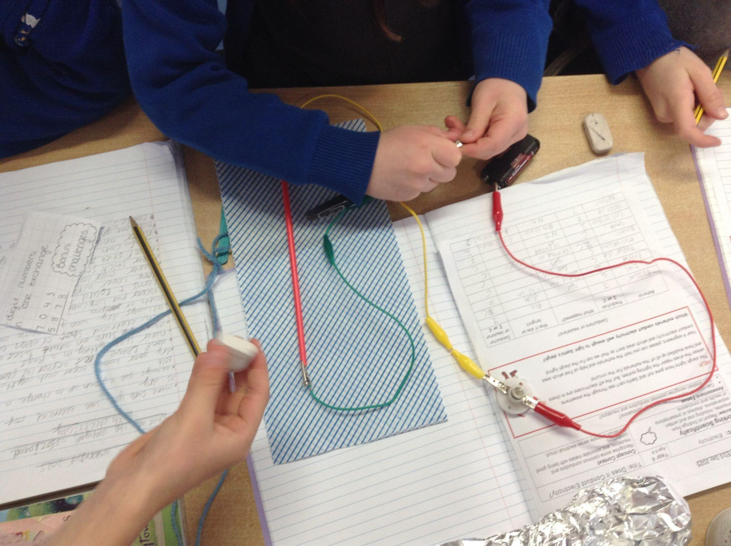
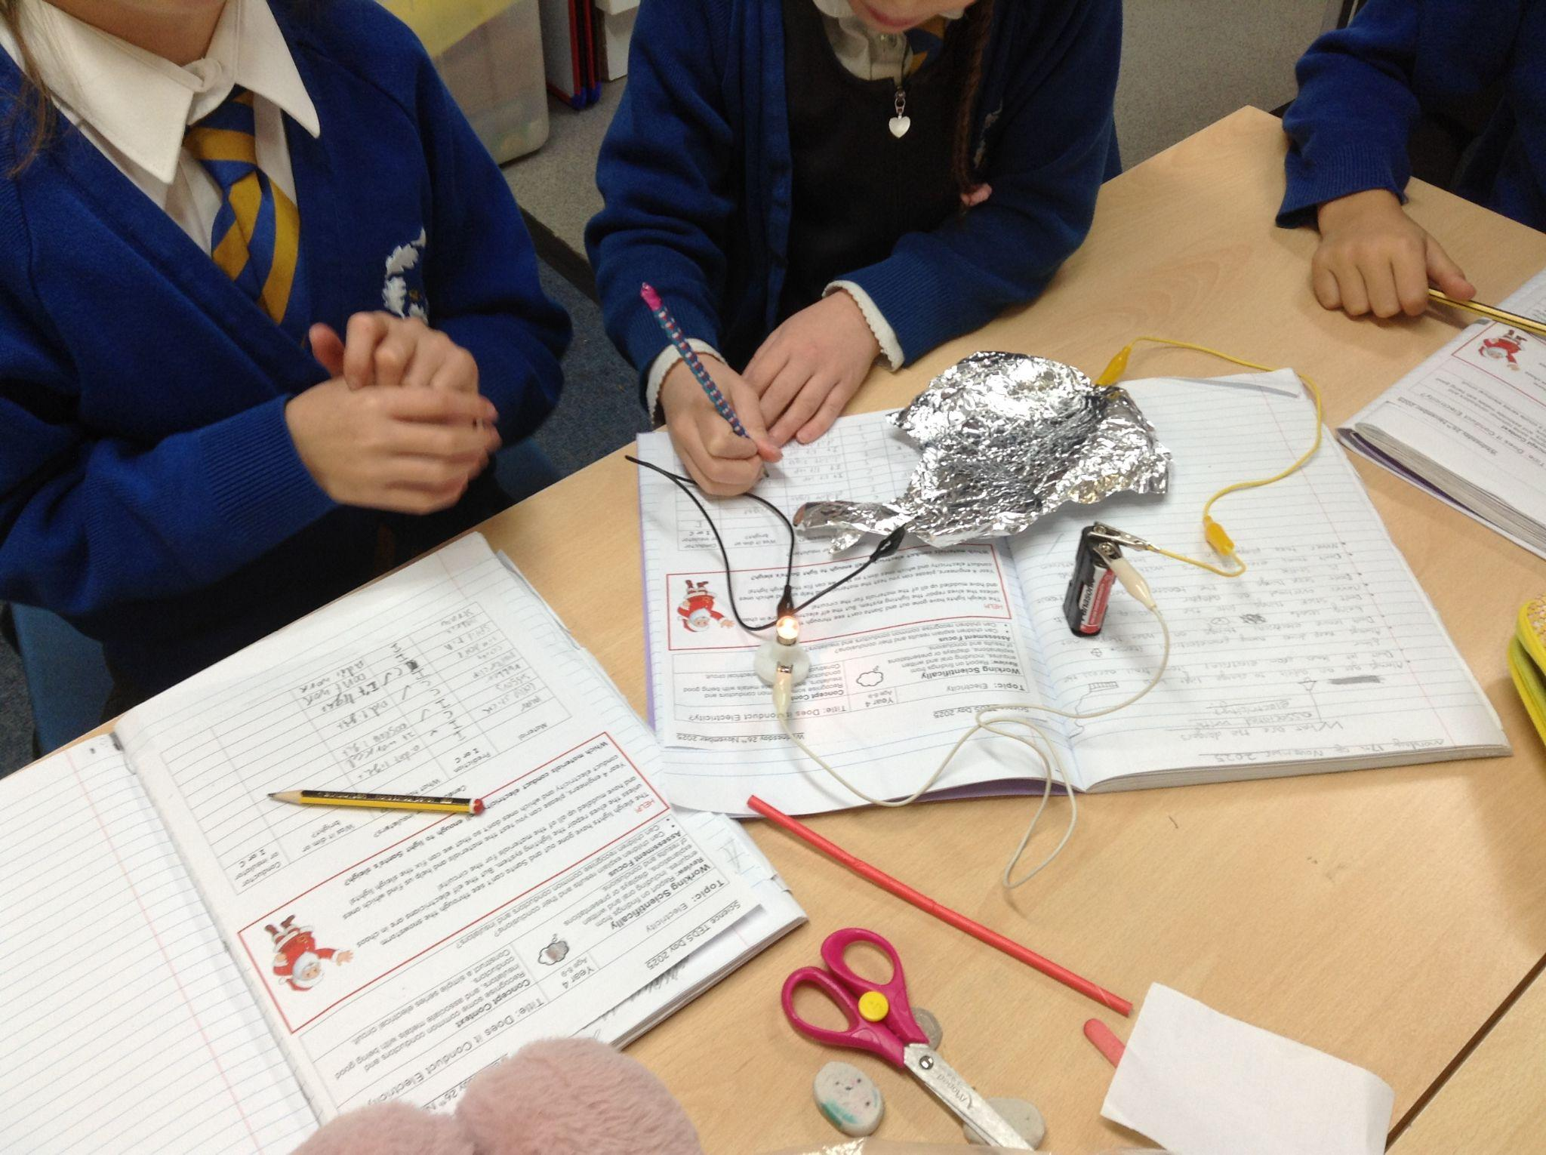
“Which materials conduct electricity well enough to light Santa’s sleigh?”
In Year 4 we tested lots of different materials to see which ones worked in a circuit to light up santa’s sleigh!
We found out that metal materials are conductors and they let electricity through and work in a circuit.
We wrote a letter of advice to Santa to suggest which materials to use to fix the lights on his sleigh!

Slide 16
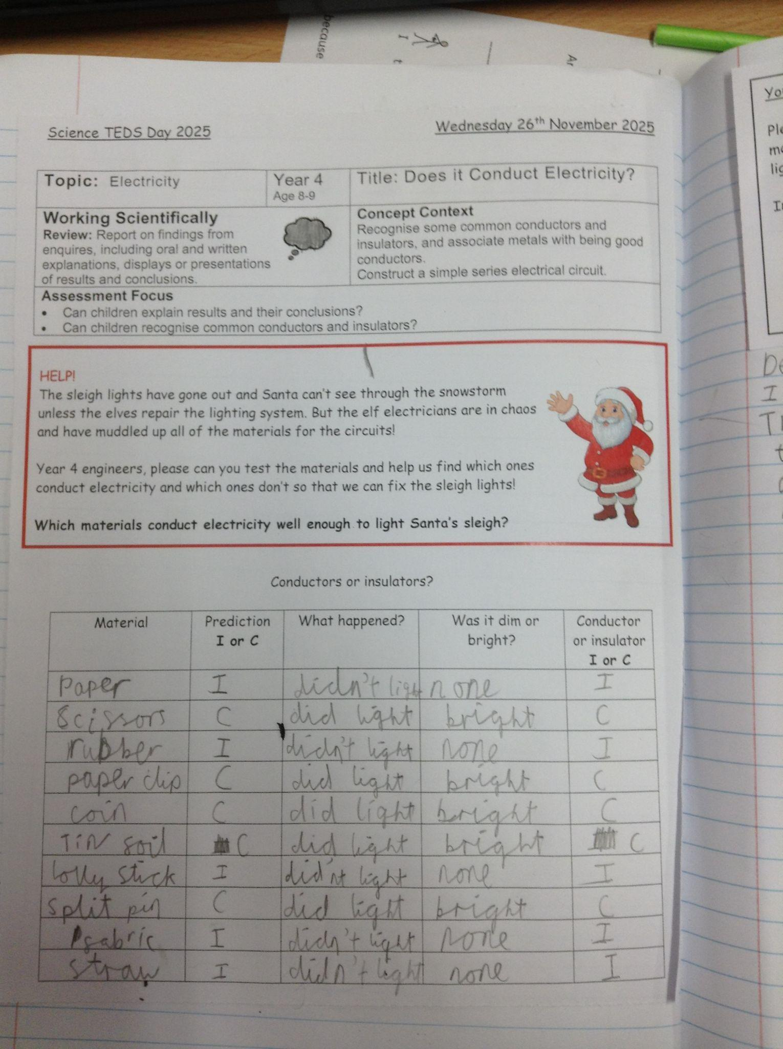
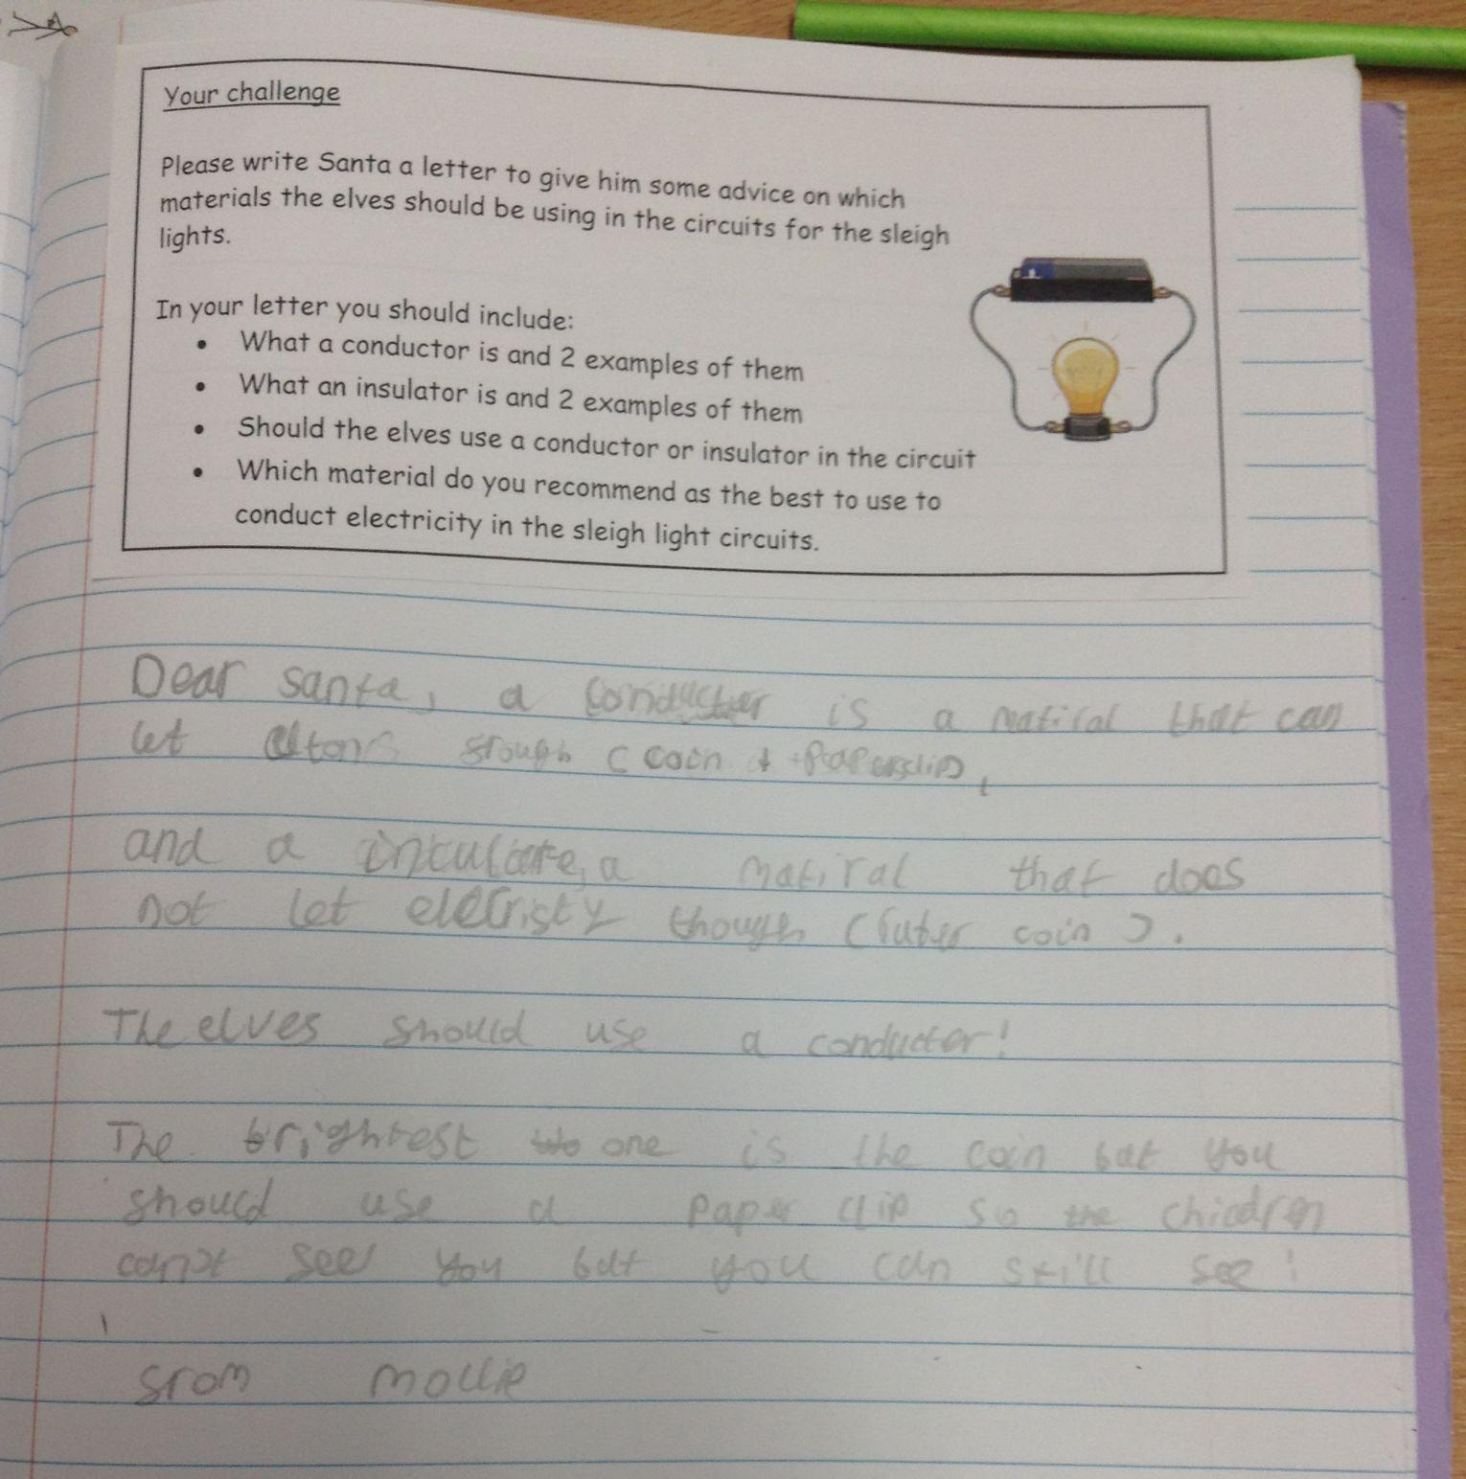

Slide 17

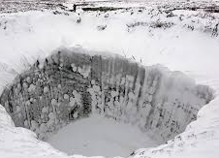

Year 5
Mysterious craters have appeared all around the workshop in the North Pole.
We need your help to investigate these craters.
What affects the size of a crater?

Slide 18

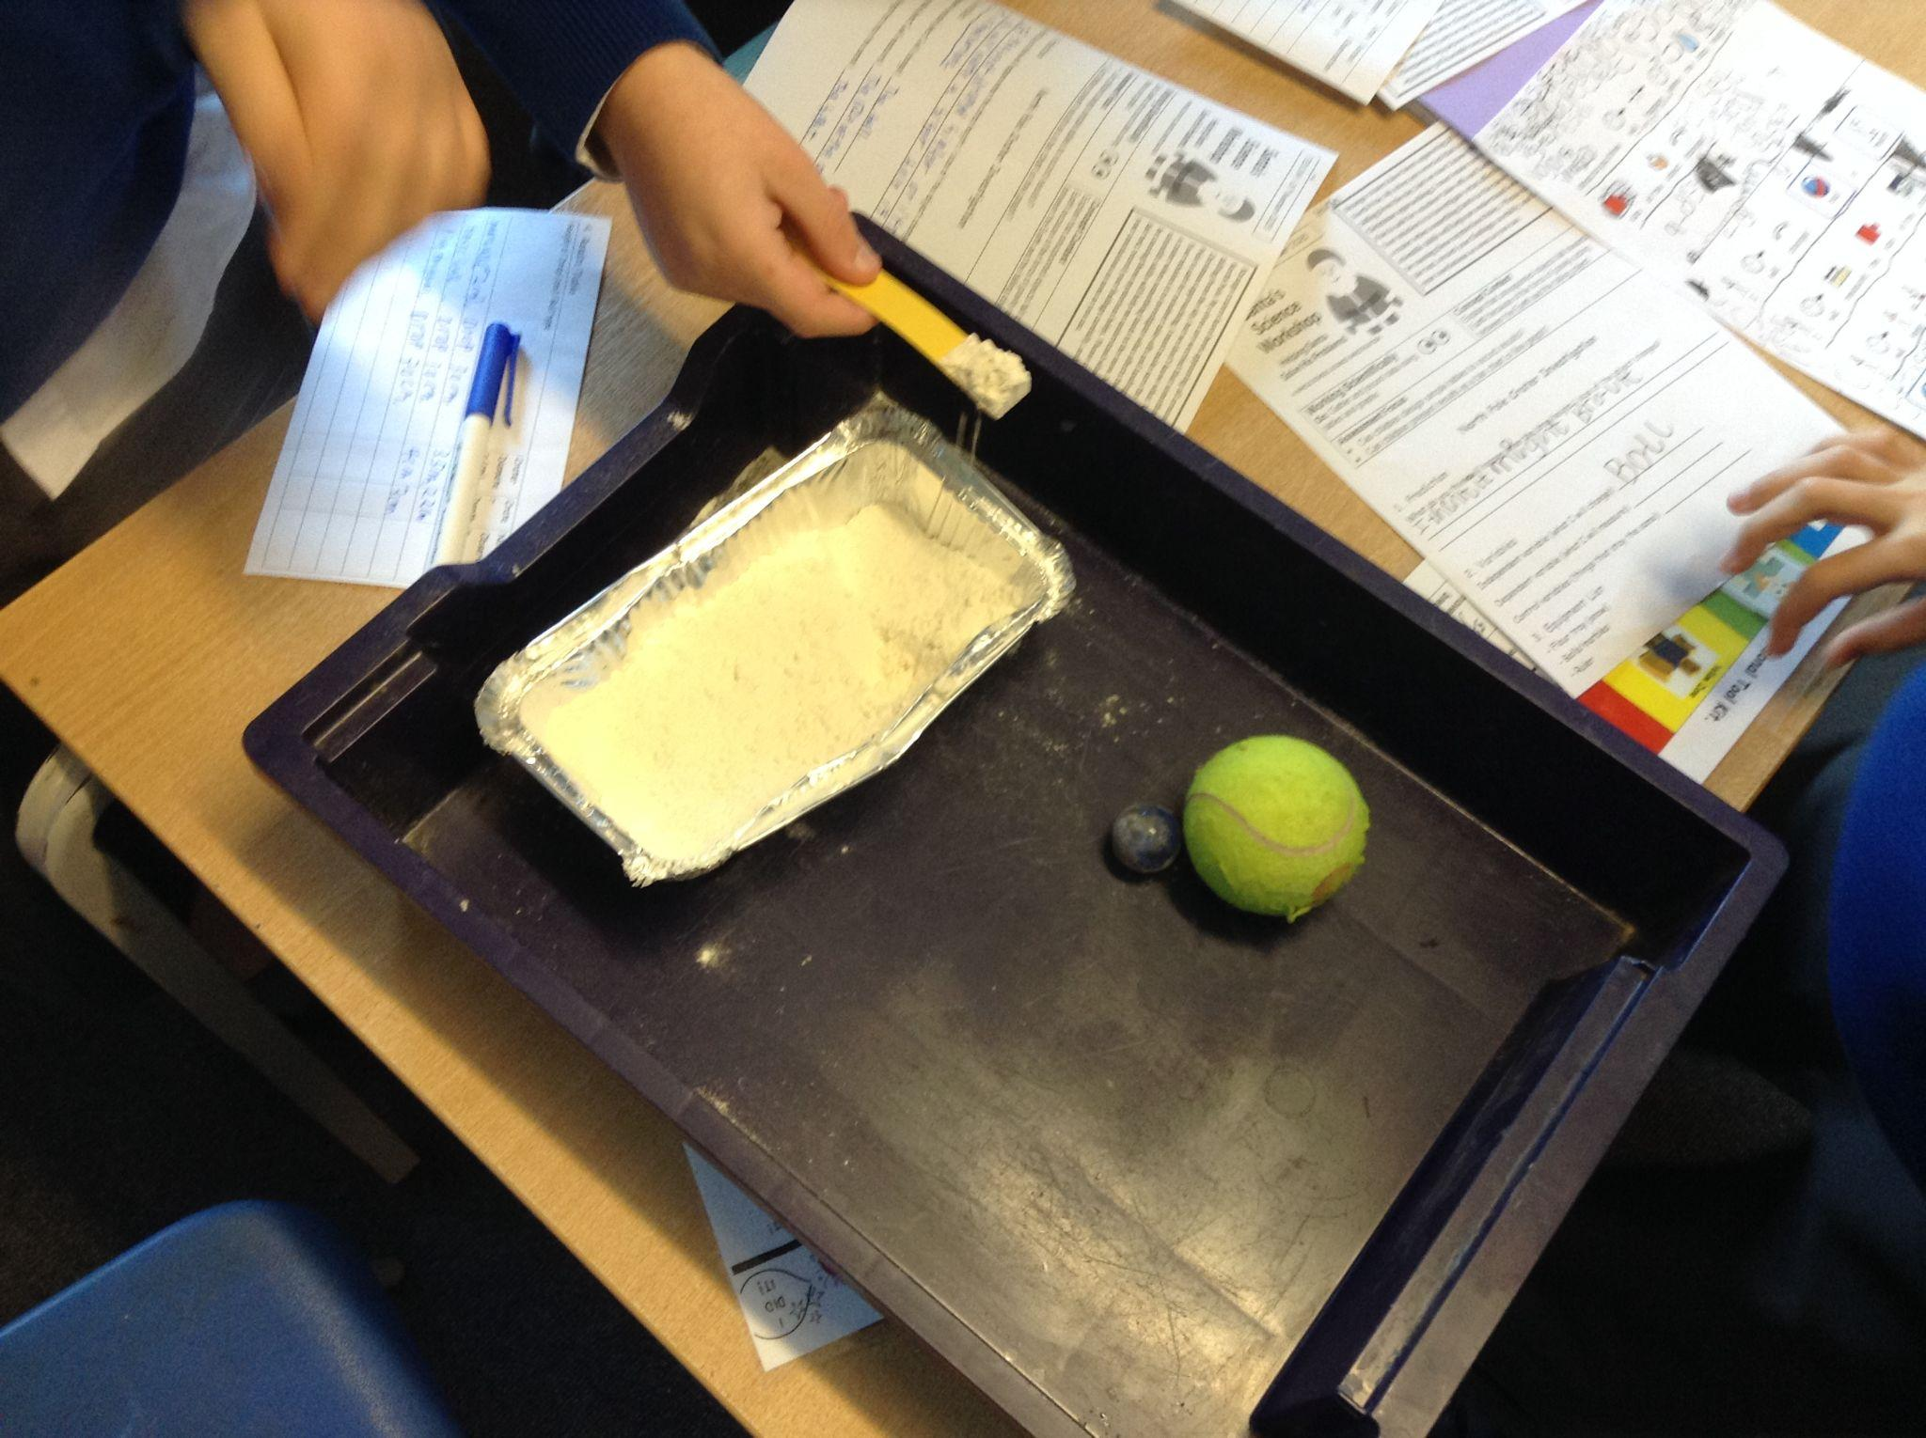
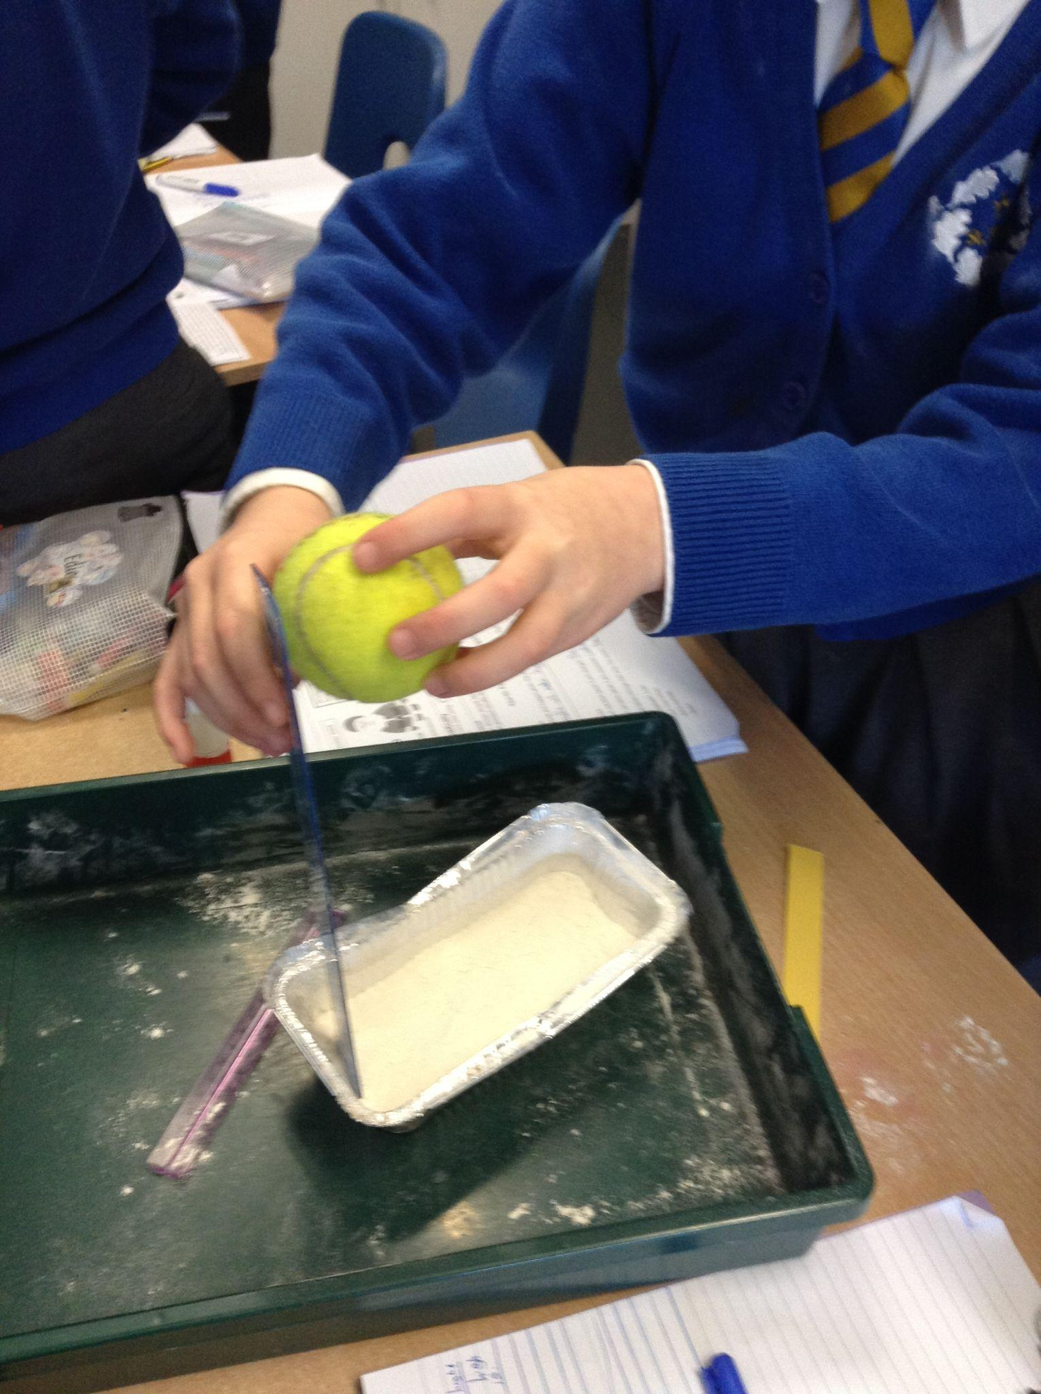
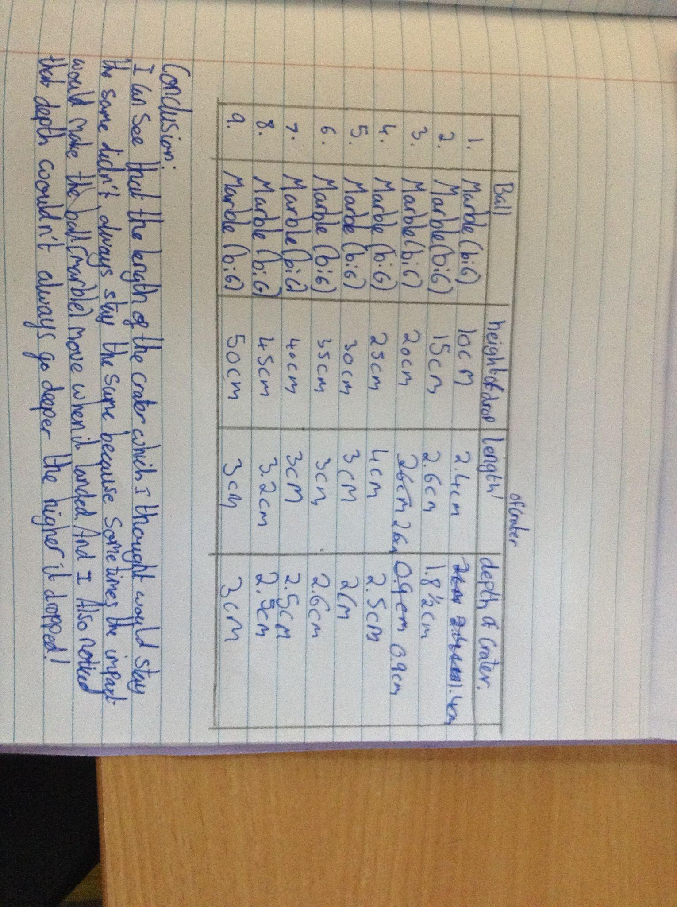
Year 5: What affects the size of a crater?
We used balls to be the model for an asteroid and flour to be the snow. We carried out fair tests in which we had a choice of changing the height that an object was dropped or changing the type of balls. We recorded our results in tables.
We discovered that a smaller, heavier object made a deeper crater . We also discovered that surprisingly the larger balls made wider craters but they were more shallow.
We also learnt that sometimes the crater was elongated in shape. We noticed this happening when we dropped a marble from higher up. We think that this happened because it fell at an angle.
Some of us wanted to measure the weight of the ball to see if that made a difference to the size of the crater. Heavier balls made deeper craters.

Slide 19
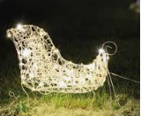
Year 6
An upgrade is needed for the sleigh so that it has a multi-light system .
There are problems.
Some of the bulbs are too dim…
Some are flickering…
And sometimes when one light goes out — all of them do!
I need Year 6 to investigate why!
How do different circuit components affect the sleigh lights?”

Slide 20
In year 6 we wanted to add more lights to Santa’s sleigh. We were testing what would affect the brightness of the bulbs. We decided to test the number of batteries to see what effect it had on the brightness of the bulbs. the children predicted that the more batteries the brighter the bulbs would be.
We had 5 bulbs in our circuit and we observed what happened each time a battery was added to the circuit.
Our results table shows that the brightness of the bulbs increased with the number of batteries that were used.
You can see how many of the 5 bulbs were lit up and how bright they were.
We decided that to make a brighter sleigh, we would need to increase the battery power.
Number of batteries | Brightness of bulbs
1 | ⅖ bulbs lit up and were very dim
2 | ⅗ bulbs lit upland were dim
3 | ⅗ bulbs were bright and ⅖ were very dim
4 | ⅗ bulbs were very bright and ⅖ were dim
5 | ⅗ bulbs were very bright and ⅖ were bright
6 | ⅗ bulbs were very bright and ⅖ were bright

