Slide 1


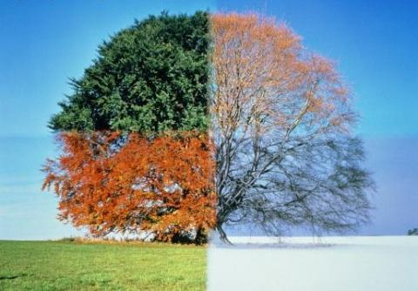
Term 3
Learning in Year 1
Toys
English
Sentence structure
Capital letters and full stops
Letter formation
Maths
Place value (within 20)
Count within 20
Understand 10
Understand the teen numbers
1 more 1 less
The number to 20
Estimate, order and compare
Addition and subtraction (within 20)
Add by counting on
Add ones using number bonds
Doubles
Subtract ones using number bonds
Subtraction – counting back
Finding the difference
Art
Painting and mixed media – Colour splash
Making colours and painting with colour
Printing with paint
Exploring colour mixing
Clarice Cliff plates
Science
Seasonal change
Think about what has changed in the seasons from Autumn to Winter
Look at how the day length changes across the different seasons
Look at how the trees change in the seasons, focusing on deciduous and evergreen
Look at what happens to the animals in winter
History
How have toys changed?
Discuss favourite toys using language related to the past
Ask questions about toys in the past
Make comparisons between toys in the past and present
Sequence artefacts from different periods of time
Describe how toys have changed over time
RE
Gospels
Matthew the tax collector
Recognise that a Gospel tells good news
Good news and peace
PE
Gymnastics
Ball Skills
Computing
Grouping data
Music

