Slide 1
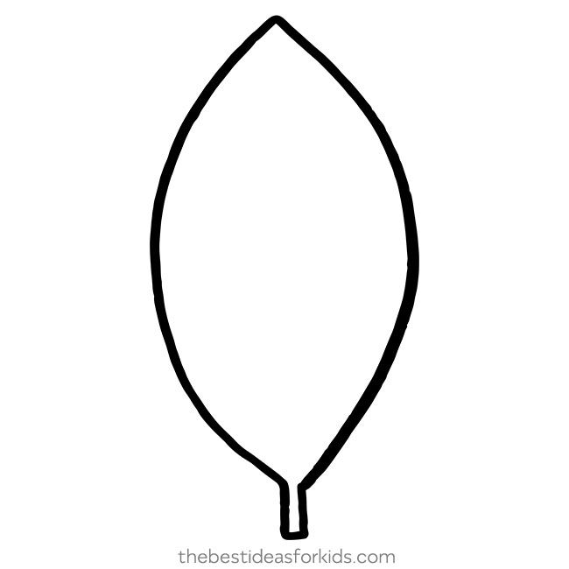

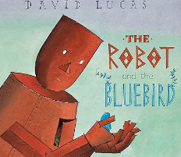

English
‘The Robot and the Bluebird’ and ‘After the Storm’
Orally composing sentences
Begin to write simple phrases
Letter formation
Finger spaces
Maths
Place value within 10
Sort objects
Count objects
Represent objects
Count forwards and backwards
Compare numbers using less than, greater than and equal to
Order objects and numbers
Addition and subtraction within 10
Use part-whole model
Write number sentences
Number bonds within 10
Number bonds to 10
Term 1
Learning in Year 1
Seasons
Art
Drawing: Making your mark
Can I explore and create different types of line?
Can I explore line and mark making to represent different seasons?
Can I develop an understanding of mark making?
Can I draw with different media to create a robot?
Science
Seasonal change
Observe changes across the four seasons
Observe and describe the weather associated with the seasons and how the day length varies
Computing
Computing systems and networks – technology around us
RE (What do Christians believe God is like?)
Can I retell The Lost Son story?
What is a parable?
Can I understand that God is loving and forgiving?
Is it good to forgive people?
How do Christians say sorry to God?
PE
Fundamentals
Forest School
History
All about me/Great Storm of Sevenoaks
What is my History?
How can I find out more about myself?
What was it like for children in the past?
Can I compare childhood now to childhood in the past?
Music
Active listening (movement)
Beat, march

