Slide 1


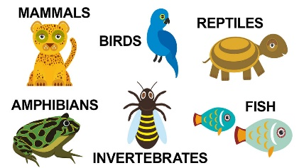
Term 4
Learning in Year 1
Animals
English
One Day On Our Blue Planet
Forming short narratives
Correcting mistakes when re reading
Simple joining words and clauses
Begin using exclamation marks and question marks
Capital letters for people, places and days of the week
Maths
Place value (within 50)
Count from 20-50
Understand 20, 30, 40 and 50
Partition into tens and ones
Estimate on a number line to 50
1 more 1 less
Length and height
Compare lengths and heights
Measure lengths using objects
Measure lengths using centimetres
Mass and volume
Heavier and lighter, full and empty
Measure and compare mass
Measure and compare capacity and volume
DT
Textiles: Puppets
Can I design my animal puppet and label the materials and joining techniques?
Can I cut out the fabric for my puppet and join the material together?
Can I embellish my puppet using decorative materials?
Can I evaluate my puppet against the design criteria?
Science
Animals
Identify and name a variety of common animals including fish, amphibians, reptiles, birds and mammals
Identify and name animals that are herbivores, carnivores and omnivores
Describe and compare the structure of a variety of common animals
Geography
What is the weather like in the UK?
Can I name and locate the four countries on a map of the UK?
Can I locate the four capital cities of the UK?
Can I observe and describe daily weather patterns?
What are the compass directions?
Computing
Creating media – digital writing
RE
Incarnation
Think about the message that the Easter story may have for us
Know how Christians celebrate Lent and Easter in church
PE
Fitness
Dance
Music

