Slide 1

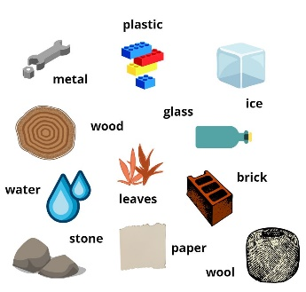
English
Grandad’s Island
Capital letters and full stops
Spelling of common exception words
Nouns, adjectives, verbs
Sequencing sentence to form an adventure narrative
Maths
Multiplication and division
Count in 2s, 5s and 10s
Recognise and add equal groups
Make arrays
Make doubles
Make equal groups by grouping and sharing
Fractions
Recognise and find half/quarter of an object or shape
Recognise and find half/quarter of a quantity
Geometry
Describe positions
Describe position (left and right, forwards and backwards)
Term 5
Learning in Year 1
Explorers
Art
Sculpture and 3D: Paper play
Roll paper tubes and attach them securely to a base
Shape paper strips in a variety of ways to make 3D drawings
Create a sculpture that includes several different techniques for shaping paper
Paint with good technique, ensuring good coverage
Science
Materials
Identify and name everyday materials
Describe simple properties of everyday materials
Sort objects according to their materials and properties
Distinguish between an object and the material it is made of
History
Explorers
What is an explorer?
Where gave explorers travelled and when?
Who was Christopher Columbus and what did he do?
Who was Matthew Henson and what did he do?
How has exploration changed?
How can we remember them?
RE
Judaism
Learn about the Jewish celebrations, beliefs and customs
PE
Invasion games
Athletics
Computing
Moving a robot (beebots)

