Slide 1

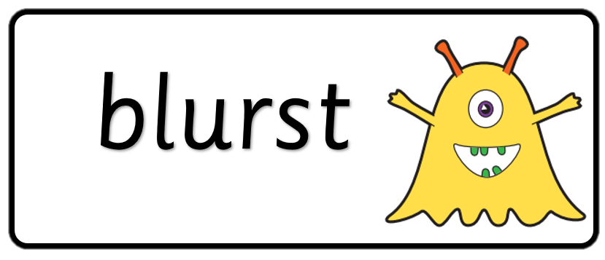

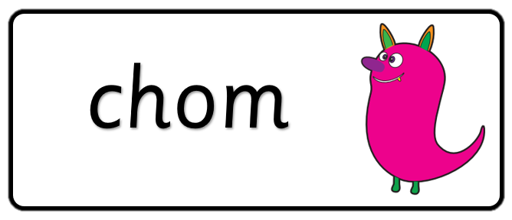

Key stage 1
Phonics Screening Practice
Set 1

Slide 2
Guidance
This document will help your child practise for the statutory phonics screening test.
It contains a mixture of real words and pseudo-words (nonsense words), just like the real test they will take in school.
All pseudo-words are accompanied by a picture of an imaginary creature. This provides context for the child (naming the type of imaginary creature) to ensure that they are not trying to match the pseudo-word to a word in their vocabulary.
Guidance

Slide 3

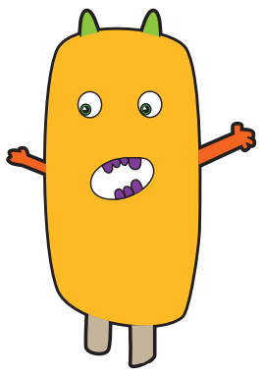


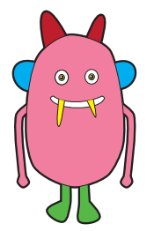



steck
hild
quemp
Page 1

Slide 4




zoo
sight
cloud
whip
Page 2

Slide 5
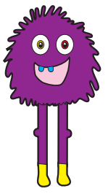

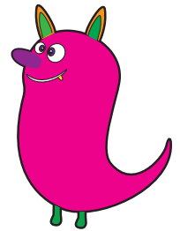

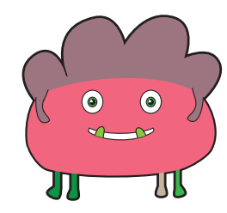



ulf
chom
tord
thazz
Page 3

Slide 6



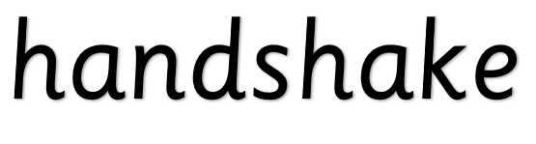
oyster
burger
text
handshake
Page 4

Slide 7
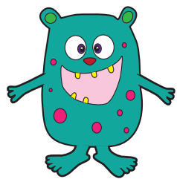



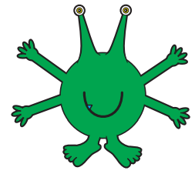



blan
tox
bim
vap
Page 5

Slide 8
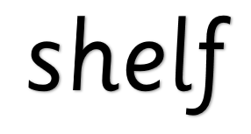



shelf
drawing
coin
photo
Page 6

Slide 9
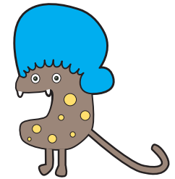


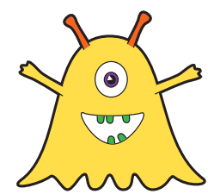
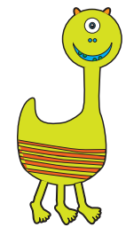

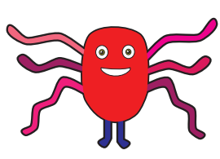

spron
blurst
voo
snemp
Page 7

Slide 10




skate
flute
straw
first
Page 8

Slide 11
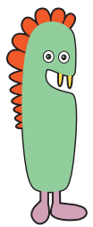
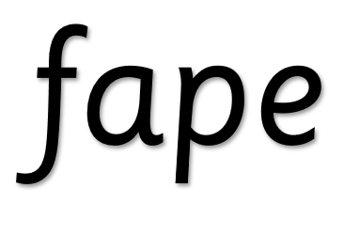



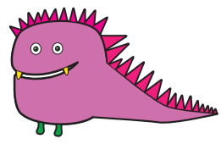


fape
jound
stroft
terg
Page 9

Slide 12




graph
script
glass
haircut
Page 10

