Slide 1
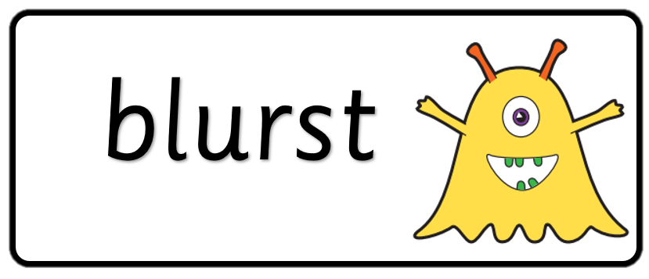

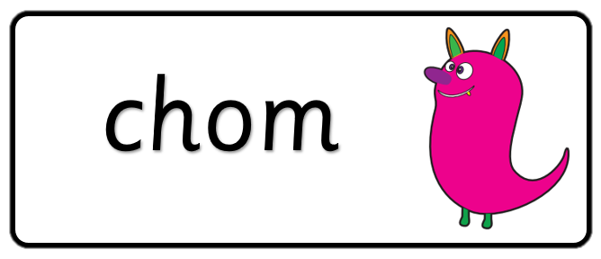

Key stage 1
Phonics Screening Practice
Set 2

Slide 2
Guidance
This document will help your child practise for the statutory phonics screening test.
It contains a mixture of real words and pseudo-words (nonsense words), just like the real test they will take in school.
All pseudo-words are accompanied by a picture of an imaginary creature. This provides context for the child (naming the type of imaginary creature) to ensure that they are not trying to match the pseudo-word to a word in their vocabulary.
Guidance

Slide 3
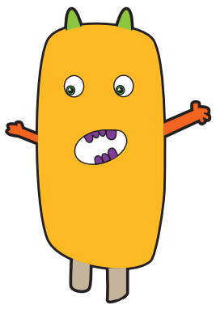



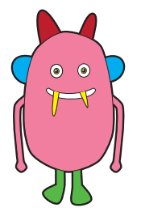



woid
ump
proy
yaup
Page 1

Slide 4




chill
start
best
grit
Page 2

Slide 5
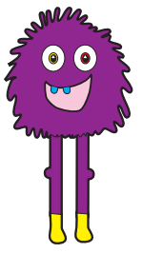

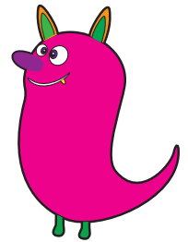
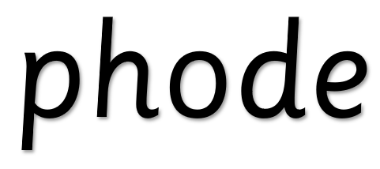
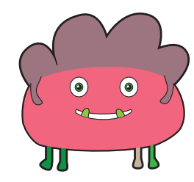



thisk
phode
scund
froe
Page 3

Slide 6




shin
gang
week
hooks
Page 4

Slide 7
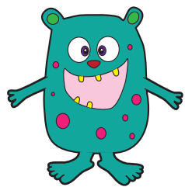



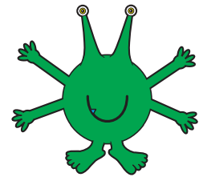



spirl
shrop
quape
Page 5

Slide 8




strap
trains
blank
scribe
Page 6

Slide 9
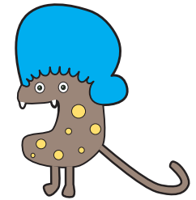

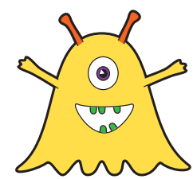

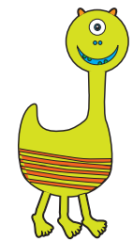


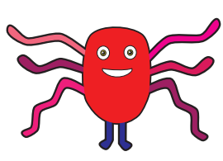
smizz
blinch
snoul
luft
Page 7

Slide 10




phone
rusty
dentist
starling
Page 8

Slide 11
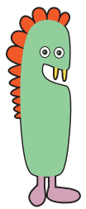




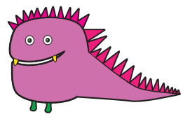
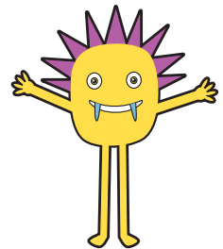

whunkey
prinker
thunk
grelt
Page 9

Slide 12




day
slide
newt
finger
Page 10

