Slide 1
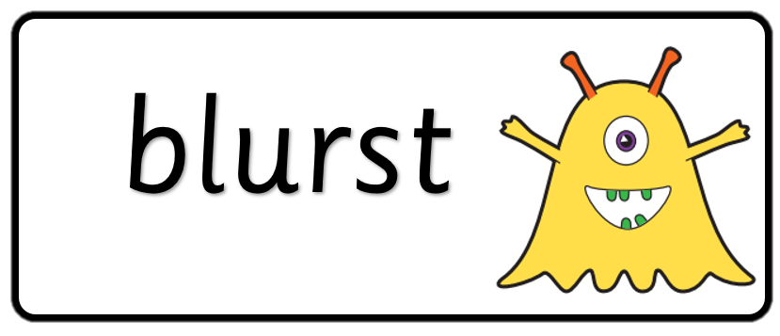

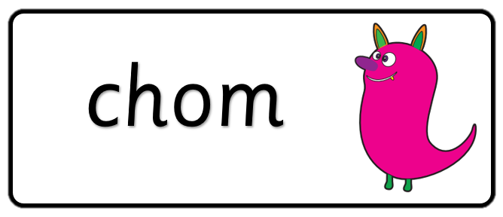

Key stage 1
Phonics Screening Practice
Set 3

Slide 2
Guidance
This document will help your child practise for the statutory phonics screening test.
It contains a mixture of real words and pseudo-words (nonsense words), just like the real test they will take in school.
All pseudo-words are accompanied by a picture of an imaginary creature. This provides context for the child (naming the type of imaginary creature) to ensure that they are not trying to match the pseudo-word to a word in their vocabulary.
Guidance

Slide 3
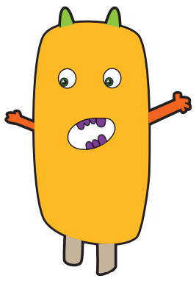



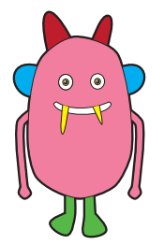



yoop
lazz
olf
quipe
Page 1

Slide 4




chain
mixer
drift
slide
Page 2

Slide 5
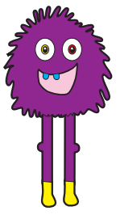

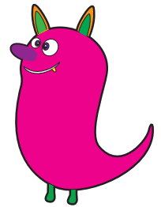

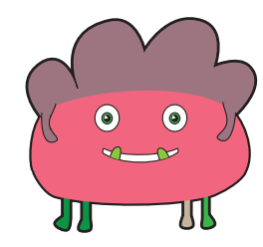



chirt
jimp
scroy
Page 3

Slide 6




pound
queue
jazz
newt
Page 4

Slide 7
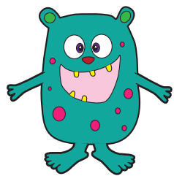

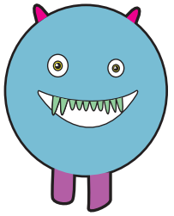
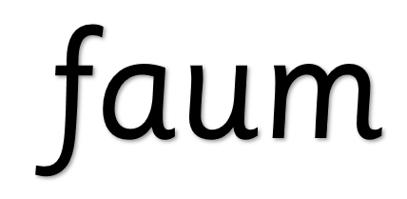
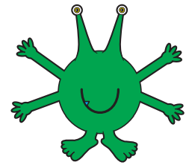



blies
faum
blate
spreet
Page 5

Slide 8




fuzzy
clown
crept
thump
Page 6

Slide 9
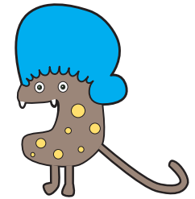

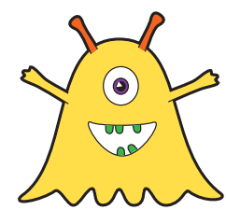

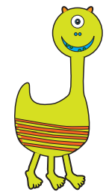


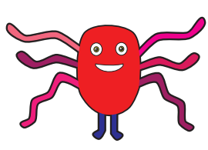
dox
melp
glisp
Page 7

Slide 10




fuel
knock
stroke
author
Page 8

Slide 11
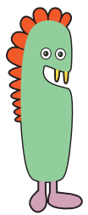




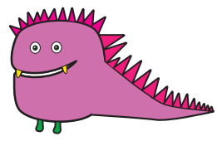


cripe
thoft
jigh
frue
Page 9

Slide 12




feeling
haystack
shortest
cabbage
Page 10

