Slide 1
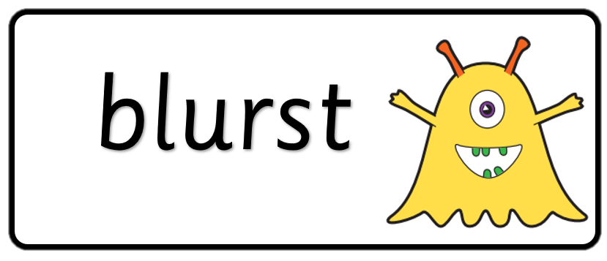

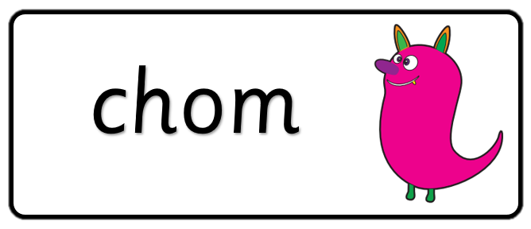

Key stage 1
Phonics Screening Practice
Set 4

Slide 2
Guidance
This document will help your child practise for the statutory phonics screening test.
It contains a mixture of real words and pseudo-words (nonsense words), just like the real test they will take in school.
All pseudo-words are accompanied by a picture of an imaginary creature. This provides context for the child (naming the type of imaginary creature) to ensure that they are not trying to match the pseudo-word to a word in their vocabulary.
Guidance

Slide 3
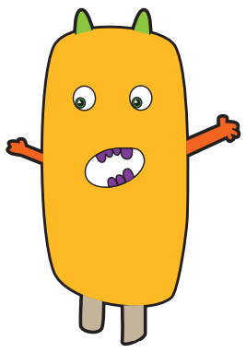



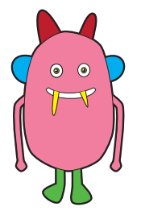

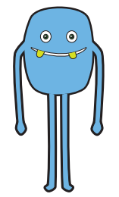

niff
pell
quazz
Page 1

Slide 4




slow
heat
glue
foot
Page 2

Slide 5
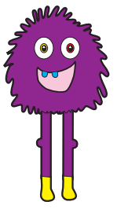

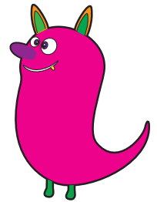

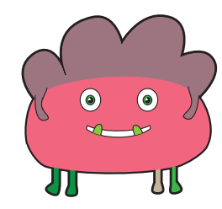

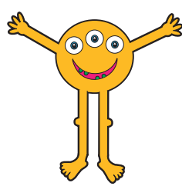
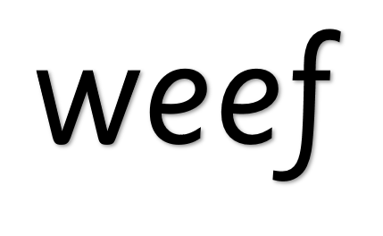
gick
jenk
baip
weef
Page 3

Slide 6




give
sore
few
toes
Page 4

Slide 7
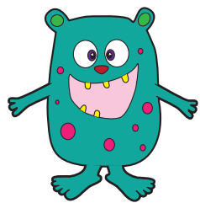

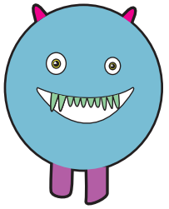

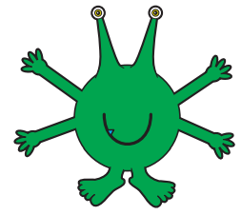

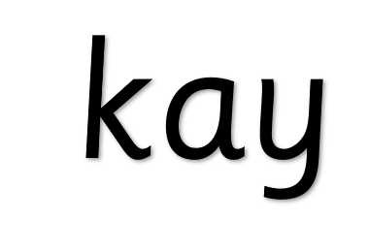

figh
soam
moot
kay
Page 5

Slide 8


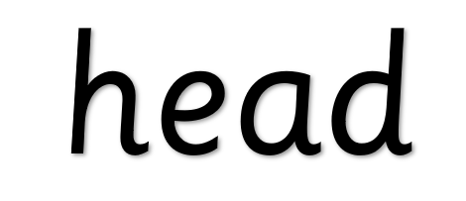

crown
ditch
head
tied
Page 6

Slide 9
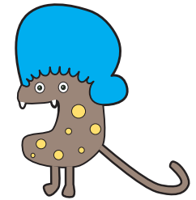

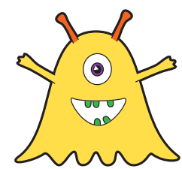

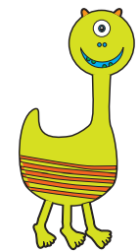


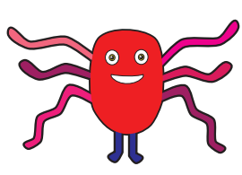
nairs
cribe
norst
Page 7

Slide 10




paw
twenty
loudest
belief
Page 8

Slide 11
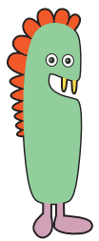




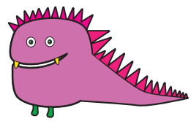
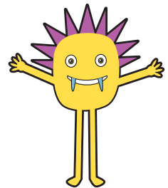

ploys
sloke
gutch
blard
Page 9

Slide 12




appear
include
better
person
Page 10

