Slide 1



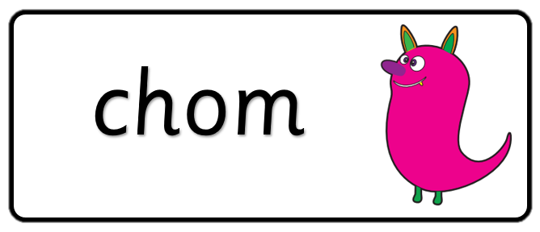

Key stage 1
Phonics Screening Practice
Set 5

Slide 2
Guidance
This document will help your child prepare for the statutory phonics screening test.
It contains a mixture of real words and pseudo-words (nonsense words), just like the real test they will take in school.
All pseudo-words are accompanied by a picture of an imaginary creature. This provides context for the child (naming the imaginary creature) to ensure that they are not trying to match the pseudo-word to a word in their vocabulary.
Guidance

Slide 3




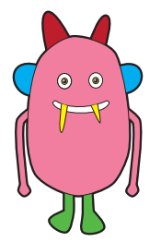



splurt
strig
spron
plonter
Page 1

Slide 4




snap
threw
slack
flake
Page 2

Slide 5
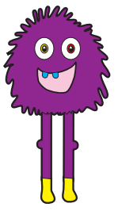

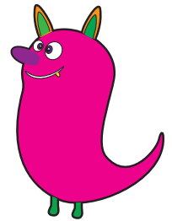

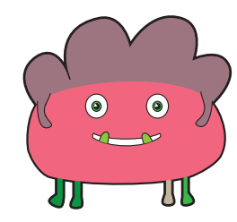



schel
stroft
quesh
thramp
Page 3

Slide 6




drain
flush
spring
block
Page 4

Slide 7
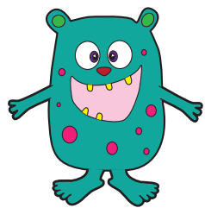







thazz
gox
wim
yup
Page 5

Slide 8




glad
zoom
snack
Page 6

Slide 9
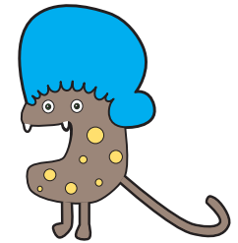



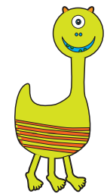

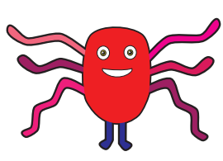

spret
gulk
joo
snomp
Page 7

Slide 10




drink
groan
spray
wrinkle
Page 8

Slide 11
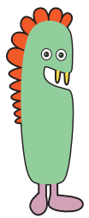







trape
kound
droy
werg
Page 9

Slide 12




should
snatched
blink
squint
Page 10

