Slide 1

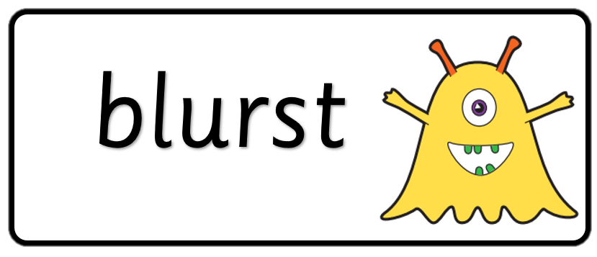
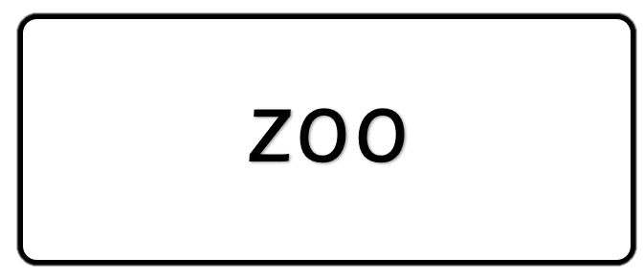
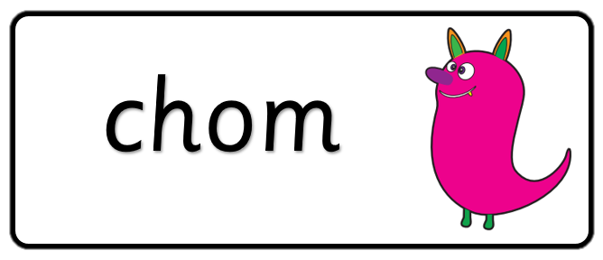
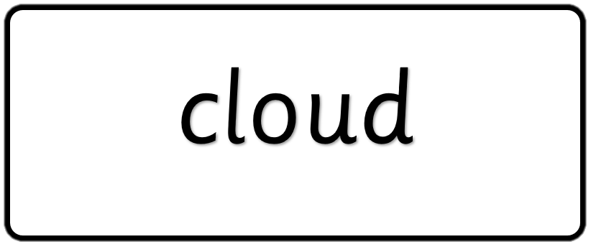
Key stage 1
Phonics Screening Practice
Set 6

Slide 2
Guidance
This document will help your child prepare for the statutory phonics screening test.
It contains a mixture of real words and pseudo-words (nonsense words), just like the real test they will take in school.
All pseudo-words are accompanied by a picture of an imaginary creature. This provides context for the child (naming the imaginary creature) to ensure that they are not trying to match the pseudo-word to a word in their vocabulary.
Guidance

Slide 3
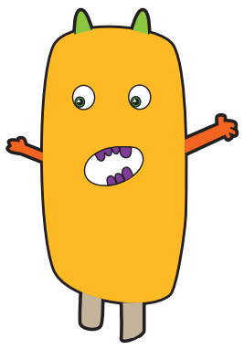



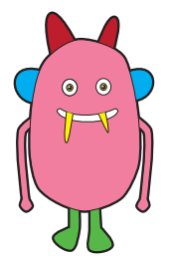


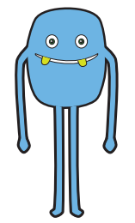
bim
tox
klape
gloy
Page 1

Slide 4




bike
cup
glass
ape
Page 2

Slide 5
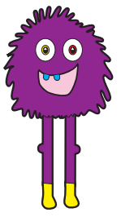

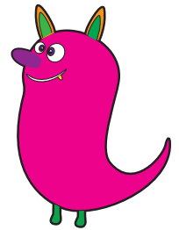

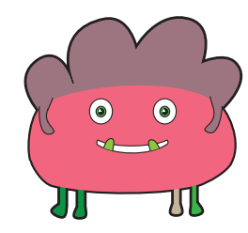



hoft
quesh
hoth
Page 3

Slide 6




train
board
sprout
cook
Page 4

Slide 7
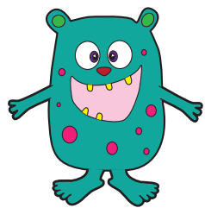


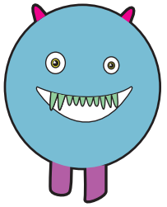




mizz
telp
fino
yox
Page 5

Slide 8




house
bush
scarf
elephant
Page 6

Slide 9

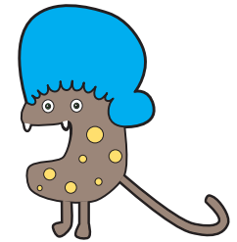

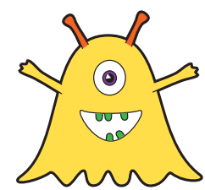
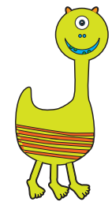


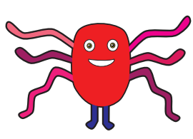
drap
nilk
yape
Page 7

Slide 10




crayon
monkey
queue
dimple
Page 8

Slide 11
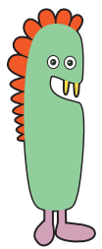




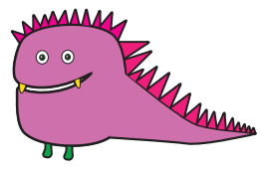


drope
boud
tury
porg
Page 9

Slide 12




ghost
tree
bigger
lamp
Page 10

