Slide 1
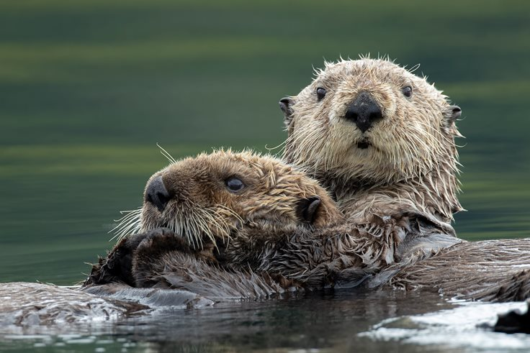
Welcome to Year 3
Otters’ Class

Slide 2


Meet the Team:
Mr Tudor and Miss Barrows
Fulltime TA – Miss Jefferies
All week

Slide 3
BBC Bitesize KS2 — Clear short videos, games, and activities across all subjects.
Topmarks — Excellent interactive maths games and English activities.
ICT Games — Simple, engaging literacy and numeracy games (very KS1/KS2 friendly).
Oxford Owl — Free eBooks and reading guidance (great for reading practice at home).
NRICH Maths — Rich problem-solving tasks (more challenging, good for reasoning).
TTRS – maths

Slide 4

The week in Year 3:
Everyday - Maths and English
Once a Week - Science, History/ Geography, Art/D.T., R.E., P.S.H.E., French, Music, Computing, P.E.
Throughout the week (shorter sessions) – Handwriting, Spellings, Grammar, Whole class reading skills, Times Tables

Slide 5

SEND Learners:
Thorough handover with the Year 2 team about the needs of all the children
Adaptive teaching – allowing the children to access the same work as the rest of the class with adaptations
Use of widgits/ visual cues
Movement breaks, fidget toys, wobble cushions to be provided by school when necessary
Zones of Regulation

Slide 6

Homework:
Spellings –Spelling Shed
Maths – MyMaths app
Reading – Banded books, record in reading record – at least 4 times a week.

Slide 7

Other things to know:
Behaviour policy – Class and school rules, positive, use reminders, warnings and restorative sanction
P.E. kit to be kept in school
Waterbottle
No need for pencil case or
equipment, we will provide
everything needed
Contact us by using…..
Label everything!

Slide 8
Any questions?

