Slide 1
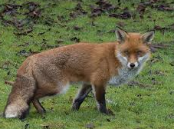

Meet the Teacher
Year 5 FOX CLASS 2026- 2027

Slide 2
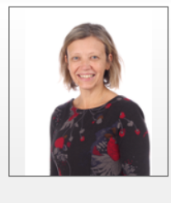
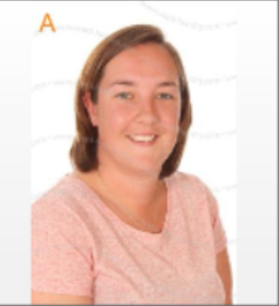
Welcome to FOX CLASS
Class teachers: Mrs Bev Casewell (Mon-Thurs) and Mrs Danielle Hollands (Fri)

Slide 3
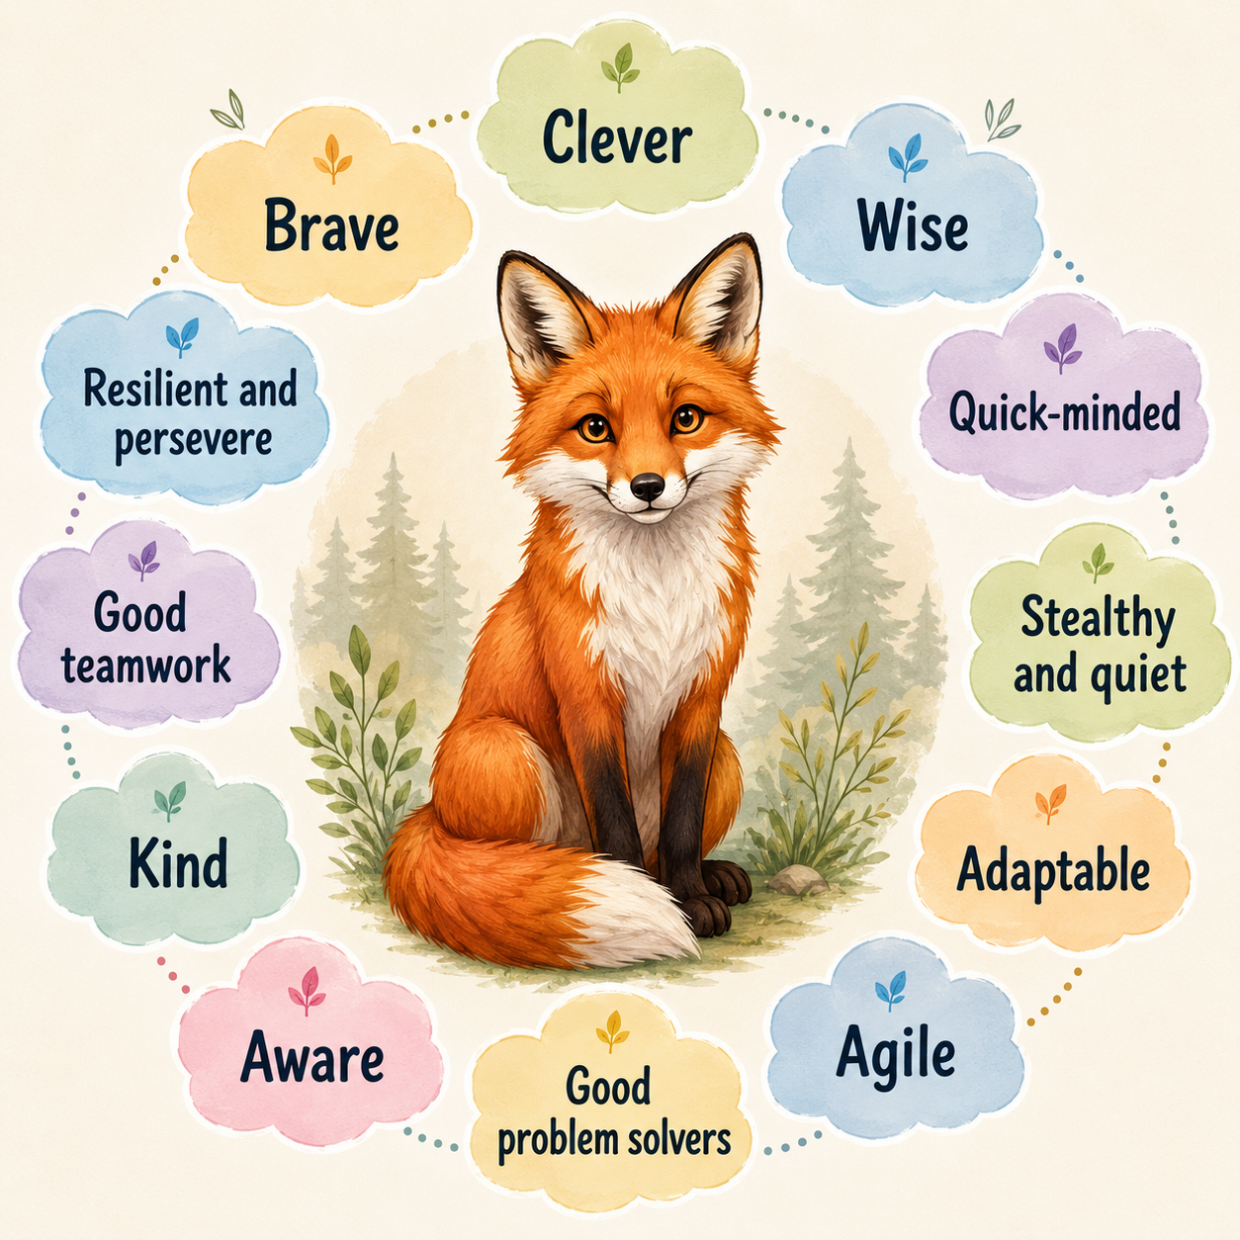
Our class characteristics

Slide 4
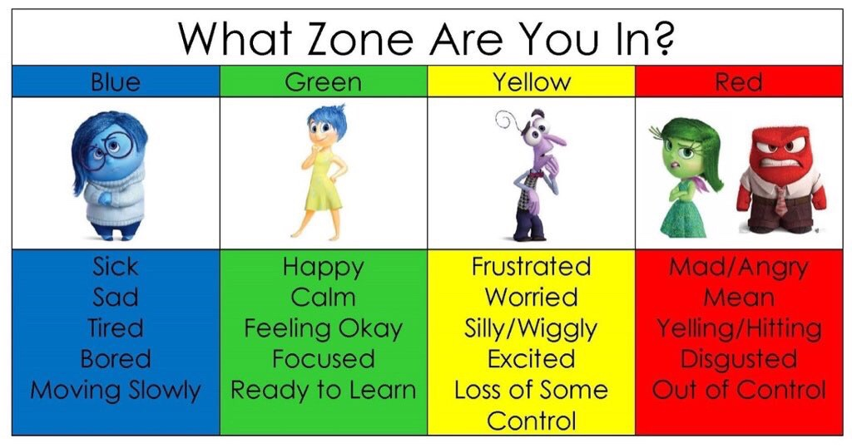
Zones of Regulation
Zones of Regulation
Children will be reminded of our strategies to self-regulate so that they can manage their emotions and behaviour. This will enable everyone to be in the appropriate zone for learning and for having a good day at school.
You may want to refer to these zones at home too!

Slide 5
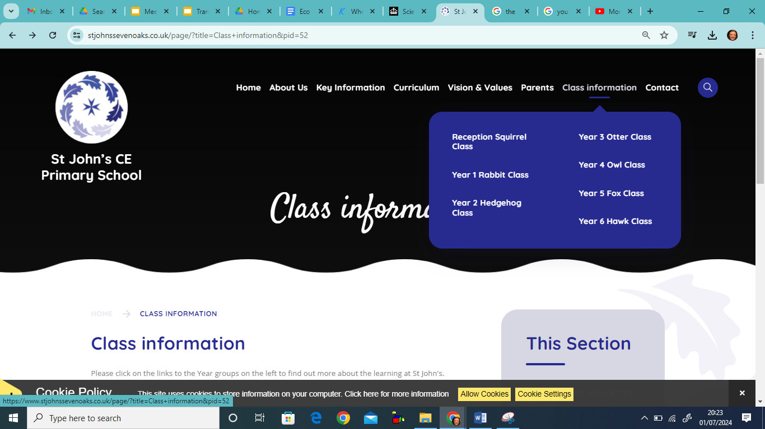
You can also find out more by referring on the Year 5 Whole Year Curriculum Map on the website

Slide 6
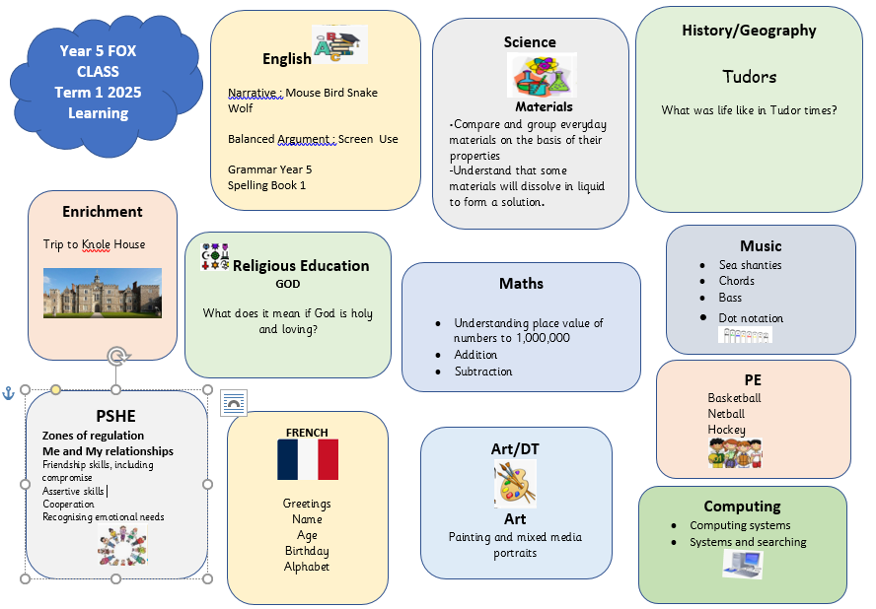
At the start of each term you will be able to find a map of our termly overview on the class page and additional resources to support learning at home

Slide 7

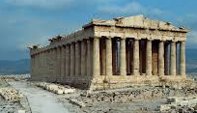

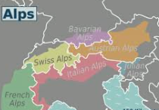

What will the children be learning about this year?
Greeks
Tudors
Life Cycles
Earth and Space
Mountains

Slide 8


Homework Expectations and Routines
Reading
Please read at least 4 times a week with your child for at least 15-20 minutes. Listen to them read out aloud, discuss the text and ensure that they understand new vocabulary and what they have read. This will enable them to build fluency and improve comprehension and vocabulary.
Children should record their reading in the yellow reading record and have it signed by an adult.
.

Slide 9

MyMaths
This will be set on Thursdays on a digital platform matched to what children are learning in the week or to consolidate prior learning.

Slide 10



Times Tables
Please practise for 5 minutes every day.
This will help children’s fluency and support them in their fraction and division work.
These will be assigned to your child.
Hit the Button
Times tables will be tested on Wednesdays

Slide 11

Spelling
A Spelling Shed homework sheet will be sent home on Thursday/Friday as a resource to practice spellings at home. This does not need to be returned to school. Although we practise in class, your support in helping your child to learn their spellings at home would be greatly appreciated.
For children who may find spelling challenging, we will talk to parents directly as they will expected to learn some of the Year 5 spellings.
OR
Some children may have individualised spellings/ or from a different year group.

Slide 12
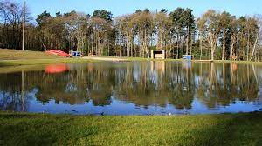
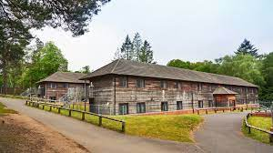
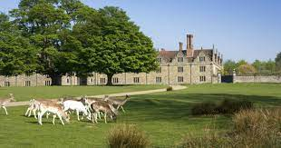
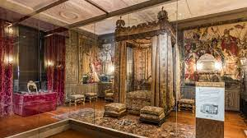
Highlights in Year 5
Knole House
Tudor Experience
September 2026
Look out for a letter!!
2 night PGLResidential
Information meeting will be held later in year.

Slide 13
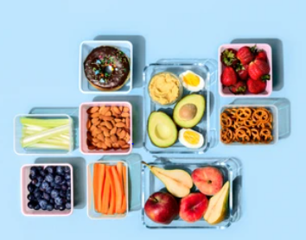

SNACKS FOR BREAK TIME
Please provide healthy options in clearly named pots or reuseable pouches
Fresh fruit or vegetables
Breadsticks or plain rice cakes

Slide 14
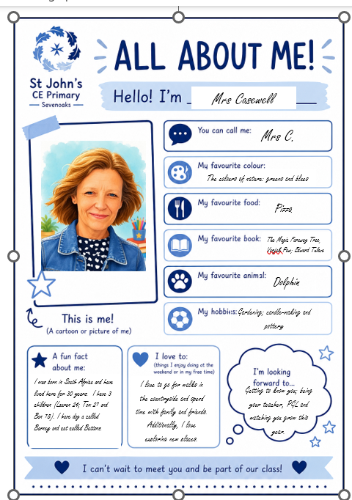
Your children will be bringing this home soon.

Slide 15
Getting in touch
For day to day communication such as changes to your child’s pick up arrangements please write in the contact book, speak to the person on the gate upon arrival or contact the school office.
Most importantly, please do come and talk to us directly if you have any questions or would like further information and support.
Email or call the school office if you have any concerns and we will get back to you as soon as we can.
Telephone:
Office email: office@stjohnssevenoaks.co.uk.
01732 453944

Slide 16
Thank you for taking the time to come and meet me. I look forward to working together with you to ensure your children have a happy and successful year in Fox Class.

